Slide 1



EEE4084F
Digital Systems
Lecture 10:
Design of Parallel Programs
Part IV
Lecturer:
Simon Winberg
Attribution-ShareAlike 4.0 International (CC BY-SA 4.0)

Slide 2
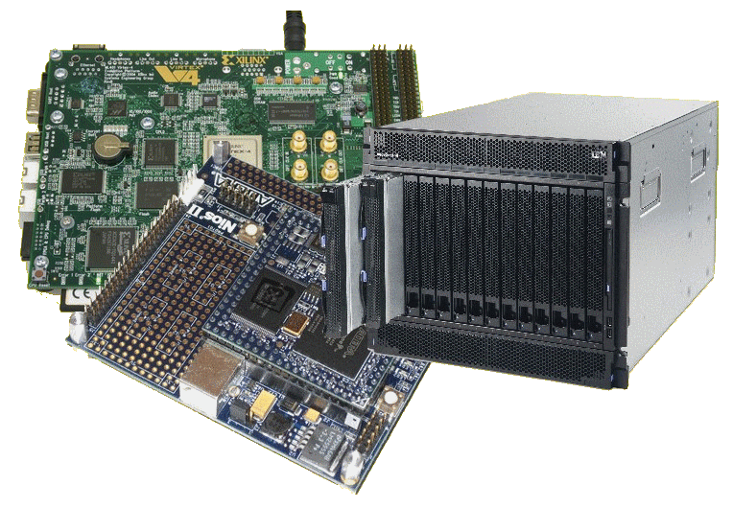
Lecture Overview
Planning ahead
Step 7: Load balancing
Step 8: Performance analysis and tuning

Slide 3
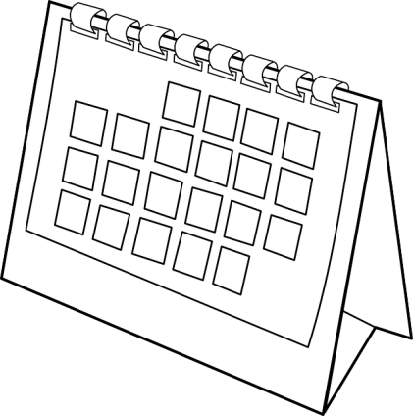
Planning ahead to Term 2
Term 2 week1
  Delving into some Verilog & FPGA issues
Prac 2 (CUDA) has started, due next term
Prac 3 OpenMP
Prac 4 (FPGA and Xilinx ISE + Verilog)
to start next term
Friday (28 March)
  9am Presentation about the Radar Remote Sending Group & 4th year Topics Offered…
  the work (related to digital systems) we are doing; and introduction to some of our 4th year project proposals
Thursday (24 April)
  9pm Quiz 3 (announcement the week before will indicate the syllabus concerned)

Slide 4


Steps in designing parallel programs
The hardware may come first or later
The main steps:
Understand the problem
Partitioning (separation into main tasks)
Decomposition & Granularity
Communications
Identify data dependencies
Synchronization
Load balancing
Performance analysis and tuning

Slide 5
Step 7: Load Balancing
EEE4084F

Slide 6
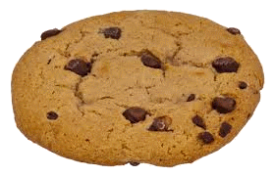

Load Balancing
Distributing work among tasks so
that all tasks are kept busy most of the time
Mainly a minimization of idle time
Relevant to parallel programs for optimizing performance.
  e.g., if every tasks encounters a barrier synchronization point, the slowest task will end up limiting the overall performance.
Relevant to costing, e.g. deciding number of processors needed (can also be used in substantiating the need for a more, rather than less, expensive platform)

Slide 7
Load Balancing – simple trial technique
prog_start
logt[1].start
idle
…
typedef struct { unsigned start, end; } LogEntry;
LogEntry logt[1024];
int logn = 0;
unsigned prog_start, prog_end;
void* task (void* arg)
{
unsigned int end;
unsigned int start = clock();
// do work
// calculate time it took
end = clock();
// update time log
pthread_mutex_lock(&mutex);
logt[logn].start = start; logt[logn].end = end; logn++;
pthread_mutex_unlock(&mutex);
}
logt[0].start
logt[0].end
logt[1].end
busy
prog_end
… in main() get prog_start time, create mutex & threads, wait join, get prog_end time.

Slide 8
Load Balancing – simple trial technique (cont)
...
double calc_stat_stddev ()
{ // calculate standard deviation of busy times
int i;
double sum = 0;
for(i = 0; i < logn; i++) sum += logt[i].end - logt[i].start;
double mean = sum / logn;
double sq_diff_sum = 0;
for(i = 0; i < logn; ++i) {
double diff = logt[i].end - logt[i].start - mean;
sq_diff_sum += diff * diff;
}
double variance = (double)sq_diff_sum / logn;
return sqrt(variance);
}
…

Slide 9
Load Balancing
Well balanced – low standard deviation in busy time*
Task 1
time busy
Time idle
Task 2
time busy
Time idle
Task 3
time busy
Time idle
Task 4
time busy
Time idle
Overall
time busy
Time idle
Poorly balanced – high standard deviation in busy time
Task 1
time busy
Task 2
busy
Time idle
Task 3
time busy
Time idle
Task 4
busy
Time idle
Overall
time busy
Time idle
* You could obviously use idle time – but that’s probably more difficult if using code in prev. slide

Slide 10

Achieving load balance
Two general techniques…
Equally partition work as a preprocess
  Workload can be determined accurately before starting the operation
Dynamic work assignment
  For operations where the workload is unknown, or cannot be effectively calculated, before starting the operation

Slide 11
Achieving balance – Work assignment as pre-process
Examples include
  Array or matrix operations for which each task performs similar work. Can evenly distribute the data set among tasks / available processors.
  Loop iterations where the work in each iteration is similar, and can be evenly distributed.
May be less easy to do if using a heterogeneous mix of machines that have varying performance characteristics. In such cases, a comprehensive analysis tool may be needed to determine load imbalances and revise work disctribution.

Slide 12
Achieving balance – Work assigned dynamically
Examples include
  Sparse arrays/matrices (i.e., if matrix simply divided equally, some tasks may have lots to do but others little to do)
  N-body simulations (particles owned by some tasks may involve more work than others)
  Adaptive grid refinement (some tasks may need to refine their grips)
General principle: tasks that are busier send a request for assistance, whereas tasks that complete quickly are available to help the busier tasks.

Slide 13
Step 8: Performance analysis
EEE4084F

Slide 14
Performance analysis
Simple approaches involve using timers (i.e., as shown in previous code snippet)
  Usually quite straightforward for a serial situation or global memory
Monitoring and analyzing parallel programs can get a whole lot more challenging than for the serial case
  May add comms overhead
  Needing synchronization to avoid corrupting results, … could be a nontrivial algorithm itself

Slide 15
MPI Timing functions
MPI_Wtime
  Returns the elapsed wall clock time in seconds (a double) on the calling processor
MPI_Wtick
  Returns the timer resolution in seconds (a double) of MPI_Wtime.

Slide 16
StdC: gettimeofday
gettimeofday
  Very portable, part of the StdC library
  Should be available on any Linux system
  Returns time in seconds and microseconds since midnight January 1 1970
  Uses struct timeval comprising
    tv_sec : number of seconds
    tv_usec : number of microseconds*
  Converting to microseconds will use huge numbers, rather work on differences
* Word of caution: some implementations always return 0 for the usec field!!
On Cygwin, the resolution is only in milliseconds, so tv_usec in multiples of 1000.
Not provided in DevC++.

Slide 17
gettimeofday example
See timing.c code file
#include <stdio.h>
#include <sys/time.h>
#include <time.h>
struct timeval start_time, end_time; // variables to hold start and end time
int main() {
int tot_usecs;
int i,j,sum=0;
gettimeofday(&start_time, (struct timezone*)0); // starting timestamp
/* do some work */
for (i=0; i<10000; i++)
for (j=0; j<i; j++) sum += i*j;
gettimeofday(&end_time, (struct timezone*)0); // ending timestamp
tot_usecs = (end_time.tv_sec-start_time.tv_sec) * 1000000 +
(end_time.tv_usec-start_time.tv_usec);
printf("Total time: %d usec.\n", tot_usecs);
}

Slide 18
Benchmarking
Process of measuring performance of DS
A program that Quantitatively evaluates computer Hardware and software resources
Benchmark suites – sets of benchmarks defined to get better system picture
Suitable benchmark for a system leads to an effective system

Slide 19
Benchmarking (cont…)
What can be benchmarked? ( In DSP Compiler, Processor, Platform)
Compiler – Converts High Level Language to Assembly language thus we benchmark compiler efficiency
The Processor – code should be an Assembly (No more high level code)
Platform – Written in High Level language(Processor & Compiler)

Slide 20
Benchmarking: what to measure
In DSP/HPEC systems we benchmark Cycle count, Data and Program memory usage, Execution time and Power consumption
What can we benchmark in Databases/Web servers (i.e Oracle, MySQL, SQL Server)?
SPEC defined several benchmarks in the digital world - SPECweb99, SPECmail, etc.

Slide 21
Benchmark: Approaches
Metrics (MIPS, MOPS, MFLOPS, etc) – not really meaningful in RISC architectures(Why?)
Complete DSP Application – consumes time and effort as well as memory because it measure the whole system
DSP Algorithm Kernels – extracted from real DSP programs and consist of small loops which perform number crunching, bit processing, etc. (see pg. xx in ref)

Slide 22

Benchmarking: Types
EEMBC (pron. embassy) – For embedded System and written in C
BDTIMARK – a DSP benchmark suite
Check this paper for a List of FPGA benchmarking types: Raphael Njuguna: A Survey of FPGA Benchmarks Available at: http://www.cse.wustl.edu/~jain/cse567-08/ftp/fpga.pdf) -- might be in a quiz
More Reading: Performance evaluation and Benchmarking, Lizy K. John and Lieven Eeckhout, Taylor & Francis Group

Slide 23

End of:
Design of Parallel Programs

Slide 24
Disclaimers and copyright/licensing details
I have tried to follow the correct practices concerning copyright and licensing of material, particularly image sources that have been used in this presentation. I have put much effort into trying to make this material open access so that it can be of benefit to others in their teaching and learning practice. Any mistakes or omissions with regards to these issues I will correct when notified. To the best of my understanding the material in these slides can be shared according to the Creative Commons “Attribution-ShareAlike 4.0 International (CC BY-SA 4.0)” license, and that is why I selected that license to apply to this presentation (it’s not because I particulate want my slides referenced but more to acknowledge the sources and generosity of others who have provided free material such as the images I have used).
Image sources:
Man running up stairs - Wikipedia (open commons)
Chocolate Chip Biscuit - Wikipedia (open commons)
Scales, Checked Flag - Open Clipart (http://openclipart.org)
Calendar Planning Image, Note pad – Pixabay (Public Domain CC0)
Yoga lady - adapted from Open Clipart

