Slide 1



EEE4084F
Digital Systems
Lecture 15
Coding in Verilog
module myveriloglecture ( techniques_out, wishes_in );
…
// implementation of today’s lecture
…
endmodule
Lecturer:
Simon Winberg

Slide 2
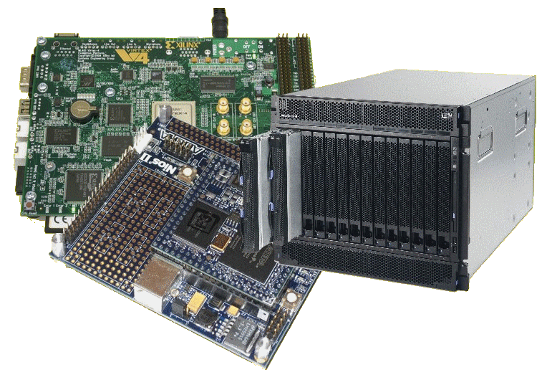
Lecture Overview
Basics of Verilog coding
Exercise
Verilog simulators

Slide 3
Why consider Verilog?
Tends to be more popular in industry than VHDL
VHDL is used quite widely in Europe (so is Verilog). Verilog used mostly in USA.
Easier to learn since it is similar to C

Slide 4

Lead in to Verilog…
History of Verilog
  1980 Verilog developed by Gateway Design Automation (but kept as their own ‘secret weapon’)
  1990 Verilog was made public
  1995 adopted as IEEE standard 1364-1995
  2001 enhanced version: Verilog 2001

Slide 5
Module: Building block of Verilog Programs
…
module2
module1
Module: the basic block that does something and can be connected to (i.e. equivalent to entity in VHDL)
Modules are hierarchical. They can be individual elements (e.g. comprise standard gates) or can be a composition of other modules.
SYNTAX:
module <module name> (<module terminal list>);
…
<module implementation>
…
endmodule

Slide 6
Module Abstraction Levels
Switch Level Abstraction (lowest level)
  Implementing using only switches and interconnects.
Gate Level (slightly higher level)
  Implementing terms of gates like (i.e., AND, NOT, OR etc) and using interconnects between gates.
Dataflow Level
  Implementing in terms of dataflow between registers
Behavioral Level (highest level)
  Implementing module in terms of algorithms, not worrying about hardware issues. Close to C programming.
Arguably the best thing about Verilog!!

Slide 7
Syntactic issues:
Constant Values in Verilog
Number format:
<size>’<base><number>
Some examples:
  3’b111 – a three bit number (i.e. 7₁₀)
  8’ha1 – a hexadecimal (i.e. A1₁₆ = 161₁₀)
  24’d165 – a decimal number (i.e. 165₁₀)
Defaults:
100 – 32-bit decimal by default if you don’t have a ‘
‘hab – 32-bit hexadecimal unsigned value
‘o77 – 32-bit hexadecimal unsigned value (77₈ = 63₁₀)

Slide 8
Syntactic issues:
Constant Values in Verilog
Constant | Hardware Condition
0 | Low / Logic zero / False
1 | High / Logic one / True
x | Unknown
z | Floating / High impedence

Slide 9
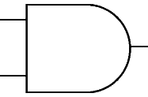
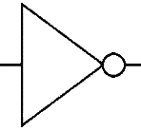
Wires
Wires (or nets) are used to connect elements (e.g. ports of modules)
Wires have values continuously driven onto them by outputs they connect to
// Defining the wires
// for this circuit:
a
c
d
wire a;
wire a, b, c;
b

Slide 10
Registers
Registers store data
Registers retain their data until another value is put into them (i.e. works like a FF or latch)
A register needs no driver
reg myregister; // declare a new register (defaults to 1 bit)
myregister = 1'b1; // set the value to 1

Slide 11
Vectors of wires and registers
// Define some wires:
wire a; // a bit wire
wire [7:0] abus; // an 8-bit bus
wire [15:0] bus1, bus2; // two 16-bit busses
// Define some registers
reg active; // a single bit register
reg [0:17] count; // a vector of 18 bits

Slide 12
Data types
Integer 32-bit value
  integer i; // e.g. used as a counter
Real 32-bit floating point value
  real r; // e.g. floating point value for calculation
Time 64-bit value
  time t; // e.g. used in simulation for delays

Slide 13
Verilog Parameters & Initial block
Parameter: a the rather obscurely named ‘parameter’ works more like a constant in C (or generic in VHLD)
Initial: used to initialize parameters or registers or describe a process for initializing a module (i.e. like constructor in C++)
Use both in implementation of a module
Example use:

Slide 14
Ports
The tradition is to list output ports first and then input ports. This makes reading of code easier. i.e.:
ModuleName ( <output ports> <input ports>);
module mygate (
xout, // 1 bit output
clk , // clock input
ain ); // a 1 bit input
// define outputs
output xout;
// define inputs
input clk, ain;
… rest of implementation …
endmodule
mygate
clk
xout
ain

Slide 15
Register Output Ports
These are output port that hold their value. An essential feature needed to construct things like timers and flip flops
module mycounter (
count_out, // 8 bit vector output of the
clk ); // Clock input of the design
// Outputs:
output [7:0] count_out; // 8-bit counter output
// All the outputs are registers
reg [7:0] count_out;
// Inputs:
input clk;
…
endmodule

Slide 16
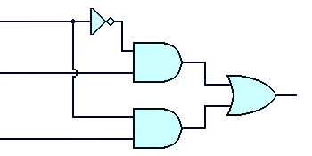
Instantiating modules and connecting up ports
These two tasks usually done in one go…
Modules are instantiated within modules
  Syntax: <module name> <instance name> (<arguments>)
EXAMPLE:
// Multiplexer implemented using gates only*
module mux2to1 (a,b,sel,y);
input a,b,sel;
output y;
wire sel,asel,bsel,invsel;
not U_inv (invsel,sel);
and U_anda (asel,a,invsel),
U_andb (bsel,b,sel);
or U_or (y,asel,bsel);
endmodule
U_inv
sel
invsel
U_anda
asel
U_or
a
y
Module instance names
b
bsel
Port mapping (like arguments in a C function call)
U_andb
* Based on source: http://www.asic-world.com/code/hdl_models/mux_2to1_gates.v

Slide 17
Instantiating modules
Why give instances names?
  In Verilog 2001 you can do:
module mux2to1 (input a, input b, input sel, output y);
…
and (asel,a,invsel), // can have unnamed instance
…
endmodule
Major reason for putting a name in is when it comes to debugging: Xilinx tends to assign instance names arbitrarily, like the and above might be called XXYY01 and then you might get a error message saying something like cannot connect signals to XXYY01 and then you spend ages trying to track down which gate is giving the problem.

Slide 18
Verilog Primitive Gates
Examples:
and
or
not
and a1 (OUT,IN1,IN2);
nand
nor
xor
not n1 (OUT,IN);
Buffer (i.e. 1-bit FIFO or splitter)
buf
Example:
buf onelinkbuf (OUT, IN);
buf twolinkbuf (OUT1, OUT2, IN);

Slide 19
BufIf (hardware if gate)
Tri-state buffer. Can choose to drive out with value of in (if ctr = 1) or don’t drive anything to out (i.e. if ctr = 0 connect high impedance to out)
in
out
bufif1 operation
ctr →
in →
ctr
 | 0 | 1 | x | z
0 | z | 0 | L | L
1 | z | 1 | H | H
x | z | x | x | x
z | z | x | x | x
bufif1 (out, in, ctr)
See also notif (works in the apposite way: if ctr=0 then drive out with in)

Slide 20
Where to go from here…
The preceding slides have given a very brief look at Verilog, but has covered much of the major things that are used most commonly.
It’s best to get stuck into experimenting and testing code in order to learn this language
Some thoughts for experimenting to do…

Slide 21
Learning Verilog By Example
EEE4084F

Slide 22
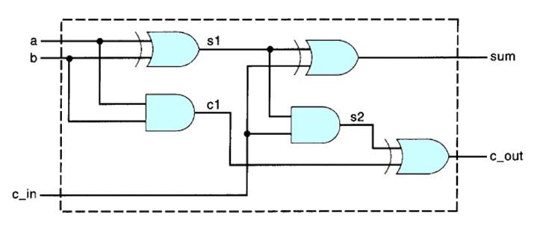
Take-home assignment
A
B
Sum
Carry
C
This is a 4-bit adder design. Try to convert this into Verilog.
Try to run on one or a few of the simulation tools presented in next slides…

Slide 23

Learning Verilog using Simulators
If you’ve got your own laptop / PC consider installing one of the simulators* as a quick way to check syntax and test designs.
Various simulators installed on forge.ee, can be accessed remotely
* I confess to using Altera Quartus II much of the time since it takes less space to install and runs faster than its obvious rival.

Slide 24
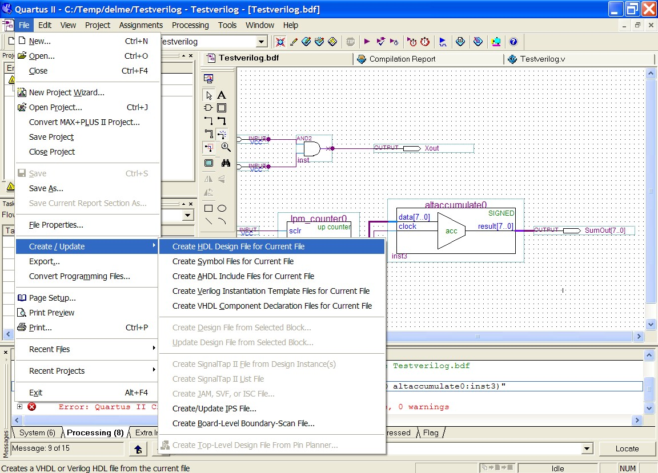
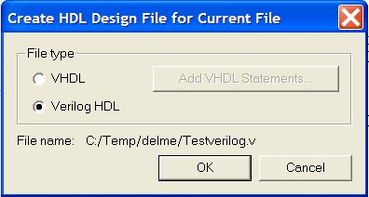
Learning Verilog
One approach is using a block diagram and converting to Verilog HDL.
E.g. using Alterna Quartus II
(See test1.zip for example Quartus project)

Slide 25
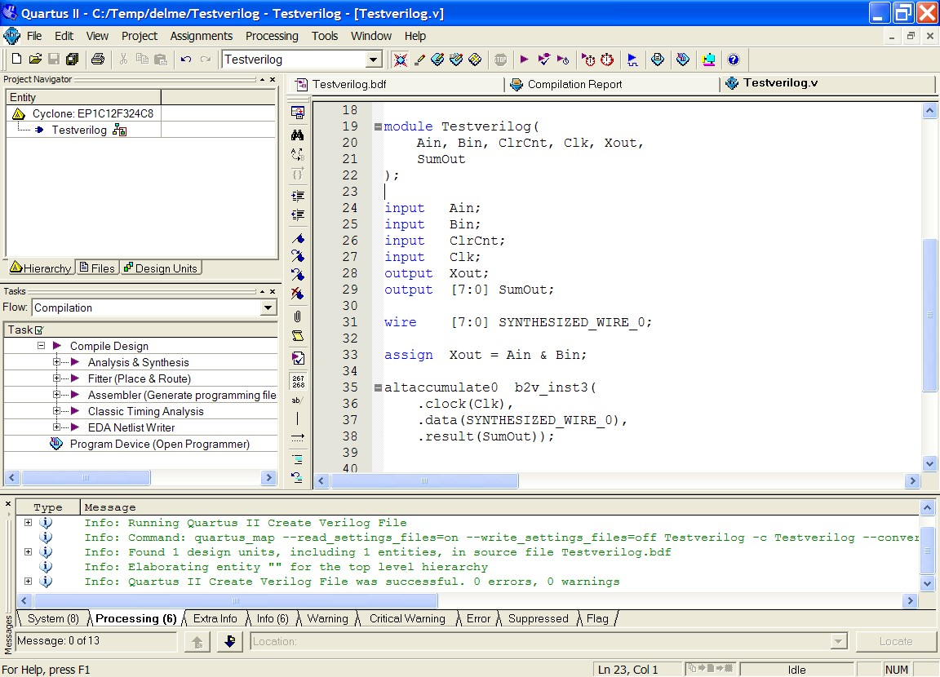
Learning Verilog
One approach is using a block diagram and converting to Verilog HDL.
E.g. using Alterna Quartus II
See how param types are
specified
See how included modules are instantiated and ports mapped

Slide 26
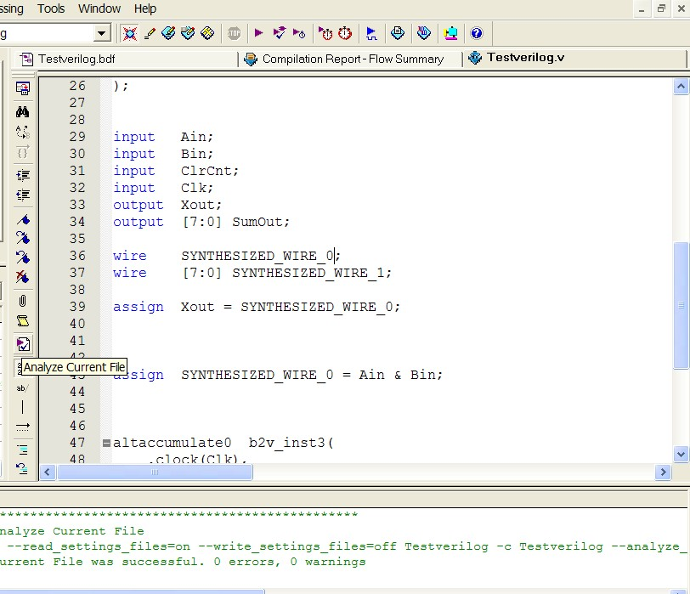
Checking syntax
I find a handy tool is the file analyser tool in Quartus II. This can be used to check the syntax of the file without having to go through the whole build process.

Slide 27
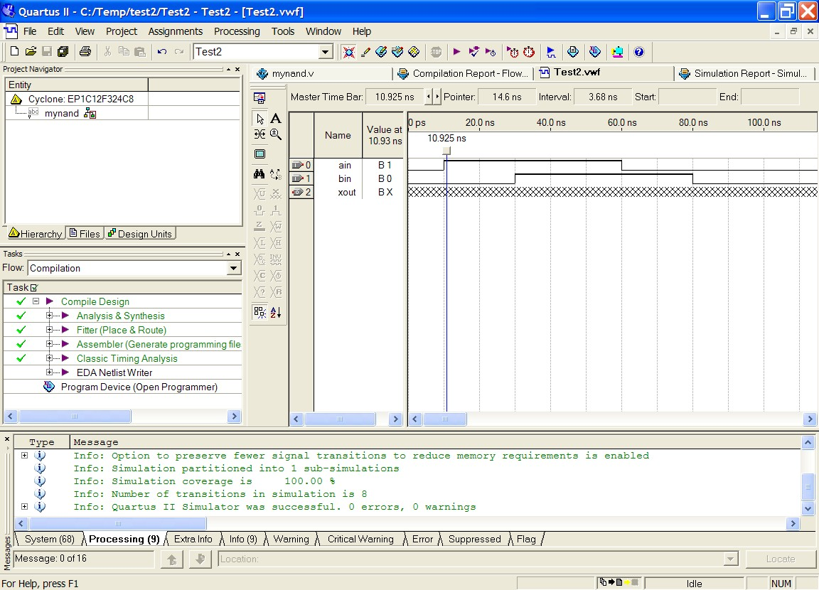
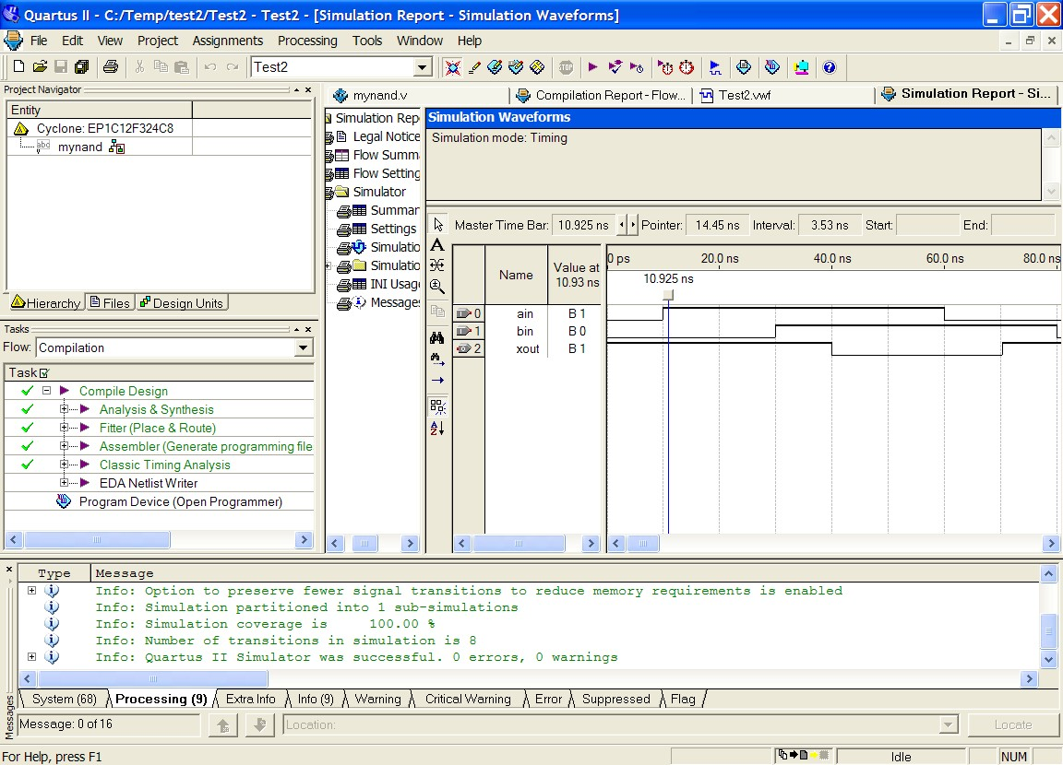
Testing
(See test2.zip for example Quartus project that contains only Verilog files and waveform file)
Running the simulation should allow you to verify the design is working as planned (i.e. NANDing)
Load the Test2 file, if using Quartus make sure that mynand is the top level Entity

Slide 28
Verilog Recommended Coding Styles
Consistent indentation
Align code vertically on the = operator
Use meaningful variable names
Include comments (i.e. C-style // or /**/ )
  brief descriptions, reference to documents
  Can also be used to assist in separating parts of the code (e.g. indicate row of /*****/ to separate different module implementations)

Slide 29

Suggested study ideas…
See Verilog tutorials online, e.g.:
  http://www.verilogtutorial.info/
Icarus Verilog – An open-source Verilog compiler and simulator
  http://iverilog.icarus.com/
  Try iverilog on forge.ee
Gplcver – Open-source Verilog interpreter
  http://sourceforge.net/projects/gplcver/
  Try cver on forge.ee
Verilator – An open-source Verilog optimizer and simulator
  http://www.veripool.org/wiki/verilator
Comprehensive list of simulators:
http://www.asic-world.com/verilog/tools.html

Slide 30
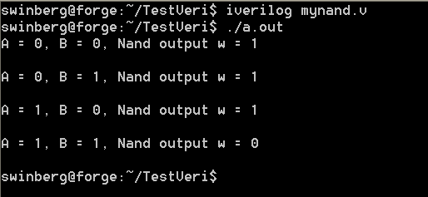
Icarus Verilog
Probably the easiest free open-source tool available
Excellent for doing quick tests.
Takes very little space (a few megs) & runs pretty fast.
Installed on forge.ee
For Ubuntu or Debian you can install it (if you’re linked to the leg server), using: apt-get install iverilog
Iverilog parsing the Verilog code and generates an executable the PC can run (called a.out if you don’t use the flags to change the output executable file name)
I suggest the following to get to know iverilog… upload mynand.v example to forge.ee, compile it with iverilog. Run it. Try changing the testbest code, put in some more operations
  http://iverilog.icarus.com/

Slide 31
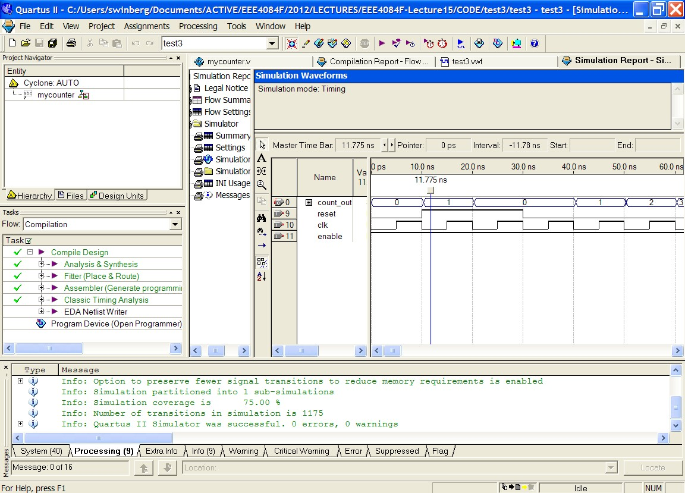
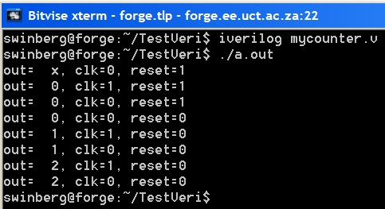
More Experimenting
Try test3 or mycounter.v as a more involved program and test
Experiment with using both Altera Qauartus II, Icarus Verilog, and Xilinx ISE ISim

Slide 32
Conclusion & Plans for Next lecture
Remember to try doing the 4-bit adder example (see slide 21)
Next lecture:
  RC Architectures

