Slide 1




EEE4084F
Digital Systems
Review of EEE4084F 2013
Lecturer:
Simon Winberg

Slide 2

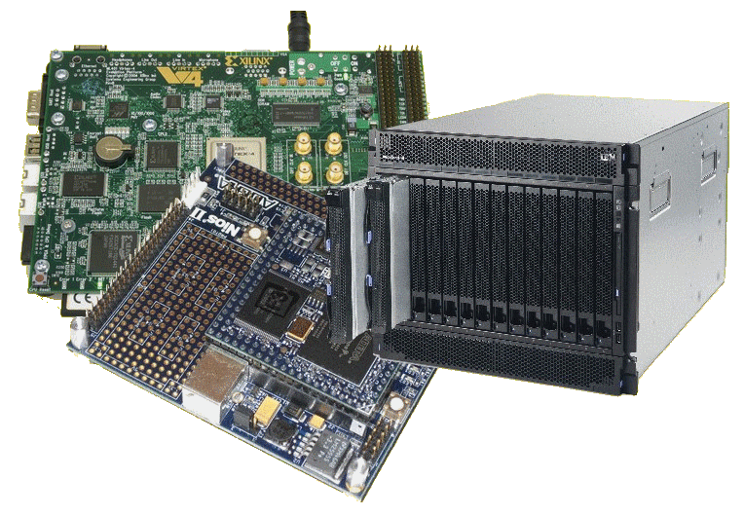
Lecture Overview
Lecture content covered
Readings, seminars, chapters
EEE4084F

Slide 3

Lecture Review
Digital
Systems
EEE4084F Digital Systems

Slide 4
Lecture 1
Nothing of Lecture 1 is examined

Slide 5
Lecture 2
Skip irrelevancies re quiz0 (slides 3-7)
All the rest is relevant
UML – Unlikely to experience Memory Loss
Parallel computing fundamentals
Automatic parallelism
Performance benchmarking
Trends

Slide 6
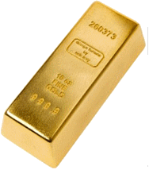
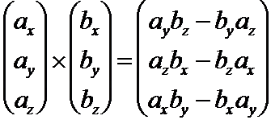
Lecture 3
Skip initial slides (1-9)
Terms. Golden Measure
Temporal & spatial computing
Benchmarking
Power
Study suggestion:
  Think of ways to implement parallel vector scalar and cross products and measure the performance and other results of this

Slide 7
Lecture 4
All Relevant.
Review of homework (scalar product)
Parallel programming.
Timing in C
Important terms
Parallel programming models: Data parallel model; Message passing model; Shared memory model; Hybrid model
Know the terms: Contiguous, Partitioned (or separated or split), Interleaved (or alternating), Interlaced

Slide 8
Lecture 5
Processor Architecture types
  Von Neumann; Flynn’s taxonomy
Memory access architectures

Slide 9
Lecture 6, 7*, 8**, 9, 10
* Lecture 7 covers some issues of the IBM Watson which you should be able to discuss. No need to watch the video, just focus on the slides.
Design of Parallel Programs
The main steps:
Understand the problem
Partitioning (separation into tasks)
Decomposition & Granularity
Communications
Identify data dependencies
Synchronization
Load balancing
Performance analysis and tuning
* Lecture 8 includes effective bandwidth and related issues which are particularly important.

Slide 10
Lecture 8 additional points
Very relevant:
  Cost of communication
  Latency, bandwidth, effective bandwidth (and related calculations)
  Blocking/non-blocking; synch/asynch
  Scope of communications
  Cloud computing (virtualization and other key technology factors)

Slide 11
Lecture 9 additional points
First part of lecture 9: GPUs & CUDA
GPU issues and benefits
Important CUDA-related terms (threads and blocks)
Rest of lecture 9 relates to design of parallel programs (specifically: 5. data dependencies and 6. synchronization) which is relevant

Slide 12
Lecture 9, 10 additional points cont.
Don’t need to know any specifics of cloud computing or how to program it; more know what it involves and its service approach
No need to know details of virtulization, or what the different cloud computing models are, or detail of the specific services offered
Should know about load balancing be able to explain what it means and how it can be performed.

Slide 13
Lecture 11
Discusses the parallel programming design patterns (i.e. slides 3-12 relevant)
Ignore slides 13 and 14
Slides 15 onwards relevant. Concerns terms: application accelerator, verification, validation

Slide 14
Lecture 12
All relevant – recaps programmable logics, HDL and VHDL

Slide 15

Lecture 13
Skip slides 1-26
Have a look over slides 27-
  Note you don’t need to memorize details about these FPGA manufacturers or their products, but know at least:
    What does ACTEL focus on? (low power small packages)
    What does TABULA focus on? (space-time FPGA technology for very high capacity)

Slide 16
Lecture 14
Description of Reconfigurable Computing, why it is ‘trendy’
Dual processing issues
Skip slides 14 onwards (these are only relevant in terms of knowing what sort of things are put into hardware)

Slide 17
Lecture 15
Know the very basics of Verilog coding.
You might be asked to
  Represent a (simple) combinational logic circuit in Verilog, or
  Translate Verilog to VHDL, or
  Translate VHDL to Verilog
A Verilog cheat sheet will be provided
Remember: module, constants, wires vs. registers, data types, parameters, initial

Slide 18
Lecture 16
RC architectures relevant, also the determining factor whether a computer platform is or is not RC
Recap of FPGAs
Calculating speed of a combinational logic design, and comparing computing speed with a CPU

Slide 19
Lecture 17
RC architecture case studies
All relevant, but you need only understand the general concepts; you don’t need to remember specifics
(i.e. you won’t be asked very specific things like does the L2 cache in the cell processor connect to the PPU or the EIB)

Slide 20
Lecture 18
Ignore slides 1-13
Amdahl’s law relevant (slides 14-18)
Know what is meant by BCE (base core equivalent) in terms of multiprocessor chip design
(ignore the last slides about the calculator, no need to read the paper)

Slide 21
Lecture 19
All relevant
Configuration architectures
  Nothing will be asked re the Scott Hauck (1998) paper
Other FPGA-based RC Building Blocks
  Memory types
  Digital logic modular design (slide 21)
  DMA
  Latches & flip flops

Slide 22
Lecture 20
Start from slide 7
DMIPS, Dhrystone, Whetstone, Coremark
C → HDL automatic conversion
  Should know how to use the HandleC notation to write a C-style representation of a digital logic circuit
  Know techniques for clocking, synchronising components, passing control signals.
  Knowing your C logic operators (& | ^ ~) goes without saying

Slide 23



Lecture 21 + textbook Ch4
Reflections on the process.
Discussion of how the spiral model would be actioned in the case of a HPEC / reconfigurable computer / digital design
Key steps and stumbling blocks in the design process
RAD approach applied to digital
system development
Common causes of project failure
Causes of project success
A happy project
sound methodology
Management
support
Good leadership

Slide 24

Chapters / Seminar Review
EEE4084F Digital Systems

Slide 25
Readings, Seminars & Chapters
The landscape of parallel computing research: a view from Berkeley
CH1: A Retrospective on High Performance Embedded Computing (HPEC)
CH2 Representative Example of a HPEC System
CH3 System Architecture of Multiprocessor System
CH4 HPEC Development process & management
CH5 Computational Characteristics of HPEC Algorithms and Applications
CH13 Computing Devices

Slide 26
Readings, Seminars & Chapters
CH7 Analog-to-Digital Conversion
CH9 Application-Specific Integrated Circuits
CH14 Interconnection Fabrics
    Ch14 isn’t included this year
CH24 Application and HPEC System Trends
CH10 Field Programmable Gate Arrays

Slide 27
Pages of text book examinable
Ch1 3-11; 13 (but for this chapter you only really need to read over from pp 3 to half-way though pg 5).
Ch2 15-21; 24-27
Ch3 29-35
Ch4 41-45 + sect 4.4 66-69 (but 4.4 you can look over but no need for specifics)
Ch5 73-78; 88-89; 96-101
Ch7 149-154; 159-162; 164-166; 168-169
Ch9 191-196; 200-201; 207 (from sec 9.8) - 210 (inc. 9.9.3)
Ch10 217-226
Ch13 267-269; 271-272; 274; 276-278 (excluding 13.4.2.3 and 13.4.2.4)
Ch14 283-285; 287-294
Ch24 463-469; 473; 475-476

Slide 28
Readings, Seminars & Chapters
Resources / Handouts:
  LECT01 Common Parallel Computing Terms _Required Reading_.pdf
Resources / Homework & Class Activities
  EEE4084F Lecture 18 Class activity.pdf
  HandleC-Example.zip
  HandleC_Syntax.pdf
  Class activities (see Lecture Resources directory in the Vula resources for the course)

Slide 29

Readings, Seminars & Chapters
Resources / Readings
  Compton=Reconfigurable Computing A Survey of Systems and Software.pdf
  Hauck 1998=The Roles of FPGAs in Reprogrammable Systems.pdf NOT EXAMINED THIS YEAR
  R01 Berkeley 2006 - Landscape of Parallel Computing Research.pdf
  The Von Neumann Architecture.pdf

Slide 30


Please complete
the course evaluation survey
SECOND OPPORTUNITY:
NEXT THURSDAY

Slide 31

End of
EEE4084F Lectures!
Good luck with the quiz 4 next week
And look forward to…
Enjoying the Vacation!!!

