Slide 1
YODA Conference
Message-Digest 5 (MD5) Hash Reversal System
Gareth Callanan
Matthew Smith
Jean Swart

Slide 2

MD5 Hash
MD5 Hash Generator
‘hello’
0x292a5af68d31c10e31ad449bd8f51263
Objective: Recover an MD5 Hash encrypted password.
$$solutions<\sum_{n=1}^{N}{{94}^{n}}$$
Problem:
N is the maximum length of the password.
Solution: Digital Accelerator
Notes:
Describe MD5 Hash
One way function
128 Bit hash
Include bounds
Passwords are stored in this manner
Password Recovery
64 Stage Pipeline
1 instruction per clockcycle
Very tedious to pc
Brute force solution
Our objective

Slide 3
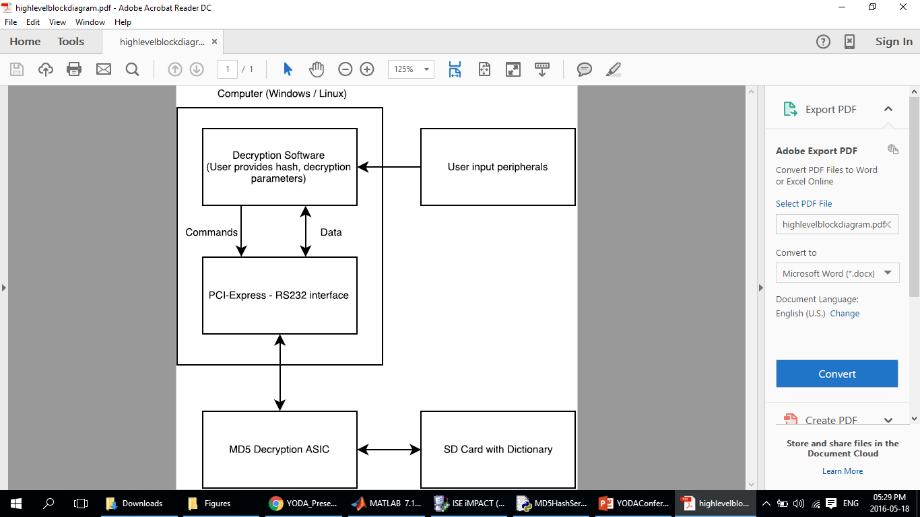
Prototype
ASIC Components
UART Sender and Receiver Modules
Controller Module
Parallel Brute Force Solver Module
Notes:
Basic Block Diagram
Parallel Solution
Talk about taking it to an asic vs fpga
Talk about pyserial

Slide 4
Methodology
Partitioning
Communications and System Control
Single MD5 Hash Generator
MD5 Decoder Module
Problem Identification
Design
Flow Charts
Communication Protocols
Block Diagram and Circuit Design
Verification and Implementation
Coding
ISE Simulation
NEXYS 4 Physical Implementation
Performance
Testing
Notes:
Describe methodology
Who did what
How we broke the problem down
Talk about golden measure
One instruction per clock cycle

Slide 5
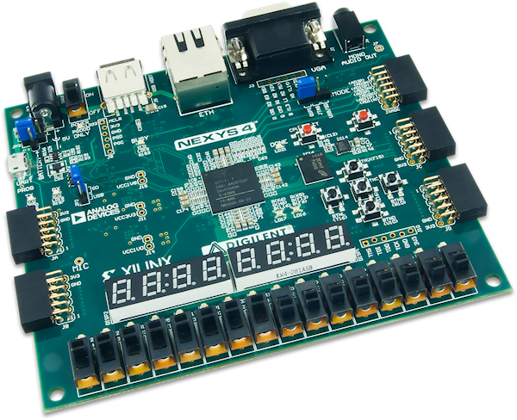
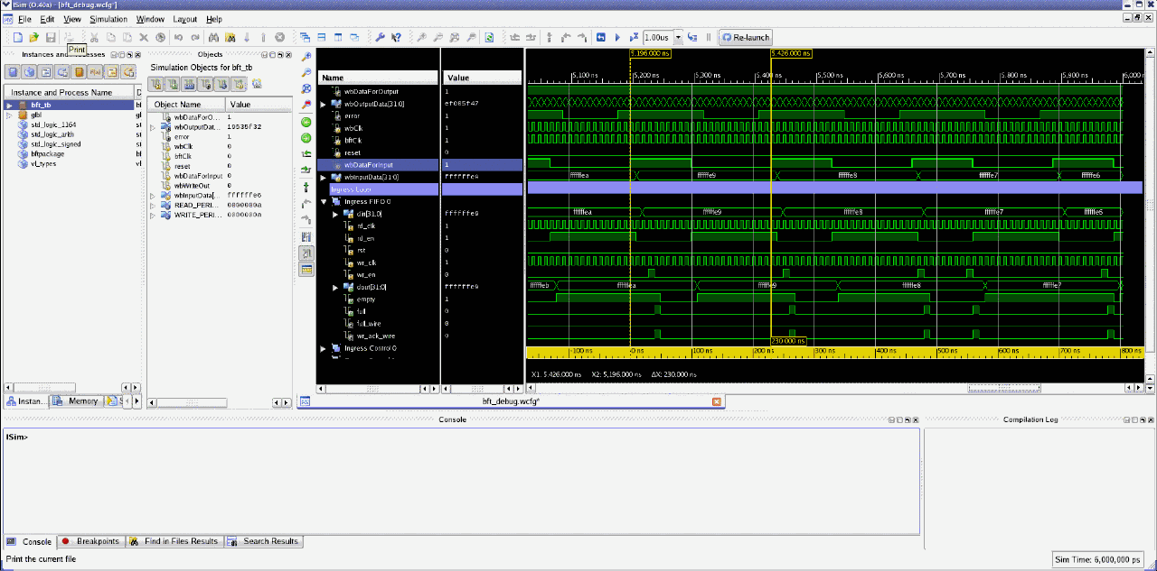
Test
Golden Measure: Compare answer and timing to a known solution.
Simulation Verification
Timing Calculations:
Complexity: O(n)
Use Number of parallel elements and clock speed
Goal: One hash per clock cycle per parallel element
Notes:
https://reference.digilentinc.com/_media/nexys/nexys4/nexys4-obl-600_1_.png
https://www.google.co.za/url?sa=i&rct=j&q=&esrc=s&source=images&cd=&cad=rja&uact=8&ved=0ahUKEwjI-e7TqeTMAhUJthoKHevDBTsQjRwIBw&url=http%3A%2F%2Fwww.xilinx.com%2Fproducts%2Fdesign-tools%2Fisim.html&psig=AFQjCNFrkLGpwT14pfAzpCngQ8EFtBtZDw&ust=1463684970166403

Slide 6
Prototype Design
Controller
Solver Manager
Solver Worker

Slide 7
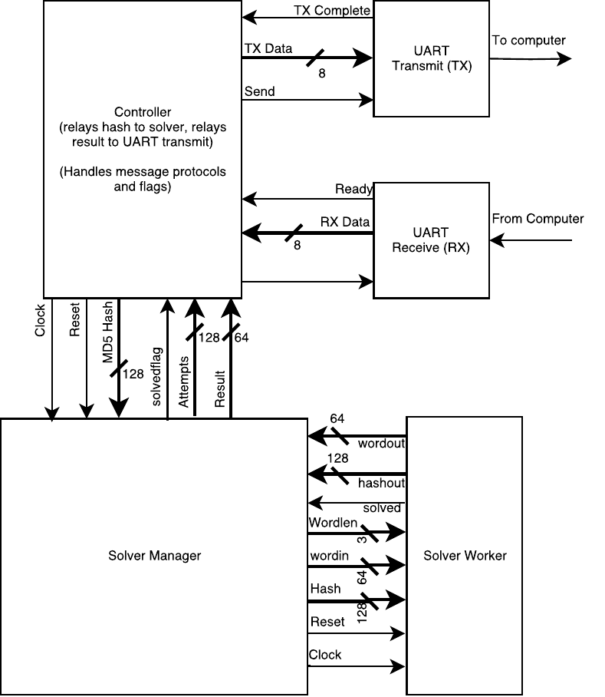
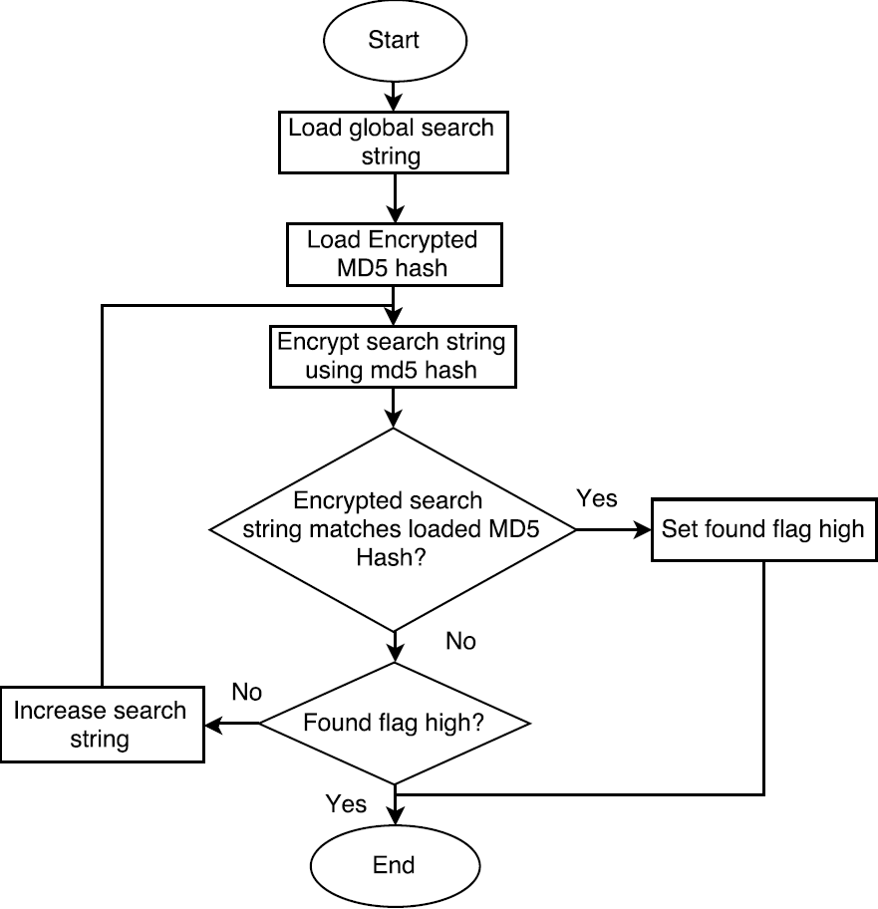
System Details

Slide 8
Solver Manager
ASCII values 32 –> 126 (space -> ~)
Brute forces up to 8 characters (_ to ~~~~~~~~)
(t_______) -> (st______) -> (est_____) -> (test____)
Can handle any number of solver modules
Continues until a solver worker indicates it has found a matching hash

Slide 9
Solver Worker
1 Hash every clock cycle
64 stage pipeline
Incoming 64 bit word gets padded to 512 bits
Split into 16 x 32bit registers
Important data is propagated through pipeline

Slide 10
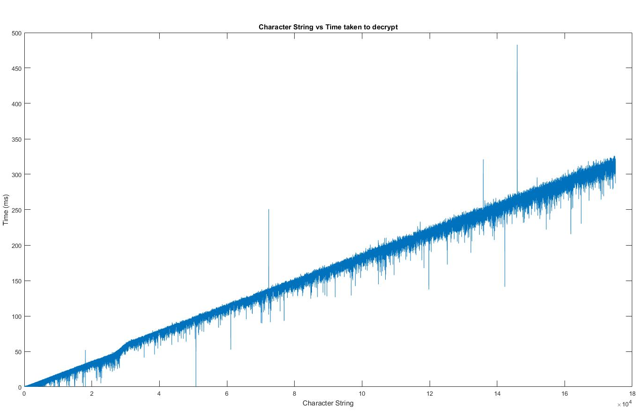
Golden Measure results

Slide 11
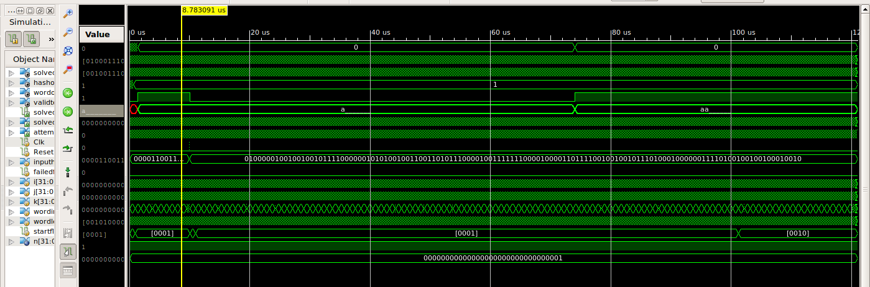
Simulation

Slide 12
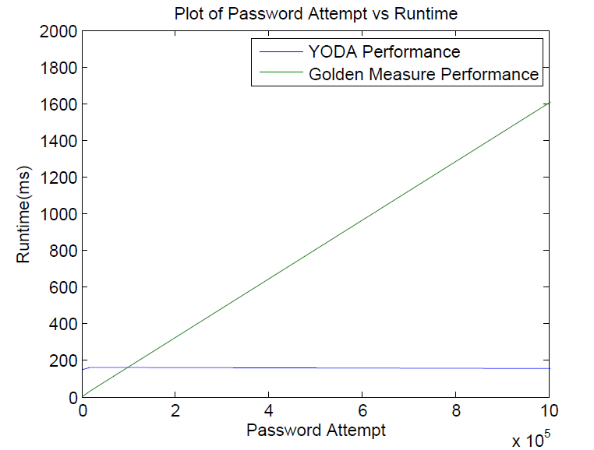
FPGA Results

Slide 13
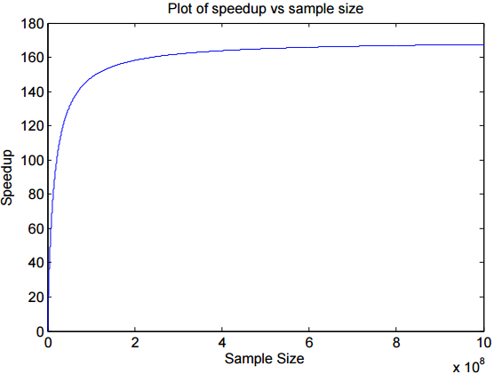
Speed Up

Slide 14
Conclusion & Recommendations
Successful experiment
Speed up of 165 per solver
Move to ASIC
Handle larger word sizes
More options
Reduce the amount of Logic Elements used
More modules
Higher clock speed

