Slide 1



EEE4084F
Digital Systems
Lecture 1
Golden Measure and
other terms (appropriate for pracs)
Lecturer:
Simon Winberg
Attribution-ShareAlike 4.0 International (CC BY-SA 4.0)

Slide 2

PART III
TERMS
TRENDS

Slide 3
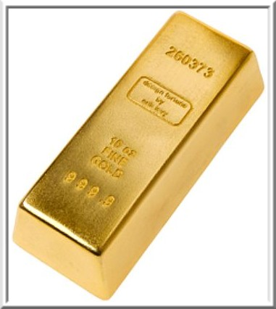
Terms
Golden measure:
  A (usually) sequential solution that you develop as the ‘yard stick’
  A solution that may run slowly, isn’t optimized, but you know it gives (numerically speaking) excellent results
  E.g., a solution written in OCTAVE or MatLab, verify it is correct using graphs, inspecting values, checking by hand with calculator, etc.

Slide 4
Terms
Sequential / Serial (serial.c)
  A non-parallized code solution
Generally, you can call your code solutions parallel.c (or para1.c, para2.c if you have multiple versions)
You can also include some test data (if it isn’t too big, <1Mb), e.g. gold.csv or serial.csv, and paral1.csv

Slide 5
Speed-up
Speed-up = T_{p1} /T_{p2}
Where T_{p1} = Run-time of original (or non-optimized) program
T_{p2} = Run-time of optimised program
Best practice for measuring speedup:
  Run the program more than one, discarding the first result (where the cache, etc. is getting ‘warmed up’)
  To be precise should indicate results from when system wasn’t ‘warmed up’*
* (which can be simulated by running a whole lot of other things like CounterStrike, Half-Life, maybe some Solitare* for good measure -- but more seriously you could write your own ‘cache cleaning program’)

Slide 6
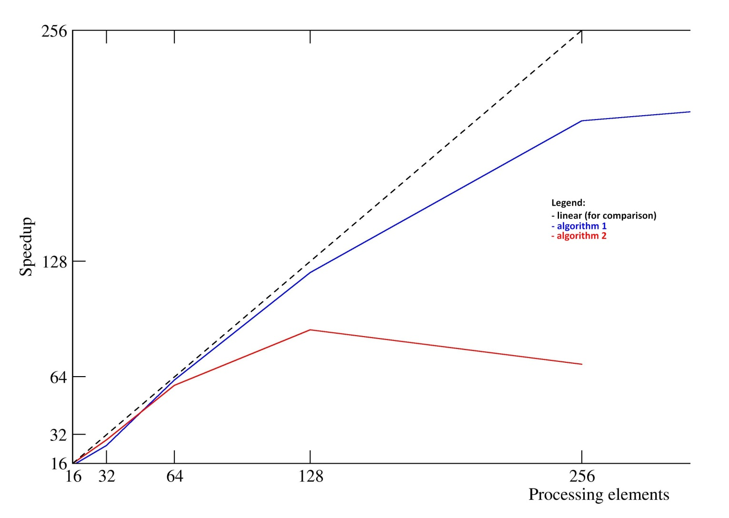
Speed-up graphs

Slide 7
Other Important Terms
Verification
Validation
Testing
Correctness proof
These terms are not merely theoretical terms to remember, but relate directly to your project.
Not something done in the project (but if you want to, you can experiment with doing a correctness proof if you are keen)

Slide 8
Verification and Validation (V&V)
Two terms you should already know…
Verification
  “Are we building the product right?”
  Have we made what we understood we wanted to make?
  Does the product satisfy its specifications?
Validation
  “Are we building the right product?”
  Does the product satisfy the users’ requirements
Verification before validation (except in duress)…
  While it would be nice to be able to validate before verifying, doing so would mean your specifications and design may be wrong in the final version (obviously this sometimes happens in practice due to insufficient time for proper validation)
Sommerville, I. Software Engineering. Addison-Wesley, 2000.

Slide 9
Verification before validation
The RC engineer (i.e., you) are effectively designing both custom hardware and custom software for the RC platform
Before attempting to make claims about the validity of your system, it’s usually best practice to establish your own (or team’s) confidence in what your system is doing, i.e. be sure that:
  The custom hardware working;
  The software implementation is doing what it was designed to do; and
  The custom software runs reliably on the custom hardware.

Slide 10
Verification
Checking plans, documents, code, requirements and specifications
Is everything that you need there?
Algorithms/functions working properly?
Done during phase interval (e.g., design => implementation)
Activities:
  Review meetings, walkthroughs, inspections
  Informal demonstrations
Focus of
project
Focus of project

Slide 11
Commonly used verification methods
Dual processing, producing two result sets
  One version using PC & simulation only;
  Other version including RC platform
Assume the PC version is the correct one (i.e., the gold measure)
Correlate the results to establish correlation coefficients
  (complex systems may have many different sets of possibly multidimensional data that need to be compared)
The correlation coefficients can be used as a kind of ‘confidence factor’

Slide 12
Validation
Focus of project
Testing of the whole product / system
Input: checklist of things to test or list of issues that need to have been provided/fixed
Towards end of project
Activities:
  Formal demonstrations
  Factory Acceptance Test

Slide 13
Testing and Correctness proofs
Testing
  Generally refers to aspects of dynamic validation in which a program is executed and the results analysed
Correctness proofs / formal verification
  More a mathematical approach
  Exhaustive test => specification guaranteed correct
  Formal verification of hardware is especially relevant to RC. Formal methods include:
    Model checking / state space exploration
    Use of linear temporal logic and computational tree logic
    Mathematical proof (e.g. proof by induction)

