Slide 1
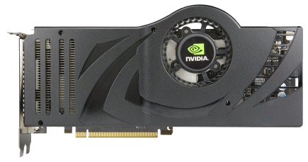
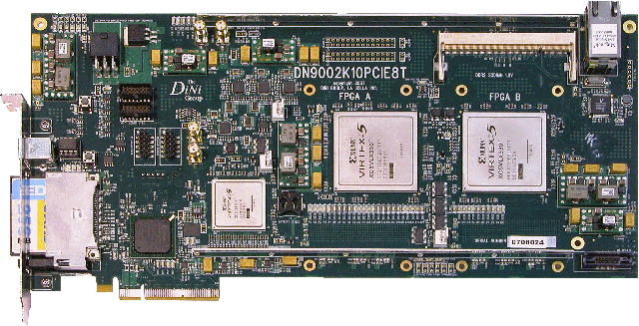
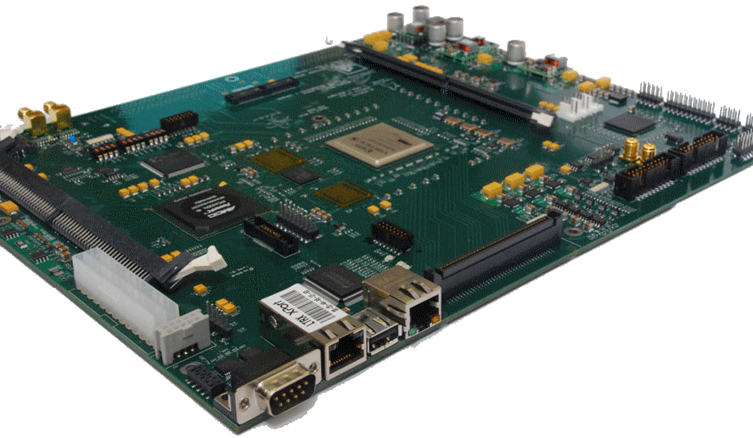
EEE4084F
Digital Systems
Lecture 1
Meet & Greet
Lecturer:
Dr. Simon Winberg
Notes:
This initial lecture session is intended as an opportunity to meet the class, give everyone a chance to find the venue and ensure the venue is suitable. Prac times and general logistics plans about the course should be discussed.

Slide 2
“Digital Systems” EEE4084F…
Top of the chart…
for courses with vague course names
EEE4084F
Digital Systems
Basics of Electrical
Engineering
Signals and
Systems
Transmission
lines
Notes:
The course name does not reflect so well the course content. You’ve already done combinational logic, computer architecture, datapaths, microoperations, instruction set architecture and other topics that I rather like, and which are more traditionally considered digital systems – so I’m building on that but taking things more towards the topic of “heterogeneous high performance embedded systems” in the first term and towards “specialized application accelerators” in the second term.

Slide 3
More suitable names for this course…?
“High Performance Heterogeneous Computing Systems” (HiPeHeS) ← preferred
“High performance computing systems for electronic and computer engineers”
“Design of special-purpose parallel and reconfigurable computer systems”
Threads, clusters, clouds, GPUs and FPGA-based digital accelerators… and other interesting computer stuff.

Slide 4
HiPeHeS : High Performance Heterogeneous Computing Systems
Couse partly guided by the HPEC handbook
Planned around systems engineers and computational scientists who will be working in the embedded computing field.
The emphasis is on a systems perspective, but complemented with specific technologies e.g.
ADCs,
front-end signal processing subsystems,
compute-intensive front-ends
back-ends requiring intensive parallel and programmable processing

Slide 5
HiPeHeS : High Performance Heterogeneous Computing Systems
We’re going to follow the content of HPEC systems in a somewhat top-down fashion, moving from application through to implementing application accelerators and other nitty grittys
Canonical framework illustrating key subsystems and components of a high performance embedded computing (HPEC) system.

Slide 6
Class handout
Available on Vula
See: Resources / GENERAL
details
boring
details

Slide 7
Objectives & …
EEE4084F Digital Systems
Relevance of EEE4084F to You

Slide 8
The Objectives
Equip you with expertise and knowledge of the state-of-the-art.
Apply and build on knowledge from previous courses, taking it to a new level.
Work on exciting and interesting projects that will help to…
Prepare you for a high-flying high-tech career!!

Slide 9
Relevance to you…
If you’re in the ECE programme, you’ll be expected to graduate with good knowledge of the fundamental + some experience with the latest techniques and technology.
But more than that… intent as a “capping course”, that draws on prior knowledge; provide an “upwards push” towards taking things further on your own in your future career or studies.

Slide 10
EEE4084F Teaching Staff
Lecturer: Dr. Simon Winberg Email: simon.winberg@uct.ac.za Office: 6.13 Menzies
Consultation times: Monday 9h00-11h00 / 14h00-16h00, Thurs 9h00-12h30. Can schedule alternate appointments using my online appointment schedule.
Tutors:
Tutor 1 Matthew Coulson
Email: clsmat002@myuct.ac.za
Tutor 2 Mpumelelo Mthethwa
Email: mthmpu003@myuct.ac.za

Slide 11
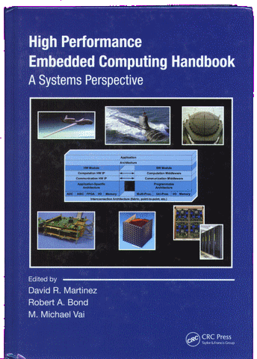
Textbook
Required textbook: Martinez, Bond & Vai, 2008. High Performance Embedded Computing Handbook. CRC Press.
This a selection of academic published papers may be provided in addition, to supplement the textbook.

Slide 12
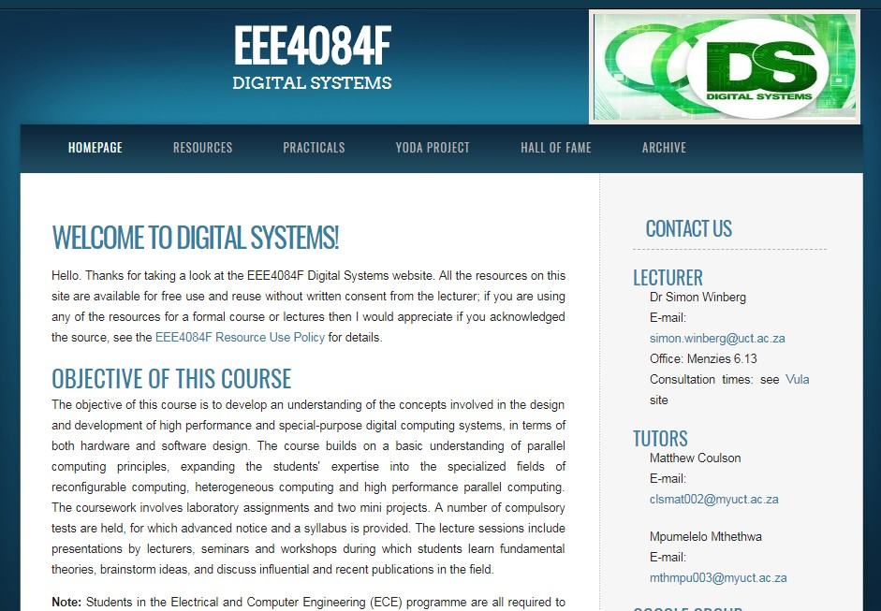
Course Websites
Resources, lectures, etc: www.rrsg.ee.uct.ac.za/courses/EEE4084F/
+
Vula site used for submitting assignments, announcements, etc.

Slide 13
Lecture & Prac times
Lectures
Day | Time | Venue | Description
Tuesday | 2-4pm | EM5 | Lecture
Thursday | 2pm | EM5 | Seminar/Test/Lecture
Thursday | 3pm | TBD | Prac Intro/Lecture
Have your pick!!
Tutor at most popular option
Pracs
Day | Time | Venue | Description
Wednesday | 9-11am | Blue lab | Prac
Thursday | 9-11am | Blue lab | Prac
Monday | 4-6pm | Blue lab | Prac
Generally Thursdays 2pm a mix, initial presentation in blue lab followed by prac

Slide 14
Prac routine
Thursdays 2nd half of the double (i.e. 3pm) gets you started
Stay on Thurs to get further with prac
Then Tue/Web following week finish off
More pracs in Term 1 than in Term 2, Term 2 will mainly be project work.

Slide 15
When do pracs start?
Would like to make a start on pracs in the first week… i.e. on Thursday at 3pm
Lab times:
Thursdays 3pm to when you want (e.g. 17h00)
Wed is mainly self-guided (tutor may be available for limited time at start)

Slide 16
Do I need to attend lab sessions?
We know the simple terminology!
To clarify (for my nomenclature):
Prac = the assignment you are tasked to do (not necessarily the place to do it)
Lab / Lab session = the booking of the lab (i.e., Blue Lab)
Question: Must we attend every lab?
To answer…
To answer: No, you don’t need to attend lab sessions. Work where you want, when you want. You just might have to use the lab in order to access the required hardware.
NB: But you do need to complete all the pracs.

Slide 17
Lab Practicals
# | Title
 | TERM 1 PRACS
1 | OCTAVE basic operations and graphing, implementing function.
2 | pThreads static: static block partitioning and speedup relative to the single-thread "golden measure"
 | (Optional) pThreads dynamic: dynamic partitioning and speed comparison to static partitioning
3 | OpenCL: An introduction to OpenCL and speeding up a computation process using this language
4 | MPI median filter: make pipelined system running on cluster (can use a single computer with multiple cores).
 | TERM 2 PRACS
5 | FPGA Introduction
… | Remainder of the prac sessions will be working on the Your Own Digital Accelerator (YODA) project.
Links to recommended C / C++ tutorials if you haven’t used C much before
http://www.cplusplus.com/doc/tutorial/

Slide 18
EEE4084F Syllabus in brief
TERM 1 THEME:
Microprocessor-based parallelism & supercomputer/HPEC
Parallel Computing
TERM 2 THEME:
Reconfigurable
Computing using FPGAs
High Performance Embedded Computing (HPEC) Systems
Essay 1
YODA Project
Not for the timid.
Your existing knowledge & prerequisites
Digital Systems
Software Engineering, Programming, etc. (CS courses)
Digital Logic, etc. (from EEE2039W or equivalent)
Embedded Systems (EEE3074W)
Microprocessor and digital circuit design & tools
(EEE3017W/EEE3064W)
Notes:
The title ‘Digital Systems’ is rather misleading, and is something of an anachronism and legacy effect of the course listing with hasn’t been changed in order not to complicate the ECE programme’s accreditation process. A name such as “High Performance Embedded Computing” would be more appropriate. After all, you already know how to develop digital systems; you’ve been doing that since 2nd year (albeit starting from a very basic beginning). So, I’ve shown HPEC as a instance of a digital system, which it of course is, although one of the most complex and involved instances of such a system. In essence, the course is meant to be a “capping course”, building upon your existing expertise in designing and developing digital systems, and also giving you a “push” towards honing your abilities and skills for a high-tech future.
You can see that the course comprises two main themes: reconfigurable computing, and microprocessor-based parallelism. These themes correspond to the two main trends of HPEC and embedded computing in general. The first theme is about building dedicated systems from scratching, building up to a sophisticated system, using basic underlying digital logic and programmable logic devices. The second theme takes a more top-down approach, repurposing and interconecting larger computing blocks that are comprised of microprocessors or configurable microcontoller systems.

Slide 19
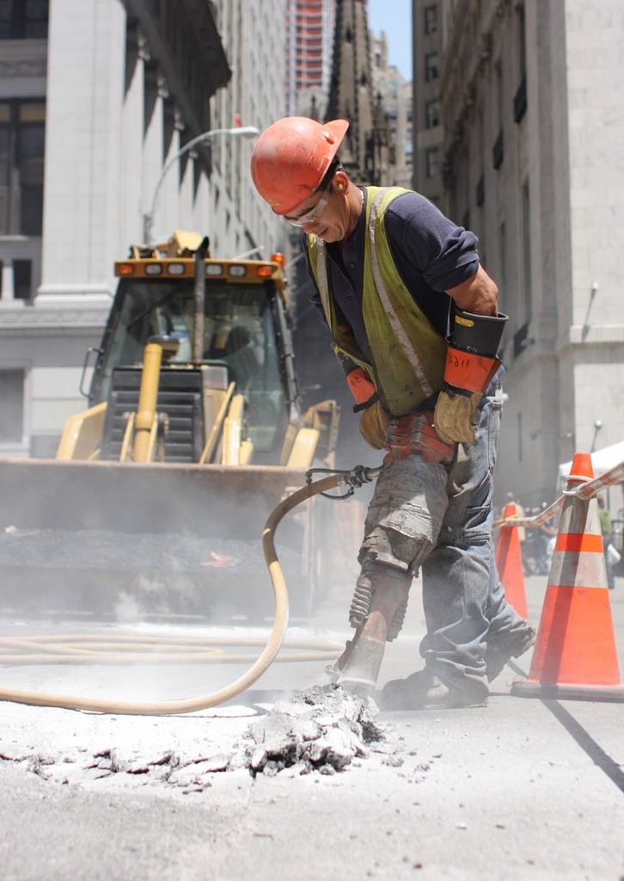
Marks Breakdown
Assessment | % Final Mark
Lab | 10
Project | 16
Tests | 16
Exam | 50
Other* | 8
Total | 100
* Seminar (6%) and tech essay (2%)
DP:
Minimum 40% overall class average to write the final exam
Seminar presentation

Slide 20
3 Types of Groups
Seminar Facilitation Group (SFG)
Need to be formed ASAP
Topics are text book chapters / readings
Technology Report Blog
Yoda Group (YOG)
Formed prior to starting a project
Can comprise the same or different individuals as to the REG
Prac Assignment Group (PAG) *
Independently or as a team of 2
* Disclaimer: You or your teammate may need to give impromptu explanations or demonstrations of what you have done to demonstrate that you both know what you are doing (if the one member seems clueless then you might both get marks deducted). The lecturer may also do random spot checks to request students to do brief prac oral tests.

Slide 21
The Technology Report
Should be done as part of the seminar group!!!
2% of final mark
This is a new innovation
Replaces “conceptual assignment”*
The purpose is to
Make seminars more interesting & educational ← NB
Get together students with similar interest
Explore literature on a digital technology
Write up a blog and shared with rest of class in a quick and ‘easily digested’ form (is for marks!)
The
Literature
* The conceptual assignment could be removed because this course is no longer core and ELO1 is no longer assessed in it.

Slide 22
Seminar & Blog Plan
Each seminar group is assigned a chapter of the textbook and is required to add another interesting somewhat related academic paper, suggestions have been given for each topic
Start by presenting/summarising the chapter(s)
Then go into presenting on the assigned paper, which are somewhat related to the chapter (but more modern examples of the case studies used in the chapter)
The blog involves a summary of the academic paper. The first student group (seminar 2) can do their blog after the seminar, the other groups should complete their blog before the seminar

Slide 23
Seminar presentation timing & marking guide
Structure of Seminar Presentation | Mark
Introduction of group and topic (~1 min) | 5
Summary/pres on important chapter issues (~10 min) | 20
Present reading / modern case study (~10 min) | 20
Visual aids / use of images / mindmaps / etc. | 20
Reflections (5 – 10 min) Including group’s viewpoints / comments / critique | 10
Facilitation and direction of class discussion & response to questions (10 min) | 5
Quality of questions posed by the presenters | 5
Wrapping up / conclusion (2 min) | 5
(all members need to participate sufficiently or marks for each may reduce)
TOTAL: | 100
See seminar_marking.pdf on website in Assignments & Resources.

Slide 24
Technology Report Blog marking
Structure of Essay | Mark
Introduction of the topic (~1 para) | 10
Background (general problem, etc.) (~½ pg) | 10
Methodology (data sources/literature used) | 5
Elaborate the technology (~2-4 para) | 20
Case study / example application (if any) | 10
Reflections (+/- 4 para) Including group’s viewpoints / comments / critique | 15
Wrapping up / conclusion (2 para) | 5
Visual aids / use of images / mindmaps / etc. | 20
Explain of division of labor (DOL)* (email to lecturer) | 5
TOTAL: | 100
The blog should be about two pages, about 1500 – 3000 words with some pictures
* If you do it individually the DOL is absorbed into the conclusions mark

Slide 25
Readings
Sections of the text book will be assigned (related to seminars)
A few readings related to lecture topics will be suggested or student can swap/add others they prefer (for technology report & seminar)

Slide 26
Heads-up on reading task 1…
Readings for Seminar 1 (27 Feb 3pm)
See Resources/Readings on Vula site
R01:
Asanovic et al. “The Landscape of Parallel Computing Research: A View from Berkeley”

Slide 27
Projects
EEE4084F

Slide 28
In this course…
fairly BIG project – implementing a digital accelerator on an FPGA
I’m open for new project ideas – previous year’s list on the website
Thoughts on
Final year projects? Eeeek!!
Various 4th year projects on offer, a initial listing is available at:
http://www.rrsg.ee.uct.ac.za/members/swinberg/Proposals/S_Winberg_BScTopics_2018.pdf
idea
If YOU have an idea of a project you want to suggest (within my area of expertise) I’d consider supervising it and adding it to my list of BSc projects offered. *
* Would need to prepare a description and discuss it with me pref. early March.

Slide 29
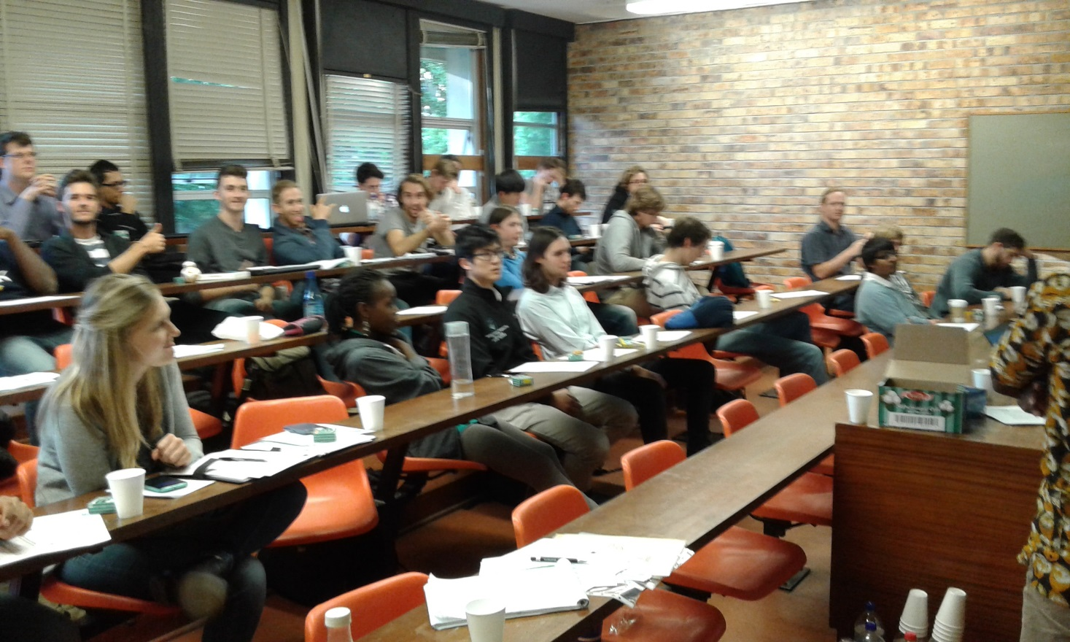
YODA Conference:
Conference where each group presents their Digital Accelerator

Slide 30
Before we finish lecture1…
info

Slide 31
Some thoughts &
Inspirations…

Slide 32
Some inspiration & food for thought…
What are You Considering…
My
Boss
Your own startup
vs.
Work for someone
vs.
Postgraduate work
research
industry
Decide later?

Slide 33
Consider the pros & cons
Postgraduate work
Like researching & experimenting; initially pay not as good though.
Might want to dev. own product, get support from adviser & community, lab space
May lead to better job options later
Work for someone
Gain experience, very beneficial; but likelihood of doing further study tends to diminish over time
Working for yourself?
Nice idea and big possibilities ☺..
but more risky ☹
hmmm

Slide 34
Thinking about your own business
Why?!
Toying with an idea of starting your own business? Then ask yourself:
Why do you want to go into business?
List your reasons; pros & cons..
What is the right business for you?
Your ambitions; your work ethic; Your emotions; Your connections
What niche/new product will you provide?
And is a business right for you?
High-tech products super highway
You?

Slide 35
Your own business (harsh) realities
What resources are needed? (equipment, software, people, space)
How long before it’s self-sustaining?
How much cash does it need?
How will it make a profit? (business model)
Where can I get the finances / should I get a business loan? *
All the while maintaining your own living expenses?
* As a graduate (esp. young graduate like most of you will be soon) with a good idea or IP and promising business plan, then there’s actually many options (at least for SA citizens), where you don’t need to commit your own or family’s hard earned cash, e.g. using an incubator or somehow having the government / venture capitalist give you a chance (but in exchange for a cut of the future earnings and/or demonstrating that you business will be creating jobs).

Slide 36
Some harsh realities
Where is there work for computer engineers?
(Most especially high-paid ones!)

Slide 37
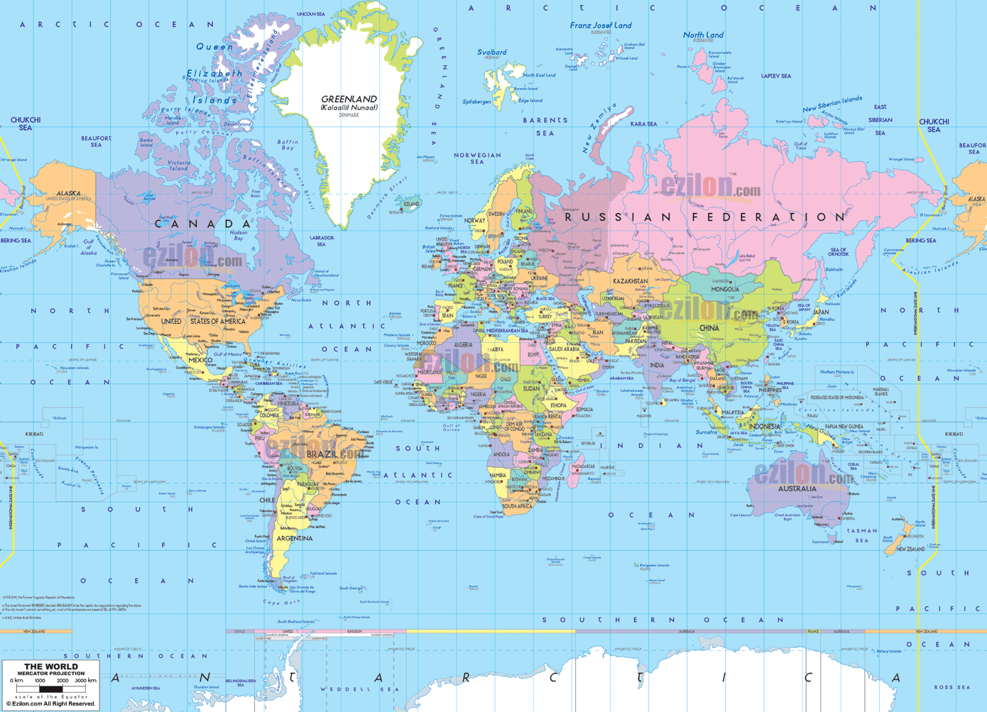
Map of the world – where are the EC jobs?
You are here

Slide 38
Where the jobs are…
(incl. Australia)
& other North
American nations
Data based on: Cass, S. 2007. “Where the jobs are”, In IEEE Spectrum: 44(2). pp 51-57
Note: in the case of continent the flag represents the country with the largest electronics industry

Slide 39
Some realities
Where is work for computer engineers?
Most in: USA, Europe (& UK), China and India
But opportunities in RSA are growing…
Good news: – if you’re skilled
Outsourcing: 40% * (esp. consumer/custom products)
World shortage of good skills in embedded and high-performance developers
Worldwide desire for electronic products and faster processing
Increase in specialized/embedded computer systems, getting increasingly complex & interconnected, rather than becoming simplified and easier…
* based on statistics of survey done by: Cass, S. 2007. “Where the jobs are”, In IEEE Spectrum: 44(2). pp 51-57

Slide 40
Are these job statistics something to worry about?
That depends…
Graduate that did well generally seem to find EC-related work wherever they would like to be (with some obvious limitations*).
Although many of our graduates end up doing nothing related to computer engineering (e.g. financial consultancy), it doesn’t mean there aren’t plenty jobs out there that would use the skills you have learned in the programme.
In all, getting your BSc in ECE will most likely be worth all the effort ☺
* Certain countries have next to zero – or less – work going on related to computer system development (by ‘less’ you can interpret however you like; which could be smelting down old machines to extract metals).

Slide 41
Suggested reading
See folder Supplementary Readings on Vula site:
The Job Market of 2045 - IEEE Spectrum
IEEESpectrum_2013.01.22_16Jobs2045.mp3 podcast
Other view based on where embedded engineers work:
http://images.content.ubmtechelectronics.com/Web/UBMTechElectronics/%7Ba7a91f0e-87c0-4a6d-b861-d4147707f831%7D_2013EmbeddedMarketStudyb.pdf

Slide 42
End of lecture 1
Summary:
You and I have (hopefully) managed to find the correct venue ☺
We discussed a number of relevant, and some not-so pertinent, issues
You’re hopefully been fired up with ideas of
- considering projects to work on this year
- thinking about postgrad study
- considering your own business / finding work & gaining experience
Lecture 1: Meet & Greet

