Slide 1
EEE4084F
Digital Systems
Lecture 2:
Terms, Amdahl Law &
Dealing with reading assignments
Lecturer:
Simon Winberg
Attribution-ShareAlike 4.0 International (CC BY-SA 4.0)

Slide 2
Outline for Lecture
Class Activity – Quiz#0
Terms
Validation vs. Verification
Commonly used verification methods
Amdahl’s Law
Dealing with reading assignments

Slide 3
TODO … short quiz
EEE4084F Digital Systems

Slide 4
Class Activity
Quiz #0 - “Initial impressions”
10 minutes to complete a few simple survey questions and prerequisite tests.
This quiz is not for marks
Name & student number voluntary

Slide 5
Marking of Quiz0 ?!
Please swap your Quiz0 with a buddy
I’ll show you the correct solutions in a moment ☺
Please hand back your quizzes at end of the lecture (you’re about to find out why!)

Slide 6
Quiz 0 marking … other slideshow

Slide 7
TERMS
TRENDS

Slide 8
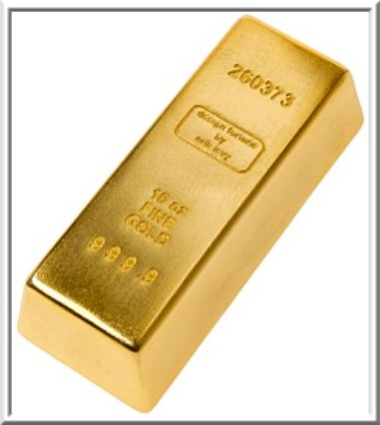
Terms
Golden measure:
A (usually) sequential solution that you develop as the ‘yard stick’
A solution that may run slowly, isn’t optimized, but you know it gives (numerically speaking) excellent results
E.g., a solution written in OCTAVE or MatLab, verify it is correct using graphs, inspecting values, checking by hand with calculator, etc.
Discussed a bit more later…

Slide 9
Terms
Sequential / Serial (serial.c)
A non-parallized code solution
Generally, you can call your code solutions parallel.c (or para1.c, para2.c if you have multiple versions)
You can also include some test data (if it isn’t too big, <1Mb), e.g. gold.csv or serial.csv, and paral1.csv

Slide 10
Speed-up
Speed-up = T_{p1} /T_{p2}
Where T_{p1} = Run-time of original (or non-optimized) program
T_{p2} = Run-time of optimised program
Best practice for measuring speedup:
Run the program more than one, discarding the first result (where the cache, etc. is getting ‘warmed up’)
To be precise should indicate results from when system wasn’t ‘warmed up’*
* (which can be simulated by running a whole lot of other things like CounterStrike, Half-Life, maybe some Solitare* for good measure -- but more seriously you could write your own ‘cache cleaning program’)

Slide 11
Speed-up graphs

Slide 12
Other Important Terms
Verification
Validation
Testing
Correctness proof
These terms are not merely theoretical terms to remember, but relate directly to your project.
Not something done in the project (but if you want to, you can experiment with doing a correctness proof if you are keen)

Slide 13
Verification and Validation (V&V)
Two terms you should already know…
Verification
“Are we building the product right?”
Have we made what we understood we wanted to make?
Does the product satisfy its specifications?
Validation
“Are we building the right product?”
Does the product satisfy the users’ requirements
Verification before validation (except in duress)…
While it would be nice to be able to validate before verifying, doing so would mean your specifications and design may be wrong in the final version (obviously this sometimes happens in practice due to insufficient time for proper validation)
Sommerville, I. Software Engineering. Addison-Wesley, 2000.

Slide 14
Verification before validation
The RC engineer (i.e., you) are effectively designing both custom hardware and custom software for the RC platform
Before attempting to make claims about the validity of your system, it’s usually best practice to establish your own (or team’s) confidence in what your system is doing, i.e. be sure that:
The custom hardware working;
The software implementation is doing what it was designed to do; and
The custom software runs reliably on the custom hardware.

Slide 15
Verification
Checking plans, documents, code, requirements and specifications
Is everything that you need there?
Algorithms/functions working properly?
Done during phase interval (e.g., design => implementation)
Activities:
Review meetings, walkthroughs, inspections
Informal demonstrations
Focus of
project
Focus of project

Slide 16
Commonly used verification methods
Dual processing, producing two result sets
One version using PC & simulation only;
Other version including RC platform
Assume the PC version is the correct one (i.e., the gold measure)
Correlate the results to establish correlation coefficients
(complex systems may have many different sets of possibly multidimensional data that need to be compared)
The correlation coefficients can be used as a kind of ‘confidence factor’

Slide 17
Validation
Focus of project
Testing of the whole product / system
Input: checklist of things to test or list of issues that need to have been provided/fixed
Towards end of project
Activities:
Formal demonstrations
Factory Acceptance Test

Slide 18
Testing and Correctness proofs
Testing
Generally refers to aspects of dynamic validation in which a program is executed and the results analysed
Correctness proofs / formal verification
More a mathematical approach
Exhaustive test => specification guaranteed correct
Formal verification of hardware is especially relevant to RC. Formal methods include:
Model checking / state space exploration
Use of linear temporal logic and computational tree logic
Mathematical proof (e.g. proof by induction)

Slide 19
Amdahl’s Law
Speed-up
Number of processors
EEE4084F

Slide 20
Amdahl’s Law: History
The guy: Gene Amdahl
Was chief architect for IBM's first mainframe series of computers
Founder of Amdahl Corporation
Amdahl found stringent restrictions on the speedup possible for given parallelized tasks.
Thee observations packaged as: Amdahl's Law

Slide 21
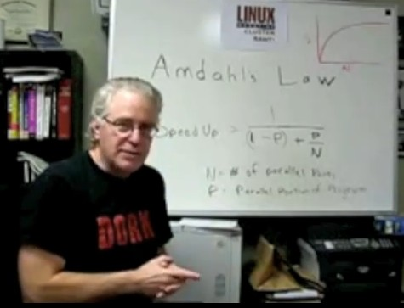
Video Clip…
Linux Magazine Video: Understanding Parallel Computing: Amdahl's Law
https://www.youtube.com/watch?v=WdRiZEwBhsM
Amdahl.flv

Slide 22
Amdahl’s Law
Classic version
Define f as: fraction of computation that can be parallelized (ignoring scheduling overhead)
Then (1 - f ) is the fraction that is sequential
Define n = no. processors for parallel case
The maximum speed-up achievable is:
1
Speedup_{parallel} =
f
( 1 – f ) +
n
Should be able to remember this formula for exams

Slide 23
Amdahl’s Law: Alternate Representation
P = expected performance improvement
E^{u} = Execution time on a uniprocessor (serial)
E^{p} = Execution time on a number of processors (parallel)
n = number of processors
S = fraction of time spent in the sequential time

Slide 24
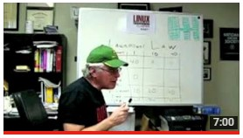
Homework task
Watch 2nd part of Amdahl’s law video
Understanding Parallel Computing (Part 2): The Lawn Mower Law
LinuxMagazine
Amdahl2.flv

Slide 25
Dealing with reading assignments, seminar and blog
You are suppose to read (at least speed read) the chapters and readings assigned for each seminar
Each Seminar Facilitation Group meant to read their aspects in depth, i.e.
Whole team to read word-for-word over chapter and paper. Look up things you don’t understand or make notes to discuss with rest of team
Meet with team to discuss the readings, to plan your blog and seminar, allocate who does what.
Make notes on the work allocations (e.g. you could have one person write up most of the blog, from team notes, and the other two make most of the slides)

Slide 26
Assigned Reading
For Thursday next week…
S1 - Landscape of parallel computing research: a view from Berkeley
Find it on: Vula Resources/SEMINARS
Short Seminar #1 facilitated by lecturer next Thursday 2pm

Slide 27
End of Lecture 2

