Slide 1




EEE4084F
Digital Systems
Lecture 3:
UML Recap, Prac1, Correlation, Simple Benchmarking
Presented by
Simon Winberg
Attribution-ShareAlike 4.0 International (CC BY-SA 4.0)
Planned to be double period lecture

Slide 2
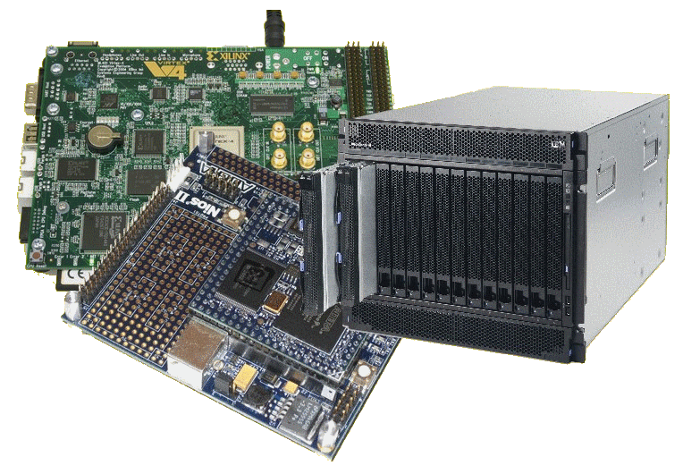
Lecture Overview
UML blurb
Prac 1 Intro
Reports
Intro to Latex
Correlation

Slide 3
UML Review

Slide 4
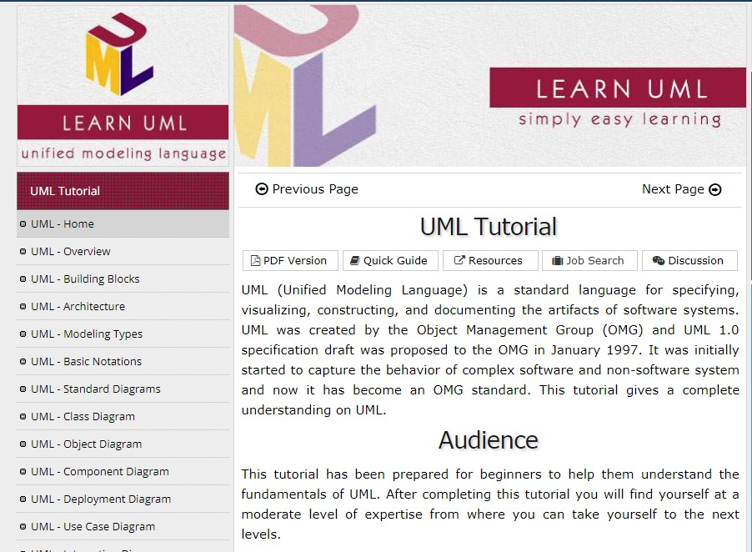
Recommended
UML Tutorials
https://www.tutorialspoint.com/uml/index.htm
See also: UML Brief Reference Card.pdf (in Vula/General)

Slide 5
UML Review*
General errors that student often make:
  Not using the UML syntax (at all)
    Block and line models, things like flowcharts
  Using the UML syntax wrongly
    Invalid modelling constructs (i.e., wrong type of connectors / associations and blocks)
    Vague models
    Insufficient information
Some examples of common mistakes…
* No longer is UML assessment in Quiz0 due to time constraints

Slide 6
UML demonstration
Look at this if your UML
understanding is lacking.
Task: Produce a UML model describing the products and people related to Joe Baggits, according to the description below.
JOE'S STORY:
Joe Baggits is a developer in the Construction Division of Freezit Commerial Products (FCP) Pty. Ltd. The FCP corporation produces a variety of Cooling systems, grouped into two product ranges, namely: 1) the portafrige range and 2) the coolzone range. The portafrige range includes the Icecart™ and the Chillblock™. Coolzone range includes the ShopFrige™ and Coolroom™. Andy Wrapp is also a developer in the Construction Division and is Joe's manager. Joe works on portafridge products, whereas Andy works on coolzone products.

Slide 7
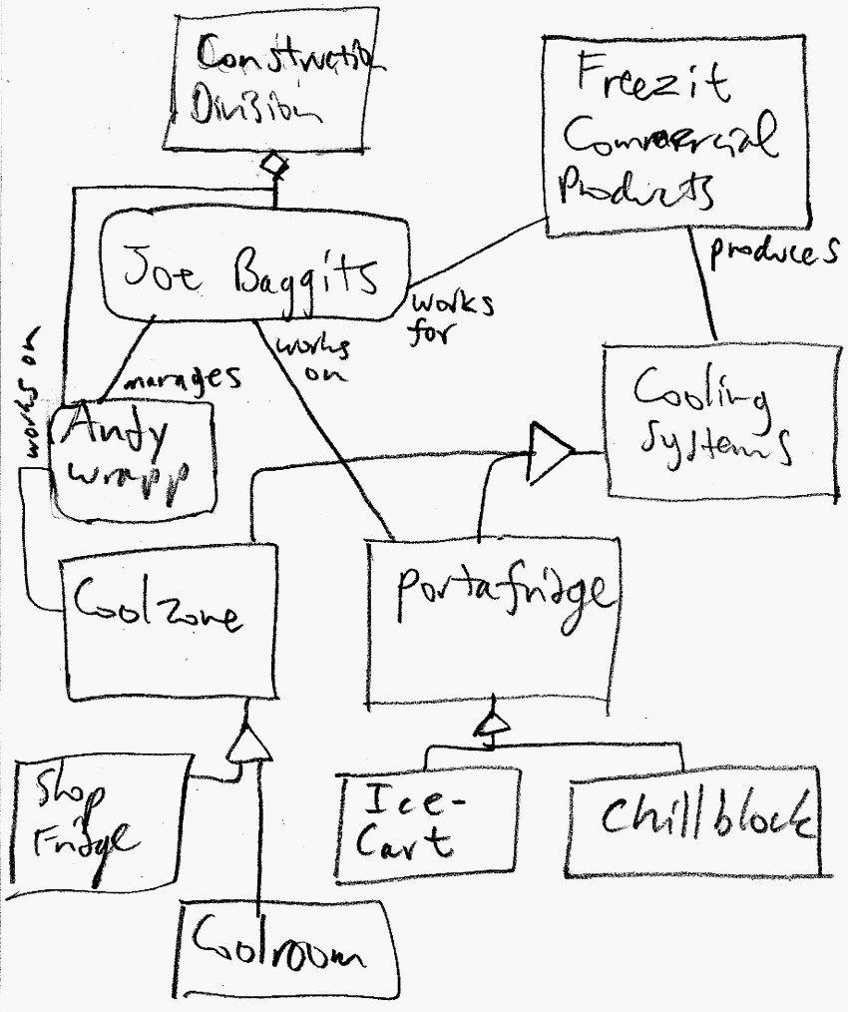
Sample
Solution
Notice use of roles, aggregation and inheritance.
In this situation, it is handy to use objects instead of classes to clearly capture things that exist as physical entities (e.g., the people)

Slide 8


Containment
vs.
Aggregation
Container
Group
Container has solid diamond
Aggregation has outline diamond
n
Arity next to item
(not next to container)
1..*
Item in the container
Item in the group
Key to arity: n → exactly n. 1..* → 1 or more * = zero or more

Slide 9
Super fast class exercise
(for Thurs double)
Briefly describe the following as a UML diagram:
A new computer system called PMB (Parallel Multicore Beast) contains eight CPUs and two blocks of 8Gb memory. It can run multiple programs from its built-in Linux O/S. Each program can spawn multiple threads. The programs each contain one or more data blocks.
Take around 5 minutes to draw a rough UML class diagram
If you haven’t used UML don’t worry, just used the containment and aggregation links shown earlier.

Slide 10
Sample solution
A new computer system called PMB (Parallel Multicore Beast) contains eight CPUs and two blocks of 8Gb memory. It can run multiple programs from its built-in Linux O/S. Each program can spawn multiple threads. The programs each
contain one or
more data blocks.
PMB
2
8GB Memory
8
Linux
CPU
Assumptions:
Threads are contained in a program, and there must be at least one thread in a program.
By stating Linux is built-in it indicates that this O/S is an instrumental non-optional aspect so this is probably more a containment relation than an aggregation.
*
Program
1..*
Thread
1..*
Data block

Slide 11
PRAC!!

Slide 12
PRAC1
Using OCTAVE

Slide 13
Planning for 22-28 Feb
Prac1 avail for you to work on. Experiment with C or OCTAVE (note includes a report to be in Latex that is for marks and to be submitted online using Vula)

Slide 14
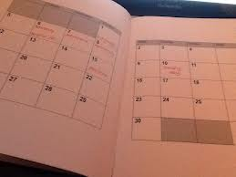
Prac1:
OCTAVE & Correlations
See Assignments on the course website
http://www.rrsg.ee.uct.ac.za/courses/EEE4084F/Practicals.html
rem.
to do
h/w
See you all on Monday 9am

Slide 15
Towards Prac1
Prac1 involves OCTAVE
OCTAVE is like a free version of MATLAB
You can install OCTAVE on your own PC you you’d like to see:
  https://www.gnu.org/software/octave/download.html
A suggested OCTAVE tutorial to help you prepare for Prac1
    Brief intro to OCTAVE: https://www.gnu.org/software/octave/doc/v4.0.0/Introduction.html

Slide 16
Parts of the Pracs
Initial Parts (e.g. Part A)
  Example program that helps get you started quicker
Subsequent Parts
  The main part, where you provide a parallelized solution

Slide 17
Prac1: Why OCTAVE
The idea of starting you out with OCTAVE is that it is a useful (free!) tool that you can use later, e.g. in further pracs to verify calculations etc.

Slide 18
Prac 1
Contains 4 parts
  Part 1: Starting out in OCTAVE, generating matrices, doing plots, saving data
  Part 2: Working with ﬁles
  Part 3: Measuring execution time with tic and toc
  Part 4: Implementing a Correlation routine
What to hand in
  Hand in a short report brieﬂy describing your solutions for Part 3 step #4 and Part 4

Slide 19
Code Quality and Professionalism
There’s a few coding habits that you should practice
  Code file header
  Section dividers
  Function comments
  Code comments
  Version backups (e.g. file.c and file_1.c)
Commenting out code
  Do at own risk
  Numbered supressed blocks

Slide 20
Code File Headers
This is the text (in comments) at the start of your code file
Should indicate
  Project
  Module name and info
  Dependencies (direct dependencies, no standard libs)
  Author(s)/coder(s), dates modified, versions
  References / Acknowledgements
  Licensing
Of course for some purposes these are not all needed. e.g. For Prac1 just need to indicate Project (Prac1) and Authors

Slide 21
Code File Heading - example
/* MyModule.cpp
============
Project: MyProject
Dependencies: myio.h
Author:
Bob Baggits last edit: 5 Jan 2018
References:
Mary May (2009), "for loop for sorting ints", vol 2(1), Computer Systems.
http://mycode.com : reuse of code from myintsarrays.c
Licensing:
public domain / permission to reuse the code without concent from authors.
*************************************************************************************/
/** LIBRARY INCLUDES **/
#include <iostream> // needed for cout
#include <strings.h> // needed for strcpy
/** PROJECT INCLUDES **/
#include "myio.h"
/** NAMESPACES UTILIZED **/
using namespace std;
/*************************************************************************************/
void mytest ( int x[], int sz )
/*! Function to increment all values in an array. */
{
for (int i=0; i<sz; i++) x[i] = x[i]+i;
}
/*************************************************************************************/
int main( int argc, const char* argv[] )
/*! The entry point to the program. */
{
string s1;
// read in values for the two strings from the console
cout << "Please enter first string : ";
cin >> s1;
}

Slide 22
Code example – numbered suppressed blocks
/* MyModule.cpp
============
Project: MyProject
Dependencies: myio.h
bla bla
*************************************************************************************/
…
/** NAMESPACES UTILIZED **/
using namespace std;
/*************************************************************************************/
//1 This version of the function wasn’t working right
//1 void mytest ( int x[], int sz )
//1 /*1! Function to increment all values in an array. (NB if using Doxygen might leave out ‘!’)*/
//1{
//1 for (int i=0; i<sz; i++) x[i] = x[i]+i;
//1}
//2 This version is better
void mytest ( int x[], int sz )
/*! Function to increment all values in an array. */
{
for (int i=0; i<sz; i++) x[i] = x[i]+1;
}
/*************************************************************************************/
int main( int argc, const char* argv[] )
/*! The entry point to the program. */
{
string s1;
// read in values for the two strings from the console
cout << "Please enter first string : ";
cin >> s1;
}

Slide 23
Prac Reports
EEE4084F

Slide 24
Recommended report structure…

Slide 25

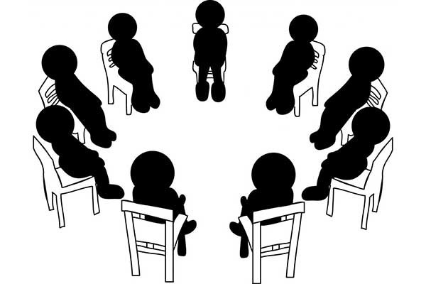
Hello everyone.
IMDRC Anonymous
My name is Simon and I am an
5 rules to clear thinking
1. Introduction 2. Methodology
3. Design 4. Results 5. Conclusions
IMDRC addict
… and I don’t think I’ll ever be able to quick the habit.
When it comes to reports
I favour the structure
Introduction
Methodology
Design
Results
Conclusions
Also known as IMDRC
Or an ILMDRC addict when it comes to big reports and theses

Slide 26
Writing Reports
Always a good idea to plan your report
Start e.g. with a list of section headings and then incrementally populate the sections
Useful sequence of development:
  Introduction (first take)
  Results (pop in some results you have)
  Design (in consideration of what you are showing in results)
  Methodology (how you went about the design)
  Conclusion
  Introduction (finalized)
  {ideally finish with a thorough proof reading}

Slide 27

Using Latex
For Prac 1 you’re all expected to use Latex.
  Use TexStudio or TexMaker, these are easy to use tools for writing documents in latex.
It is quite straightforward unless you want to do fancy things, such as
  Adding equations
  Positioning text in non-standard ways (e.g. indenting)
  Getting images / tables / listings to be where you want them (as opposed to where Latex decides they should be placed).
  With some practice you’ll see it isn’t so difficult and could actually be a big help in the longrun for example for writing your BSc final year project report.

Slide 28
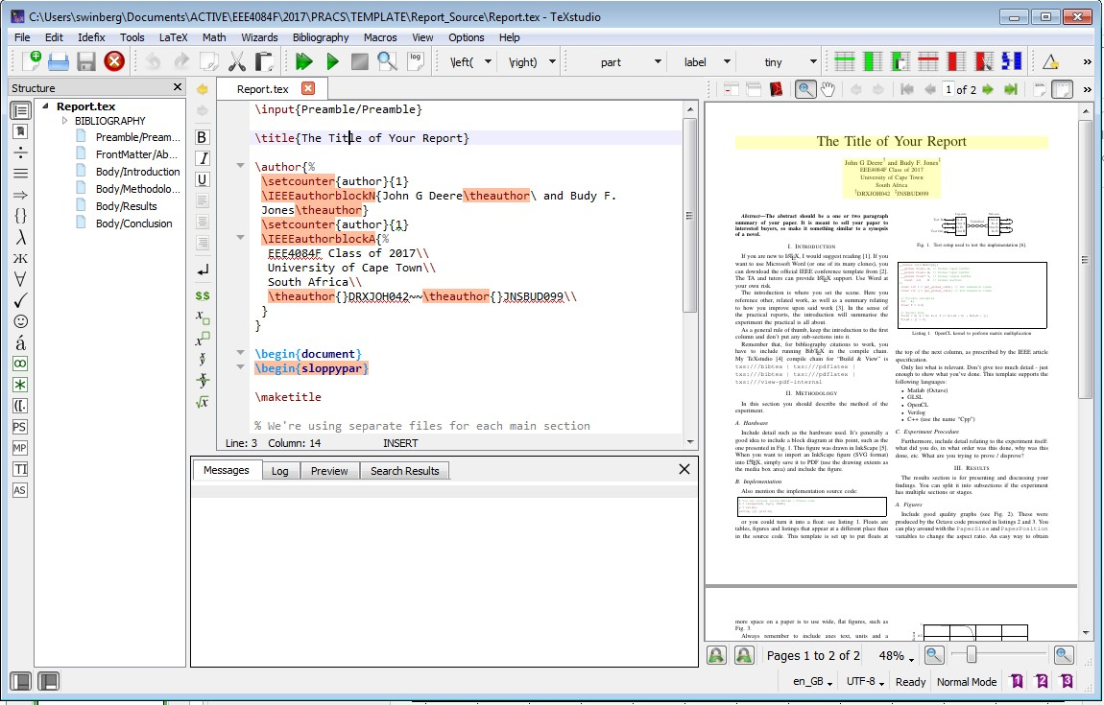
TexStudio – suggested tool to use!

Slide 29
Brief
Demo
Using TexStudio

Slide 30
Latex Help
Latex Stack Exchange
  http://tex.stackexchange.com/
  This is essentially the go-to place for help in solving Latex problems easy or hard.
Online manuals/guide
  Tobias Oetiker's Guide to Latex
  Latex WikiBook:
    https://en.wikibooks.org/wiki/LaTeX

Slide 31
Some Useful Latex Tools
Table Generator
  The Table Generator web service which you can use to generate code for latex tables.
  https://www.tablesgenerator.com/
Overleaf
  Collaborative online latex editor (good idea for e.g. team projects).
  https://www.overleaf.com/
Detexify
  You might initially think this is very gimmicky, but actually it can be jolly useful. Basically you draw a symbol (e.g. a tick) and Detexify gives you options for latex symbol names that most closely match it.
  http://detexify.kirelabs.org/classify.html

Slide 32
Correlation recap
EEE4084F

Slide 33
Why is Correlation important in this course?
Correlation is used as a means to objectively tell how accurate your experimental solution is measured against a known good solution (the Golden Measure)
Typically used to get a sense (confirm) that your experimental system is adequately correct

Slide 34
Correlation
Finding the relationship between two quantitative variables, e.g. the price of cheese to the age of cheese.
Correlation is a statistical technique used to determine the degree to which two variables are related

Slide 35

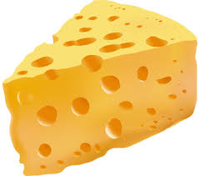
Correlation
Looking at a scatter diagram gives an impression of how variables are related…
What has the cost of cheese got to do with its age?
Straight line linear regression

Slide 36
Correlation
The pattern of data is indicative of the type of relationship between your two variables:
  positive relationship
  negative relationship
  No / minimal relationship

Slide 37
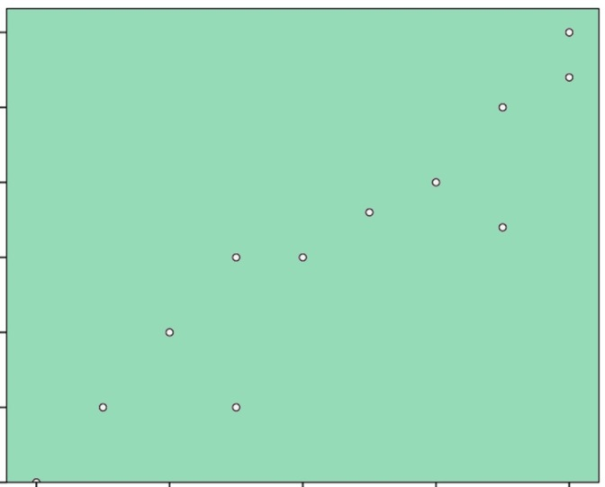
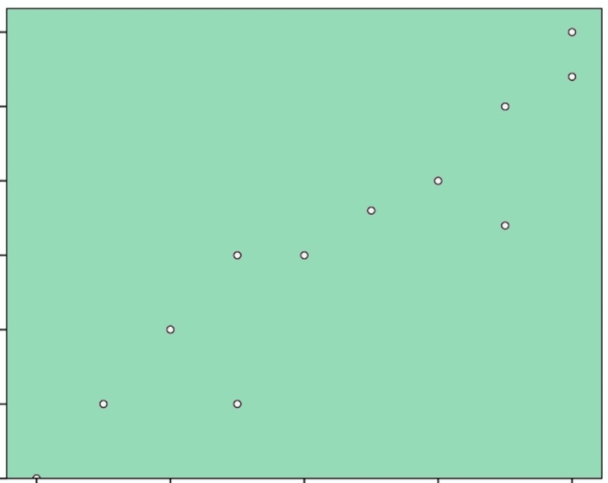
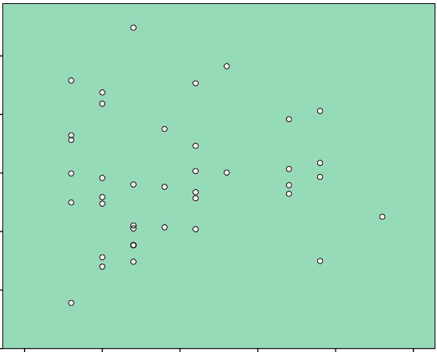
Correlation Relations
Positive Relation
Negative Relation
No Relation

Slide 38
Correlation Coefficient (r)
It measures the nature and strength between the variables.
The sign of r denotes the nature of the relationship
  +’ve : direct relation (increase of the one variable leads to increase of the other)
  -’ve: indirect relation (increase of the one variable leads to decrease of the other)
The magnitude denotes the strength of the relationship
  Between 1 (strong) and 0 (week/none)

Slide 39
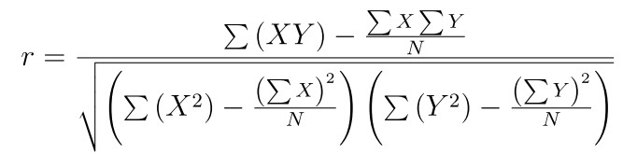
Computing the correlation coefficient
Computation of correlations
You can calculate it in one pass through the data… i.e.
sum up x, y, xy, x² and y²

Slide 40
Multiple Dimension Correlation
Usually use a table, do correlations between two of the variables for all possible combinations…
What has the cost of cheese got to do with its weight & age
 | Weight | Age | Cost
Weight | 1 | 0.02 | 0.81
Age | 0.02 | 1 | 0.65
Cost | 0.81 | 0.65 | 1
symmetric matrix likely to result

Slide 41
Simple benchmarking
Using tic and toc in OCTAVE
tic : starts the performance timer
toc : returns the elapsed time since tic was invoked.
Best practice:
  It’s recommendable to use tic and toc in a M file
  It’s a little more accurate if you have tic on the same line as the first instruction to time: i.e.
    tic; do_something; t=toc

Slide 42
Some sample reports
EEE4084F

Slide 43
Prac1:
Over to you
to make a start!

Slide 44


Now Let’s make like
Cyril
and walk!
down to the blue lab
Who thought you could get some cardiovascular exercise in an engineering course?!

Slide 45
Disclaimers and copyright/licensing details
I have tried to follow the correct practices concerning copyright and licensing of material, particularly image sources that have been used in this presentation. I have put much effort into trying to make this material open access so that it can be of benefit to others in their teaching and learning practice. Any mistakes or omissions with regards to these issues I will correct when notified. To the best of my understanding the material in these slides can be shared according to the Creative Commons “Attribution-ShareAlike 4.0 International (CC BY-SA 4.0)” license, and that is why I selected that license to apply to this presentation (it’s not because I particulate want my slides referenced but more to acknowledge the sources and generosity of others who have provided free material such as the images I have used).
Image sources:
Clipart sources – public domain CC0 (http://pixabay.com/)
commons.wikimedia.org
images from flickr

