Slide 1
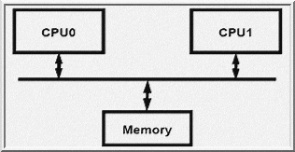
EEE4084F
Digital Systems
Lecture 4:
Parallel Computing Fundamentals,
Base Core Equivalents
Presented by
Simon Winberg
go parallel!
Attribution-ShareAlike 4.0 International (CC BY-SA 4.0)
Planned to be double period lecture

Slide 2
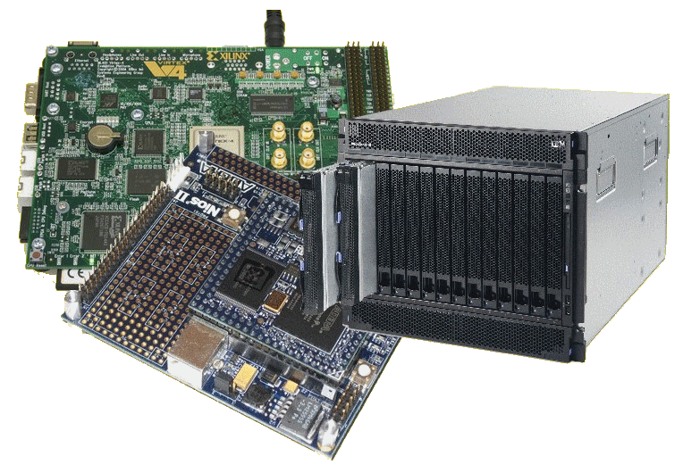
Lecture Overview
Parallel computing fundamentals
Large Scale Parallelism
Some Calculations
Amdahl’s Law Revisited
Base Core Equivalents (BCEs)
Calculating performance using BCEs

Slide 3
Seminar Facilitation Groups??
Group# | Chapter | Team* | Paper | BlogDone
1 | N/A | Lecturer | The landscape of parallel computing research: a view from Berkeley | 0
2 | CH1,2 | Alexandra Barry, Nicholas Antonaides | CH1-A Retrospective on High Performance Embedded Computing, CH2-Representative Example of a High Performance Embedded Computing System | 0
3 | CH3 | Munsanje Mweene, Claude Betz | CH3 System Architecture of a Multiprocessor System | 0
4 | CH3 | Alexander Knemeyer, Sylvan Morris, Anja Muhr | CH5 Computational Characteristics of High Performance Embedded Algorithms and Applications | 0
5 | CH15 | Liam Clark, Andrew Olivier, Hannes Beukes, Jonothan Whittaker | CH15 CH15 Performance Metrics and Software Architecture | 0
6 | CH7 | Dominic Manthoko, Tafadzwa Moyo, David Fransch | CH7 Analog-to-Digital Conversion | 0
7 | CH9 | Tatenda Mhuvu, Petrus Kambala, Mustafa Rashid | CH9 Application-Specific Integrated Circuits | 0
8 | CH13 | Qayyoom Arieff, Ash Naidoo, Prej Naidu & Muhammed Razzak | CH13 Computing Devices | 0
9 | CH14 | groupnames | CH14 Interconnection Fabrics | 0
10 | CH24 | Xolisani Nkwentsha, Kgomotso Ramabetha, Sange Maxaku, Makabongwe Nkabinde | CH24 Application and HPEC System Trends | 0
You guys are great!!!
Thanks for so many groups having signed up without extra cohersion

Slide 4
Parallel Systems
Y !
A?
-
C?
+
*
X !
B?
EEE4084F: Digital Systems

Slide 5
Question:
Do you sometimes feel that despite
having a wizbang multicore PC,
it still just isn’t keeping up well
with the latest software demands?...
…
Anyone else beside me feel that way?
Major software
Processor cores

Slide 6
It may be so because your software isn’t designed to leverage the full potential of the available hardware.
CPUs at idle

Slide 7
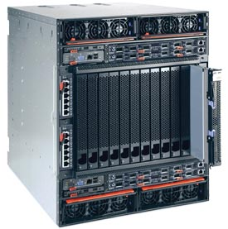
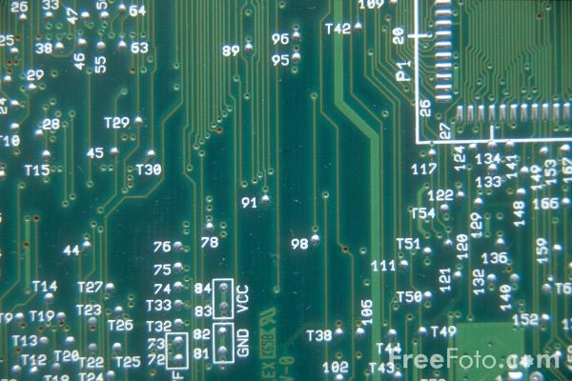
Computation Methods
Hardware
Reconfigurable
Computer
Software
Processor
e.g. PCBs, ASICs
Advantages:
High speed & performance
Efficient (possibly lower power than idle processors)
Parallelizable
Drawbacks:
Expensive
Static (cannot change)
e.g. IBM Blade, FPGA-based
computing platform
Advantages:
Faster than software alone
More flexible than software
More flexible than hardware
Parallelizable
Drawbacks:
Expensive
Complex
(both s/w
& h/w)
e.g. PC, embedded software on microcontroller
Advantages:
Flexible
Adaptable
Can be much cheaper
Drawbacks:
The hardware is static
Limit of clock speed
Sequential
processing

Slide 8
Short Video:
Latest Intel Chipsets
https://www.youtube.com/watch?v=Q8Akad-OxRI
Intel's New 4th Gen Core i7 Processors and More - PAX Prime 2014.mp4

Slide 9
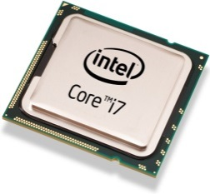
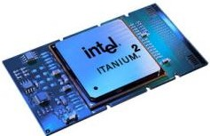
Quick view: Intel’s Latest CPUs
Intel® Core™ i7
I7 Extreme Edition vs. (regular) i7 processor
Intel® Xeon™ Processors
4/8 cores; 8/16 threads; 40W to 130W (more cores, exponential growth in power)
1.86-3.3 Ghz CPU clock, 1066-1600 Mhz bus
Intel® Itanium®
Scalable. 1/2/4 cores; hyperthreading*
Allows designs up to 512 cores, 32/64bit
Power use starts around 75W
1-2.53 Ghz (Itanium 9500 ‘Poulson’); QPI 6.4GT/s bus
gigatransfers per second (GT/s) or megatransfers per second (MT/s): (somewhat informal) number of operations transferring data that occurs each second in a given data-transfer channel. Also known as sample rate, i.e. num data samples captured per second, each sample normally occurring at the clock edge. [1]
* Hyperthreading → two virtual/logical processors per core (more: http://www.techopedia.com/definition/2866/hyperthreading-ht)

Slide 10
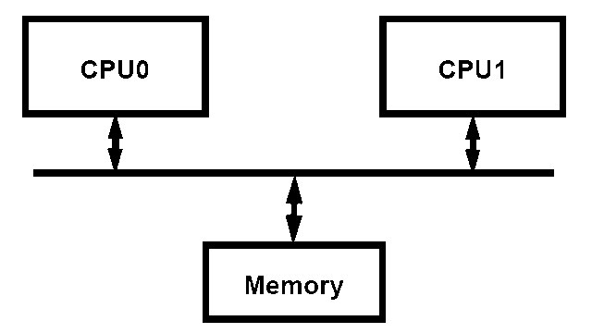
Mainstream parallel computing
Most server class machines today are:
PC class SMP’s (Symmetric Multi-Processors *)
2, 4, 8 processors - cheap
Run Windows & Linux
Delux SMP’s
8 to 64 processors
Expensive:
16-way SMP costs ≈ 4 x 4-way SMPs
Applications: Databases, web servers, internet commerce / OLTP (online transaction processing)
Newer applications: technical computing, threat analysis, credit card fraud...
SMP offers all processors and memory on a common front side bus (FSB –bus that connects the CPU and motherboard subsystems).
* Also termed “Shared Memory Processor”

Slide 11
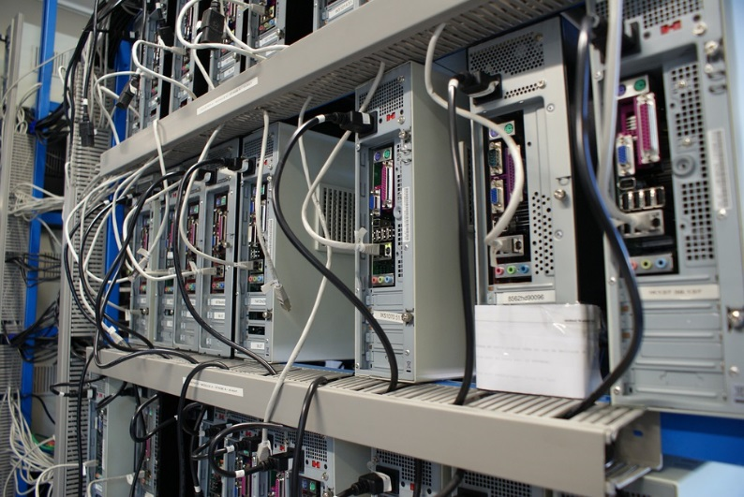
Large scale parallel computing systems
Hundreds of processors, typically built as clusters of SMPs
Traditionally
Often custom built with government funding (costly! 10 to 100 million USD)
National / international resource
Total sales tiny fraction of PC server sales
Few independent software developers
Programmed by small set of majorly smart people
Later trends
Cloud systems
Users from all over
E.g. Amazon EC, Microsoft Azure

Slide 12
Large scale parallel computing systems
Some application examples
Code breaking (CIA, FBI)
Weather and climate modeling / prediction
Pharmaceutical – drug simulation, DNA modeling and drug design
Scientific research (e.g., astronomy, SETI)
Defense and weapons development
Large-scale parallel systems are often used for modelling

Slide 13
Designing Multicore Chips
Designers contend with single-core design options
Wakeup (of sleeping cores) – How? Economical methods?
Instruction fetch – From where? Latencies?
Instruction Decoding – CISC vs. RISC trade-offs
Variable clock speeds – esp. power saving modes
Execution unit – Pipelined? Monolithic? Shared components?
Execution modes (e.g. system, user, interrupt)
Load/Save queue(s) & data cache
Additional degrees of freedom for design of parallel architectures
How many cores? Size & features of each?
Shared caches? Cache levels?
Memory interfacing? How many memory banks? Where to place them?
On-chip interconnects: bus structures, switching fabric, ordering and priority of cores/devices?

Slide 14
Significant Tradeoff:
Infrastructure & Setup Cost
vs.
Effective Parallelism
Consideration for
- hardware
- software
Maximum Effective Parallelism:
This refers to the point of the number of cores / amount of parallelism beyond which additional parallelism provides no further benefit or (worse) may reduce performance.
go parallel!

Slide 15
Significant Tradeoff:
Infrastructure & Setup Cost
vs.
Effective Parallelism
Hardware
Software
Performance
improvement
(speedup)
comms cost and time
cores / available parallelism
cores / available parallelism
Maximum Effective Parallelism:
This refers to the point of the number of cores / amount of parallelism beyond which additional parallelism provides no further benefit or (worse) may reduce performance.
cost of parallelism
startup time
cores / available parallelism
cores / available parallelism

Slide 16
Calculations Example
Remember from Amdahl:
S = T_{S} / T_{P} (i.e. sequential time over parallel time)
You can use these equations of course to approximate behaviour of modelled systems. For example to represent speedup, comms overhead, cost of equipment, etc. and use calculations to estimate optimal selections. (simple example to follow)

Slide 17
Class Activity
Quick estimation for maximum effective parallelism
Solution follows shortly!

Slide 18
Class Activity Answer
N | Proc (ms) | Comms (ms) | Total (ms)
1 | 100.000 | 0 | 100.000
2 | 50.000 | 10 | 60.000
4 | 25.000 | 20 | 45.000
8 | 12.500 | 40 | 52.500
16 | 6.250 | 80 | 86.250
32 | 3.125 | 160 | 163.125
64 | 1.563 | 320 | 321.563
Could do some rough calculations (or use binary search)…
check:
N=2,
N=64,
N=8,
N=4 ✓

Slide 19
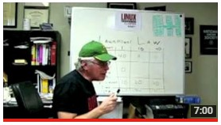
Multi processors and sequential setup time
2nd part of Amdahl’s law video
Understanding Parallel Computing (Part 2): The Lawn Mower Law
LinuxMagazine
Amdahl2.flv

Slide 20
Parallel Efficiency (E_{par})
We can think of the efficiency of various things, e.g. power systems, motors, heaters etc. We can also think of the efficiency of parallel computing…
Parallel Efficiency
Defined as the:
ratio of speedup (S) to the number of processors (p)
Parallel Efficiency measures the fraction of time for which a processor is usefully used.
An efficiency of 1 is ideal (>1 means you may be harnessing energy from another dimension ☺)

Slide 21
The BCE
Abstraction

Slide 22
BCE Abstraction
It all gets a bit complicated to keep track of the various umpteen types of processors that might be used
Therefore to theorize and predict performance expectations of a conceptualized* heterogeneous system, the concept of a Base Core Equivalent is proposed…
* i.e. where you might be toying with a variety of different type of processor solutions for a platform

Slide 23
Base Core Equivalent (BCE)
EEE4084F

Slide 24
Calculating performance using BCEs
A great many papers on the subject of Amdahl’s law
Many mention the term BCE
BCE = Base Core Equivalent
A single processing core in a multicore processor design

Slide 25
BCE: Simple Multicore Hardware Model
An abstracted hardware model to complement Amdahl’s software model
The simplified model…
Chip Hardware, abstracted as
Multiple Cores (with L1 caches)
Supporting architecture (L2/L3 cache banks, interconnect, pads, etc.)
Resources for Multiple Cores Bounded
Due to area, power, cost, or multiple factors…
Bound of N resources per chip for cores
Bound in terms of Power and Area

Slide 26
1x BCE vs. 1x N-BCE vs. Mx N-BCE
Remember that the BCE is equivalent to a basic single core processor
= 1x 1-BCE
= 16x 1-BCE
= 4x 4-BCE
It’s an abstraction, and likely not very precise. For example a 16x4-BCE may have faster comms between cores in same block and slower comms between cores in different blocks, whereas the 16x1-BCE might have the same speed comms between all cores.

Slide 27
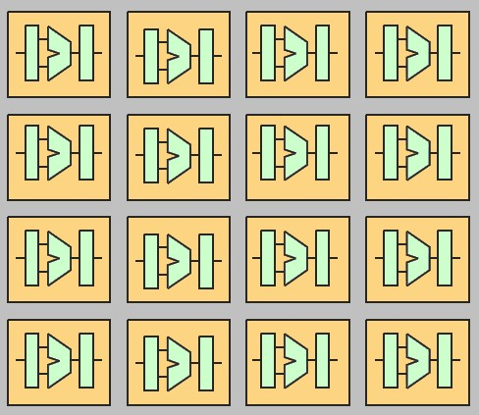
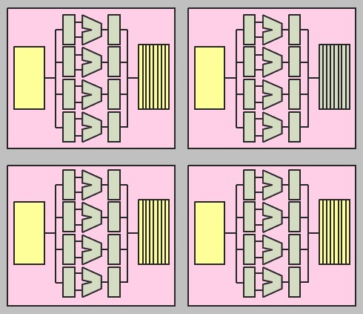
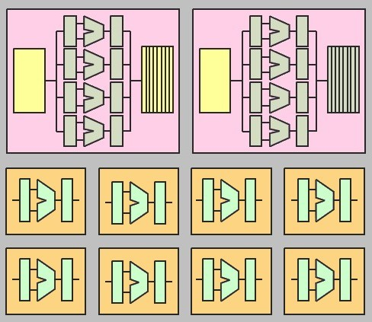
Example processor structures Symmetric vs. Asymmetric multicores
a BCE
core
with 4-BCE
(I call them megacores to emphasize it equates to multiple BCEs)
Symmetric multicore 16 one-BCE cores
Symmetric multicore 4 x 4-BCE megacores
Asymmetric multicore comprising 2 x 4-BCE cores + 8 x 1-BCE cores
Clearly can become increasingly more difficult to achieve very accurate equivalences due to the architecture structures and things like memory latencies and inter-core comms.

Slide 28
Symmetric core model
Variables:
n cores per chip
each core consumes r BCEs
16 x 1-BCE
n = 16, r=1
Symmetric four 4-BCE megacores
perf(r) = performance (speedup) of r-BCE over 1-BCE
Always perf(r) <= r (i.e. diminishing returns on increased parallelism)
Good heuristic: perf(r)=sqrt(r)

Slide 29
Modelling Performance of Symmetric Multicore Chips
Execution Time
Serial Fraction
1-F
n cores per chip
r BCEs per megacore
Parallel Fraction of execution is F
Assume symmetric → all cores identical
Serial Fraction is 1-F and uses 1 megacore at rate perf(r)
Therefore: Serial time = (1 – F) / perf(r)
Parallel Fraction uses n/r megacores at rate perf(r) each
Parallel time = F / (perf(r) * (n/r)) = F*r / perf(r)*n
Therefore, w.r.t. one base core:
Implications?..
Parallel
Fraction F
1
Symmetric Speedup =
F * R
1 - F
+
perf(r)
perf(r)*n
Enhanced Cores speed Serial & Parallel

Slide 30
Calculate performance…
Model up to 50 BCEs
Speedup →
Parallel fraction F=90%
Parallel fraction F=50%
r →
BCEs/megacore

Slide 31
Asymmetric (Heterogeneous) Multicore Chips
Symmetric Multicore required all cores equal
Let’s enhance some (not all) of the cores in the processor chip…
For Amdahl’s simplified assumptions
One Enhanced Core
Others are base cores
How does this effect our hardware model?

Slide 32
Asymmetric Multicore Chips
Chip bounded to total of n BCEs
One r-BCE megacore leaves n -r BCEs
Symmetric case: four 4-BCE megacores (i.e. here r=4 and n=16)
Asymmetric case: one r-BCE megacore with n - r BCEs (i.e. one 4-BCE and 12 1-BCEs, r=4, n=16)

Slide 33
Modelling Performance of Asymmetric Multicore Chips
Execution Time
Serial Fraction
1-F
n cores per chip
1x r-BCEs , n-r 1-BCEs
Parallel Fraction of execution is F
Serial Fraction still 1-F and uses 1 core at rate perf(r)
Therefore: Serial time = (1 – F) / perf(r)
Parallel Fraction F uses 1 cores at rate perf(r) and n-r cores at rate 1
Parallel time = F / (perf(r) + n - r)
Therefore, w.r.t. one base core:
Implications?..
Parallel
Fraction F
1
Asymmetric Speedup =
F
1 - F
+
perf(r)
perf(r) + n - r

Slide 34
Calculate performance…
Model up to r=64 BCEs
Parallel fraction F=99%
Speedup →
Parallel fraction F=90%
Parallel fraction F=50%
r →
BCEs/megacore

Slide 35
Dynamic Multicore Chips
n base cores for best parallel performance
Harness r cores together for best serial performance (a bit of an optimistic dream perhaps)
Serial Case
1x n-BCE megacore
Parallel Case
n x 1-BCE cores

Slide 36
Modelling Performance of Dynamic Multicore Chips
Execution Time
Serial Fraction
1-F
n base cores per chip where r can be harnessed
1x r-BCEs , n-r 1-BCEs
Parallel Fraction of execution is F
Serial Fraction 1-F uses r BCEs at rate perf(r)
Therefore: Serial time = (1 – F) / perf(r)
Parallel Fraction F uses n BCEs at rate 1 each
Parallel time = F / n
Therefore, w.r.t. one base core:
Implications?..
Parallel
Fraction F
1
Dynamic Speedup =
F
1 - F
+
Perf(R)
N

Slide 37
Calculate performance…
Looks wonderful! But it is realistic?
Model up to r=64 BCEs
Parallel fraction F=99%
Speedup →
Parallel fraction F=90%
Parallel fraction F=50%
r →
BCEs/megacore

Slide 38
BCE Performance Calculator – M Hill & M Marty
To apply Amdahl’s law to a multicore chip, we need
A cost model for the number and performance of cores that the chip can support.
1) assume a multicore chip can contain at most n base core equivalents (based on resources a chip designer devotes to cores & portion of code is parallelized)
2) Assume (micro-)architects have techniques for using the resources of multiple BCEs to create a core with greater sequential performance.
Let the performance of a single-BCE core be 1.
Assume architects can expend the resources of r BCEs to create a more powerful processor with sequential performance perf(r).
Example assume perf(r) = sqrt(r) … In other words, we assume efforts that devote r BCE resources will result in sequential performance r. Thus, architectures can double performance at a cost of four BCEs, triple it for nine BCEs, etc. Graph results…

Slide 39
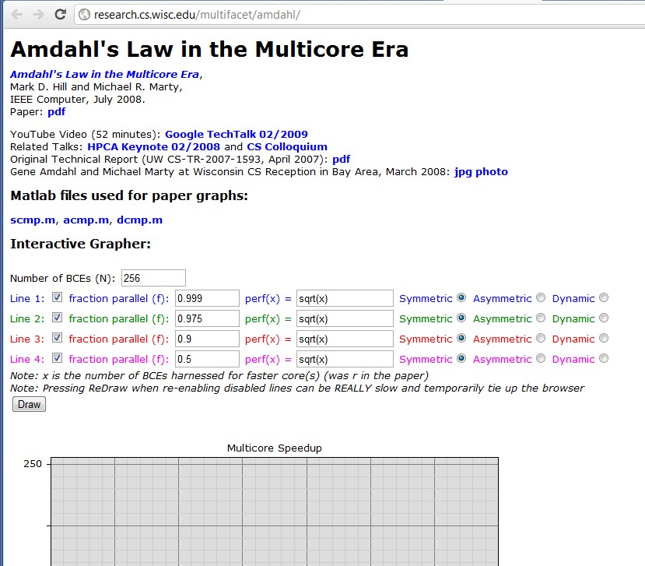
Amdahl’s Law Milticore Performance Calculator
Check out Hill and Marty’s Amdahl’s interactive grapher at:
http://research.cs.wisc.edu/multifacet/amdahl/
You can also download the OCTAVE / Matlab code to do these graphs!
How it works:
Specify #cores, portion parallel code, type of BCE cores to use
Quiz example of
resultant graph…
http://research.cs.wisc.edu/multifacet/amdahl/

Slide 40
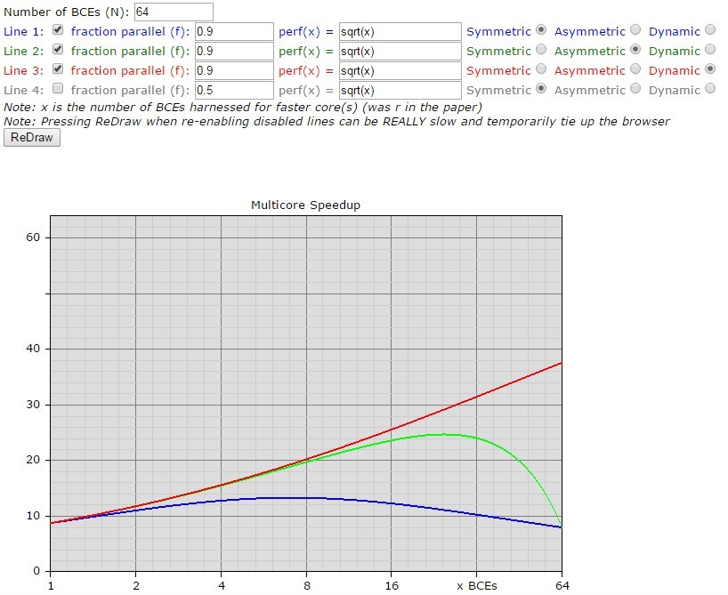
Example run of Hill and Marty’s Amdahl’s interactive grapher:
Gives a comparison of the different architecture models. Clearly Dynamic is probably always going to win.
Speedup →
r →
BCEs/megacore

Slide 41
Recommended Reading
Hill and Marty 2008: “Amdahl’s Law in the Multicore Era” Available: http://research.cs.wisc.edu/multifacet/papers/ieeecomputer08_amdahl_multicore.pdf
Good article on Wikipedia look over: http://en.wikipedia.org/wiki/Amdahl's_law
NB: do try to read this one! *
See Vula: L21 - 04563876 - Amdahl Law in the Multicore Era.pdf
* Questions on BCEs likely to to appear in test or exam

Slide 42
Further Reading / Refs
Suggestions for further reading, slides partially based / general principles elaborated in:
https://computing.llnl.gov/tutorials/parallel_comp/
http://www2.physics.uiowa.edu/~ghowes/teach/ihpc12/lec/ihpc12Lec_DesignHPC12.pdf
Some resources related to systems thinking:
https://www.youtube.com/watch?v=lhbLNBqhQkc
https://www.youtube.com/watch?v=AP7hMdnNrH4
Some resources related to critical analysis and critical thinking:
An easy introduction to critical analysis:
http://www.deakin.edu.au/current-students/study-support/study-skills/handouts/critical-analysis.php
An online quiz and learning tool for understanding critical thinking:
http://unilearning.uow.edu.au/critical/1a.html

Slide 43
Next lecture… (after break)
Automatic parallelism
Moore’s law and related trends, from a high performance computing angle
Discussion of Prac2 & Pthreads
Finalizing Seminar Groups
Benchmarking, etc.

Slide 44
Intermission

Slide 45
Disclaimers and copyright/licensing details
I have tried to follow the correct practices concerning copyright and licensing of material, particularly image sources that have been used in this presentation. I have put much effort into trying to make this material open access so that it can be of benefit to others in their teaching and learning practice. Any mistakes or omissions with regards to these issues I will correct when notified. To the best of my understanding the material in these slides can be shared according to the Creative Commons “Attribution-ShareAlike 4.0 International (CC BY-SA 4.0)” license, and that is why I selected that license to apply to this presentation (it’s not because I particulate want my slides referenced but more to acknowledge the sources and generosity of others who have provided free material such as the images I have used).
Image sources:
Clipart sources – public domain CC0 (http://pixabay.com/)
datacenter image – pixabay
commons.wikimedia.org
images from flickr

