Slide 1
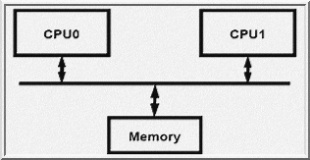
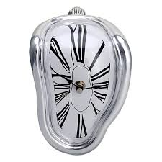
EEE4084F
Digital Systems
Lecture 5:
Parallel Languages, Automatic Parallelization,
Performance Benchmarking, Metrics of Performance
Presented by
Simon Winberg
Attribution-ShareAlike 4.0 International (CC BY-SA 4.0)

Slide 2
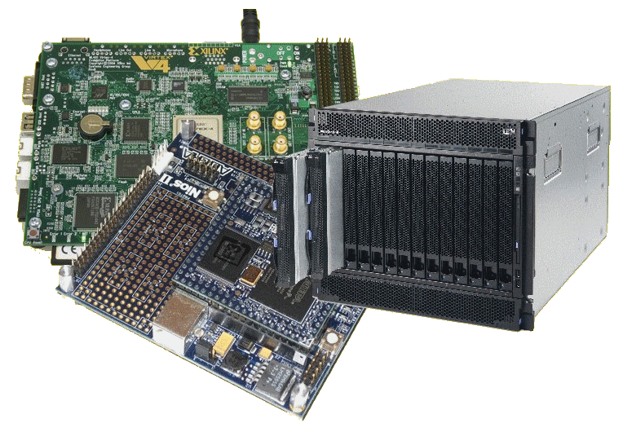
Lecture Overview
Parallel computing programming
Automatic parallelism
Performance benchmarking

Slide 3
Software development for parallel computers
Focus on critical sectios
Important software sections (frequently run sections)
Usually hand-crafted
Often derived from initial sequential versions ported to run on the parallel computing platform
Why this happens:
Parallel programming is difficult
Parallel programs run poorly on sequential machines (need to simulate them)
Automatic parallelization difficult (& messy)
Leads to high utilization expenses

Slide 4
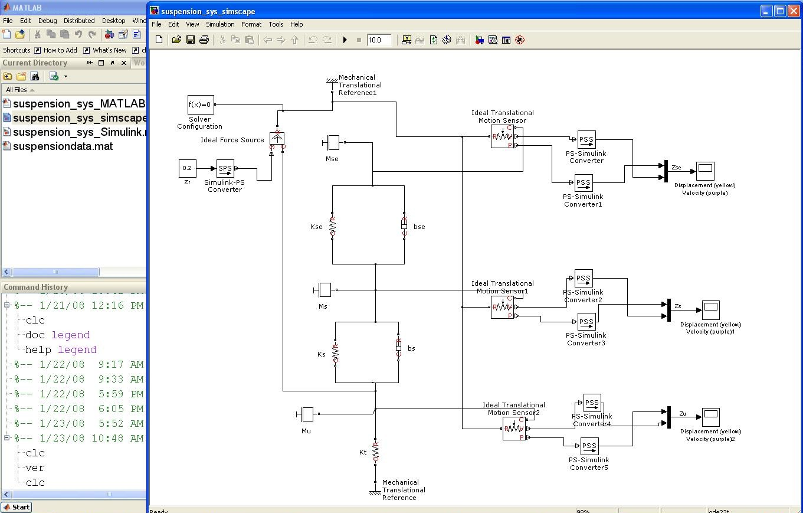
Do parallel languages and compilers exist?
Yes!
… some other examples…

Slide 5
L05 - Further Reading
Parallel and Distributed Computing: Memories of Time Past and a Glimpse at the Future
Author: D C Marinescu. Pub date: June 2014
We propose to look at the evolution of ideas related to parallel systems, algorithms, and applications during the past three decades and then glimpse at the future. The journey starts with massively parallel systems of the early nineties, transitions gently to computing for the masses on the clouds of the ﬁrst decade of the new millennium, and continues with what we could expect from quantum computers and quantum parallelism in the next few decades...
File: 06900194.pdf
http://dx.doi.org/10.1109/ISPDC.2014.33
This paper gives good insight into the current state of the art and likely approaches that will be used in the future

Slide 6
Do parallel languages and compilers exist?
Yes!
MatLab, Simulink, SystemC, UML*, NESL** and others
“Automatic parallelization”:
Def: converting sequential code into multi-threaded or vectorized code (or both) to utilize multiple processors simultaneously (e.g., for SMP machine)
… short powwow on the topic…
Try interactive tutorial on: http://www.cs.cmu.edu/~scandal/nesl/tutorial2.html
* Model-Driven Development using case tools, e.g. Rhapsody for RT-UML

Slide 7
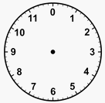
Powwow* moment
Consult the four winds, and your neighbouring classmates, as to: Why is it probably not easy to automate conversion from sequential code (e.g. BASIC or std C program) to parallel code?
HINT: Perhaps start by clarifying the difference between sequential and parallel code.
TIME
UP
Time
limit
Next slide provides some reasons...
PS: You’re also welcome to get up, stretch, move about, infiltrate your choice of tribe, and so on. Note approx. 5 min. time limit!
* It’s a term from North America's Native people used to refer to a cultural gathering.

Slide 8
Return from the Powwow
What the winds decree…

Slide 9
Some thoughts
On why is it probably not easy to automate conversion from sequential code (e.g. BASIC or C) to parallel code.
Difficulty in figuring out data dependencies
Deciding when to implement semaphores and locks
What the wind has
to say…
How to split-up a loop into parallel parts
Timing issues
Deciding how to break-up data to distribute
Data hazards
When code needs to block and when not
Figuring out timing dependencies
Having to convert clocks of statements
or functions in inter process calls

Slide 10
Why automatic parallelism isn’t “quite there yet”
Accumulation of 30+ years of research…
Only limited success in parallelism detection and program transformations
Instruction-level parallelism at the basic-block level (e.g., pipelining of instructions)
Parallelism in nested for-loops containing arrays with simple index expressions
Analysis methods: data dependence analysis, pointer analysis, abstraction back to more optimized implementation, flow analysis

Slide 11
Why automatic parallelism isn’t “quite there yet”
Main reasons (user perspective):
Tends to take too long.
Tend to be too fragile (i.e., breaks down after small changes to the code).
Tends to miss many things a human would notice and provide an effective solution for, i.e., human intellect, underlying knowledgeable of the application, and trained to write and problem-solve parallel code.
So: Instead of training compilers to recognize parallelism, people (like you) are being trained to write parallel code (i.e., no “middle man” approach).

Slide 12
Terminology Moment

Slide 13
Temporal and Spatial Computation
Temporal Computation
Spatial Computation
The traditional paradigm
Typical of Programmers
Things done over time steps
Suited to hardware
Possibly more intuitive?
Things related in a space
A = input(“A= ? ”);
B = input(“B =? ”);
C = input(“B multiplier ?”);
X = A + B * C
Y = A – B * C
Y !
A?
-
C?
+
*
Which do you think is easier to make sense of?
X !
B?
Can provide a clearer indication of relative dependencies.

Slide 14
“Extracting concurrency”
Being able to comprehend and extract the parallelism, or properties of concurrency, from a process or algorithm is essential to accelerating computation
The Reconfigurable Computing (RC) Advantage:
The computer platform able to adapt according to the concurrency inherent in a particular application in order to accelerate computation for the specific application

Slide 15
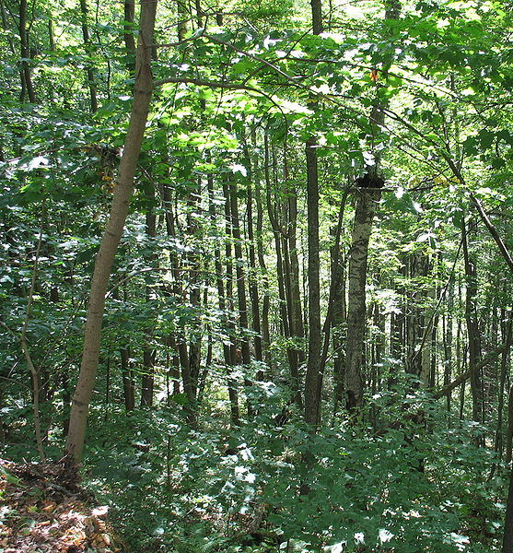
Performance Benchmarking
“Don’t loose sight of the forest for the trees…”
Generally, the main objective is to make the system faster, use less power, use less resources…
Most code doesn’t need to be parallel.
Important questions are…

Slide 16
Important questions
Should you bother to design a parallel algorithm?
Is your parallel solution better than a simpler approach, especially if that approach is easier to read and share?
Major telling factor is:
Real-time performance measure
Or “wall clock time”

Slide 17
Benchmarking
EEE4084F

Slide 18
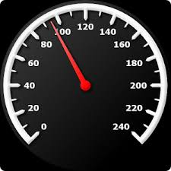
Benchmarking
MIPS
Process of measuring performance of a digital system
A program (or systematic approach) that Quantitatively evaluates performance, cost and computer hardware and software resources (among other things) of a computing solution
Benchmark suites – sets of benchmark programs designed to get a comprehensive view of the performance of a computer system for executing a variety of representative processing operations.
Suitable benchmark
A meaningful representation of what the system can do
Helps select of an effective system
Indicates a measure of what one system can do compared to other options

Slide 19
Wall clock time
Generally the most accurate: use built in timer, which is directly related to real time (e.g., if the timer measures 1s, then 1s elapsed in the real world)
Technique:
unsigned long long start; // store start time
unsigned long long end; // store end time
start = read_the_timer(); // e.g. time()
DO PROCESSNG
end = read_the_timer(); // e.g. time()
.. Output the time measurement (end-start), or save it to an array if printing will interfere with the times. Note: to avoid overflow, used unsigned vars.
See file:
Cycle.c

Slide 20
StdC: gettimeofday
gettimeofday
Very portable, part of the StdC library
Should be available on any Linux system
Returns time in seconds and microseconds since midnight January 1 1970
Uses struct timeval comprising
tv_sec : number of seconds
tv_usec : number of microseconds*
Converting to microseconds will use huge numbers, rather work on differences
* Word of caution: some implementations always return 0 for the usec field!!
On Cygwin, the resolution is only in milliseconds, so tv_usec in multiples of 1000.
Not provided in DevC++.

Slide 21
gettimeofday example
See timing.c code file
#include <stdio.h>
#include <sys/time.h>
#include <time.h>
struct timeval start_time, end_time; // variables to hold start and end time
int main() {
int tot_usecs;
int i,j,sum=0;
gettimeofday(&start_time, (struct timezone*)0); // starting timestamp
/* do some work */
for (i=0; i<10000; i++)
for (j=0; j<i; j++) sum += i*j;
gettimeofday(&end_time, (struct timezone*)0); // ending timestamp
tot_usecs = (end_time.tv_sec-start_time.tv_sec) * 1000000 +
(end_time.tv_usec-start_time.tv_usec);
printf("Total time: %d usec.\n", tot_usecs);
}

Slide 22
What is wrong about using only wall clock time?
It can provide a false impression of how effectively your solution is – at least doesn’t give a ‘full picture’ …
Typically do tests after the system has ‘warmed up’ (cache loaded) by running the same data multiple times
May show the solution is quicker… but at what costs? e.g.:
Speed improved but accuracy sacrificed?
Development effort vs. execution speed improvement?
Resource costs for upgrading vs. costs saved by remaining with the old version?
Power usage? Does the new solution need more power (per execution, also on average including idle time)
Maintainability? (e.g. is the new version more complex?)
Environment impact? (Does the upgrade result in waste that could be environmentally detrimental)

Slide 23
Benchmarking: what to test
What can be benchmarked? For DSP and HPC…
Compiler
Converts High Level Language to Assembly language thus we benchmark compiler efficiency, such as how efficient is the generated assembly code?
The Processor
Code in hand-crafted/inspected assembly (to make comparisons fair)
Operating System
Interrupt latencies, overhead of operating system calls, limits on devices, kernel size, availability of services and facilities such as support for virtual memory and paged memory.
Platform
Scalability of memory. Peripheral limits. Interfaces supported. Power use. Power saving features. OS’s supported.
Applications (e.g. representative operations for certain application domains – think ‘DWARFS’ as in Berkeley paper)

Slide 24
Benchmarking: what is usually measured
For DSP/HPEC systems we typically benchmark:
Cycle count
Data and Program memory usage
Execution time
Power consumption (has recently become a common thing to report on)

Slide 25
Metrics of Performance
Application
Operations per second
Programming language
Expressiveness*
Code density
Processing system
MIPS: Million Instructions Per Second GIPS: Giga (i.e. 10⁹) IPS
MFLOPS: Million FLoating point OPerations per Second GFLOPS: Giga (10⁹) FLOPS TFLOPS: Terra (10¹²) FLOPS
Datapath
MBps: Megabytes per second
Function unit / processor hardware
Cycles per second (clock rate)
* Felleisen, M., 1991. On the expressive power of programming languages.Science of computer programming, 17(1-3), pp.35-75.

Slide 26
Aspects of CPU Performance
CPU time = Seconds = Instructions x Cycles x Seconds
Program Program Instruction Cycle
 | Instruction Count (IC) | Cycles Per Instruction (CPI) | Clock
Rate Program | 
Computer |  | 
Instruction Set |  |  *
Organization |  |  | 
Technology |  |  | 
* Some instructions may of course take multiple cycles … see next slides for ACPI

Slide 27
Average Cycles Per Instruction: processors with varying clocks per instruction
Average Cycles Per Instruction (ACPI)
CPI = Cycles / Instruction Count
= (CPU Time * Clock Rate) / Instruction Count
n
i.e. all instructions I₁ to I_{n}
where CPI_{i} is the cycles needed to complete instruction I_{i}
CPU time = CycleTime * Σ CPI_{i} * I_{i}
i = 1
“Instruction Frequency” (F_{i}) (how often particular instruction is invoked)
n
CPI = Σ CPI_{i} * F_{i} where F_{i} = I_{i}
i = 1
Instruction Count

Slide 28
Example: Calculating ACPI
Operation | Frequency (F_{i}) | CPI_{i} | CPI_{i} * F_{i} | Time %
Store | 10% | 2 | 0.2 | 13%
Load | 20% | 2 | 0.4 | 27%
Branch | 20% | 2 | 0.4 | 27%
ALU | 50% | 1 | 0.5 | 33%
ACPI | 100% |  | 1.5 | 100%

Slide 29
Summarizing Performance
Arithmetic mean (weighted *arithmetic mean) tracks execution time (n = number runs):
Σ(T_{i})/n or Σ(W_{i}*T_{i})
Harmonic mean (weighted harmonic mean) of rates (e.g., R = MFLOPS) tracks execution time:
n/ Σ(1/R_{i}) or n/ Σ(W_{i}/R_{i})
Normalized execution time useful for scaling performance
e.g. X times faster than a Pentium4
Arithmetic mean impacted by choice of reference machine (e.g. MIPS-1 processor)
Use the geometric mean for comparison:
Σ(T_{i})^1/n
Independent of chosen machine…
but not good metric for total execution time
* Weighting assigns particular value (or priority of importance to certain runs)
T_{i} = time of run i

Slide 30
Cost/Performance: The Relationship of Cost to Price?
Recurring Costs
Component Costs
Direct Costs, recurring costs: labor, purchasing, scrap, warranty
Non-Recurring Costs or Gross Margin
R&D, equipment maintenance, machine and test equipment rentals, marketing, sales, financing cost, pretax profits, taxes, etc. etc.
Average Discount to get List Price
Allowing for volume discounts and/or retailer markup

Slide 31
What’s Next??
Thursday 2pm – first seminar
Seminar #1
The Landscape of Parallel Computing Research: A view from Berkeley (presented by lecturer)

Slide 32
Disclaimers and copyright/licensing details
I have tried to follow the correct practices concerning copyright and licensing of material, particularly image sources that have been used in this presentation. I have put much effort into trying to make this material open access so that it can be of benefit to others in their teaching and learning practice. Any mistakes or omissions with regards to these issues I will correct when notified. To the best of my understanding the material in these slides can be shared according to the Creative Commons “Attribution-ShareAlike 4.0 International (CC BY-SA 4.0)” license, and that is why I selected that license to apply to this presentation (it’s not because I particulate want my slides referenced but more to acknowledge the sources and generosity of others who have provided free material such as the images I have used).
Image sources:
Gold bar: Wikipedia (open commons)
IBM Blade (CC by 2.0) ref: http://www.flickr.com/photos/hongiiv/407481199/
Clipart, Takeaway, Clock, Factory and smoke – public domain CC0 (http://pixabay.com/)
Forrest of trees: Wikipedia (open commons)
Moore’s Law graph, processor families per supercomputer over years – all these creative commons, commons.wikimedia.org

