Slide 1



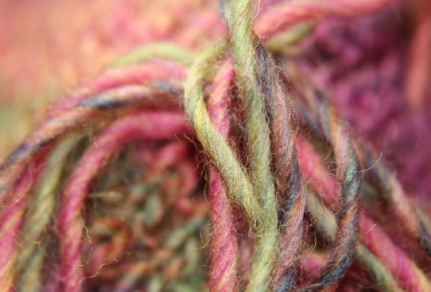
EEE4084F
Digital Systems
Lecture 6:
Introduction to Pthreads
Lecturer:
Simon Winberg
pThreads
Attribution-ShareAlike 4.0 International (CC BY-SA 4.0)

Slide 2
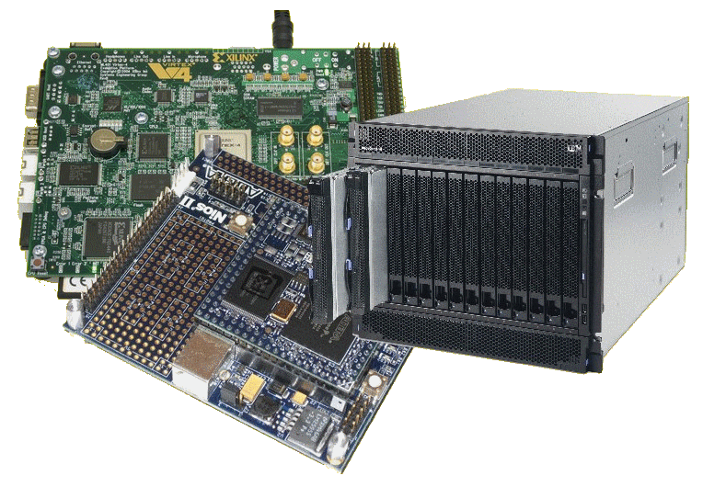
Lecture Overview
Benchmarking tips
Supporting Functions Needed
Scalarprod.cpp example
  Golden Measure
  pThread version with mutex

Slide 3
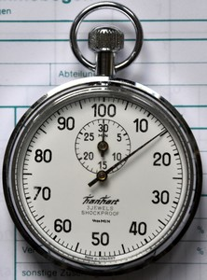
Benchmarking tips
Timing methods have generally been included in
baseline projects for the pracs (e.g. tic and toc for OCTAVE/MATLAB)
Avoid having many programs when doing performance benchmarking as this may interfere slightly with timing results. Running tests on virtual machines can also have inconsistencies.
Usually you want to run the program a few times before you record the results (to compare how might have speeded up algorithms)
If you are testing throughput, e.g. a real-time system processing data or a database doing queries, then you probably want to also get an impression of how the system performs if it doesn’t have data to work on in cache already, the easiest way of course is to just use different data files you haven’t run through the system in a while.

Slide 4
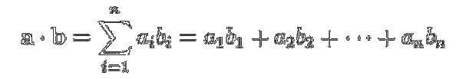
Towards pThreads
Vector operations are commonly used to demonstrate and teach parallel coding
The scalar product (or dot product) and Matrix multiply are the ‘usual suspects’
Vector scalar product
Matrix multiplication
C_{i,j} = Σ A_{i,k} B_{k,j}
Both of these operations can be successfully
Implemented as deeply parallel solutions.
k

Slide 5
Suggested function prototypes
Scalar product:
  float scalarprod (float* a, float* b, int n)
  {
  // a,b = input vectors of length n
  // Function returns the scalar product
  }
Matrix multiply:
  void matrix_multiply (float** A, float** B, float** C, int n)
  {
  // A,B = input matrices of size n x n floats
  // C = output matrix of size n x n floats
  }

Slide 6

Testing the program
What else do we need to test a C/C++ program? *
  Golden measure
  Test data (or means to generate test data)
  Timing
* And knowing how to program in C/C++ would be a big advantage ☺

Slide 7
Tools / Supporting Functions Needed
Need to generate random numbers
Need a tic
Need a toc
Ideally want things to be portable so that you can work in Linux or Windows (if not other systems too!).

Slide 8
Scalarprod.cpp – functions needed
// random_f returns a random value between 0.0 and 1.0
float random_f ()
{
return (float)rand()/(float)(RAND_MAX);
}
Need a function to generate some random data to use.
I like to define a random_f() function that returns a float value between 0 and 1 rather than using the int values returned by rand() which are 0 to RAND_MAX.

Slide 9
Linux: tic and toc
void tic(){
static bool First = true;
timespec Time;
if(First){
clock_getres(CLOCK_MONOTONIC, &Time);
Start = (double)(Time.tv_sec) +
(double)(Time.tv_nsec)*1e-9;
printf("Clock resolution: %lg ns\n", Start*1e9);
First = false;
}
clock_gettime(CLOCK_MONOTONIC, &Time);
Start = (double)(Time.tv_sec) +
(double)(Time.tv_nsec)*1e-9;
}
(Linux version)
Should have this all in a separate module

Slide 10
Linux: tic and toc
double toc(){
double End;
timespec Time;
clock_gettime(CLOCK_MONOTONIC, &Time);
End = (double)(Time.tv_sec) +
(double)(Time.tv_nsec)*1e-9;
return End - Start;
}
(Linux version)
Should have this all in a separate module

Slide 11
Scalarprod.cpp – tic and toc
#include <iostream>
#include <ctime>
#include <sys/time.h>
#include <stdlib.h> // for srand, rand
timeval clk_tic, clk_toc; // store the timestamps
void tic () {
gettimeofday(&clk_tic, NULL);
}
double toc () {
gettimeofday(&clk_toc, NULL);
double t = double(clk_toc.tv_sec -clk_tic.tv_sec )
+ double(clk_toc.tv_usec-clk_tic.tv_usec)*1.e-6;
return t;
}
double CPU_ticks_to_ms (long ticks) {
return ticks * 1000.0;
}
Linux version (probably poor accuracy if you try running on Windows, e.g. compiling using DevC++)

Slide 12
Windows: CPU_tic and CPU_toc
#include <windows.h>
#include <ctime>
LARGE_INTEGER clk_frequency, clk_tic;
void CPU_tic () {
QueryPerformanceFrequency(&clk_frequency);
QueryPerformanceCounter(&clk_tic);
}
double CPU_toc () {
LARGE_INTEGER clk_toc;
QueryPerformanceCounter(&clk_toc);
return (double)(clk_toc.QuadPart - clk_tic.QuadPart) *
1000.0 / clk_frequency.QuadPart;
}
double CPU_ticks_to_ms (long ticks) {
return (double)ticks / CLOCKS_PER_SEC * 1000.0;
}
(Windows version)
Should have this all in a separate module

Slide 13
Scalarprod.cpp – CPU_tic and CPU_toc
#include <iostream>
#include <ctime>
#include <sys/time.h>
#include <stdlib.h> // for srand, rand
timeval clk_tic, clk_toc; // store the timestamps
void CPU_tic () {
gettimeofday(&clk_tic, NULL);
}
double CPU_toc () {
gettimeofday(&clk_toc, NULL);
double t = double(clk_toc.tv_sec -clk_tic.tv_sec )
+ double(clk_toc.tv_usec-clk_tic.tv_usec)*1.e-6;
return t;
}
double CPU_ticks_to_ms (long ticks) {
return ticks * 1000.0;
}
Linux version (probably poor accuracy if you try running on Windows, e.g. compiling using DevC++)

Slide 14

Scalarprod.cpp – golden measure
float scalarprod (float* a, float* b, int n) {
unsigned i;
CPU_tic(); // get initial tick value
// Do processing ...
srand((unsigned int)time(NULL)); // provide random seed
// first initialize the vectors
for (i=0; i<n; i++) {
a[i] = random_f();
b[i] = random_f();
}
float sum = 0.0f;
for (i=0; i<n; i++) {
sum = sum + (a[i] * b[i]);
}
// get the time elapsed
double t1 = CPU_toc(); // get final tick value
std::cout << "scalarprod " << " took " << t1 << " ms\n";
}
An example Golden measure / sequence solution
Lets have a look at two of the functions that aren’t available in stdlib or iostream …

Slide 15
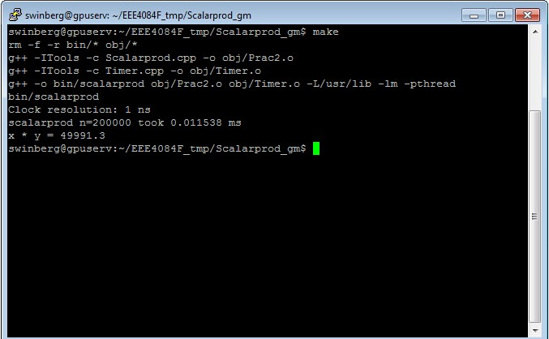
Compiling the example
Note: you can type in make run to re run the program. Or type in ./bin/scalarprod

Slide 16
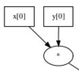
Scalar product – parallel version?
If we consider implementing a CPU
version using e.g. pthreads, we
need to think about a balance between
the cost of spawning and joining threads
and the time each thread spends.
So the most parallel approach of each thread of working on only one element from each vector, doing one multiply, will likely give poor performance because the time to spawn all
the threads may be longer than the time to
do the multiply and add. Especially considering
that a mutex is probably needed for the add.

Slide 17
Scalar product – parallel version?
We would rather compromise, balance the workload better so that each thread works on multiple elements of each vector.
So the approach would be:
  Assuming N length vectors, M threads, then:
  each thread works on N/M elements, multiplies and keeps a local sum, then at the end of the operation needs to add to a shared sum value (which would need to be protected by a mutex).
Some example code follows…

Slide 18
Getting data to threads
But you need a means to send data to threads. You could:
  Use global variables or
  Pass a pointer to the thread (the p parameter) to pass a data structure to the thread that it will use.

Slide 19
Scalarprod.cpp – parallel version
#include <iostream>
#include <pthreads> .. Others libs ...
// First plan data to share between threads:
// Define data structure to be shared between the threads
struct DotprodData {
double *A;
double *B;
double sum;
unsigned block_len;
} ;
// Allocate the shared data, thread process data, and a mutex
DotprodData shared_data; // data that is shared
pthread_t thread[N_THREADS]; // thread data
pthread_mutex_t mux_sum; // mutex for summing up the results

Slide 20
Scalarprod.cpp – parallel version
/** Thread operation, multiplied and adds one block of the shared vectors */
void *dotprod(void *arg) {
/* Define and use local variables for convenience */
long i, m, start, stop;
double my_sum, *A, *B;
long offset = (long)arg;
// read in to local registers
m = shared_data.block_len;
start = offset*m;
stop = start+m;
// set up arrays
A = shared_data.A;
B = shared_data.B;
// do the calculation
my_sum = 0;
for (i=start; i<stop; i++) {
my_sum = my_sum + (A[i] * B[i]);
}
/* Lock mutex prior changuing the shared data. */
pthread_mutex_lock (&mux_sum);
/* This code is protected by the mutex mux_sum */
shared_data.sum += my_sum;
// debug info to print what this thread has done
printf("thread#%lu computed %lu -> %lu: my_sum=%f "
"total_sum=%f\n",offset,start,stop,my_sum,shared_data.sum);
pthread_mutex_unlock (&mux_sum); /* release the mutex */
/* Exit the thread */
pthread_exit(0);
}
PLAN WHAT THE THREAD PROCESS WILL DO…
But need to first calculate what
part of the vectors to work on

Slide 21
Scalarprod.cpp – parallel version
int main (int argc, char *argv[])
{
… some vars initialized left out here …
… initialize the vectors …
/* set the sum to 0, note that the sum will be locked by a mutex */
shared_data.sum=0.0;
/* initialize the mutex for protecting the shared sum variable */
pthread_mutex_init(&mux_sum, NULL);
/* Initialize the threads library */
pthread_attr_init(&attr);
pthread_attr_setdetachstate(&attr, PTHREAD_CREATE_JOINABLE);
/* start the timer: */
CPU_tic();
/* spawn the threads */
for (i=0;i<N_THREADS;i++)
pthread_create(&thread[i], &attr, dotprod, (void *)i);
…
/* This main thread now just waits on the other threads to complete. */
for (i=0;i<N_THREADS;i++) pthread_join(thread[i], &pstatus);
/* At this point the joins are all complete, i.e. the threads have completed. */
double t1 = CPU_toc(); /* End the timer */
/* Display the results of the vector product... */
printf ("Sum = %f \n", shared_data.sum);
delete shared_data.A, shared_data.B;
cout << "for n=" << N_THREADS*BLOCK_LEN<< " elements took " << t1 << " ms\n";
…
}
Finally set up the main function to create the threads and join them.

Slide 22
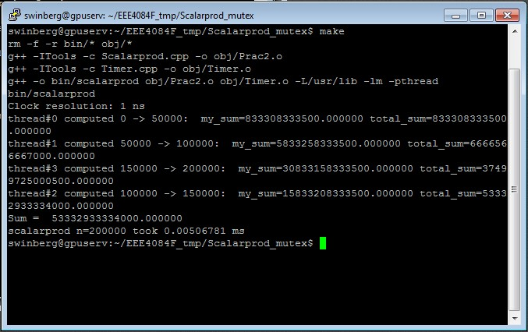
Run the thread program
4 threads : speedup 0.0112/0.0051 = 2.1960

Slide 23
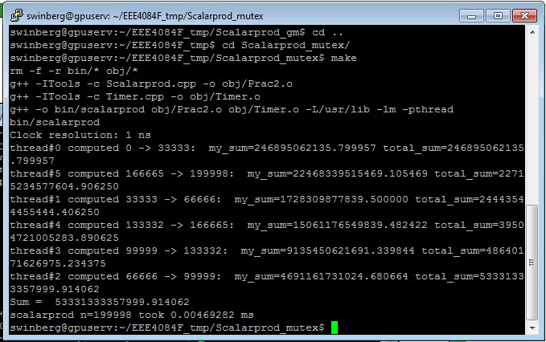
Run the thread program
6 threads : speedup 0.0112/0.0047 = 2.383

Slide 24


pthreads
off to the lab…

Slide 25
Disclaimers and copyright/licensing details
I have tried to follow the correct practices concerning copyright and licensing of material, particularly image sources that have been used in this presentation. I have put much effort into trying to make this material open access so that it can be of benefit to others in their teaching and learning practice. Any mistakes or omissions with regards to these issues I will correct when notified. To the best of my understanding the material in these slides can be shared according to the Creative Commons “Attribution-ShareAlike 4.0 International (CC BY-SA 4.0)” license, and that is why I selected that license to apply to this presentation (it’s not because I particulate want my slides referenced but more to acknowledge the sources and generosity of others who have provided free material such as the images I have used).
Image sources:
Gold bar: Wikipedia (open commons)
http://www.clker.com (open commons)
https://pixabay.com
http://pngimg.com/download/6633 (Stopwatch, CC BY-NC 4.0)

