Slide 1
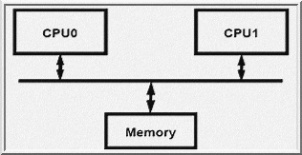
EEE4084F
Digital Systems
Lecture 7:
Power concerns,
Socially Conscious Computer Design
Presented by
Simon Winberg
Attribution-ShareAlike 4.0 International (CC BY-SA 4.0)

Slide 2
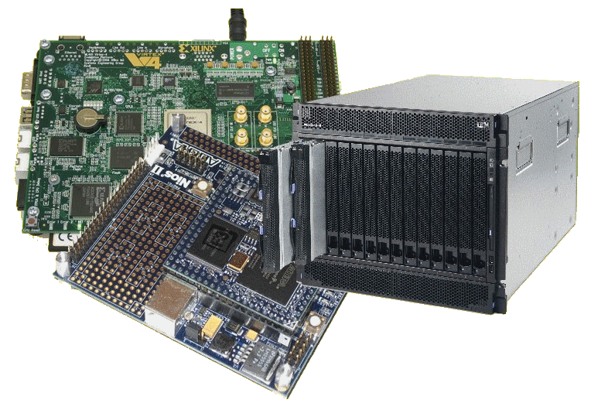
Lecture Overview
Power concerns
GST and socially conscious computer engineers
Grosch's ‘law’
Supercomputer performance

Slide 3
Summarizing Performance
Arithmetic mean (weighted *arithmetic mean) tracks execution time (n = number runs):
Σ(T_{i})/n or Σ(W_{i}*T_{i})
Harmonic mean (weighted harmonic mean) of rates (e.g., R = MFLOPS) tracks execution time:
n/ Σ(1/R_{i}) or n/ Σ(W_{i}/R_{i})
Normalized execution time useful for scaling performance
e.g. X times faster than a Pentium4
Arithmetic mean impacted by choice of reference machine (e.g. MIPS-1 processor)
Use the geometric mean for comparison:
Σ(T_{i})^1/n
Independent of chosen machine…
but not good metric for total execution time
* Weighting assigns particular value (or priority of importance to certain runs)
T_{i} = time of run i

Slide 4
Cost/Performance: The Relationship of Cost to Price?
Recurring Costs
Component Costs
Direct Costs, recurring maintenance costs: labor, purchasing, scrap, warranty
Non-Recurring Costs or Gross Margin
R&D, equipment maintenance, machine and test equipment rentals, marketing, sales, financing cost, pretax profits, taxes, etc. etc.
Average Discount to get List Price
Allowing for volume discounts and/or retailer markup

Slide 5
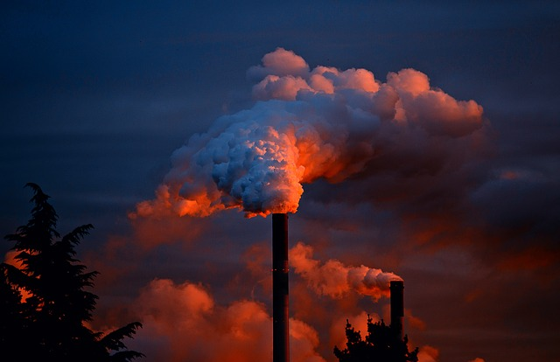
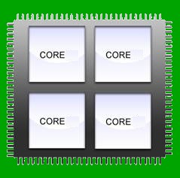
Power concerns
(a GST* perspective)
* GST = General System Thinking

Slide 6
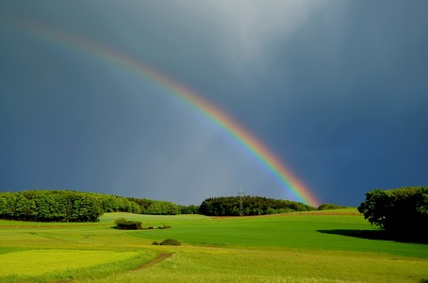
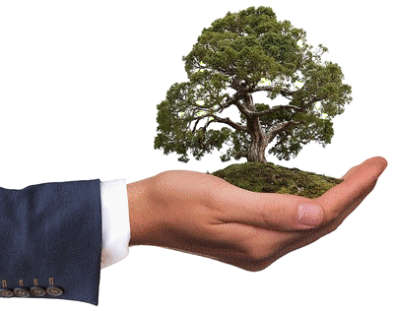
GST & ecologically conscious computer engineers
As good engineers it is appropriate to keep in mind socially conscious and environmentally friendly principles
Be aware of the potential implications of engineering work – which may have both good and bad consequences.
Ideally, one wants to strive towards solutions that are ‘good for all concerned’.
Most of our choices have little or no socioenvironmental impact. But some decisions may have a significant impact – and for engineering work this is not necessarily limited to those in positions of leadership & responsibility!*
So we should be attentive and develop our awareness of decisions that may be detrimental to ourselves, the workplace, clients, users or the environment and society at large.
* Why I say this is that design work can firstly involve many aspects, and while there would (esp. for large and/or commercial projects) be people checking up to see that things are indeed safe and the components appropriate, we should not assume someone else will always be checking and confirming that the right choices are being made. And besides, there are limitations to policies and their validity that may not account for all situations especially in the fast pace of innovation today..

Slide 7
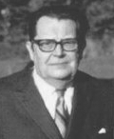
GST – a brief aside
GST is a movement that was pioneered by the Australian Biologist Karl Bertalanffy in the 1930s
General Systems Theory (GST, or just Systems Theory nowadays) is
“GST is a philosophy of thinking about systems that emphasize ‘holism’ ” – Karl Bertalanffy
Essentially holism it is about complex wholes or intricate systems that cannot simply be partitioned into pieces to understand them.

Slide 8
GST – a brief aside
“GST is a philosophy of thinking about systems that emphasizing ‘holism’ ” – Karl Bertalanffy
This contrasts with the more commonly used principle of
‘Reductionism’ is the approach of separating an object of study into parts to understand it (i.e. it is in many ways the antithesis of systems thinking).
–
In terms of engineering (which much GST literature concerns) the systems thinking approach is about considering the variety of systems that the system under development may influence or be influenced by.

Slide 9
GST – a brief aside
I didn’t say GST is the solution to all things!
“GST is a philosophy of thinking about systems that emphasizing ‘holism’ ” – Karl Bertalanffy
vs.
‘Reductionism’ is the approach of separating an object of study into parts to understand it
Note:
The (engineering) literature generally does not say the one is better than the other;
Rather engineers should have an awareness of both strategies and know when the one may be better than the other, to help us build systems that are better, both environmentally and functionally!

Slide 10
With those thoughts
Let’s get back to considering
Computer Design Trends

Slide 11
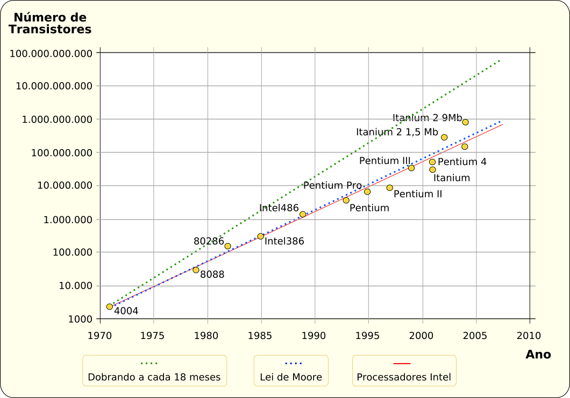
Computation Design Trends
For the past decades the means to increase computer performance has been focusing to a large extent on producing faster software processors.
This included packing more transistors into smaller spaces.
Moore’s law has been holding pretty well… when measured in terms of transistors (e.g., doubling number of transistors)
But this trend has drawbacks, and seems to be slowing…
Intel performance graph

Slide 12
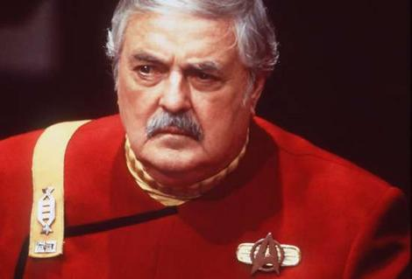
Power use
Power dissipation (hard not to have):
Rate at which energy is taken from the supply (PSU) and transformed into heat
P = E/t
Energy dissipation for a given instruction depends upon type of instruction (and state of the processor)
Blime, we need moor speed bot the warp engines arr cookin’
Remember: P = energy / second (and W = Joules/s)
n
P = (1/CPU Time) * Σ E * I
therefore:
i
i
i = 1

Slide 13
Exercise
Work out the power that would be used…
Hint: you might want to add more columns!
Instruction Type | Energy
Load/Save | 40 nJ
Add/Sub/CMP/Branch/Mov | 20 nJ
Multiply/Divide | 60 nj
The following routine takes 10ms to complete
How much power does it use in Watts?
MOV B, #0x0000 ; set B to constant value
LOOP: LD A, [B] ; read memory
MUL A, A, C ; A = A * C
ST A, [B] ; save changed value of A back to [B]
ADD B, #1 ; B = B + 1
CMD B, #0xFFFF ; compare B to 0xFFFF
JNE LOOP

Slide 14
Exercise – sample answer
Instruction Type | Energy | Outside Loop | Inside Loop | Total | Power (nJ)
Load/Save | 40 nJ |  | 2 x 65535 | 131070 | 5242800
Add/Sub/CMP/Branch/Mov | 20 nJ | 1 | 3 x 65535 | 196606 | 3932120
Multiply/Divide | 60 nj |  | 1 x 65535 | 65535 | 3932100
Total |  |  |  | 13107020
13,107,020 nJ = 0.013 J … in 10ms → x100 to get to seconds → 1.3W
MOV B, #0x0000 ; set B to constant value
LOOP: LD A, [B] ; read memory
MUL A, A, C ; add A to C
ST A, [B] ; save changed value of A back to [B]
ADD B, #1 ; B = B + 1
CMD B, #0xFFFF ; compare B to 0xFFFF
JNE LOOP

Slide 15
Measures
MIPS/mW (also GIPS/mW or OPS/mW)
Quantifying the amount of power dissipated per second for completing 10⁶ instructions
This is becoming important to include in benchmarking results and product specifications to make comparisons more fair, e.g:
You might be comparing a machine that gives 100 MIPS to a machine that gives 80MIPS, but the first machine might use 2x the power of the second – is it still a fair comparison?

Slide 16
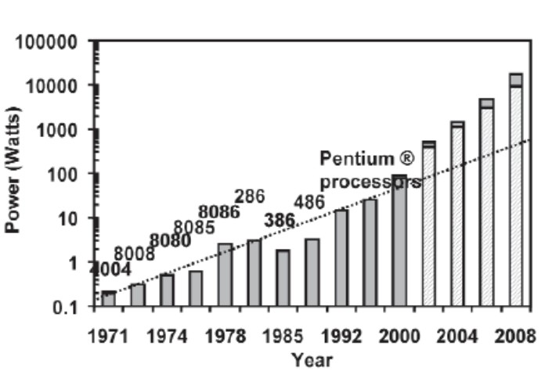
Computation Design Trends – Power concerns
Processors are getting too power hungry! There’s too many transistors that need power.
Also, the size of transistors can't come down by much – it might not be possible to have transistors smaller than a few atoms! And how would you connect them up?
A dual core Intel system with GPU, LCD monitor
draws about 220 watts
Slide 22 - Power over time.jpg
Projections obviously we’ve seen the reality isn’t as bad
Now tending to multi-core processors.. Sure it can double the transistors every 2-3 years (and the power? Just double?). But what of performance?

Slide 17
The Energy-Flexibility Gap
1000
Dedicated
HW
100
Reconfigurable Processor/Logic
Pleiades
10-80 MOPS/mW
Energy Efficiency
MOPS/mW (or MIPS/mW)
10
ASIPs
DSPs
2 V DSP: 3 MOPS/mW
1
Embedded Processors
SA110
0.4 MIPS/mW
0.1
Flexibility (Coverage)
The usual, comfort-zone PC sits way down below the page… but is very flexible

Slide 18
Cost of Computation
This is something that is becoming relevant considering the trend towards sharing computing infrastructure and cloud computing systems
The developer doesn’t necessarily need to care what the underlying hardware costs, but rather what it will cost to do calculations on the available hardware.
There’s various ways to quantify this, let’s look at a basic view for now…
We look at cloud computing and commonly used cost models in more detail in a later lecture

Slide 19
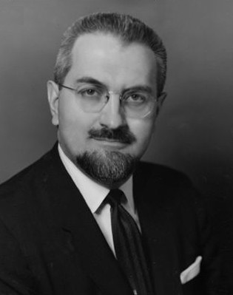
Grosch's law *
2x price =
4x performance?
(or used to!)
Grosch's law (Herb Grosch,1965):
A computer's hardware should exhibit an "economy of scale" which means the difference in performance between two computers is generally [proportionate to] the difference in their price, squared.
That is to say:
To do a calculation X times as cheaply it must take 10X the time
But note this is not valid for after about 1980s! *
Still Grosch’s law is occasionally mentioned where one is talking about situations were the more pricy option is way more functional than cheaper (entry level) option (e.g. Basic cellphone ~R500 vs. (basic) Smartphone ~R1000).
*The relevance of Grosch's law today is a debated subject. Paul Strassmann asserted in 1997, that Grosch's law is now “thoroughly disproved” and ”serves as a reminder that the history of economics of computing has had an abundance of inaccurate predictions”
* Is not necessarily valid nowadays but still mentioned form time to time

Slide 20
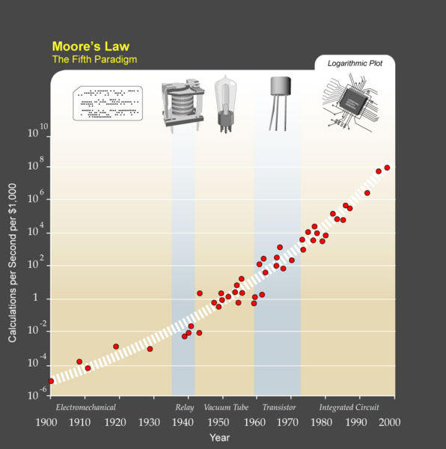
Calculation
per seconds per 1k$
Over time trend
Based on the cost of the underlying compute system (e.g. ENIAC for Vacuum tubes)

Slide 21
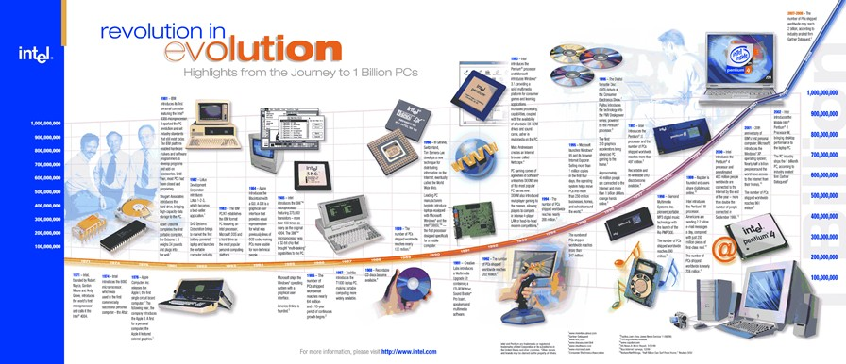
Illustration of demand for computers (Intel perspective)
Source:
alphabytesoup.files.wordpress.com/2012/07/computer-timeline.gif
slide 22 - demand for computers.jpg
(unknown license)

Slide 22
The Top500 List
The TOP500 list (www.top500.org) has provided a defining yardstick for supercomputing performance since 1993.
It is published 2x a year, it lists the world’s 500 largest installations and some of their main characteristics.
Systems are ranked according to their performance of the Linpack benchmark
Linpack solves a dense system of linear equations.
Over time data collected for the list has enabled the early identification and quantification of many important technological and architectural trends related to high-performance computing.
Optional further reading: Strohmaier et al.“The TOP500 List and Progress in High-Performance Computing”, IEEE Compter. 2015 On Vula: L04 - 07328648 - The TOP500 List in HPC.pdf

Slide 23
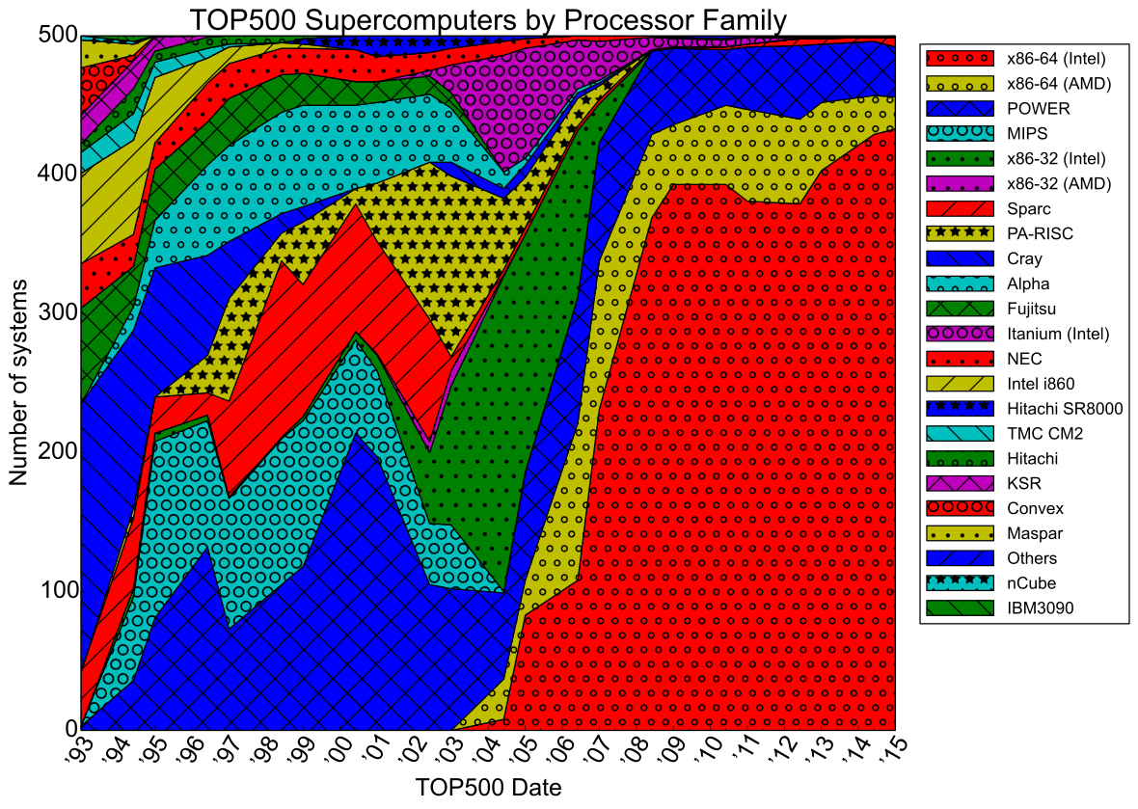
Image source: http://commons.wikimedia.org/wiki/File:Processor_families_in_TOP500_supercomputers.svg

Slide 24
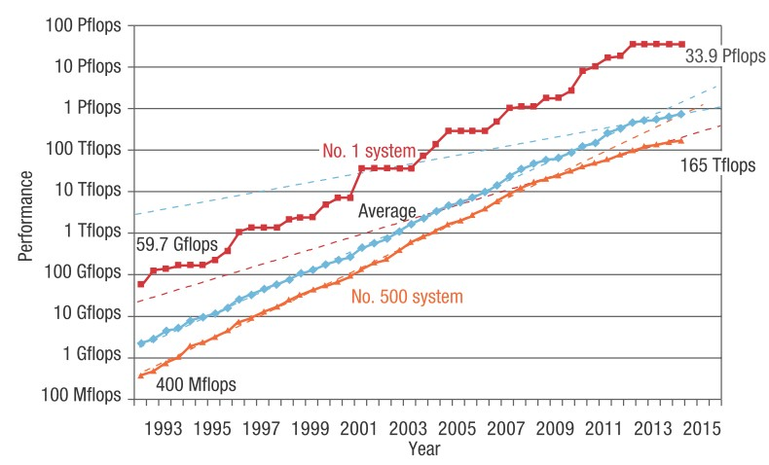
Supercomputer performance over time tracked by TOP500.
red and orange lines: performance of first and last systems
blue line: avg. performance of all systems.
Dashed lines: fitted exponential growth curves before and after 2008
Image source: Strohmaier et al.“The TOP500 List and Progress in High-Performance Computing”, IEEE Compter. 2015

Slide 25
Intermission
Where to next:
Parallel Programming Models
Parallel System Approaches
Parallel Programming Tools
Shared Memory

Slide 26
Disclaimers and copyright/licensing details
I have tried to follow the correct practices concerning copyright and licensing of material, particularly image sources that have been used in this presentation. I have put much effort into trying to make this material open access so that it can be of benefit to others in their teaching and learning practice. Any mistakes or omissions with regards to these issues I will correct when notified. To the best of my understanding the material in these slides can be shared according to the Creative Commons “Attribution-ShareAlike 4.0 International (CC BY-SA 4.0)” license, and that is why I selected that license to apply to this presentation (it’s not because I particulate want my slides referenced but more to acknowledge the sources and generosity of others who have provided free material such as the images I have used).
Image sources:
Clipart including ecology image, clock, factory and smoke – public domain CC0 (http://pixabay.com/)
Moore’s Law graph, processor families per supercomputer over years – all these creative commons, commons.wikimedia.org

