Slide 1
EEE4084F
Digital Systems
Lecture 8: Parallel Models
Parallel Programming Models and Tools, Shared Memory Models
Presented by
Simon Winberg
models
Attribution-ShareAlike 4.0 International (CC BY-SA 4.0)

Slide 2
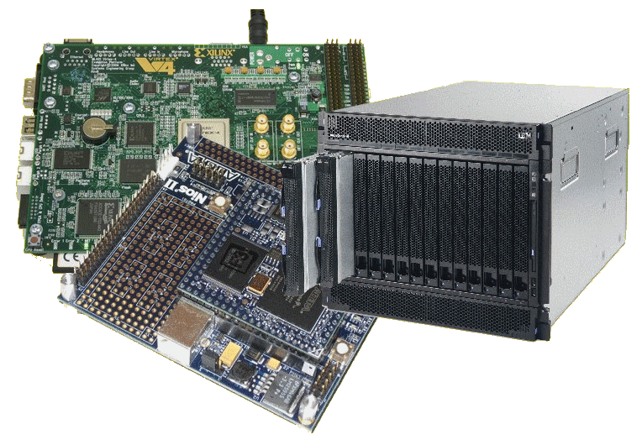
Lecture Overview
Parallel Programming Models
Parallel System Approaches
Parallel Programming Tools
Parallelizing Compilers
Shared Memory Models
Shared Memory Terms

Slide 3
Parallel Programming Models
EEE4084F

Slide 4
L08 - Linked Reading
Structures for parallel processing
D. Aspinall Pub date: 1990
Parallel processing is employed to achieve high performance by replication or a unique function by interconnecting diﬀerent processes. In each case the engineering problem, of providing the structure to interconnect the processors, is a combination of issues concerning not only the implementation technology but also the needs of the application. The concepts of geometric parallelism and algorithmic parallelism are introduced along with the concepts of granularity and degree of parallelism. The author discusses parallel processing paradigms and performance metrics such as latency, response crisis time and stimulus crisis time. The author discusses multi-computer systems; interconnection pathway, geometric parallelism by shared pathways, stars, rings and other topologies and the implementation of algorithmic parallelism. Parallelism within the mainframe computer is discussed. The von Neuman machine (processor-memory pair), eﬀect of a technology performance ratio; parallelism in the processor, pipelined computers and array computers.
File: L05 - 00084372 - Structures for parallel processing.pdf
Aspinall, D. "Structures for parallel processing." Computing & Control Engineering Journal 1.1 (1990): 15-22. DOI: 10.1049/cce:19900005
This paper, which is of a later date than Flynn’s work, presents additional parallel processing models, particularly ones that are not fully accurately for by Flynn’s taxonomy.

Slide 5
Aspinall: structures of parallel processing
Parallel processing (author’s description):
systems which allow more than one particular process to be active at any given instant.
Geometric Parallelism (SIMD*):
all data are available at once and each node operates on a unique portion of it according to the same program of instructions
Algorithmic Parallelism:
pattern of linkages by which the elements communicate with each other. Information flows from element to element in sequence to provide a result.
= processing node
= processing node
* This acronym will be encountered in next lecture

Slide 6
Aspinall: structures of parallel processing
3x dimensions for the spaces of parallel processing…
Process level
Granularity
Degree of Parallelism (DOP)
Let’s look at each one briefly…

Slide 7
Aspinall: structures of parallel processing
3x dimensions for the spaces of parallel processing…
Process level:
This is the lowest level
E.g. Register transfer logic, instruction procedure or program.
Granularity
Degree of Parallelism (DOP)
instruction
regs

Slide 8
Aspinall: structures of parallel processing
instruction
3x dimensions for the spaces of parallel processing…
Process level: e.g. register transfer logic, instruction procedure or program.
Granularity:
Ratio of the amount of computation (processing instructions per datum) to the amount of communication (transfer cost per datum).
i.e. instructions : communications or result 1:N → fine grained (high interdependence, each result needs a lot of communication, much of the data) 1:1 → medium grained e.g. sum(X) N:1 → course grained (low interdependence, each computation needs little or no other data) e.g. X[1:10]=0
Degree of Parallelism (DOP)
regs
f()
data

Slide 9
Aspinall: structures of parallel processing
instruction
3x dimensions for the spaces of parallel processing…
Process level: e.g. register transfer logic, instruction procedure or program.
Granularity: ratio of amount computation to communication i.e. instructions : communications or result 1:N → fine grained (high interdependence) 1:1 → medium grained e.g. sum(X) N:1 → course grained (low interdependence) e.g. X[1:10]=0
Degree of Parallelism (DOP):
How many operations can be simultaneously executed by a computer. (Useful for predicting potential performance of parallel programs).
regs
f()
data
f1
f2
f3
# functions running together?

Slide 10
Parallel System Approaches
Loaded & run when needed, time-shared system (very basic approach)
Communication by shared memory
Transputer paradigm: communicating by message passing – nowadays more commonly referred to as Message Passing (MP) model
Pipelined: stages of processing that runs in lockstep. Intermediate accumulator registers (result registers between stages) equals the degree of parallelism. Maximum parallelism achieved when stages fully synchronisation (i.e. no stalls).
Computer Array/Grid: mesh structure, neighbouring nodes share data
(from Aspinall, 1990)

Slide 11
Parallel Programming Models
Parallel Programming Models:
Data parallelism vs. Task parallelism
Explicit parallelism / Implicit parallelism
Shared memory / Distributed memory
Other parallel programming paradigms
Object-oriented
Functional and logic
Look at these

Slide 12
Data parallelism
Data-parallel =
Parallel programs that emphasize concurrent execution of the same task on different data elements
Most programs for scalable parallel computers are data parallel in nature

Slide 13
Task Parallel
Task parallel =
Parallel programs that emphasize the concurrent execution of different tasks on the same or different data
Uses: Modularity reasons
Parallel programs, structured as a task-parallel composition of data-parallel components is common.

Slide 14
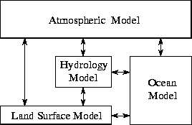
Data vs. Task Parallel Examples
Data parallelism
Task Parallelism

Slide 15
General Parallel Programming Models
Explicit Parallelism
The programmer specifies directly the activities of the multiple concurrent threads of control that forms the parallel computation.
Provides the programmer with more control over program behaviour and hence can be used to achieve higher performance.
Implicit Parallelism
The programmer provides high-level specification of program behaviour.
The compiler/library/framework needs to provide the means to implement the parallelism correctly and efficiently.

Slide 16
Parallel Programming Tools
Parallel Virtual Machine (PVM)
Distributed memory, explicit parallelism
PThreads
Shared memory, explicit parallelism
Message-Passing Interface (MPI)
Distributed memory, explicit parallelism
OpenMP
Shared memory, explicit parallelism
Parallelizing Compilers
Implicit parallelism

Slide 17
Parallelizing Compilers
Automatically transform a sequential program into a parallel program.
Finds loops whose iterations can be executed in parallel.
Identifies data dependencies and orders the execution accordingly
Often done in stages.

Slide 18
Types of Data Dependences
Data Dependences: used to determine what loops can or cannot be run in parallel.
Flow dependence – Read-After-Write (RAW).
A true dependence as read a value after it has been written into a variable.
Anti-dependence - Write-After-Read (WAR). Writes new value into a variable after the old value has been read.
Output dependence - Write-After-Write (WAW). Write a new value into a variable and then later write another value into the same variable.

Slide 19
Example – data dependencies
Dependencies ….
line 1: A = 90;
line 2: B = A;
line 3: C = A + D
line 4: A = 5;
Flow dependence on A from line 1 to 2, and from 1 to 3. …
Anti dependence on A from line 2 to 4 and from line 3 to 4. …
Output dependence on A between line 1 and stmt 4.

Slide 20
Example 1
Can this code be parallelized?
line 1: for i = 1 to 1000
line 2: A(i) = B(i) + C(i)
line 3: D(i) = A(i)
line 4: next
answer:
YES: There is a flow dependence on A(i) from line 1 to 2 in an iteration, but no dependences between any iterations.
Each iteration reads and writes to a different location in the array A, thus this loop can be executed in parallel – and even better we could execute the loop iterations in any order (so if some take longer to run than others that is OK).
A parallelizing compiler would split the 1000 iterations among the number of cores available

Slide 21
Example 2
Can this code be parallelized?
line 1: for i = 1 to 1000
line 2: A(i) = B(i) + C(i)
line 3: D(i) = A(i+1)
line 4: next
answer:
YES – if you have a good compiler: This example clearly contains an anti-dependence from line 2 to 1…
But in the subsequent iteration a WRITE will be done after we have already READ it in the previous iteration.
Line 2 is meant to read an old value of A(i+1) before the same location will be written over in the next loop iteration.
If the iterations were spread among e.g. 4 threads, then thread #2 could have already written a new value to A(251) in its first loop iteration, long before thread #1 tries to read (the old value) in its last loop, iteration 250.
So the compiler could chicken out and say it is not parallelizable – or it could realize that this problem only occurs at the boundaries and attempt to modify the loop to solve the problem, e.g. using saving the last A(i+1) in temp variable.

Slide 22
Shared Memory Models
happy memories
EEE4084F

Slide 23
Shared Memory Model
Tasks share a common address space, can read and write to memory asynchronously.
Memory control access is needed (e.g., to cater for data dependencies), such as:
Locks and semaphores to control access to shared memory.
In this model, the notion of tasks ‘owning’ data is lacking, so there is no need to specify explicitly the communication of data between tasks.

Slide 24
Shared Memory Model: pros and cons
Adv: often allows program development to be simplified (e.g. compared to message passing, discussed in a later lecture).
Adv: Keeping data local to processor working on it conserves memory accesses (reducing cache refreshes, bus traffic and the like that occurs when multiple processors use the same data).
Disad: tends to become more difficult to understand and manage data locality, which may detract from the overall system performance.

Slide 25
Using a Mutex
using mutexes so that neighbours are forced to talk (an adapted dining philosophers problem)
A mutex provides a means to protect parts of code so that only one thread runs that piece of code at a time
The mutex operations are
lock : enter the protected code
unlock : exit protected code / release key
C code snippets for using a mutex
// initialize the mutex
pthread_mutex_init(&mutex, NULL);
// lock the mutex
pthread_mutex_lock(&mutex);
// unlock the mutex
pthread_mutex_unlock(&mutex);
#include <pthread.h>
// this is the library usually used
// instantiate a mutex:
pthread_mutex_t mutex;
See example code at: http://apiexamples.com/c/pthread/pthread_mutex_lock.html

Slide 26
Introducing to some important terms related to shared memory
Using scalar product pthreads type implementation for scenarios…

Slide 27
Partitioned memory
Vectors in
global / shared
memory
[a₁ a₂ a₁ a₂ … a_{m-1}]
[b₁ b₂ b₁ b₂ … b_{m-1}]
Thread 1
main()
starts
main()
sum = sum1+sum2
sum1
[a_{m} a_{m+1} a_{m+2} … a_{n}]
[b_{m} b_{m+1} b_{m+2} … b_{n}]
a
b
Thread 2
1
1
sum2
2
2
Assuming a 2-core machine
Memory access by thread

Slide 28
Interlaced* memory
Vectors in
global / shared
memory
[a₁ a₃ a₅ a₇ … a_{n-2}]
[b₁ b₃ b₅ b₇ … b_{n-2}]
Thread 1
main()
starts
main()
sum = sum1+sum2
sum1
[a₂ a₄ a₆ … a_{n-1}]
[b₂ b₄ b₆ … b_{n-1}]
a
b
Thread 2
sum2
Assuming a 2 core machine
* Data striping, interleaving and interlacing usually means the same thing.
Memory access by thread

Slide 29
Memory Partitioning Terms
Contiguous
Partitioned (or separated or split)
Interleaved/interlaced (or alternating or data striping)
Interleaved – small stride (e.g. one word stride)
Interleaved – large strides (e.g. row of image pixels at a time)
(the ‘stride’ in data interleaving or data striping refers to the size of the blocks alternated, generally
this is fixed but could be changeable, e.g. the last stride might be smaller to avoid padding data.)

Slide 30
What’s Next??
Thursday 2pm: Seminar #2 first student group seminar
CH1-A Retrospective on High Performance Embedded Computing
CH2-Representative Example of a High Performance Embedded Computing System presented by: Alexandra Barry, Nicholas Antonaides, Edwin Samuels
Thursday 3pm: Prac Prep
Introduction to OpenCL (towards Prac3)

Slide 31
Disclaimers and copyright/licensing details
I have tried to follow the correct practices concerning copyright and licensing of material, particularly image sources that have been used in this presentation. I have put much effort into trying to make this material open access so that it can be of benefit to others in their teaching and learning practice. Any mistakes or omissions with regards to these issues I will correct when notified. To the best of my understanding the material in these slides can be shared according to the Creative Commons “Attribution-ShareAlike 4.0 International (CC BY-SA 4.0)” license, and that is why I selected that license to apply to this presentation (it’s not because I particulate want my slides referenced but more to acknowledge the sources and generosity of others who have provided free material such as the images I have used).
Image sources:
Pixabay http://pixabay.com
Stop watch slides 1 & 14, Gold bar: Wikipedia (open commons)
books clipart: http://www.clker.com (open commons)

