Slide 1




EEE4084F
Digital Systems
Lecture 9:
OpenCL overview
with
OpenCL in C
example
Lecturer:
Simon Winberg
Attribution-ShareAlike 4.0 International (CC BY-SA 4.0)

Slide 2
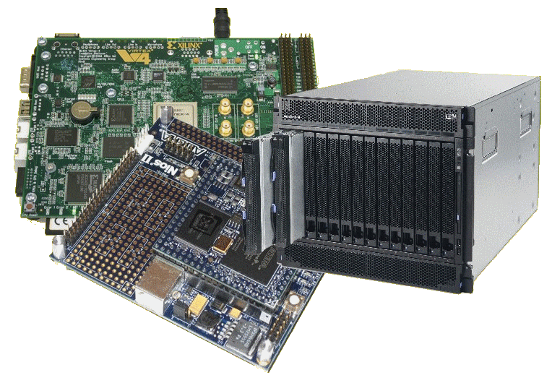
Lecture Overview
Why OpenCL
Brief overview of OpenCL
  Abstractions & platform model
  OpenCL Scenario
Preparation for Prac 3
The following slides are based on a presentation
prepared by Dr. Suleyman Demirsoy, DSP Technology Specialist, Intel Programmable Solutions Group
See also paper in reading list:
L09 - 06502816 - OpenCL Overview, Implementation, and Performance Comparison.pdf
Licensing details last slide

Slide 3
Why OpenCL?
EEE4084F

Slide 4
Why OpenCL…
Increasing demands for more functionality and performance
Size of datasets and complexity of pipelines for moving data around continue to increase
It’s an increasing struggle to sustain performance trajectory without massive increases in:
cost, power & size
  Power consumption & thermal dissipation limits system size
  Control of data and synchronization complexity is growing out of control (i.e. complexity that develops in MPI code for large parallel systems)

Slide 5
OpenCL
– for acceleration & other kernels
Also a response for needs to cater for
  BIG DATA
  HIGHLY INTEGRATED SYTEMS
  SPECIAL-PURPOSE ACCELERATORS
OpenCL is not (currently) meant for creating most of the application code – it is designed around developing accelerated kernels that are highly parallel or exercise the specialized hardware (not necessarily an application accelerator)
Host Computer
Application Code
mainly ‘glue code’ & GUI / IO
Reused Libraries
lots of data
Active kernel
Inactive kernels
Application Accelerator

Slide 6
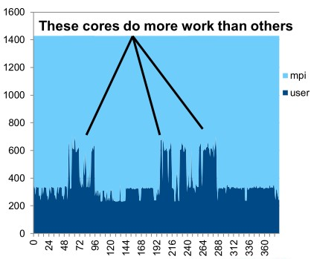
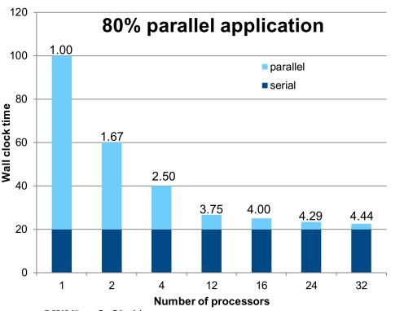
Why OpenCL…
Not all applications scale well linearly
Not all apps load balance across all cores equally
LIMITED SCALABILITY
POORLY BALANCED

Slide 7

Why OpenCL…
Heterogeneous Computing Systems as a potential solution to the problems of limited scalability and balancing
  Distribute your different processing needs among processing cores better suited
  to the particular types of processing.
workload
Essentially like matching the
equipment with the task
Definition:
Heterogeneous computing refers to systems that use more than one kind of processor. These are systems that gain performance not just by adding the same type of processors, but by adding dissimilar processors, usually incorporating specialized processing capabilities to handle particular tasks (or entire applications).

Slide 8
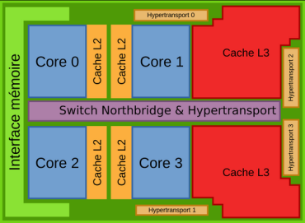

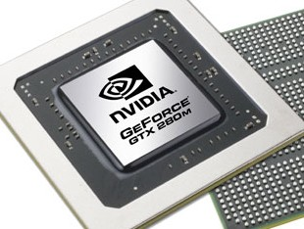
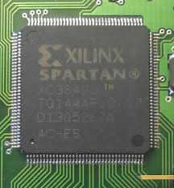
Examples of devices form which heterogeneous computing systems are composed
Multi-core, general purpose, central
processing units (CPUs)
  Include multiple execution units ("cores")
  on the same chip
Digital Signal Processing (DSPs) processors
  Optimized for the operational needs of digital
  signal processing
Graphics Processing units (GPUs)
  Heavily optimized for graphics processing
Field Programmable Gate Arrays (FPGAs)
  Custom architectures for each problem solved
  SoC FPGAs combine CPU+FPGA in single device

Slide 9
Challenges to developers
Various applications becoming bottlenecked by scalable performance requirements
  e.g. Object detection and recognition, image tracking and processing, cryptography, cloud, search engines, deep packet inspection, etc…
Overloading CPUs capabilities
  Frequencies capped
  Processors keep adding additional cores
  Need to coordinate all the cores and manage data
Source: points based on course notes by B. Subramanian, Department of Computer Science, University of Texas, Austin

Slide 10
Challenges to developers (cont)
Product life cycles are long
  GPUs lifespan is short (which goes with the problem of getting replacements of the same model in the future)
  Require re-optimization and regression testing between generations
  (not limited to accelerators/GPUs!! It could be some cryptic control code for a robot, e.g. multiple processors of an integrated device)
Maintaining coherency throughout scalable system
Support agreement for GPUs costly
Power dissipation of CPUs and GPUs limits system size
Source: points based on course notes by B. Subramanian, Department of Computer Science, University of Texas, Austin

Slide 11
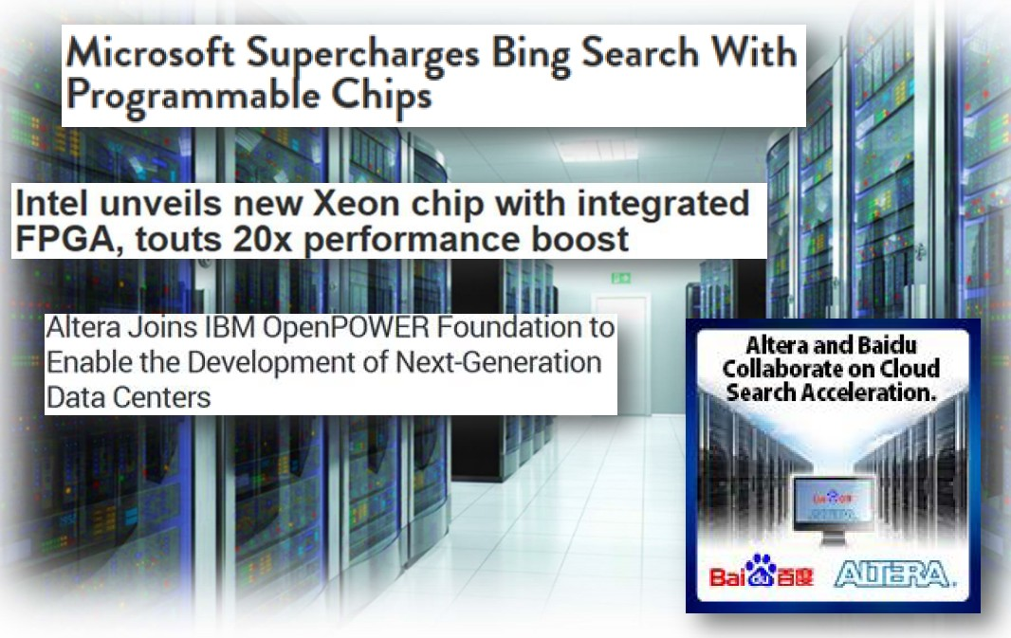
FPGA in datacentres
An increasing number of datacentres nowadays are having FPGAs a
integral parts of their processing offerings. For example…

Slide 12
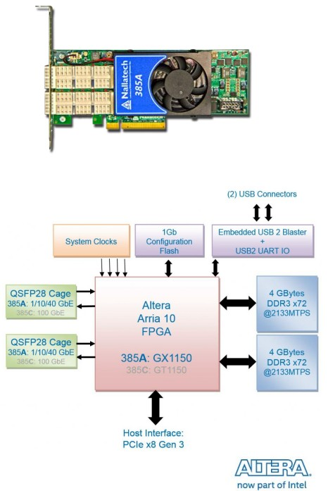
FPGA boards designed for use in datacentres
The [Intel] Altera Arria 10 is a high performance FPGA suited to these applications.
The Nallatech PCI accelerator boards are an example of how a ‘supercomputer performing’ hybrid system can be constricted from a multi-core CPU + GPU + Nallatech FPGA custom accelerator board

Slide 13
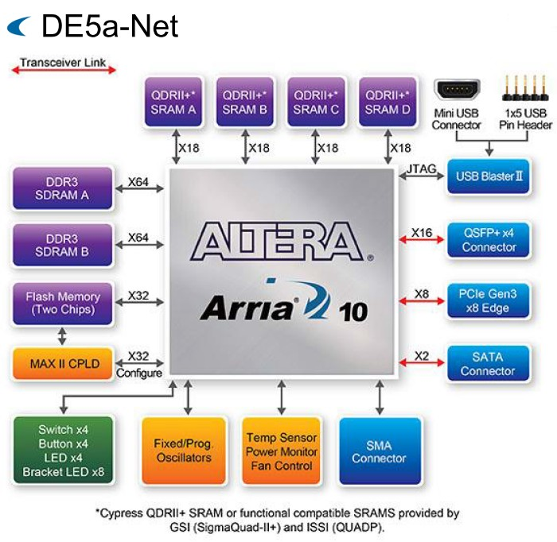
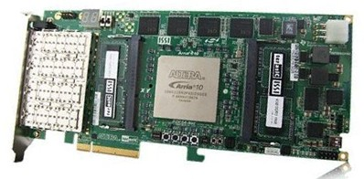
FPGA boards designed for use in datacentres
Another example of FPGA accelerator for a PC architecture: the Terasic DE5a-Net
Terasic has lowest cost, highest performance platform offerings, you can get e.g. a DE0 which connects via USB (while it has a reasonable FPGA

Slide 14
OpenCL – abstractions and platform model
EEE4084F

Slide 15
Overview of OpenCL
Open standard for parallel programming across heterogeneous devices
Devices can consist of CPUs, GPUs, embedded processors etc. – uses all the processing resources available
Includes a language based on C99 for writing kernels and API used to define and control the devices
Parallel computing (or hardware acceleration*) through task-based and data-based parallelism
* Which is more generic e.g. if the hardware is faster but not necessarily more parallel

Slide 16
Purposes of OpenCL
Use all computational resources of the system via a consistent programming language
Greater platform independence
Provides both a data and task parallel computational model
A programming model which abstracts the specifics of the underlying hardware
Much flexibility in specifying accuracy of floating-point computations
Supports desktop, server, mobile, custom, etc.

Slide 17
The OpenCL Platform Model
This could simply be your workstation PC or a network server
Host connected to one or more OpenCL devices
Device consists of one or more cores
Execution per processor may be SIMD or SPMD*
Contexts group together devices and enable inter-device communication
HOST
Context
Device A - CPU
Device B - GPU
Context
Device C - DSP
* Single Program, Multiple Data - where cores are running the same program but not necessarily the same instructions at the same time
Slide adapted from course notes by B. Subramanian, Department of Computer Science, University of Texas, Austin

Slide 18
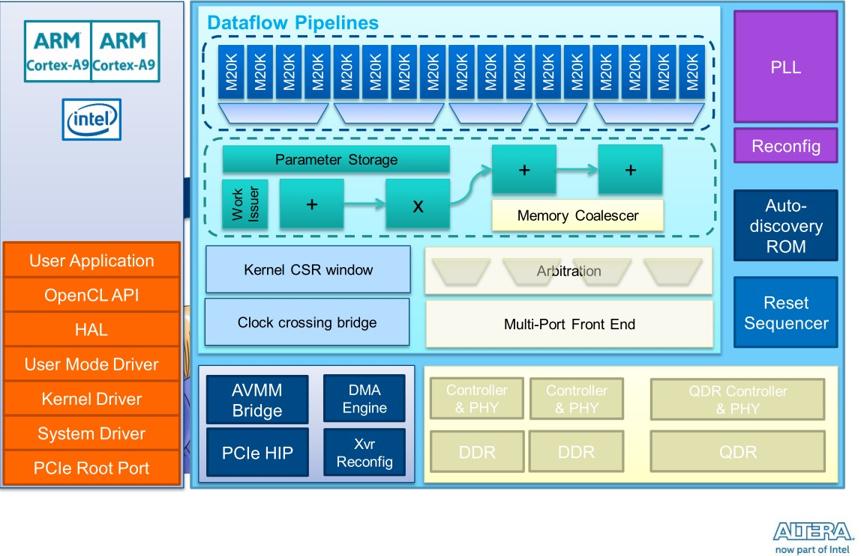

Altera OpenCL Platform Model
Developers
mostly working
happily at
Application
level in C for kernels and favourite application programming language
The OpenCL compiler takes care of much of the worries including machine-based profiling, tuning and optimization

Slide 19
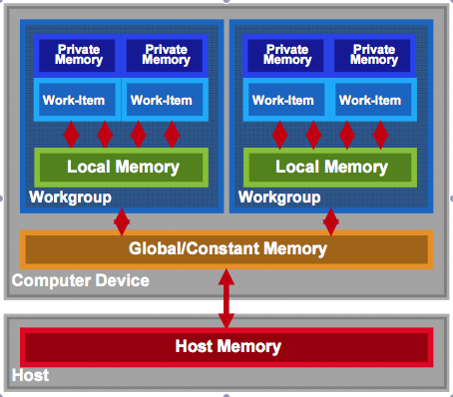
OpenCL Memory model
Private memory:
available per work item
Local memory:
shared in workgroup
NB: No synchronization between workgroups
Synchronization possible between work items in a common workgroup
Global/constant memory accessible by any work-items (no guarantee to be synchronized)
Host memory: access through the CPU
PICe (usually)
Memory management is explicit…
Data moved from:
host->global->local and back

Slide 20
OpenCL Memory model
Private memory:
available per work item
Local memory:
shared in workgroup
NB: No synchronization between workgroups
Synchronization possible between work items in a common workgroup
Global/constant memory accessible by any work-items (no guarantee to be synchronized)
Host memory: access through the CPU
PICe (usually)
Memory management is explicit…
Data moved from:
host->global->local and back

Slide 21
OpenCL Memory model
Private memory:
available per work item
Local memory:
shared in workgroup
NB: No synchronization between workgroups
Synchronization possible between work items in a common workgroup
Global/constant memory accessible by any work-items (no guarantee to be synchronized)
Host memory: access through the CPU
PICe (usually)
Memory management is explicit…
Data moved from:
host->global->local and back

Slide 22
OpenCL Memory model
Private memory:
available per work item
Local memory:
shared in workgroup
NB: No synchronization between workgroups
Synchronization possible between work items in a common workgroup
Global/constant memory accessible by any work-items (no guarantee to be synchronized)
Host memory: access through the CPU
PICe (usually)
Memory management is explicit…
Data moved from:
host->global->local and back

Slide 23
OpenCL Memory model
Private memory:
available per work item
Local memory:
shared in workgroup
NB: No synchronization between workgroups
Synchronization possible between work items in a common workgroup
Global/constant memory accessible by any work-items (no guarantee to be synchronized)
Host memory: access through the CPU
PICe (usually)
Memory management is explicit…
Data moved from:
host->global->local and back

Slide 24
OpenCL Memory model
Private memory:
available per work item
Local memory:
shared in workgroup
NB: No synchronization between workgroups
Synchronization possible between work items in a common workgroup
Global/constant memory accessible by any work-items (no guarantee to be synchronized)
Host memory: access through the CPU
PICe (usually)
Memory management is explicit…
Data moved from:
host->global->local and back

Slide 25
Advantages of OpenCL compiler
HLS (high level synthesis) phase leverages the OpenCL compiler
You can (if you want to) still specify and adjust:
  High performance datapaths
  Automatic pipelining
  New QoR enhancements as they are developed
  DSPB back-end optimizations
  Memory optimizations
In addition to:
  Control constraints (latency, fmax, area, …)
  Control interfaces (stall, valid, Avalon-MM, …)
  Control architecture (memory configuration, scheduling, …)
  IP core verification flows
Code.c
IP optimizations
executables

Slide 26
OpenCL Coding
EEE4084F

Slide 27
OpenCL Programming Model
Kernel
  basic unit of execution – data parallel
Program
  collection of kernels and related functions
Kernels executed across a collection of
work-items
  one work-item per computation
Work-items
  Independent processing tasks; grouped into
  workgroups
Workgroups
  Work-items that executed together on one device
Workgroups are executed independently can take place simultaneously or via specific schedule
Applications structuring
  Queue kernel instances for execution in-order, but they may be executed in-order or out-of-order
Work items and OpenCL memory model

Slide 28
OpenCL Objects (work task elements)
Devices: multiple cores on CPU/GPU together taken as a single device
  Kernels executed across all cores in a data-parallel manner
Contexts: Enable sharing between different devices
  Devices must be within the same context to be able to share
Queues: used for submitting work, one per device
Buffers: simple chunks of memory like arrays; read-write access
Images: 2D/3D data structures
  Access using read_image(), write_image()
  Either read or write within a kernel, but not both

Slide 29
OpenCL Kernel Objects
Declared with a kernel qualifier
Encapsulate a kernel function
Kernel objects are created after the executable is built
Execution
  Set the kernel arguments
  Enqueue the kernel
Kernels are executed asynchronously
Events used to track the execution status
  Used for synchronizing execution of two kernels
  clWaitForEvents(), clEnqueueMarker() etc.

Slide 30
OpenCL Program Objects
Encapsulate
  A program source/binary
  List of devices and latest successfully built executable for each device
  List of kernel objects
Kernel source specified as a string can be provided and compiled at runtime using clCreateProgramWithSource() – platform independence
Overhead – compiling programs can be expensive
  OpenCL allows for reusing precompiled binaries

Slide 31
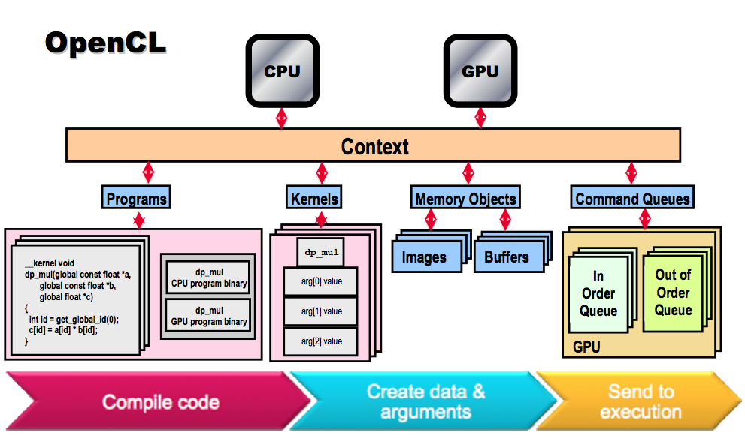
OpenCL Overall Pipeline
A view on how some of the objects fit in to the execution model

Slide 32
OpenCL C Language
C99 (previously ‘C9X’) is an informal name for ISO/IEC 9899:1999, a past version of the C programming language standard. It extends the previous version (C90) with new features for the language and the standard library. Helps implementations make better use of available computer hardware and compiler technology.
Source & more info: https://en.wikipedia.org/wiki/C99
Derived from ISO C99
Non standard headers, function pointers, recursion, variable length arrays, bit fields
Added features: work-items, workgroups, vector types, synchronization
Address space qualifiers
Optimized image access
Built-in functions specific to OpenCL
Data-types
  Char, uchar, short, ushort, int, uint, long, ulong
  Bool, intptr_t, ptrdiff_t, size_t, uintptr_t, half
  Image2d_t, image3d_t, sampler_t
  Vector types – portable, varying length (2,4,8,16), endian safe
  Char2,ushort4,int8,float16,double2 etc.
Many of these are recognizable from C!
(skip in lecture, may be useful to refer to when writing a OpenCL program)

Slide 33
OpenCL C Language
Many of these are not so common in C!
Work-item and workgroup functions
  get_work_dim(), get_global_size()
  get_group_id(), get_local_id()
Vector operations and components are pre-defined as a language feature
Kernel functions
  get_global_id() – gets the next work item
Conversions
  Explicit – convert_destType<_sat><_roundingMode>
  Reinterpret – as_destType
  Scalar and pointer conversions follow C99 rules
  No implicit conversions/casts for vector typs
(skip in lecture, may be useful to refer to when writing a OpenCL program)

Slide 34
OpenCL C Language: dealing with address spaces
Address spaces
  Kernel pointer arguments must use global, local or constant
  Default for local variables is private
  Image2d_t and image3d_t are always in global address space
  Global variables must be in constant address space
  NB: Casting between different address spaces undefined
(skip in lecture, may be useful to refer to when writing a OpenCL program)

Slide 35
Advantages of OpenCL
OpenCL
C++ -> HDL translators
Targets CPU, GPU and FPGAs
Target user is Software developer
Implements FPGA in software development flow
Performance is determined by resources allocated
Host Required
Targets FPGA
Target user is FPGA designer
Implements FGPA in traditional FPGA development flow
Performance is defined and amount of resource to achieve is reported
Host not required
(skip in lecture, may be useful to refer to when writing a OpenCL program)

Slide 36
CUDA vs OpenCL correspondence
CUDA
OpenCL
Thread
Thread-block
Global memory
Constant memory
Shared memory
Local memory
__global__ function
__device__ function
__constant__ variable
__device__ variable
__shared__ variable
Work-item
Work-group
Global memory
Constant memory
Local memory
Private memory
__kernel function
no qualification needed
__constant variable
__global variable
__local variable
(skip in lecture, may be useful to refer to when writing a OpenCL program)

Slide 37
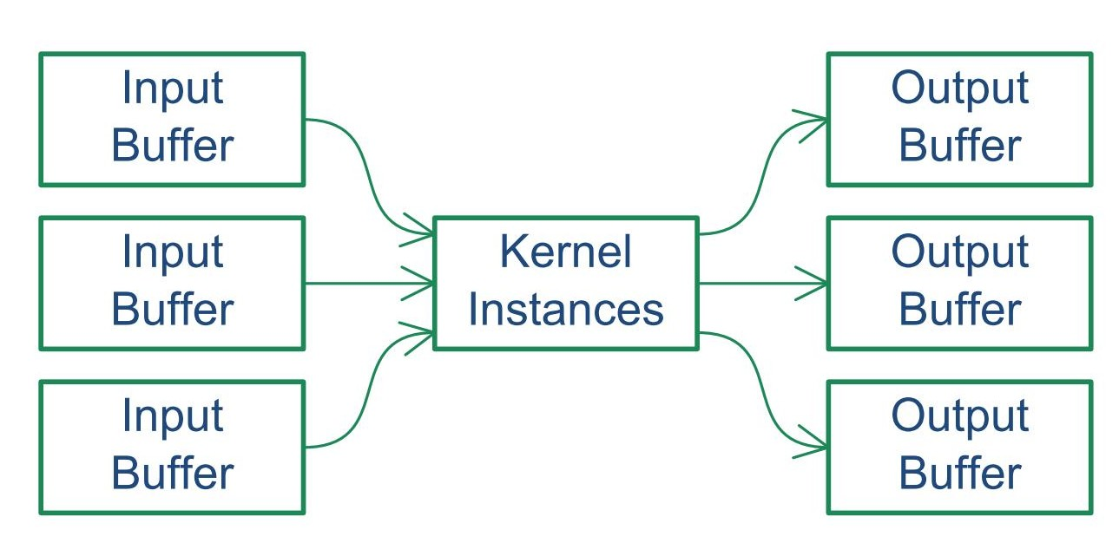
Conceptual view of how a kernel fits in
Similar to
vertex buffers
and textures
Similar to
depth and
frame buffers
Similar to
vertex and
fragment shaders
… comparing to GPU / CUDA type approach …

Slide 38
OpenCL Scenario
EEE4084F

Slide 39
Initialisation
Get platform ID
Compile kernels
Create buffers
Create command queue
Enqueue write
Enqueue kernel run
Enqueue read
Wait for queue to ﬁnish
  Wait for the OpenCL system to ﬁnish performing the commands in the queue

Slide 40
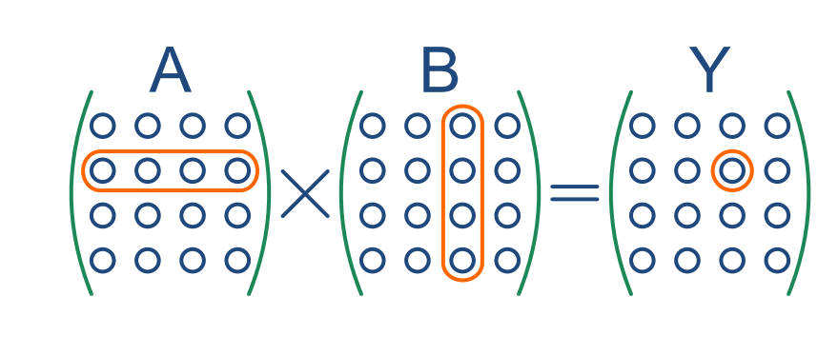
Matrix Multiplication Example
Let’s multiply two NxN matrices, A and B, and store the result in Y.

Slide 41
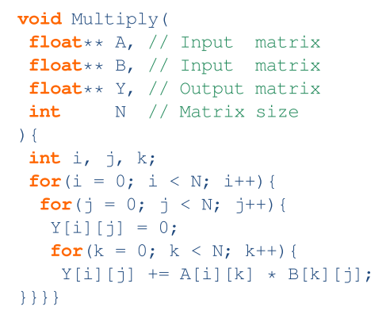
C++ Implementation (Golden Measure)

Slide 42
OpenCL implementation
Golden measure, the cpu has a double nested for loop
i.e. i: 0->N-1
j: 0->N-1
k: 0->N-1
GPU version is going to have NxN threads, calculating the result for each Y[i,j] so each core should do just one for loop (i.e. the inner loop of the golden measure) i.e.
k: 0->N-1 to compure Y[i,j])
So need to group the threads into a 2D NxN structure, so that the thread IDs will have ID(0) going form 0..N-1 (for columns) and ID(1) going from 0..N-1 (for rows)
Let’s start by defining the OpenCL kernel …

Slide 43
OpenCL Implementation
/** This Kernel perform part of the standard matrix multiply on
two NxN matrices, calculating one of the output elements:
Sum of A(k,i) x B(j,k) for k=0..N-1. */
__kernel void Multiply(
__global float* A,
__global float* B,
__global float* Output,
const unsigned int N )
{
const int i = get_global_id(1); // Row
const int j = get_global_id(0); // Column
int k;
float result = 0;
for (k = 0; k < N; k++){
result += A[N*i + k] * B[N*k + j];
}
Output[N*j + i] = result;
}
Put this in a file called e.g. Kernel.cl

Slide 44
Code to execute the kernel
Writing the kernel was easy…
But now we need to write the surrounding CPU-based code that
  Initialize the OpenCL driver
  Load the kernel (and compiles it)
  Creates on the CPU some test data
  Structures the kernel thread execution dimensions (kernel global ID dimensions)
  Sets up the memory buffers on the GPU (to hold input and output matrices)
  [Run a golden measure for checking the output]
  Send the test data from CPU to GPU
  Run the kernel
  Read back the result from the kernel
  [Compare the golden measure to the kernel result]

Slide 45
Let’s do each step

Slide 46
Initialize the driver
First create a main.c program and project as needed.
The main.c will run on the CPU
Set up a main() function
Now we can initialize the OpenCL library that connects to the driver
if(
!OpenCL_Init("NVIDIA" ) && // nVidia
!OpenCL_Init("Advanced Micro Devices") && // AMD
!OpenCL_Init(0 ) // Default
){
printf("Error: Cannot initialise OpenCL.\n");
return 1;
}
In this code we attempt first to connect to a nVidia device, then if that fails we try to connect to an AMD device (many come with a graphics driver that support OpenCL) and if neither of those work, the tries a default (any other device, e.g. Intel multicore processor driver for OpenCL). If we can’t find any device the program might as well exit.

Slide 47
Initialize the driver
Let’s start by loading in and compiling the kernel (assuming the Kernel is in a file Kernel.cl and in a subdirectory for the project called OpenCL)
This is a tip: separate your kernels from the rest of the CPU code, I like putting it in a subdirectory OpenCL
if(!OpenCL_LoadKernel("OpenCL/Kernel.cl", "Multiply"))
return 1;
If there are any syntax errors then this command will fail, possibly displaying error information to the screen depending on what OpenCL driver you use.

Slide 48
Set up memory
Set up buffers on the CPU that will hold the matrices to multiple as well as the result.
// Choose the matrix size and how much memory it needs
N = 3;
size_t BufferSize = N*N*sizeof(float);
// Allocate CPU RAM
A = (float*)malloc(BufferSize);
B = (float*)malloc(BufferSize);
Output_Serial = (float*)malloc(BufferSize);
Output_OpenCL = (float*)malloc(BufferSize);
To start with we’re doing a trivial 3x3 matrix. Why? So that we can print it easily to the screen and inspect the result manually to check all it is working.
The inputs are called A and B, I’ve set up two output matrices:
Output_Serial for the golden measure and Output_OpenCL for the kernel return.

Slide 49
Initialize the matrices
Let’s define a function Fill to populate the matrices
/** Fill an NxN matrix with random values ranging
from 0 to 20 */
void Fill(float* A){
int i, j;
for(j = 0; j < N; j++){
for(i = 0; i < N; i++){
A[N*j + i] = rand() % 20;
}
}
}
We’re just initializing with random values, but making them ints between 0 and 19 so as to be displayed easily. It’s doesn’t make a difference to the speed when running the multiply.

Slide 50
Initialize the matrices
Use the Full function we just did to populate the matrices
// Provide seed to random number generator
srand(time(NULL));
// Put data into the matrices
Fill(A);
Fill(B);

Slide 51
Set up kernel thread dimensions and memory
We want the threads to be arranged in a 2D grid, 0..N-1 x 0..N-1
We want to have 3x buffers on the GPU for A,B matrix inputs and C output
size_t LocalSize[2] = {1, 1}; // dimensions of threads
OpenCL_PrepareLocalSize(N, LocalSize);
// Allocate GPU memory…
// This is buffer ID 0 and it is read only (write protected)
A_Buffer = OpenCL_CreateBuffer(0, CL_MEM_READ_ONLY,
BufferSize);
// This is buffer ID 1 and it is read only (write protected)
B_Buffer = OpenCL_CreateBuffer(1, CL_MEM_READ_ONLY,
BufferSize);
// This is buffer ID 2 and it is write only
OutputBuffer = OpenCL_CreateBuffer(2,CL_MEM_WRITE_ONLY,
BufferSize);

Slide 52
Run the serial golden measure
Let’s run the serial version that was already given as the golden measure (placed in function Process_Serial)
Note that we are using the tic and toc C implementations see in earlier lectures (these are attached below in the Timer module)
tic();
Process_Serial();
printf("Serial: %lg ms\n", toc()/1e-3);
/** This function does a complete Matrix multiply of an NxN matrix, calculating
the output elements: Sum of A(k,i) x B(j,k) for k=0..N-1. */
void Process_Serial(){
int i, j, k;
float result;
for(j = 0; j < N; j++){
for(i = 0; i < N; i++){
result = 0;
for(k = 0; k < N; k++){
result += A[N*i + k] * B[N*k + j];
}
Output_Serial[N*j + i] = result;
}
}
}

Slide 53
Run the OpenCL version
Let’s run the openCL kernel
The process for invoking the kernel can be put in a separate function to make the main function less complicated (see next slide)
tic();
Process_OpenCL();
printf("\nOpenCL: %lg ms\n\n", toc()/1e-3);

Slide 54
Run the OpenCL version
Procedure for invoking the kernel…
/** Set up the data on the GPU and Run the kernel. */
void Process_OpenCL(){
printf("\n");
// Send N as argument 3. Note that arguments are indexed from 0
OpenCL_ConstantInt(3, N);
// Send over the buffers A and B to the GPU memory
OpenCL_WriteData(A_Buffer, N*N*sizeof(float), A);
OpenCL_WriteData(B_Buffer, N*N*sizeof(float), B);
// Execute the kernel function
OpenCL_Run(N, LocalSize);
// Read back the result from the GPU
OpenCL_ReadData(OutputBuffer, N*N*sizeof(float), Output_OpenCL);
}

Slide 55
Compare CPU & GPU results
Now lets compare the golden measure (Openput_Serial) with the kernel output (Output_OpenCL). Just call this function from main().
/** Compare the Output_Serial and Output_OpenCL matrices
and indicate if they are the same or not. */
void Compare(){
int i, j;
// compare the two result matrices
int same = 1;
for(j = 0; j < N; j++){
for(i = 0; i < N; i++){
if (Output_Serial[N*j + i] != Output_OpenCL[N*j + i])
same=0;
}
}
if (same) printf(" Result matrices are the same :)\n");
else printf(" Result matrices differ!!\n");
}

Slide 56
Clean up
And at the end of the main() function remember to free the allocated memory on both the CPU and on the GPU
// Dispose of the allocated memory on CPU and on GPU
free(A);
free(B);
free(Output_Serial);
free(Output_OpenCL);
OpenCL_FreeBuffer(A_Buffer );
OpenCL_FreeBuffer(B_Buffer );
OpenCL_FreeBuffer(OutputBuffer);
OpenCL_Destroy();

Slide 57
What does the output look like?
Should see something like the following (this example run was done on a Intel i5 with a nVidia GForce GTX550Ti card.
-- dump of various OpenCL driver information --
Should see vendors of Intel(R) Corporation and NVIDIA Corporation
Clock resolution: 342.1 ns
Serial: 0.000342102 ms
Local work group size: 3 x 3
OpenCL: 1.26679 ms
Result matrices are the same :)
A:
9 12 9
14 7 5
14 1 1
B:
18 4 11
10 19 19
17 9 3
Output_Serial:
435 407 279
345 234 84
354 302 176
Output_OpenCL:
435 407 279
345 234 84
354 302 176
Note that with these tiny 3x3 matrices the time to get data to the GPU and invoke the kernel takes way longer than doing the actual multiplication.
N=100 was just past the breakeven point. Taking N over 500 started seeing substantial differences (e.g. for N=1000 got:
Serial: 7295.86 ms vs.
OpenCL: 63.9901 ms)

Slide 58
Further Reading
R Wright, N Haemel and G Sellers
  OpenGL SuperBible, 6 th ed
  Addison-Wesley, 2014, ISBN 978-0-321-90294-8
A Munshi, B R Gaster, T G Mattson, J Fung and D Ginsburg
  OpenCL Programming Guide
  Addison-Wesley, 2012, ISBN 978-0-321-74964-2
Mac Developer Library
  OpenCL Hello World Example
Altera
  OpenCL SDK for FPGA

Slide 59
Complete application
See the Prac3 on the EEE4084F website (attached here a .zip of the current version used in this presentation, with a Code::Blocks project, should compile on Linux or Windows)

Slide 60
End of lecture

Slide 61
Disclaimers and copyright/licensing details
I have tried to follow the correct practices concerning copyright and licensing of material, particularly image sources that have been used in this presentation. I have put much effort into trying to make this material open access so that it can be of benefit to others in their teaching and learning practice. Any mistakes or omissions with regards to these issues I will correct when notified. To the best of my understanding the material in these slides can be shared according to the Creative Commons “Attribution-ShareAlike 4.0 International (CC BY-SA 4.0)” license, and that is why I selected that license to apply to this presentation (it’s not because I particularly want my slides referenced but more to acknowledge the sources and generosity of others who have provided free material such as the images I have used).
Image sources:
Wikipedia (open commons) commons.wikimedia.org
flickr.com
Gadgets, Block diagrams for Altera OpenCL models – fair usage
public domain CC0 (http://pixabay.com/)

