Slide 1
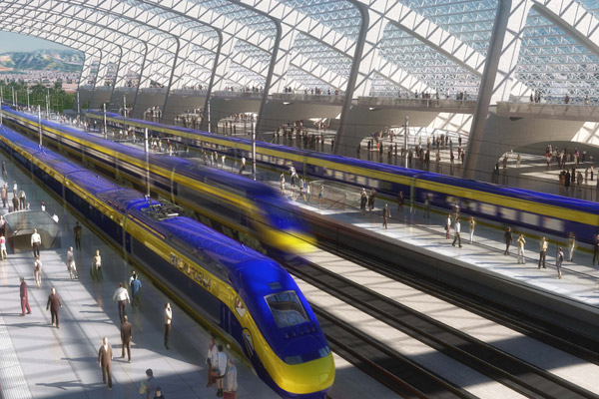
EEE4084F
Digital Systems
Lecture 10:
Architectures Types, Memory Access Architectures, Flynn’s Taxonomy, Classic Microcontroller Case Studies
Attribution-ShareAlike 4.0 International (CC BY-SA 4.0)

Slide 2
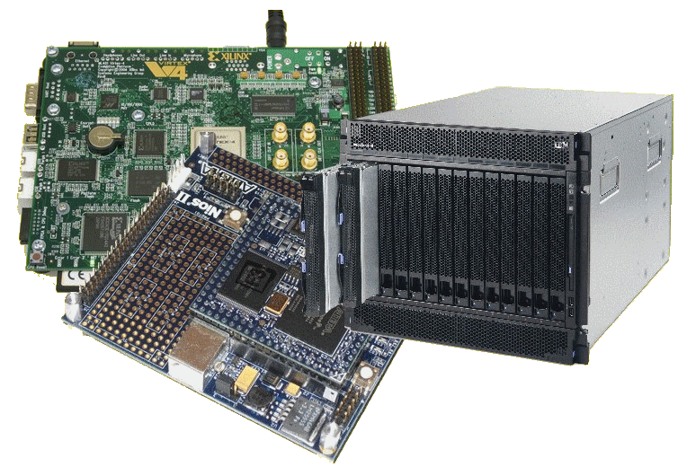
Lecture Overview
Classic parallel programming techniques
Processor Architecture Types
Von Neumann
Class activity
Flynn’s Taxonomy
Memory access architectures
Case Studies of classic microprocessor/ microcontroller architectures
Additional readings

Slide 3
Classic Parallel
EEE4084F

Slide 4
Classic techniques for parallel programming*
Single Program Multiple Data (SPMD)
Consider it as running the same program, on different data inputs, on different computers (possibly) at the same time
Multiple Program Multiple Data (MPMD)
Consider this one as running the same program with different parameters settings, or recompiling the same code with different sections of code included (e.g., uisng #ifdef and #endif to do this)
Following this approach performance statistics can be gathered (without necessarily any parallel code being written) and then evaluated after the effect to deem the feasibility of implementing a parallel (e.g. actual pthreads version) of the program.
*Informally know as the lazy parallel programming model.

Slide 5
Terms
EEE4084F

Slide 6
Terms (reminders)
Observed speedup =
Parallel overhead:
Amount of time to coordinate parallel tasks (excludes time doing useful work).
Parallel overhead includes operations such as: Task/co-processor start-up time, Synchronizations, communications, parallelization libraries (e.g., OpenMP, Pthreads.so), tools, operating system, task termination and clean-up time
Wallclock time initial version
Wallclock time sequential (or gold)
=
Wallclock time refined version
Wallclock time parallel version
The parallel overhead of the lazy parallel model could clearly be extreme, considering that is would rely on manual intervention to (e.g.) partition and prepare the data before the program runs.

Slide 7
Some terms
Embarrassingly Parallel
Simultaneously performing many similar, independent tasks, with little to no coordination between tasks.
Massively Parallel
Hardware that has very many processors (execution of parallel tasks). Can consider this classification of 100 000+ parallel tasks.
{ Stupidly Parallel }
While this isn’t really an official term it typically relates to instances where a big (and possibly very complex) coding effort is put into developing a solution that in practice has negligible savings or worse is a whole lot slower (and possibly erroneous/buggy) than if it was just a simpler sequential implementation.

Slide 8
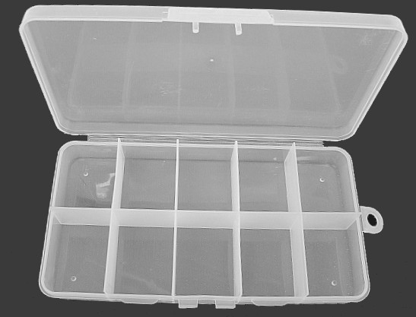
Types of Processor Architecture
Type
A
Type
B
Type
C
Type
D
Type
E
Type
F
Type
G
Type
H
Type
I
Type
J
EEE4084F

Slide 9
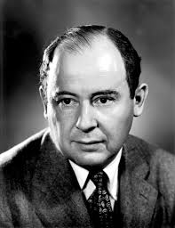
von Neumann Architecture
Named after John von Neumann
A Hungarian mathematician. He was the first to write about requirements for an electronic computer (done in 1945).
The ‘von Neumann computer’ differed from earlier computers that were programmed by hard wiring.
Most computers since then have followed this design

Slide 10
John von Neumann & the JvN Machine
“The Greatest Computer Programmer Was Its First!”
https://www.youtube.com/watch?v=Po3vwMq_2xA

Slide 11
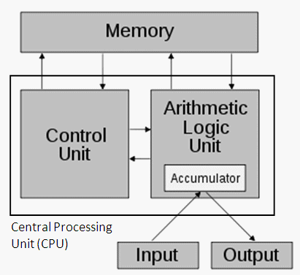
von Neumann Architecture
The von Neumann computer comprises the following four components:
Memory
Control Unit
Arithmetic Logic Unit (ALU)
Input/Output
See 1-page reading in Resources on VULA
Figure 1: The Von Neumann architecture*
(* image adapted from http://en.wikipedia.org/w/index.php?title=Von_Neumann_architecture)

Slide 12
von Neumann Architecture: Memory
Random access, read/write memory stores both programs and data
Program comprises instructions (von Neumann termed ‘machine instructions’) that tells the computer what do.
Data is simply information to be used by the program

Slide 13
von Neumann Architecture: Operation
Control unit fetches instruction or data from memory, decodes and executes the instruction, sequentially completes sub-operations for the instruction
Arithmetic Unit performs basic arithmetic operations (earlier CPUs didn’t have multiply or divide; had few instructions, e.g. LOAD, STORE, ADD, IN, OUT and JUMP on flags)
Input/Output is interface to other systems and human operator

Slide 14
Suggested further learning
Simple recap of Von Neumann Arch:
http://www.youtube.com/watch?v=DMiEgKZ-qCw
Some history of Von Neumann leading towards his machine: (not examined!)
“The Greatest Computer Programmer Was Its First”
http://www.youtube.com/watch?v=Po3vwMq_2xA

Slide 15
The Harvard Architecture
Von Neumann
Harvard
The Big Competitor…
EEE4084F

Slide 16
The Harvard Architecture
The Harvard architecture physically separates storage and signal lines for instructions and data.
The term originated from the “Harvard Mark I” relay-based computer that stored instructions on (24-bits wide) punched tape and data in electro-mechanical counters.
Data storage entirely contained within the central processing unit, and provided no access to the instruction storage as data.
(for the original MarkI) programs needed to be loaded by an operator as the processor could not initialize itself.
Nowadays this general architecture (albeit greatly enhanced) is still relevant! They are technically referred to as “modified Harvard architecture”. Many processors today (especially embedded ones) still implement this separation of data and storage for performance and reliability reasons.
ALU
Instruction memory
Control Unit
Data memory
I/O
Harvard Architecture

Slide 17
The Harvard Mark I
“Harvard Mark I”
https://www.youtube.com/watch?v=4ObouwCHk8w

Slide 18
Flynns Taxonomy of Processor Architectures
Type
A
Type
B
Type
C
Type
D
Type
E
Type
F
Type
G
Type
H
Type
I
Type
J
EEE4084F

Slide 19
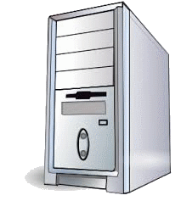
Flynn’s taxonomy
Flynn’s (1966) taxonomy was developed as a means to classify parallel computer architectures
Computer system can be fit into one of the following four forms:
SISD
Single Instruction Single Data
SIMD
Single Instruction Multiple Data
MISD
Multiple Instructions Single Data
MIMD
Multiple Instructions Multiple Data
Flynn’s
Taxon.
MI
MD
Not to be confused with the terms of “Single Program Multiple Data (SPMD)” and “Multiple Program Multiple Data (MPMD)”.

Slide 20
Single Instruction Single Data (SISD)
This is (obviously) the classic von Neumann Computer: serial (not parallel) computer, e.g.:
Old style single core PC CPUs, e.g. i486
Single instruction →
One instruction stream acted on by the CPU during any one clock cycle
Single data →
Only one input data stream for any one clock cycle
Deterministic execution
x = 2 * (y + z);
0x1000
LD A,[0x2002]
0x1003
LD B,[0x2004]
0x1006
ADD A,B
0x1007
SHL A,1
0x1008
ST A,[0x2000]

Slide 21
Single Instruction Multiple Data (SIMD)
A form of parallel computer
Early supercomputers used this model first
Nowadays it has become common – e.g., used in modern computers on GPUs
Single instruction →
All processing units execute the same instruction for any given clock cycle
Multiple data →
Each processing unit can operate on a different data element
y= [1 2 3 4]
z = [2 3 4 5]
x = 2 * (y + z)
LD AX,[DX+0]
LD AX,[DX+3]
LD BX,[EX+0]
LD BX,[EX+3]
ADD AX,BX
…
ADD AX,BX
SHL AX,1
SHL AX,1
ST AX,[CX+0]
ST AX,[CX+3]
…
…
CPU 1
CPU 4

Slide 22
Single Instruction Multiple Data (SIMD)
Runs in lockstep (i.e., all elements synchronized)
Works well for algorithms with a lot of regularity; e.g. graphics processing.
Two main types:
Processor arrays
Vector pipelines
Still highly deterministic (know the same operation is applied to specific set of data – but more data to keep track of per instruction)

Slide 23
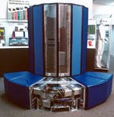
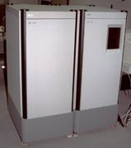
Single Instruction Multiple Data (SIMD) Examples
Vector pipelines
IBM 9000, Cray X-MP, Fujitsu vector processor, NEC SX-2, Hitachi S820, ETA10
Processor arrays
Thinking Machine CM2, MasPar MP-1 & MP-2, ILLIAC IV
Graphics processor units usually use SIMD
←Cray X-MP
←MasPar MP-1

Slide 24
Multiple Instruction Single Data (MISD)
Single data stream fed into multiple processing units
Each processing unit works on data independently via independent instruction streams
Few actual examples of this class of parallel computer have ever existed

Slide 25
Multiple Instruction Single Data (MISD) Example
Possible uses? Somewhat intellectual?
Maybe redundant! (see next slide)
Possible example application:
Different set of signal processing operations working the same signal stream
Example:
Simultaneously find the min and max input, and do a sum of inputs.
A = input
x = +MAXINT
x = -MAXINT
x = 0
If A<x then x = A
If A>x then x = A
x = x + A
…
…
…
CPU 1
CPU 2
CPU 3

Slide 26
Multiple Instruction Multiple Data (MIMD)
The most common type of parallel computer (most late model computers, e.g. Intel Core Duo, in this category)
Multiple Instruction →
Each processor can be executing a different instruction stream
Multiple Data →
Every processor may be working with a different data stream
Execution can be asynchronous or synchronous; non-deterministic or deterministic

Slide 27
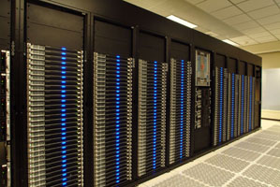
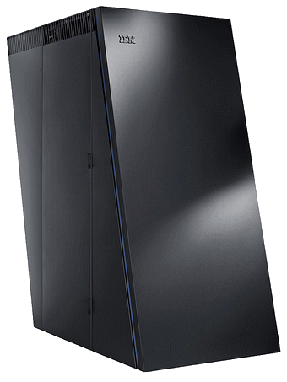
Multiple Instruction Multiple Data (MIMD)
Examples
Many of the current supercomputers
Networked parallel computer clusters
SMP computers
multi-core PCs
MIMD architectures could include all the other models. e.g.,
SISD – just one CPU active, others running NOP
SIMD – all CPUs load the same instruction but apply to different data
MISD – all CPUs load different instructions but apply it to the same data
AMD Opteron
IBM BlueGene

Slide 28
Class Activity
Step 1: choose an application
Consider an application:
Transaction processing
Face recognition
3D graphics rendering
Pattern search (or string search)
Radar
Database queries
Types of architecture models
SISD
Single Instruction Single Data
SIMD
Single Instruction Multiple Data
(1)
(2)
MISD
Multiple Instructions Single Data
MIMD
Multiple Instructions Multiple Data
(3)
(4)
Step 2: which programming model would you like to use?
Step 3: which computer architecture would you use?
Consider the types of programming models:
Sequential / non-parallel
Data parallel model
Message passing model
Shared memory model
Hybrid models
TODO: Work in groups. Follow steps 1-3 shown for a selection of the applications listed in step 1.
We will them vote on the choices.
Your task

Slide 29
Voting for Flynn’s
SQ = Sequential / non-parallel
DP = Data parallel model
MP = Message passing model
SM = Shared memory model
HM = Hybrid models
SISD
Single Instruction Single Data
SIMD
Single Instruction Multiple Data
(1)
(2)
MISD
Multiple Instructions Single Data
MIMD
Multiple Instructions Multiple Data
Click to see my suggested answers…
(3)
(4)
Program | SISD(1) | SIMD(2) | MISD(3) | MIMD(4)
Transaction processing
Face recognition
3D graphics rendering
Pattern search
Radar
Database queries
SQ
MH: SM+MP
SM
DP
MP
(MP)
DP
Many of these are somewhat debatable. In a quiz situation it would probably be a good idea to add comments to your answer motivating your choices.

Slide 30
Memory Architectures & Case Studies of classic micro-controller/processor architectures
To follow later….
EEE4084F

Slide 31
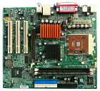
Shared Memory Architecture
happy memories
EEE4084F
Mine!!
No! It’s mine!!

Slide 32
Shared Memory Architectures
Generally, all processors have access to all memory in a global address space.
Processors operate independently, but they can share the same global memory.
Changes to global memory done by one processor are seen by the other processors.
Shared memory machines can be divided into two types, depending on when memory is accessed:
Uniform Memory Access (UMA) or
Non-uniform Memory Access (NUMA)

Slide 33
Uniform Memory Access (UMA)
Common today in form of Symmetric Multi-Processor (SMP) machines
Identical processors
Equal access and access times to memory
Cache coherent
Cache coherent =
When one processor writes a location in shared memory, all other processors are updated.
Cache coherency is implemented at the hardware level.
CPU
MEMORY
CPU
CPU
CPU

Slide 34
Non-Uniform Memory Access (NUMA)
Not all processors have the same access time to all the memories
Memory access across link is slower
If cache coherency is maintained, then may also be called CC-NUMA - Cache Coherent NUMA
This architecture has two SMPs
connected via a bus. When a CPU on SMP1 needs to access memory connected to SMP2, there will be some form of lag which may be a few times slower than access to SMP1’s own memory.
MEMORY
CPU
CPU
MEMORY
CPU
Interconnect bus
CPU
SMP 1
SMP 2

Slide 35
Shared memory pros & cons
Advantages
Global address space gives a user-friendly programming approach (as discussed in shared memory programming model)
Sharing data between tasks is fast and uniform due to the proximity of memory to CPUs
Disadvantages:
Major drawback: lack of scalability between memory and CPUs.
Adding CPUs can increases traffic on shared memory-CPU path (for cache coherent systems also increases traffic associated with cache/memory management)

Slide 36
Shared memory pros & cons
Disadvantages
Programmer responsible for implementing/using synchronization constructs to make sure that correct access of global memory is done.
Becomes more difficult and expensive to design and construct shared memory machines with ever increasing numbers of processors.

Slide 37
Distributed memory architecture
Similar to shared memory, but requires a communications network to share memory
Local Memory
CPU
Local Memory
CPU
…
Local Memory
CPU
Communications network
Each processor has its own local memory (not directly accessible by the other processors’ memory addresses)
Processors connected via a communication network – the communication network fabric varies; could simply be Ethernet.
Cache coherency does not apply (when a CPU changes its local memory, the hardware does not notify the other processors – if needed the programmer needs to provide this functionality)
Programmer responsible for implementing methods by which one processor can access memory of a different processor.

Slide 38
Distributed Memory architectures: Pros & Cons
Advantages:
Memory scalable with number of processors
Each processor can access own memory quickly without communication overheads or maintaining cache coherency (for UMA).
Cost benefits: use of commercial off-the-shelf (COTS) processors and networks

Slide 39
Distributed Memory: Pros & Cons
Disadvantages:
Programmer takes on responsibility for data consistency, synchronization and communication between processors.
Existing (legacy) programs based on shared global memory may be difficult to port to this model.
May be more difficult to write applications for distributed memory systems than it is for shared memory systems.
Restricted by non-uniform memory access (NUMA) performance (meaning a memory access bottle neck that may be many times slower than shared memory systems)

Slide 40
Distributed Shared Memory (i.e. Hybrid) System
Simply a network of shared memory systems (possibly in one computer or a cluster of separated computers)
Use in many modern supercomputer designs today
Shared memory part is usually UMA (cache coherent)
Pros & Cons? – Best and Worst of two worlds.

Slide 41
Thursday Pracs
Thursday prac slot will be available from next week!

Slide 42
Intermission
Next period:
Considerations of reading based on shared memory and pthreads
“An architecture of on-chip-memory multi-threading processor” by T Matsuzaki, H Tomiyasu and M Amamiya
“Quantifying the Performance Impact of Memory Latency and Bandwidth for Big Data Workloads” by R Clapp, M Dimitrov, K Kumar, V Viswanathan and T Willhalm

Slide 43
Parallel computer memory architectures
The choice of memory architecture is not necessarily dependent on the ‘Flynn classification’
For a SISM computer, this aspect is largely irrelevant (but consider a PC with GPU and DMA as not being in the SISM category)

Slide 44
A look at some classic microprocessor architectures
EEE4084F
Audience participation…

Slide 45
The PIC - an 8bit example
Let’s focus in a bit on the main elements…
Q: Architecture type?
A: Harvard (or modified Harvard architecture)

Slide 46
The PIC - I/O structure
How the IO ports are connected up and interrupt system.

Slide 47
The AVR tiny84
Q: Architecture type?
A: Harvard (or modified Harvard architecture)
focus in…

Slide 48
The AVR tiny84 focusing in…

Slide 49
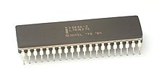
The 8086
Q: Architecture type?
A: Von Neumann

Slide 50
Further (more complex) architecture case study
EEE4084F

Slide 51
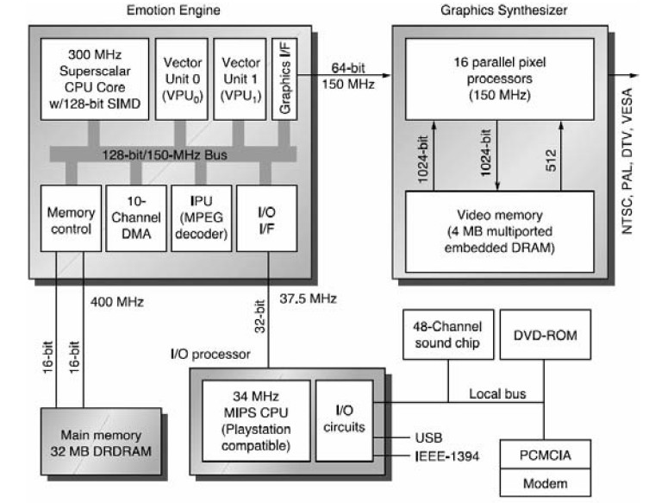
Sony Play Station (ver. 2)
* Slides adapted from “memory3 case study” by Z. Jerry Shi, University of Connecticut

Slide 52
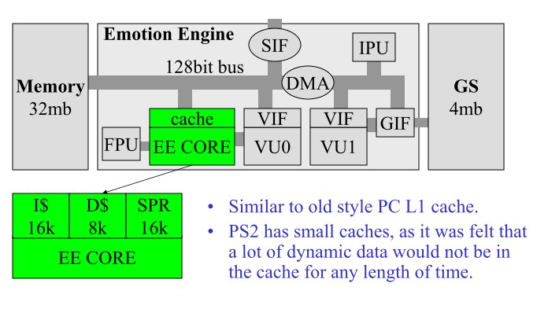
Sony Play Station 2 Caches and scratch memory
Somewhat like L1 cache
PS2 has small caches since it was expected the system would be very dynamic and data would not be in the cache for long
* Slides adapted from “memory3 case study” by Z. Jerry Shi, University of Connecticut

Slide 53
L10 - Linked Reading
Quantifying the Performance Impact of Memory Latency and Bandwidth for Big Data Workloads
R Clapp, M Dimitrov, K Kumar, V Viswanathan and T Willhalm Pub date: 2005
In recent years, DRAM technology improvements have scaled at a much slower pace than processors. While server processor core counts grow from 33% to 50% on a yearly cadence, DDR 3/4 memory channel bandwidth has grown at a slower rate, and memory latency has remained relatively ﬂat for some time. Combined with new computing paradigms such as big data analytics, which involves analyzing massive volumes of data in real time, there is a trend of increasing pressure on the memory subsystem. This makes it important for computer architects to understand the sensitivity of the performance of big data workloads to memory bandwidth and latency, and how these workloads compare to more conventional workloads. To address this, we present straightforward analytic equations to quantify the impact of memory bandwidth and latency on workload performance, leveraging measured data from performance counters on real systems. We demonstrate how the values of the components of these equations can be used to classify diﬀerent workloads according to their inherent bandwidth requirement and latency sensitivity. Using this performance model, we show the relative sensitivities of big data, high-performance computing, and enterprise workload classes to changes in memory bandwidth and latency.
File: 07314167.pdf
http://dx.doi.org/10.1109/IISWC.2015.32
This paper gives a useful insights into memory architectures in relation to big data processing. Note re studying this paper: the different classifications of workload models don’t need to be remembered for tests etc, you’d be given a scenario description; the useful learning is more insights into approaches for the different scenarios presented.

Slide 54
L10 - Linked Reading
An architecture of on-chip-memory multi-threading processor
T Matsuzaki, H Tomiyasu and M Amamiya Pub date: 2001
This paper proposes an on-chip-memory processor architecture: FUCE. FUCE means Fusion of Communication and Execution. The goal of the FUCE processor project is fusing the intra processor execution and inter processor communication. In order to achieve this goal, the FUCE processor integrates the processor units, memory units and communication units into a chip. FUCE Processor provides a next generation memory system architecture. In this architecture, no data cache memory is required, since memory access latency can be hidden due to the simultaneous multithreading mechanism and the on-chip-memory system with broad-bandwidth low latency internal bus of FUCE Processor. This approach can reduce the performance gap between instruction execution, and memory and network accesses.
File: 00955202.pdf
http://dx.doi.org/10.1109/IWIA.2001.955202
This paper gives a useful case study discussing the FUCE processor. I recommend have a brief look through this paper to get a sense of the architecture and particularly the approach these authors take to explain their design and discuss the performance of the system. Unlikely any test/exam questions would ask specific questions about this paper/ archtitecture

Slide 55
Disclaimers and copyright/licensing details
I have tried to follow the correct practices concerning copyright and licensing of material, particularly image sources that have been used in this presentation. I have put much effort into trying to make this material open access so that it can be of benefit to others in their teaching and learning practice. Any mistakes or omissions with regards to these issues I will correct when notified. To the best of my understanding the material in these slides can be shared according to the Creative Commons “Attribution-ShareAlike 4.0 International (CC BY-SA 4.0)” license, and that is why I selected that license to apply to this presentation (it’s not because I particulate want my slides referenced but more to acknowledge the sources and generosity of others who have provided free material such as the images I have used).
Image sources:
Stop watch slides 1 & 14, Gold bar: Wikipedia (open commons)
books clipart: http://www.clker.com (open commons)
computer motherboard - Wikipedia (open commons)
various clipart - Pixabay

