Slide 1






EEE4084F
Digital Systems
Lecture 11:
Cloud Computing & Virtualization
Lecturer:
Simon Winberg
Attribution-ShareAlike 4.0 International (CC BY-SA 4.0)

Slide 2
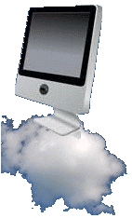
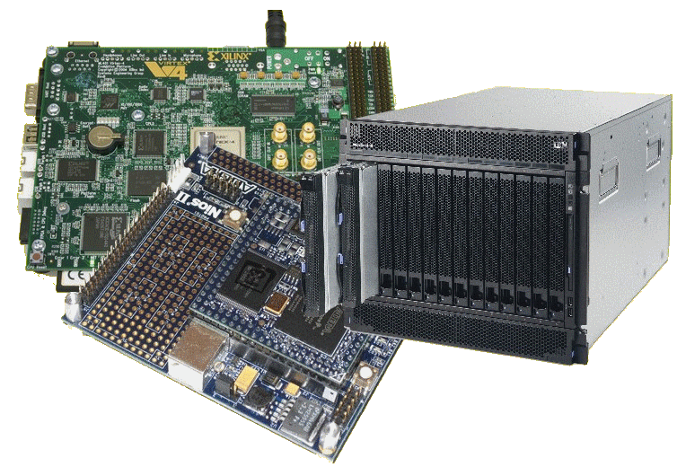
Lecture Overview
Cloud computing
Virtualization

Slide 3

Cloud Computing
EEE4084F

Slide 4
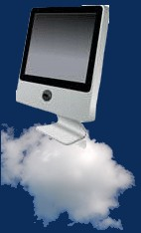
Cloud Computing
Cloud computing is a style of computing in which dynamically scalable and usually virtualized computing resources are provided as a service over the internet.
Cloud computing use:
Request resources or services over the internet (or intranet)
Provides scalability and reliability of a data center
The following video presents this technology and its benefits…

Slide 5

Cloud Computing: a short but
informative marketing clip…
Salesforce.com - What is Cloud Computing (4min)
Watch on your own : Cloud Computing- What is Cloud Computing.mp4 (less sales talk)
https://www.youtube.com/watch?v=uYGQcmZUTaw

Slide 6


Checking your understanding…
Which one(s) of these are not official Cloud Computing Services as mentioned in the video?
Daas
IaaS
PaaS
SaaS
YaaS
… answer …
?
?
?
Infrastructure as a Service
Platform as a Service
?
Software as a Service

Slide 7
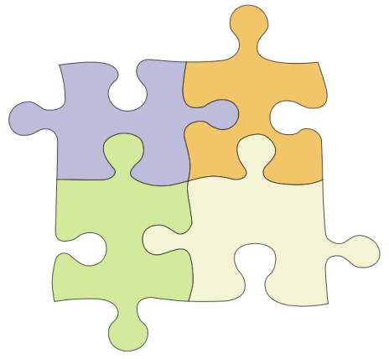
Characteristics
On demand scalability
  Add or subtract processors, memory, network bandwidth to your cluster
  (Be billed for the QoS / resource usage)
Virtualization and virtual systems & services
  Request operating system, storage, databases, databases, other services

Slide 8
Key Technology for Cloud Computing: Virtualization
App
App
App
App
App
App
OS
OS
OS
Operating System
Hypervisor
Hardware
Hardware
Traditional Computing Stack
Virtualized Computing Stack
Discussed a bit later…

Slide 9
Cloud Computing Models
Driving philosophy:
Why buy the equipment, do the configuration and maintenance and yourself,
if you can contract it out? Can work out much more cost effectively.
Utility computing (kind of IaaS)
  Rent cycles
  Examples: Amazon’s EC2, GoGrid, AppNexus
Platform as a Service (PaaS)
  Provides user-friendly API to aid implementation
  Example: Google App Engine
Software as a Service (SaaS)
  Just run it for me (and make sure it keeps running)
  Example: Gmail
Infrastructure as a Service (IaaS)
  Just give me remote access to some machines, I’ll take care of installing and running programs on them and sort out software issues on my own.

Slide 10
Amazon Web Services
Elastic Compute Cloud (EC2)
  Rent computing resources by the hour
  Basic unit of accounting = instance-hour
  Additional cost for bandwidth usage
Simple Storage Service (S3)
  Persistent storage
  Charge by the GB/month
  Additional costs for bandwidth
(Planning a guest lecture / seminar by Engineer(s) from Amazon Data Center
for both ECE & CS Hons class to happen soon)

Slide 11
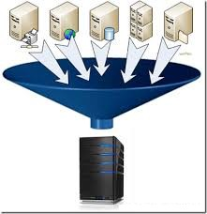
Virtualization
EEE4084F

Slide 12
What is virtualization?
The concept of “cloud computing” is often used as a generalized term to refer to remotely accessing application software stored on centralized servers or a cluster where you don’t know which PC may be hosting the app.
The term “virtualization” is sometimes confused with “cloud computing”, typically used incorrectly in such situations (to refer to a virtual computer).
While these technologies are similar the terms are not interchangeable…

Slide 13
Definitions
Definition of Cloud Computing:
  Cloud computing is a computing term or metaphor that evolved in the late 2000s, based on utility and consumption of computing resources. Cloud computing involves deploying groups of remote servers and software networks that allow centralized data storage and online access to computer services or resources. [source: www.en.wikipedia.org/wiki/Cloud_computing ]

Slide 14
Definitions
Definition of Virtualization:
  Virtualization (in computing) refers to the act of creating a virtual (rather than actual) version of something, including but not limited to a virtual computer hardware platform, operating system (OS), storage device, or computer network resources.
  [Source: www.en.wikipedia.org/wiki/Virtualization]
  It is essentially software that separates physical computing infrastructures to create a variety of dedicated computing resources. It is the fundamental technology behind cloud computing, particularly as it allows a consistent software layer for the same programs to run on different hardware. (see next slide for elaboration…)

Slide 15
Virtualization
Virtualization software allows multiple operating systems and multiple applications all to run at the same time on the same server.
“It enables businesses to reduce IT costs while increasing the efficiency, utilization and flexibility of their existing computer hardware.” -- Quote by Mike Adams (VMware director of product marketing)

Slide 16
Difference between virtualization and cloud computing
Main fundamental difference between these:
  Virtualization is software that manipulates hardware and provides a layer to present a consistent interface; whereas cloud computing is a service / collection of services that runs on top of that layer (i.e., on the virtual machine).
You can also argue that:
  Cloud computing is the delivery of services, using shared computing resources, software or data, on-demand through via Internet.
  Whereas virtualization is more a lower level interface unseen by the users.
A confusion is “virtualization as a service” – i.e. where the cloud basically provides virtual machines and operating system of the particular type requested that the users then writes code for. (tends to be a type of IaaS)

Slide 17
You don’t have to have a cloud for the virtualized environment
A major advantage of
virtualization is allowing for
sustainability (increased
product lifespan) of crucial
software products, such as
bespoke applications developed
in-house and which are very
important for the business.
(e.g. expert system, estimation
engine, simulation modelling)
app
app
app
app
Cloud
Services
Virtualized
Environment
Crucial
Software
Product
Virtualized
Environment

Slide 18
Example Virtualization Products
EEE4084F

Slide 19
Common Virtualization Products
Name | Creator | Host CPU | Guest CPU | Host OS | Guest OS | License
bhyve | FreeBSD | x86-64 | x86-64 | FreeBSD | FreeBSD, OpenBSD, GNU/Linux … | BSD
DOSBox | Peter Veenstra, Sjoerd, community help | Any | x86, ARM | Linux, Windows, Mac OS X, BeOS, FreeBSD, Solaris, QNX, IRIX, AmigaOSymbian, … | Internally emulated DOS shell; classic PC booter games, … | GPL
Hyper-V (2012) | Microsoft | x86-64 + hardware-assisted virtualization (Intel VT-x or AMD-V … | x86-64, (up to 64 physical CPUs) | Windows 8/8.1 & Windows Server 2012 (R2) w/Hyper-V role, Microsoft Hyper-V Server | supported drivers for Windows NT, FreeBSD, Linux (SUSE 10, RHEL 6, CentOS 6) … | Proprietary
VirtualBox | Innotek, acquired by Oracle Corporation | x86, x86-64, Intel VT-x, AMD-V | x86, x86-64 | Windows, Linux, Mac OS X x86, Solaris, FreeBSD, eComStation | DOS, Linux, Mac OS X Server, FreeBSD, Haiku, OS/2, Solaris, Syllable, Windows., | GPL version 2; full version with extra enterprise features is proprietary:
Windows Virtual PC | Connectix & Microsoft | x86, x86-64 with Intel VT-x or AMD-V | x86 | Windows 7 | Windows XP, Windows Vista, Windows 7, … | Proprietary (generally free for non-comm.)
VMware Server | VMware | x86, x86-64 | x86, x86-64 | Windows, Linux | Same as VMware ESX Server | Proprietary
Adapted from: http://en.wikipedia.org/wiki/Comparison_of_platform_virtualization_software

Slide 20

Should you consider virtualization?
Virtualization using a virtual
computer could be an effective
way to reduce risks in project
development and to save setup
time. For example if working on
a team project one person could be responsible for configuring the computer (getting all the tool setting right etc.) and then share the computer with the rest of the team. Similarly if the physical PC is damaged the virtual computer could simply be used on an alternate PC without having to go through the process of setting up the OS, tools, libraries etc.

Slide 21
Next lecture
Next Lecture
  System Management
Later Lecture
  MPI and OpenMP

Slide 22
Disclaimers and copyright/licensing details
I have tried to follow the correct practices concerning copyright and licensing of material, particularly image sources that have been used in this presentation. I have put much effort into trying to make this material open access so that it can be of benefit to others in their teaching and learning practice. Any mistakes or omissions with regards to these issues I will correct when notified. To the best of my understanding the material in these slides can be shared according to the Creative Commons “Attribution-ShareAlike 4.0 International (CC BY-SA 4.0)” license, and that is why I selected that license to apply to this presentation (it’s not because I particulate want my slides referenced but more to acknowledge the sources and generosity of others who have provided free material such as the images I have used).
Image sources:
Wikipedia (open commons)
www.flickr.com (public domain images)
Picture of running going up stairs – Wikimedia open commons
http://pixabay.com open commons / public domain images

