Slide 1





EEE4084F
Digital Systems
Lecture 12
HPEC Development Process and Management Aspects
Spiraling to
success
* Relates to Martinez, Bond and Vai Ch 4.
towards happy projects
Lecturer:
Simon Winberg
Attribution-ShareAlike 4.0 International (CC BY-SA 4.0)

Slide 2

20 March
Today’s theme –
HPEC development process and methodology
– towards happy projects

Slide 3
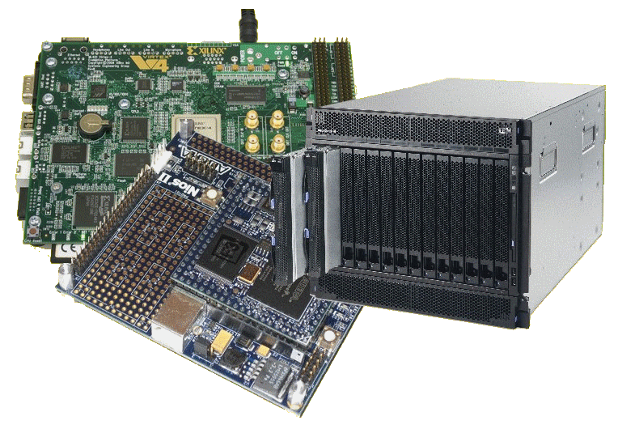
Lecture Overview
Where work is done, division of labour
HPEC management
HPEC development process
Setting system objectives
Costs & risks
Monitoring progress
Documentation
Effort, Productivity
and Progress
  (Optional extra slides re
  intro to Doxygen)

Slide 4
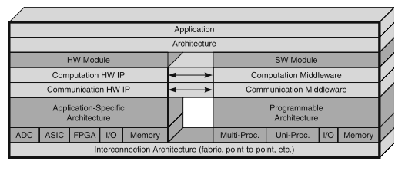

HPEC System – where work is done
Keep in mind Martinez & co’s “canonical framework” illustrating key subsystems and components of a high performance embedded computing (HPEC) system…
May have many members of the development team involved at the various levels.
Where would you like to fit in?

Slide 5
HPEC Design: Personnel and Division of Labour
HPEC system development is influenced by the usual suspects:
  requirement, plans, and implementation decisions for the systems.
There is likely separation between significant subsystems, e.g. between backend and frontend, as well as between hardware and software.
May draw on a range of experts from various disciplines … (lets consider some …)

Slide 6
HPEC Design: Personnel and Division of Labour
  Application expects e.g.
    Radar experts to advise on radar system design & processing algorithms
    Medical system experts to design on standards, fault tolerance and safety requirements
    Masses of others…

Slide 7
HPEC Design: Personnel and Division of Labour
  Application expects e.g.
    radar experts to advise on radar system design & processing algorithms
    Medical system experts to design on standards, fault tolerance and safety requirements
  Hardware specialists e.g.
    Computer platform design experts
    Radio Frequency (RF) experts for design of the RF hardware
    Experts to design of power supplies to provide the power needed by the system

Slide 8
HPEC Design: Personnel and Division of Labour
  Application expects e.g.
    radar experts to advise on radar system design & processing algorithms
    Medical system experts to design on standards, fault tolerance and safety requirements
  Hardware specialists e.g.
    Computer platform design experts
    Radio Frequency (RF) experts for design of the RF hardware
    Experts to design of power supplies to provide the power needed by the system
  Software & HDL specialists e.g.
    Personnel experienced in high performance signal processing
And these individuals need to work effectively together on the system being constructed…

Slide 9
Roles for division of labour
Manager
Team leader
Hardware designer
Software designer
Implementer / Programmer
Engineering Technician
Test Designer, Test Analyst
Tester
Tool specialist
Documentation writer
Librarian
These are also some ideas for the roles you might give team members in the YODA project

Slide 10
HPEC Management
The management of the development must be tailored to meet the particular technology choices, which could comprise a variety of technologies and tools…
Each technology has its own development cycle, cost, technical limitations, and risks. E.g.:
  Developing a custom ASIC
    tends to slow down the implementation.
    Could have high risk (e.g. cannot afford more than one run prior to initial release);
    Need strategies to mitigate these potential risks (e.g. backup plan of using an FPGA)
  Programmable processors
    also have various risks (e.g. licensing tools, what happens if they go out of production).

Slide 11
HPEC Development Process
EEE4084F

Slide 12
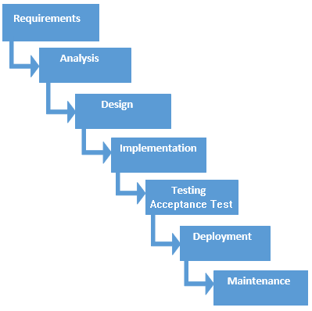
HPEC Process Model
Commonly planned broadly with the waterfall model in mind to cover all needed steps
Relevant to both the
software and hardware
aspects of the system
In practice
  The spiral model provides a
  better guide to HPEC projects
  overall, with the waterfall
  model being applicable to
  iterations of HW/SW
  development within cycles
  of the spiral model
Classic representation of the Waterfall model

Slide 13

Spiral Model: the natural way
As per general development projects, HPEC, Reconfigurable and High-performance computing systems tend to follow the Spiral Model (Bloehm 1988) with phases of…
Main phases
of development
(usually starts with
requirements; the
subsequent iterations start with a requirements review and deciding what next to do.)
Starting small (i.e. start from centre of spiral and expand out) with little risk. Adding features and mitigating risk with each additional iteration.
Review
Analysis
Testing /
Release /
Planning
Design and
Implementation
A spiral* model overview of development
* B. W. Boehm, “A spiral model of software development and enhancement,” Computer, vol. 21, pp. 61-72, 1988.

Slide 14
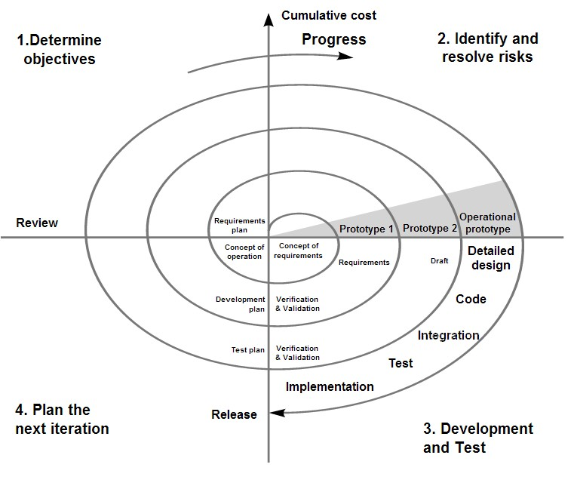
Spiral model (Boehm, 1988)
More detailed classic model.
Each cycle begins with the identification of the objective of the portion of the product
to be elaborated
When does it end?
Image from Wikipedia open commons
See discussion in Martinez, Bond and Vai, 2008, “High Performance Embedded Computing Handbook”, CSC Press, pg 43.

Slide 15

HPEC System Objectives
Objectives of each cycle
  specified in terms of the overall system into which the computing resource/processing is to be incorporated
In early stages of the process
  System objectives are usually more in terms of
  algorithms and processing needed (see next slide).
Subsequent stages (after a few iterations)
  More high-level design and experimental rapid prototyping of subsystems (e.g. writing a rough C routine version of a decided upon algorithm to evaluate its performance)
Later stages (after a good understanding of processing needs and algorithms to use)
  More focused on hardware subsystems fabrication
  Software implementation
  Testing
Final stage(s)
  Preparing and performing acceptance test(s)
  Installation and post installation maintenance

Slide 16
System level goals
Functional requirements
  What the system should do
  Operations to perform
  Input → Output relations
  Use cases (to be satisfied)
Non-functional requirements
  The ‘ilities’
    Availability, Scalability, Reliability, Reusability, Maintainability
  Performance
    Speed of operation, throughput, response time (max. latencies)
  Size, Weight, And Power (SWAP)

Slide 17
Goals of the Early Cycles
In the early cycles, the goal is typically: reduce the largest technical risks and initiate lengthy tasks that may influence the overall (contractual) schedule.
  If can’t eliminate big risks need to reconsider continuing
Some common risks addressed in early cycles of HPEC development:
  Form-factor constraints
  Algorithm and functional uncertainty
  Synchronization and control (exploiting regularity of data flow in computation)
  Software complexity
  Selecting COTS components
  Custom ASIC design (high volume production only)

Slide 18
Costing and Risk management
Once the requirements, alternatives, and constraints are established, risk analysis is performed.
Once development has progressed successfully, it should be feasible to retire certain risks at a Plan (stage 4) iteration
At this point, management may review the cost of the previous cycle, scheduling of the next iteration and also revise the overall costing and development timeline.

Slide 19
Monitoring development progress & productivity
EEE4084F

Slide 20
Monitoring progress
An important management tasks for HPEC projects is developing accurate estimates for, and ways to measure development ‘PECS’:
  Progress
  Effort
  Cost and
  Schedule
This may need to be tailored according to activities and types of technologies used during the project e.g.
  MATLAB/Simulink coding vs. C coding vs. Assembly coding vs. FPGA HDL coding

Slide 21
Monitoring productivity/progress
Need ways to measure both performance and progress for
  Hardware development progress and
  Software development progress

Slide 22
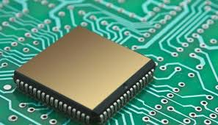
Hardware design progress
EEE4084F

Slide 23
Hardware progress
A often mentioned method:
  Determining the number of transistors, components and interconnects used in a design…
… surely that will give you a good impression of where the design is at?
Do you think this is a valid and fair approach?
Q

Slide 24
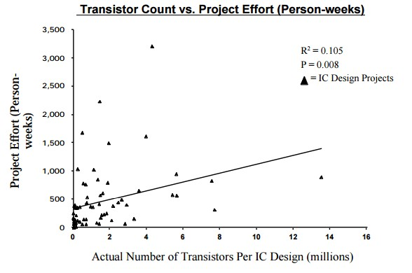
Hardware progress
Not necessarily
  The graph on left shows
  number of transistors vs.
  weeks of design effort
  As can be seen there
  may be little correlation in
  number of components in a
  design to amount of effort
  Consider further there are usually cycles of design-test-optimization, so over time there may be increases and decreases in components used
But agreeably it is likely the number of components will increase over long time periods when looking at one project
It is better to consider the completion of functional units (or required functionality)
* Numetrics Management Systems (2000) “Measuring IC and ASIC Design Productivity”

Slide 25
Hardware progress
Factors indicating progress
  Requirements/Specifications provided
  Number subsystems completed
  Functionality completed (i.e. not looking necessarily in relation to specific requirements but more functions given, e.g. counter added to design)
  System complexity (interconnects & modules)
  Design size
  IP usage
Considered in relation to
  Technology/tools used
  Application domain
  Frequency/speed of operation (e.g. high frequency, faster systems are more difficult to build)
Based on http://www.eetimes.com/document.asp?doc_id=1276032

Slide 26
Design Complexity Measures
Two aspects of system design complexity*
  Structural design complexity
    Depth of hierarchies
    Number of components
    Number of connections
    Interconnections between components
  Functional design complexity
    Number of functions provided
    Complexity of the functions (e.g. symbols needed to describe the operation)
    Sophistication of communication, handshaking protocols, flow control
    Data management
Simple
More complex
* Dan Braha and Oded Maimon, 1998, “The Measurement of a Design Structural and Functional Complexity” In IEEE Transactions On Systems, Man, and Cybernetics

Slide 27
McCabe’s Cyclomatic Complexity Metric
Considers design as a graph representation.
Uses the formula of “cyclomatic complexity”, which is as follows:
M = V(G) = e – n + 2p
where:
V(G) = cyclomatic number of Graph G
e = number of edges
n = number of nodes
p = number of unconnected parts of the graph
McCabe, 1976

Slide 28
Cyclomatic Complexity
Cyclomatic complexity is a software metric (measurement), used to indicate the complexity of a program. It is a quantitative measure of the number of linearly independent paths through a program's source code.
https://en.wikipedia.org/wiki/Cyclomatic_complexity

Slide 29
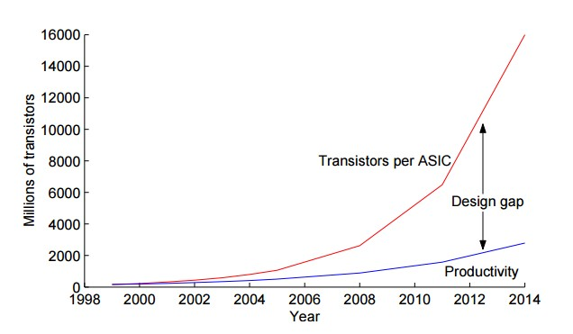
Design Productivity Gap
Design productivity gap:
  The difference between the transistors (resources) available in a single semiconductor die and the ability for the transistors to be used effectively in a design
1980s leading chip needing
100 transistors/month *
2002 leading chip needing
30,000 transistors/month *
Productivity in
K transistors/staff member
Can (to some extent) substitute vertical axis for complexity of the system
* Vahid, Frank, and Tony Givargis. Embedded system design: a unified hardware/software introduction. Vol. 52. New York: Wiley, 2002.

Slide 30

Software design progress
EEE4084F

Slide 31
Monitoring progress of software
Usual (easy) approach:
  Measuring Lines Of Code (LOC) is one way
SLOC: a possible improvement (mentioned in seminar 2)
  SLOC = non-blank, non-comment source lines of code (SLOC) : some relation to the complexity of the code
Potential inaccuracies and unfairness?
  Well documented code is typically considered more valuable and reusable… but taking longer to get a solution could cause a product to fail.
  … (next slide) …

Slide 32
Difficulty of monitoring progress based on LOC
Potential inaccuracies and unfairness of using SLOC to measure progress / performance …
  May have sudden needs for large blocks of code to be provided due to library limitations or incompatibility (e.g. textbook example, needing to fill in functions that were expected to be in the library)
  Commented code is often better (and possibly easier to understand and share) than uncommented code.
  Some difficult problems may have a short but non-obvious answer (e.g. coding a FIR filter)
  Some easy problems may have a long and obvious answer (e.g. GUI code)
  Some development tasks end in dead ends not contributing to the final design
    Code/design may be thrown away
  Some development tasks might be the result of a lot of learning (and the design team gaining skills) but having slower code production

Slide 33
Monitoring software progress
Size of application
Function points: measuring the functionality offered by a system
Average number LOC between bugs
Coupling (of classes, functions)
  Measure of the strength of association between different entities
Cohesion
  Degree to which methods in a class (or functions in a module) are related to each other
Various other OO metrics can be considered, not included or examined in this course

Slide 34
Function Points (my preferred metric)
Function Points gauge the functionality offered by a system
A function can be defined as a collection of executable statements that performs a certain task
Function points can be calculated before a system is developed
They are language and developer independent (could apply to C / Java / Python / assembly / HDL)

Slide 35
Function Points
A function point count is calculated as a weighted total of five major components that comprise an application, these are:
  External Inputs
  External Outputs
  Logical Internal Files/modules
  External Interface Files – files accessed by the application but not maintained by it
  External Inquiries – types of online inquiries supported

Slide 36
Calculating a Function Point
A simple way to calculate a function point count is as follows:
  Function point count (or fpc) =
  (Number of external inputs x 4) +
  (Number of external outputs x 5) +
  (Number of logical internal files x 10) +
  (Number of external interface files x 7) +
  (Number of external enquiries x 4)
These weightings are decided based on the degree of complexity of the development

Slide 37

Quick Class Activity:
Function Points Calculation

Slide 38
Function Point Example
See handout
Build a system that allows customers to submit product ratings of company X. These ratings will be stored in a file and company X staff will receive daily updates with new ratings. Customers can subscribe to weekly updates of product ratings that were submitted. Management can query the system for a summary of product ratings for a particular period.
Fill in a count
for each of
these items
External Inputs
Logical Internal Files
External Outputs
External Enquiries

Slide 39


Quick Class Activity:
Function Points Calculation
My
Solution

Slide 40
Function Point Example
Build a system that allows customers to submit product ratings of company X. These ratings will be stored in a file and company X staff will receive daily updates with new ratings. Customers can subscribe to weekly updates of product ratings that were submitted. Management can query the system for a summary of product ratings for a particular period.
1
External Inputs
1
Logical Internal Files
2
External Outputs
1
External Enquiries

Slide 41
Functional Points Example (cont.)
Functional Point Count calculation:
External Inputs: 1
External Outputs: 2
Logical Internal Files: 1
External Interface Files: 0
External Enquiries: 1
∴Function Point Count = (1x4) + (2x5) + (1x10) + (0x7) +(1x4) = 28

Slide 42
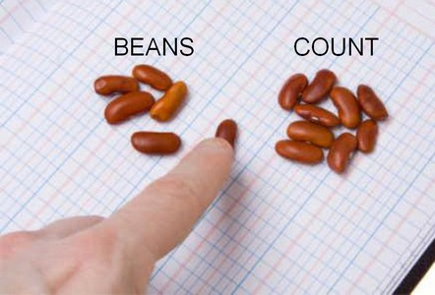
Future Productivity Measurement
For individual developers or teams:
Cost per Function Point
Mean Time required to develop a Function Point
Defects produced per hour
Defects produced per function point
This is probably not used much in industry at present, but things are moving towards this direction. In my view it seems draconian and doesn’t allow for how varied development work, especially embedded systems development, can be. Maybe for more straightforward programming (e.g. simpler web service development) it could be applicable. Basic moral of the story: don’t tell the managers because they might just like this, and we likely would not!

Slide 43

Intermission
Spiral of Project Management

Slide 44
Functional Point Extensions
The original Functional Points (shown in previous slides) are adequate for many applications
However these have been extended for specialized domains (e.g. embedded systems) where the weightings need adjustment due to the nature and complexity of the applications developed.

Slide 45
Effort, Productivity and Progress
Development effort, productivity and progress are not all the same thing
Effort = amount of time involved (person hours; this is a simplistic view of effort)
Productivity = rate of progress (high productivity → progress happening quickly)
Progress = extent to which the desired objectives are complete (measured usually in terms of functionality provided and requirements satisfied)

Slide 46
Issues of Effort & Productivity
Some tasks need more effort than others to gain a desired level of productivity
Tools, programming language, prior knowledge, learning aptitude (among many other factors) can all clearly impact this significantly
The expressive power of a language can influence the productivity achieve by using that language…

Slide 47
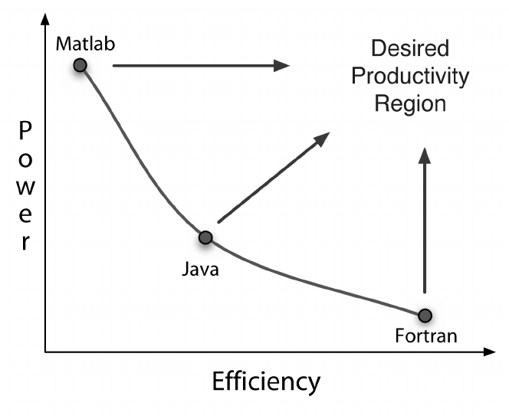
Expressive Power vs Developer Efficiency
Expressive Power = ability of a language to provide advanced primitives and constructs to reduce the amount of effort required to program a solution
Might be the “silver bullet” of software development
Often there is a tradeoff between the expressive power of a language and its efficiency. For example according to the study by Kennedy et al. they demonstrated how certain commonly used languages can have noticeable tradeoffs between the expressive power
Expressive Power
Kennedy, K., Koelbel, C., Schreiber, R., Kennedy, K., Koelbel, C., and Schreiber, R. Deﬁning and measuring the productivity of programming languages. The International Journal of High Performance Computing Applications, (18)4, Winter 2004 (2004), 441–448.

Slide 48
Mythical man month
The Mythical Man-Month * also known as “Brooks's law”:
  Central theme is adding manpower to a late project makes it even later…
The second-system effect *:
  The tendency of small, elegant, and successful systems to be plagued with feature creep due to inflated expectations.
* Brooks, Jr., Frederick P. (December 2006) [1975]. "The Second-System Effect". The Mythical Man-Month: essays on software engineering (Anniversary ed.). Addison Wesley Longman. p. 53. ISBN 0-201-83595-9.

Slide 49
Documentation
Documentation is important for the reuse and maintainability of designs
A major barrier to reuse is lacking or poor documentation (the web is full of useful code libraries suffering from this)
Automated documentation generation tools are a means to save time and improve the accuracy of design documents, such as use of Doxygen

Slide 50
Processes and trends
Please ready through the rest of CH4 on your own. We’ve already seen much of what is said there, and experienced simplified instances of the development issues in pracs.
The slides that follow is a brief discussion of automated documentation
generation using the Doxygen tool, it is optional reading and can be skipped for test purposes

Slide 51


Doxygen
EEE4084F
These slides are aimed more at additional reading and for application to Prac4 in which a brief intro to Doxygen is given.

Slide 52
Doxygen – code documentation tool
Doxygen is a highly recommended tool for generating code documentation from comments in the code.
It is a documentation system for C, C++, Java, among other programming languages.
It helps to
  Generate on-line or offline reference manuals from commented source files.
  Extracting the code structure and visualising relations between software components using dependency graphs, and various UML modelling techniques such as inheritance diagrams, and collaboration diagrams that are generated automatically.
  NOTE: This doesn’t mean to say you can skip the software design phase of development but it can help synchronize what your implementation becomes with its design visualization

Slide 53
Where to get Doxygen
Doxygen website
  http://www.stack.nl/~dimitri/doxygen/

Slide 54
Using Doxygen
Initial setup
  Step 1: Create a Configuration File
  Doxywizard is a GUI program for creating the config file
  Construct templates (to copy and paste to save typing)
Following cycle repeats:
  Step 2: Document the Code
  Step 3: Run the Doxygen
Don’t usually run doxygen for each compile in code-compile-test cycle as it can take a while to complete.

Slide 55
How to use Doxygen
Techniques for documenting
  Code blocks or lines
  Functions / member functions
  Classes and structures
  Class attributes
  Code structures (e.g. for loop, if then else)

Slide 56
How to use Doxygen
Doxygen comments start with a * or !
  Examples:
    /** description of function. */
    /*! Another description */
    //! Another Doxygen comment
    /// Also Doxygen comment with 3 x ‘/’

Slide 57
Documenting code
int var1; //! Document member or variable
/*** Document function,
at top of declaration */
void myfunc (int a, int b)
{
}

Slide 58
Doxygen formatting
Bulleted lists
  Unnumbered:
  Use a column aligned minus sign –
  Numbered
  Use a column aligned minus sign – followed by a # (i.e. -# blurb)
  Nested lists: indent the – or -#
Arbitrary HTML code can be added
  HTML commands (e.g. <b>blurb</b> ) can be used inside comment blocks

Slide 59
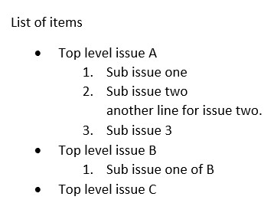
Doxygen list example
/**
* List of items
* -Top level issue A
* -#Sub issue one
* -#Sub issue two \n
* another line for issue two.
* -#Sub issue 3
* -Top level issue B
-#Sub issue one of B
* -Top level issue C
*/

Slide 60
Doxygen
These slides were meant as a brief into, for more details on Doxygen commands and syntax please see the Doxygen online manual
http://doxygen.nl/manual.html

Slide 61


General causes making a…
Success!
OR
Failure!

Slide 62

Common causes of failure
Requirements Analysis
  Nothing recorded / no written
  requirements
  Requirements vague or insufficiently described
  Leaving it ‘till too late to actually formalize requirements
  No directions on user interface
  No end-user involvement (occasionally difficult to organize)
Design
  Insufficient design and planning done
  No documents (or poorly formed)
  Inefficient data structures / file formats
  Infrequent or no design reviews
  Lack of consultation/input from experts and senior engineering staff
You?
Poorly Planned Project?

Slide 63

Common causes of failure
Implementation
  Lack of, or insufficient coding standards (incl. inconsistent coding style etc.)
  Infrequent or no code reviews
  Poor in-line code documentation
Subsystem/component testing & Integration
  Insufficient component testing
  Incomplete testing or
  running ineffective tests
  No quality assurance

Slide 64

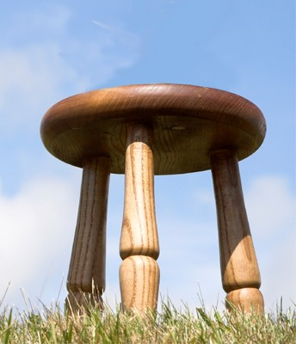

Most common cause of success??
How can we avoid making the mistakes that lead to project failure? Besides the obvious point of having competent staff?
Apparently* the answer is simply:
  By using “simple common sense… which
  is often ignored in systems projects.”*
Need the three pillars of success:
  A sound methodology
  Solid technical leadership by someone
  who’s successfully done a similar project
  Management support
A happy project
sound methodology
Good leadership
Management
support
(a likely question or bonus question )
* M. I. Sanchez-Segura, J. García, A. Amescua, F. Medina-Dominguez, and A. Mora-Soto, “A Study on How Software Engineering Supports Projects Management,” Innovative Techniques in Instruction Technology, E-learning, E-assessment, and Education, pp. 161-165, 2008.

Slide 65
Class Activity on Development Process
EEE4084F

Slide 66
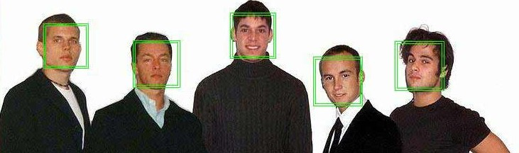
Reflections – short activity
Keep in mind the main recurring phases of the spiral model:
  Analysis
  Review
  Design /
  implementation /
  prototype
  Testing and
  Planning of
  next iteration
Consider that you are embarking on a project that involves developing a face recognition system for The Hawks *. The system is accessed via possibly (very low budget) workstation PCs, which are used to upload photos to a remote central computing site where the face recognition functions are run. The central computing site comprises a fast PC with one or more digital accelerator to do the main number crunching. (to next slide..)
Face detection (green boxes) followed by face identification
* The Hawks, officially called the ‘Police's Directorate for Priority Crime Investigation’, is the South African current take on the US’s version of the FBI.
Image source – Wikipedia open commons

Slide 67

Todo – group task
Form into groups to discussion:
  How would the first step of the spiral model be carried out for the face recognition system
  What are some of the risks to content with for the first thing to carry out
  What would you do to test and analyse the results (if applicable)
  What would the next cycle involve?

Slide 68
Any Questions?
End of Slideshow

Slide 69
Disclaimers and copyright/licensing details
I have tried to follow the correct practices concerning copyright and licensing of material, particularly image sources that have been used in this presentation. I have put much effort into trying to make this material open access so that it can be of benefit to others in their teaching and learning practice. Any mistakes or omissions with regards to these issues I will correct when notified. To the best of my understanding the material in these slides can be shared according to the Creative Commons “Attribution-ShareAlike 4.0 International (CC BY-SA 4.0)” license, and that is why I selected that license to apply to this presentation (it’s not because I particulate want my slides referenced but more to acknowledge the sources and generosity of others who have provided free material such as the images I have used).
Image sources:
Face identification image; crowd scene – Wikipedia open commons
Group task image – OpenClipart.org
Human thinking, man clicking - Pixabay
Sunset – flickr open commons
Composite project success image – sources include flickr and openclipart.org

