Slide 1



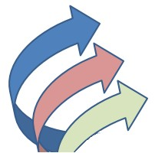
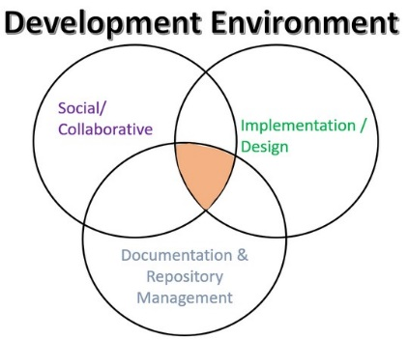
EEE4084F
Digital Systems
Lecture 15:
Development Environment &
Productivity Tools
Presented by
Simon Winberg
Attribution-ShareAlike 4.0 International (CC BY-SA 4.0)

Slide 2
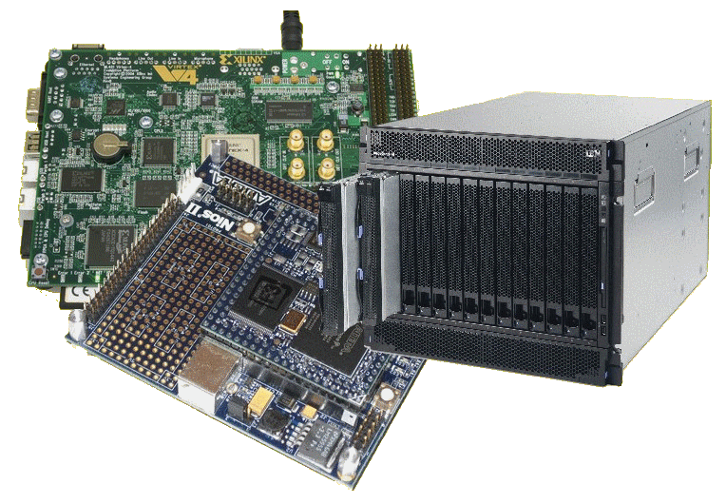
Lecture Overview
Development Environment
What are productivity tools?
Some productivity tools I use

Slide 3
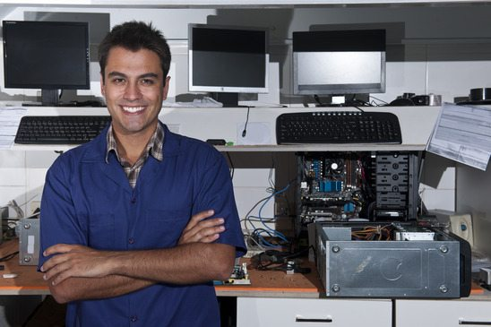
Development Environment
The development environment is where the development happens
It comprises the software and hardware tools and equipment that are used to construct the desired system
Nowadays an effective
selection of productivity
tools is an essential
ingredient for efficient
and secure work
The physical side of my development environment may look messy but with SVN my software is safe.

Slide 4
Development Environment
Social/
Collaborative
Implementation / Design
Documentation &
Repository
Management
You development environment should combines (and be planned around) all these areas

Slide 5
Productivity Tools
Productivity tools (in terms of computer system development) are planned around facilitating and integrating development practices.
These include
  Planning Tools
  Online Collaboration tools
  Version Control Software
  Repository Managers
  Synchronization tools
  Backup tools*
* You might think backup is redundant with synchronization, but this is not really the case especially for high-stakes projects

Slide 6
Working Efficiently
Complex projects have lots of things going on, and becomes more challenging with bigger teams. In these cases it is easy …
  For workspaces to become disorganized
  To loose things
  For file and folders to become haphazard
  To overwrite code
  To confuse versions or pieces of different versions
  To waste time find/recover things you did already
Thus, it is essential to have a well-structured and effective work environment from the start…
  This can be eliminated, or significantly reduce, the problems above, ensuring projects can better achieve their objectives.

Slide 7
Why?
Why am I boring you with these things?
You’re not going to work on big projects yet are you?
…
Actually we are leading in to the YODA project soon.
It attempts to simulate aspects of an industry project.
As one of the aspects is to gain experience in setting up a development environment for effective team work.

Slide 8





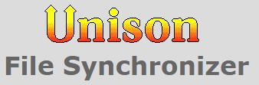

Some productivity tools I use
Code sharing &
version control
Requirements & design docs, parts lists, etc. Generally not code sharing.
Tracking
Design docs
Concept sketches, GUI displays
Slack #Threads
VoiP Call
Search
Saving internet (i.e. synch files on campus)
Backups (could auto schedule local backups)

Slide 9

Slack is mainly useful for sharing info among team members in a largely “chat” or email forum way. Images or code snippets and other files can be added at well. Slack as multiple discussion/information threads where members basically dump useful information or answer questions. …

Slide 10
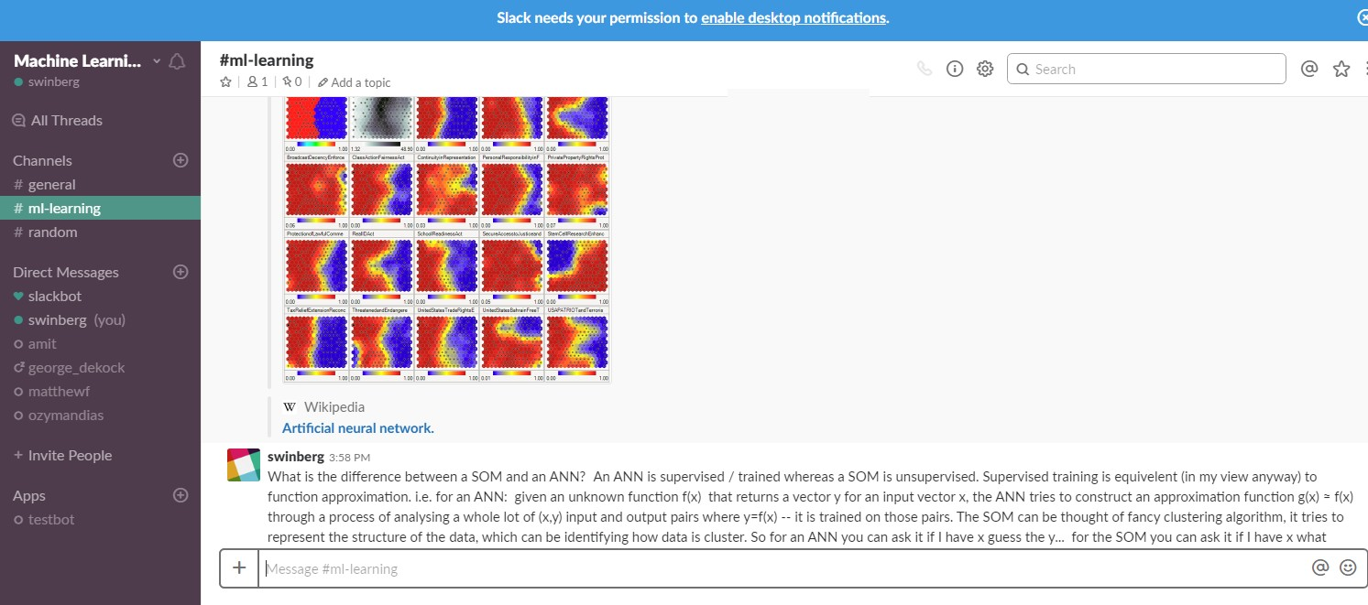
This screenshot is an example from a fairly small project in which slack was used to form a team of students who were working on separate but related projects. They could quickly post interesting points or requirement needs, it was easier to keep track of the messages and data than e.g. just using emails.

Slide 11
Slack allows you to form a ‘toolkit’, essentially a list of online tools that the team is using. These tools can work somewhat together, e.g. sharing one google drive with the whole team, with draw.io accessing one of the subfolders.
Slack also allows for VoIP calls, but doesn’t unfortunately allow for recording of the calls (which would be very useful). However you can use a screen recorded for this purpose and then share the recording.

Slide 12
I hardly need to mention this one.
While Drive can technically keep track of prior versions and allow deleted files to be recovered, it does not really provide the level of code handing and techiques for dealing with the programming language files as Git allows.
It is extremely useful especially in constructing requirements and (draft) documents. Usually you’d probably want to write the final report or user manual for the system in Latex or Word. *
* The main reason being that Drive tends not to manage so well with sophisticated layouts and images as Latex or Word allows.

Slide 13
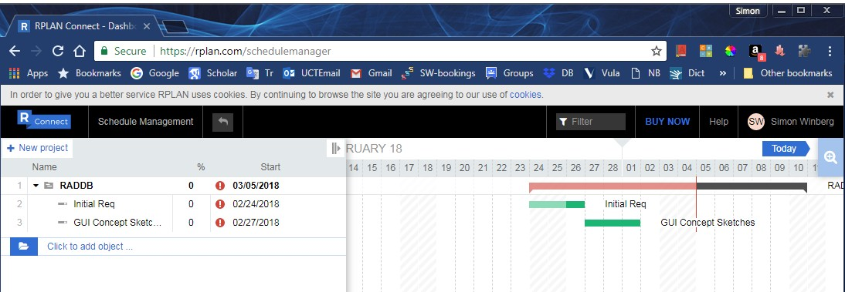
Rplan is essentially a nice user-friendly online Gantt chart planning application. Basically all you planning can be done through the Gantt chart. You can add team members, allocate their responsibilities, etc.
Rplan integrates with Slack (all members of the slack team can log into the same Rplan project).

Slide 14

GitLab (in my view) is a more desirable Git facility. But lets see what the difference is between GitLab and the better known GitHub…
I tend to use Subversion (SVN) more commonly for smaller projects or projects you don’t necessarily want to share with more than a small number of people.

Slide 15
GitHub vs. GitLab
Git aims to manage a software dev. project and its files as these changing over time
  It comprises commit objects (e.g. code file) and references to commit objects
GitLab and GitHub are both web-based Git repositories.

Slide 16
Git Inventor
Who invented Git?!
Any guesses?
It was
Linus Torvalds !!
He also invented Linux as you should know ☺

Slide 17
GitHub vs. GitLab
GitHub
  Since 2008 (by the GitHub founders: Tom Preston-Werner, Chris Wanstrath, and PJ Hyett)
  ~ 25 million users, 67 million repositories
  Free for public repositories only
  Permissions by user
  Contiguous integration has to be added separately
GitLab
  Since 2011 (by founders: Dmitriy Zaporozhets and Valery Sizov)
  Unlimited public and private repositories!!
  Permission by user & by role
  Operations Dashboard
  Continuous integration included – basically tells rest of team a new push has occurred and would they like to update the code
Both:
  Issue trackers
  Import and export features

Slide 18
SysML
SysML = System Modeling Language
A modelling language that is possibly better suited to HPEC and digital accelerator design than standard UML
SysML main difference to UML
  More about modelling blocks/parts instead of modelling classes
  Has 9 instead of 13 diagrams in UML2
SysML involves…

Slide 19
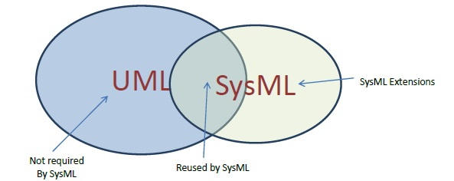
SySML
It is both a subset and extension of UML
Essentially both a visual language and a machine interoperable language (i.e. representation in XML) allowing for model checking etc. of the language.

Slide 20
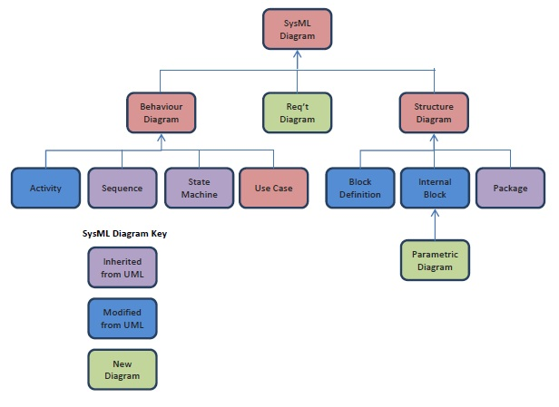
SysML
Adds derive, satisfy, verify, refine. (also allows for visual desciption of req’s.)
Composed of related constraint blocks that define generic or basic mathematical formulas on how items are related. E.g. how volume of a box relates to its weight.
You basically need to have a reasonable understanding of UML before starting with SysML

Slide 21
Class Activity
Discuss briefly with classmates in terms of any productivity tools you are particularly fond of and what uses they are.
  Welcome to share these with the lecture and the rest of the class
Suggest starting thinking what will be in the arsenal of tools for your Development Environment

Slide 22
Some other useful methods and tools
Google Test
  C++ code testing framework
  https://github.com/google/googletest/blob/master/googletest/docs/Primer.md
BOUML
  Draw UML diagrams, allows code generation
Agile methodology with
  Sprints - focused work and
  Scrums - stand-up short to review progress and further plans (usually at a whiteboard)

Slide 23
Any other ideas??

Slide 24


Productive team work
Ready for Action

Slide 25

Intermission
Your Next Mission:
Prepare for briefing on Project YODA
Calm Ambient Mix by Syneptic
Share Alike instrumental
https://www.youtube.com/watch?v=V48rVjh2ADA

Slide 26
End of lecture
Ready for YODO project

