Slide 1
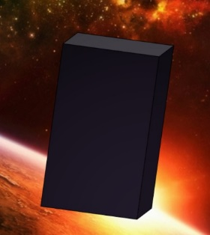
EEE4084F
Digital Systems
Lecture 16
YODA Project &
Discussion of Digital Accelerators
Presented by
Simon Winberg
Attribution-ShareAlike 4.0 International (CC BY-SA 4.0)

Slide 2
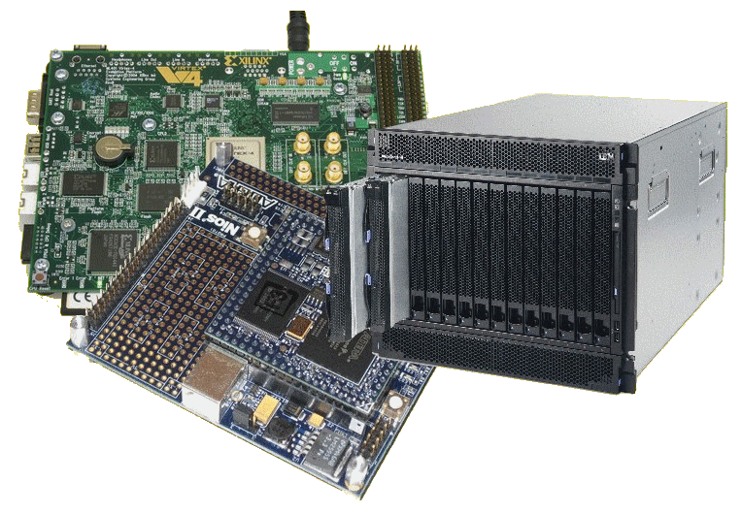
Lecture Overview
YODA Project
Digital accelerators
Project Milestones
YODA ‘Conference’

Slide 3
Reconfigurable Computing
A Scenario…
EEE4084F

Slide 4
The Reconfigurable Hardware Platform
More colloquially, at the start
of the mission: “The Doorstop”
In the not too distant future,
There was a device…
Indeed, your own galaxy…
Very close to home…
In a galaxy

Slide 5
The Reconfigurable Hardware Platform
More colloquially, at the start
of the mission: “The Doorstop”
Like most doorstops, this one starts out being a
lump that is in the way; although it may have
all sorts of potential if you…
… apply your mind, you must!

Slide 6
Scenario: Reconfigurable platform
LCD
reconfigure
MP3
player
Doorstop
Jabba the Hutt says:
I need a
MP3 player!
(you may need some additional
external items in order to make
use of the reconfigured system)

Slide 7
MP3
player
reconfigure
IP phone
The Hutt is satisfied.
But now wants more…
Now I need an IP phone!
Yak yak *
In case you’re wondering what sort of client Jabber is like, especially if he had an MP3 player, you could watch this amusing skit: https://www.youtube.com/watch?v=H2ftVPk-WZw

Slide 8
With the expanding product line your RC development firm is likely to get more and more (and even more unlikely) clients… such as
IP phone
Compressor
110111001101
110100
But I (beep beep) need a
data stream
compressor
(click squeak)

Slide 9
But what is this “doorstop” of which you speak?
Your Doorstop
A “doorstop” for your enlightenment and education…
But first: patience you must have as this knowledge will be
revealed once you are ready…

Slide 10
Evaluation Kit: Nexys2 or Nexys3 or Nexys 4
Getting ready for your “doorstop”…
Reconfigurable Computing EEE4084F
A brief overview of Reconfigurable Computing operation…

Slide 11
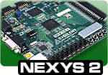
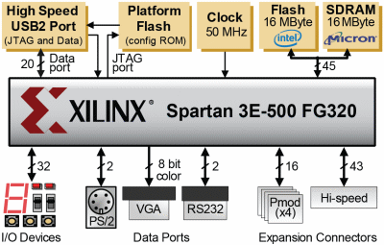
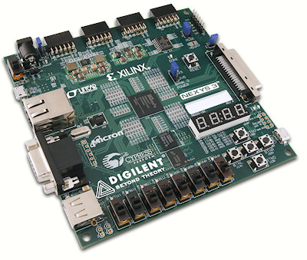
Nexys2: The evaluation board to be used
in the laboratories…
Source: http://www.digilentinc.com/Products/Detail.cfm?NavPath=2,400,789&Prod=NEXYS2

Slide 12
Nexys2: The evaluation board to be used
in the laboratories…
Simplified Model
16 bit Pmods (4x)
Flash 16MByte
DATA
PORT BUS
(USB, JTAG)
45 bit memory ADDRESS
BUS
FPGA
43 bit extra IO
32 bit LEDs, PB PIO
SRAM

Slide 13
Nexys2:
Simplified Model
16 bit Pmods (4x)
USB
DEVICE
Flash 16MByte
ETHERNET
DEVICE
Soft
Processor
Logic
USB
45 bit memory ADDRESS
BUS
DATA
PORT BUS
(USB, JTAG)
FPGA
BLOCK RAM
Your own
peripheral
43 bit extra IO
32 bit LEDs, PB PIO
SRAM

Slide 14
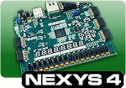
Want your own Nexys?
If you want your own Nexys you can order one from the DigilentInc website. The Nexys4 is somewhat pricier than the Nexys3 (of which stock may be limited). Nexys4 about $179 with education discount. Nexys3 about $189 USD. The lower cost (and simpler) option is the Basys™3 Artix-7 FPGA Board, about $79; it has much of the peripherals as the Nexys4 has but cut down in other aspects.
There are enough to go round for labs if working as teams. If enough students would like their own Nexys board it’s a good idea to group all into one order to save on the postage costs (the postage is about $50 or R500, only courier options are available).
If you do decide to get your own Nexys, I recommend getting the Nexys4 if you can afford it since it has the bigger and more fancy FPGA of these options.
http://www.digilentinc.com/Products/Detail.cfm?NavPath=2,400,1184&Prod=NEXYS4
http://www.digilentinc.com/Products/Detail.cfm?NavPath=2,400,897&Prod=NEXYS3
http://www.digilentinc.com/Products/Detail.cfm?NavPath=2,400,1288&Prod=BASYS3

Slide 15
YODA Project: Your Own Digital Accelerator
About YODA
Reconfigurable Computing
Final Hand-in date: 20 May (last day of lectures)

Slide 16
What’s A Digital Application Accelerator?
An add-on card (or reconfigurable co-processor) used to speed up processing for a particular solution
‘Digital’ - comprises digital logic/circuitry to speed-up computation
A GPU could be considered an example (except GPUs often have analogue circuitry as well to connect to monitors)

Slide 17
YODA Example and Scenario
Delta modulator that grabs set of 8 bytes and outputs 1 byte
128 | 200 | 220 | 201 | 201 | 201 | 127 | 108
=> 100 = 01100100₂
Application 1
Flash LEDs according to data send from PC
Application 2
Perform delta compression on data sent from PC, send compressed steam back to PC

Slide 18
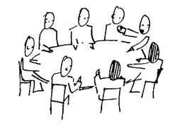
YODA Project Structure
YODA Feature List
Due: 19-May-2017 11:55pm
Blog
blogging
Design Review
Final Paper (report)
Presentation ‘YODA Conference’
Code/Resource Submission
(Celebrate
)

Slide 19
Project Teams & Marking
Projects done as teams of 2 or 3 members
(confirm team of 4 members with lecturer)
Milestone Dates – leading-up to ‘YODA Conference’
Blog (due 17 April)
Conceptual Design (by 3 May + progress evidence*)
Status update (post on blog by 8 May)
Draft YODA Paper (17 May)
Final paper (25 May)
Presentation ‘YODA Conference’ (22,24 May)
* Need to actually have something to show beyond just discussion of plans.

Slide 20
The ‘YODA Conference’ approach
Why?
It is essentially planned around being a small scale experience of the typical ‘academic R&D progress’ …
The usual Research & Development process (simplified)…
Come up with an idea (or discover a problem to solve)
[do research to see if the problem has been solved perfectly already, lets assume you’re taking the opinion your team wants to do it regardless]
Elucidate the problem and propose a solution (e.g. a conceptual design)
Take on board the feedback to help decide what else to do with the solution
Write about and present what you have achieved to see what others in the feel think of it (peer review)
Prepare a prototype of the solution to test it out
YODA Conference

Slide 21
Yoda Conference
The usual process is as follows.
Prepare and submit an initial paper
Usually around 4-6 pages double column
Explain the solution, incl. some background.
Give sufficient explanation, but not too much detail
Get feedback from reviewers
Reviewers give feedback on what they think, any aspects they found unclear, if it is it useful / sufficiently novel, appropriateness of topic for conference, etc.
Revise the paper
Respond to reviewer requests
Submit revised paper + brief report describing responses made to reviewers’ comments
Present the paper
Usually 8-15 minutes for an engineering conference presentation.
This larger audience (i.e. more than the reviewers) ask questions and give further insights beyond what was gained from the reviewers.

Slide 22
Project Teams & Marking
Important: final report counts the most !
Breakdown of marking
Blog: 10%
Design Review: 10% (can post on blog)
Presentation: 30% (i.e. YODA conf.)
Report & Code: 50%
YODA Project counts 20% of course mark

Slide 23
YODA – Purpose
At the end of the course you should have developed an FPGA-based application accelerator for a PC using either a Xilinx-based Digilent Nexys or other evaluation board

Slide 24
YODA Design Strategy
In order to trial the reconfigurable aspect, your YODA prototype should support two applications
Application 1: something very simple (i.e., for testing your setup, send/receive data)
Application 2: more sophisticated / meaningful application (e.g., parallel pattern searches)

Slide 25
YODA Plan
Offloads
processing to
PC
(Lab computer)
Windows / Ubuntu
Soft processor
YODA
Your Own
Digital Accelerator
YODA
Form 1
Application 1
Supports
YODA Form 2
Supports
Application 2
Custom logic defined using
Public / freely available VHDL or Verilog HDL code
Peripherals
(e.g. Ethernet device)
Your VHDL or Verilog HDL code
Adapted
from

Slide 26
YODA
Plan A & Plan B
Plan A = All the bells and whistles, may not be sufficient time to do
Plan B = Backup / fall-back design more achievable in a short time
Let’s see possible examples…

Slide 27
Example Scenario
Plan A = Music synthesizer that can play MIDI files (or similar type) and allows for multiple concurrent instruments, able to
provide smooth sounds with a wide dynamic range.
FPGA Full Synth demo (A).mp4
Plan B = Music Beep Box, has a hard-coded tune sequence
(stored in an array in BRAM) that specifies tone and
duration. Can play one tone at a time.
FPGA Music Beep Box (B).mp4

Slide 28
YODA Presentation
The presentation gives a clear impression of what was done
You choose what to showcase (in the short time available)
Should be close to the final version (the resources of which are submitted to provide evidence of having completed the work), but doesn’t necessarily need to be the final final version.

Slide 29
YODA Report (‘YODA conference paper’)
Use the paper template, and follow the guidelines for the sections (some flexibility in the headings)
Introduction
Brief indication of background / context
Recap your topic and purpose of the solution
Methodology
Procedure followed to design, implement and test the system
Design
High level design
Finite State Machine (FSM) documenting your digital accelerator operation
Pseudo code (if relevant)
VHDL / Verilog snippets (indicating how your FSM was implemented)
Experimentation and Testing procedure
Conclusion and discussion (+ suggested future work, e.g. if another student group were to build upon the work next year)

Slide 30
What you need to do…
for the first two steps of the project

Slide 31
First step on the YODA project
After the lecture please start trying to form a YODA team
Teams need to be 2 members (check with lecture if 1 or 3 members)
Don’t need to choose a topic yet.. can start thinking about it in your teams
Later on
If you’ve chosen your team, please update the YODA team list on the Vula Wiki for this course
Can use the rest of the lecture to continue finding team mates or start discussing possible topics (you might need a smartphone/laptop to visit the website to facilitate this)

Slide 32
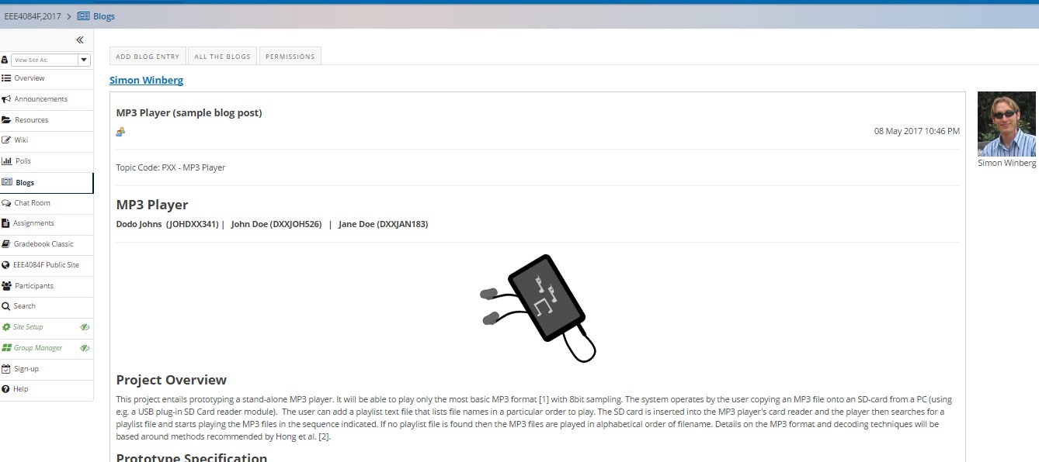
The second step – Milestone 1
Once you’re formed a team you need to get together a conceptual design description and add a blog entry to the Vula site for this
Example of a blog entry showing what is needed

Slide 33
Conclusion of YODA Project Intro
EEE4084F
Start choosing a topic and getting together your YODA teams

