Slide 1



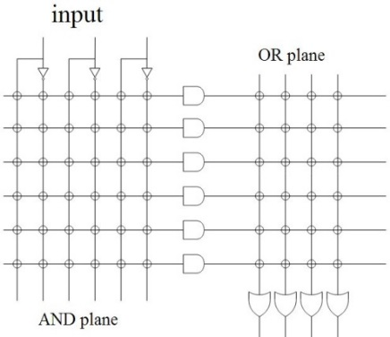

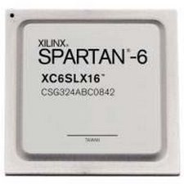
EEE4084F
Digital Systems
Lecture 17
Programmable Logics & FPGAs
FPGA Interns
Lecturer:
Simon Winberg
Attribution-ShareAlike 4.0 International (CC BY-SA 4.0)

Slide 2
Outline for today
Programmable Logic Devices
What is so special about FPGAs
FPGA interns
Xilinx Slices

Slide 3
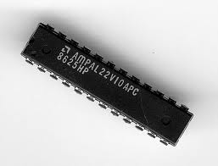
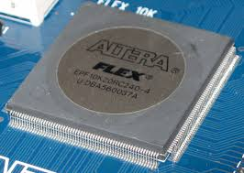
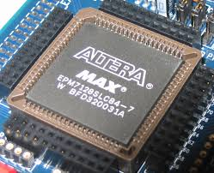
Programmable Logic Devices
EEE4084F
PLA
PLD + SoC
CPLD

Slide 4
Programmable Chips
In comparison to hard-wired chips, a programmable chip can be reconfigured according to application or user needs
Provides a means to use the same chip(s) for a variety of different applications.
Makes programmable chips attractive for use in many products, e.g. prototyping products.
Further benefits are:
  Low starting cost (e.g. Web pack+ FPGA dev kit)
  Risk reduction
  Quick turnaround time
The term PLD refers to “Programmable Logic Device” which could technically be any of the programmable devices (i.e. PLA / CPLD / FPGA), in early work it often referred to a PLA but this is no longer a correct assumption.

Slide 5
ASICs vs. Programmable Chips
Application Specific Integrated Circuit (or ASICs) have a longer design cycle and higher engineering cost than using programmable chips.
Still a need for ASIC: faster performance and lower cost for high volume
Generally, programmable chips are suited to low to medium product production. (e.g. product runs needing under 10,000 chips)

Slide 6
PLAs, CPLDs and FPGAs
Programmable logic chips variety in terms
simple→complex cheap→expensive
PLA = Programmable Logic Array
  Simple: just AND and OR gates; but Cheap
CPLA = Complex PLA
  Midrange: compose interconnected PLAs
FPGA = Field Programmable Gate Array
  Complex: programmable logic blocks and
  programmable interconnects; but Expensive
FPGA orders of magnitude larger than CPLD

Slide 7
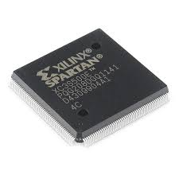
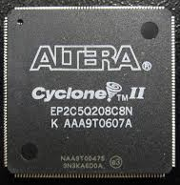
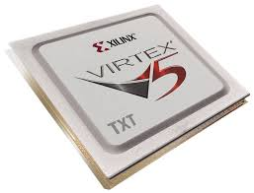
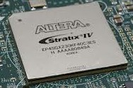
Some examples of PLDs
PLA:
TIBPAL22V10-7C from Texas Instruments is a commonly used
CPLD:
The Altera MAXII and arguably the Altera FLEX as well
FPGA:
Xilinx Spartan and Virtex range;
Altera Cyclone and
The Xilinx, Altera FPGA are probably the most commonly known manufacturers, others include: Lattice, Microsemi / Actel, Achronix

Slide 8
So what?
What is so special about FPGAs?
?

Slide 9

So what?
What is so special about FPGAs?
FPGA
A sea of possibilities…
01001010101000100101001010010100
10010010010100100101101001
100100110101011010011101

Slide 10
FPGAs –
“A sea of possibilities”
The huge number of logic elements (LEs) within these chips, and their many PIO pins, makes it possible to implement large & complex digital systems in them.
The ease and speed of programming them provides the ability to rapidly change the hardware (within ms timing) to adapt to application needs.
Greater potential for testing and tweaking designs before fabricating them as ICs

Slide 11

Any Drawbacks?
Here’s
just a few
drawbacks
Only does the digital part – still need analogue components, user interface, and circuitry that interacts with the outside world.
Has a limited number of IO
pins that can connect up with external signals.
Susceptible to EM disturbances, PCB and other components needs to be suitably placed to avoid interfering with functioning of FPGA.
Typically a slower clock than most fast CPUs nowadays (e.g. 100MHz clock speed).
Eeek!
Often can’t achieve full utilization of PLBs
Typically has lots of pins that need to be soldered on, needing small track width and multilayer PCBs
Limitations of internal interconnects
Place & route can take a long time to complete
A specialized form of development, combines the challenges of both s/w and h/w
Things can get rather… muddy!

Slide 12
Structure of FPGA
A completely different architecture for PLAs was introduced in the mid-1980’s that uses RAM-based lookup tables instead of AND-OR gates to implement combinational logic
These devices are called field programmable gate arrays (FPGAs).
The device consists of an array of configurable logic blocks (CLBs) surrounded by an array of I/O blocks
FPGAs really don’t have AND and OR gates, (they have a few) but rather just RAM look-up tables.

Slide 13
FPGA Interns
EEE4084F
Skip to slide 22; already covered in text book but scan through these slides to ensure you are well versed in these issues.

Slide 14
FPGA internal structure
Programmable logic element (PLE)
(or FPLE*)
Image adapted from Maxfield (2004)
Note: one programmable logic block (PLB) may contain a complex arrangement of programmable logic elements (PLE).
The size of a FPGA or programmable logic device (PLD) is measured in the number of LEs (i.e., Logic Elements) that it has.
* FPLE = Field Programmable Logic Element

Slide 15
Logic Elements
– Remember your logic primitives
You already know all your logic primitives…
  The primitive logic gates
    AND, OR, NOR, NOT, NOR, NAND, XOR
    AND3, OR4, etc (for multiple inputs).
  Pins / sources / terminators
    Ground, VCC
    Input, output
  Storage elements
    JK Flip Flops
    Latches
  Others items: delay, mux
OR
Input Pin
Output Pin
Altera Quartus II representations

Slide 16
Look Up Tables (LUTs)
The usual strategy for implementing PLBs
A simple but powerful approach to FPGA design is to use lookup tables for the PLBs. These are usually implemented as a combination of a multiplexer and memory (even just using NOR gates)
Essentially, this approach is building complex circuits using truth tables (where each LUT enumerates a truth table)
examples follows…

Slide 17
Simple 3-LUT implementation for a PLB
input values
000
0
001
1
010
1
011
0
1-bit output
100
1
101
0
Any guesses as to what logic circuit this LUT implements?
110
0
111
1
8-bit static memory
3
3-bit input bus

Slide 18

Simple 3-LUT implementation for a PLB
It’s an XOR of the 3 input lines!!!
input lines
in out
output
000
0
001
1
010
1
011
0
100
1
101
0
110
0
111
1

Slide 19
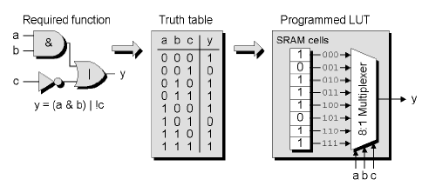
Mainstream* Programmable Logic Block (PLB)
Configure synchronous or asynchronous response (i.e. a line from another big LUT).
config_sync
k-input LUT
0
k inputs
output
…
DFF
1
clock
Another example for implementing an alternate logic function.
Image adapted from Maxfield (2004)
* Used by manufacturers like Xilinx

Slide 20
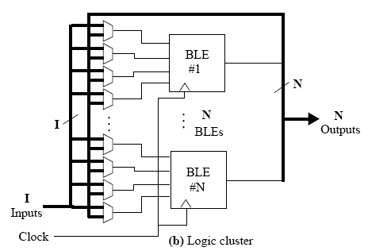
Logic block clusters (LBCs) and Configurable logic blocks (CLBs)
Assume a k-input LUT for each logic block (LB)
Assume N x LBs per logic cluster
BLEs in each logic clusters are fully connected or mostly connected
The diagram shows the same input lines (I) are sent to each LB, in addition to each of the N LBs’ output lines. Each LB operates on 4 input lines at a time, and a MUX is used to decide which input to sample. The MUXs may be configured from a separate LUT, or could be controlled by the LB it is connected to.
LB
…
N x LBs
LB
Diagram adapted from Sherief Reda (2007), EN2911X Lecture 2 Fall07, Brown University

Slide 21
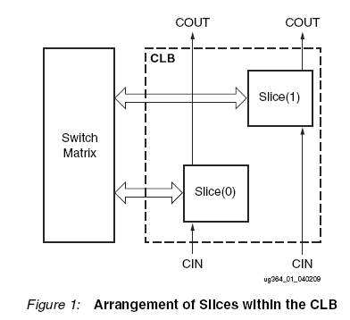
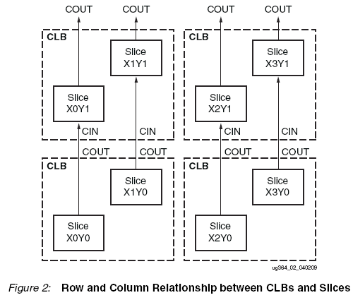
Xilinx L and M Slices Approach for configurable logic blocks (CLBs)
“Every slice contains four logic-function generators (or LUTs), eight storage elements, wide-function multiplexers, and carry logic. These elements are used by all slices to provide logic, arithmetic, and ROM functions. In addition to this, some slices support
two additional functions: storing data using distributed RAM and shifting data with 32-bit registers. Slices that support these additional functions are called SLICEM; others are called SLICEL. SLICEM represents a superset of elements and connections found in all slices. Each CLB can contain zero or one SLICEM. Every other CLB column contains a SLICEMs.
In addition, the two CLB columns to the left of the DSP48E columns both contain a SLICEL
and a SLICEM.”
Source: http://www.xilinx.com/support/documentation/user_guides/ug364.pdf pg 8

Slide 22
Xilinx Slices
EEE4084F

Slide 23
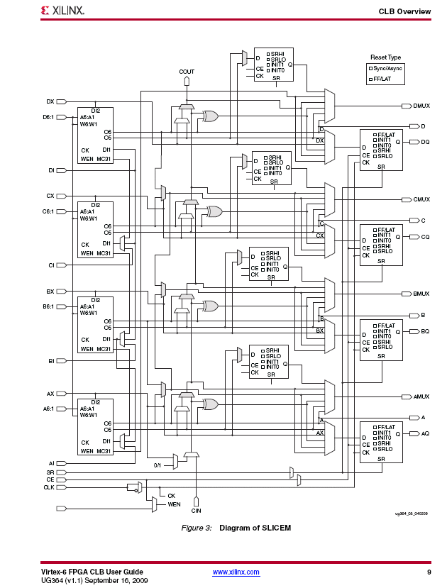
SLICEM slices support additional functions; they are a superset of SLICELs; i.e. the have all the standard LEs plus some additions.
Source: http://www.xilinx.com/support/documentation/user_guides/ug364.pdf pg 9

Slide 24
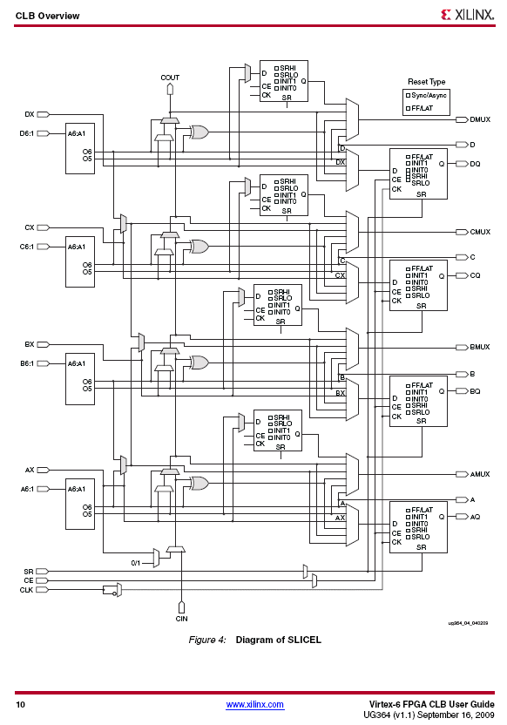
SLICEL slices contain the standard set of LEs for the particular FPGA concerned. As the diagram shows, it looks a little less complicated than the design of a SLICEM.
Source: http://www.xilinx.com/support/documentation/user_guides/ug364.pdf pg 10

Slide 25
Disclaimers and copyright/licensing details
I have tried to follow the correct practices concerning copyright and licensing of material, particularly image sources that have been used in this presentation. I have put much effort into trying to make this material open access so that it can be of benefit to others in their teaching and learning practice. Any mistakes or omissions with regards to these issues I will correct when notified. To the best of my understanding the material in these slides can be shared according to the Creative Commons “Attribution-ShareAlike 4.0 International (CC BY-SA 4.0)” license, and that is why I selected that license to apply to this presentation (it’s not because I particulate want my slides referenced but more to acknowledge the sources and generosity of others who have provided free material such as the images I have used).
Image sources:
PLD illustration on title slide - Wikipedia Open Commons
FPGA chip illustrations - Wikipedia Open Commons
Stuck in Mud – fickr (CC2 for free reuse and modification)
Typing ninja – Pixabay http://pixabay.com/ (public domain)

