Slide 1



EEE4084F
Digital Systems
Lecture 18
Coding in Verilog
module myveriloglecture ( wishes_in, techniques_out );
…
// implementation of today’s lecture
…
endmodule
Learning Verilog with
Xilinx ISE, Icarus Verilog or
Altera Quartus II
Lecturer:
Simon Winberg
Attribution-ShareAlike 4.0 International (CC BY-SA 4.0)

Slide 2
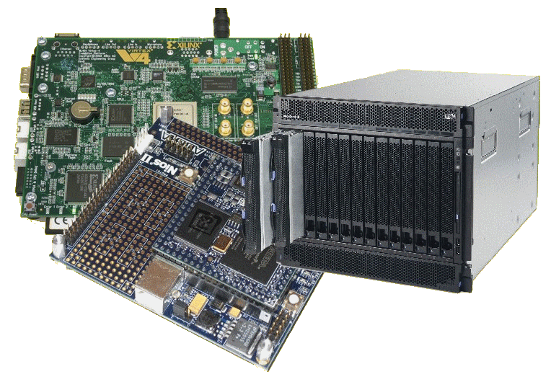
Lecture Overview
Why Verilog?
Basics of Verilog coding
Exercise
Verilog simulators
Intro to Verilog in
ISE/Vivado
Test bench
Generating Verilog
from Schematic
Editors

Slide 3

Why consider Verilog?
Because it is…
Becoming more popular than VHDL!!
Verilog is used mostly in USA.
VHDL is used widely in Europe, but Verilog is gaining popularity.
Easier to learn since it is similar to C
Things like SystemC and OpenCL are still a bit clunky in comparison (although in years to come they become common)
I think it’s high time for a new & better HDL language!! (Let’s let go of C! And scrap ADA for goodness sake. Maybe I’ll present some ideas in a later lecture.)
break free from the constraints of the old language constructs

Slide 4

Lead in to Verilog…
History of Verilog
  1980 Verilog developed by Gateway Design
  Automation (but kept as their own ‘secret weapon’)
  1990 Verilog was made public
  1995 adopted as IEEE standard 1364-1995
  (Verilog 95)
  2001 enhanced version: Verilog 2001
    Particularly built-in operators +, -, /, *, >>>.
    Named parameter overrides, always, @*
  2005 even more refined version: Verilog 2005
  (is not same as SystemVerilog!)
  SystemVerilog (superset of Verilog-2005) with new features. SystemVerilog and Verilog language standards were merged into SystemVerilog 2009 (IEEE Standard 1800-2009, the current version is IEEE standard 1800-2012).

Slide 5
Module: Building block of Verilog Programs
…
module2
module1
Module: the basic block that does something and can be connected to (i.e. equivalent to entity in VHDL)
Modules are hierarchical. They can be individual elements (e.g. comprise standard gates) or can be a composition of other modules.
SYNTAX:
module <module name> (<module terminal list>);
…
<module implementation>
…
endmodule

Slide 6
Module Abstraction Levels
Switch Level Abstraction (lowest level)
  Implementing using only switches and interconnects.
Gate Level (slightly higher level)
  Implementing terms of gates like (i.e., AND, NOT, OR etc) and using interconnects between gates.
Dataflow Level
  Implementing in terms of dataflow between registers
Behavioral Level (highest level)
  Implementing module in terms of algorithms, not worrying about hardware issues (much). Close to C programming.
Arguably the best thing about Verilog!!

Slide 7
Syntactic issues:
Constant Values in Verilog
Number format:
<size>’<base><number>
Some examples:
  3’b111 – a three bit number (i.e. 7₁₀)
  8’ha1 – a hexadecimal (i.e. A1₁₆ = 161₁₀)
  24’d165 – a decimal number (i.e. 165₁₀)
Defaults:
100 – 32-bit decimal by default if you don’t have a ‘
‘hab – 32-bit hexadecimal unsigned value
‘o77 – 32-bit hexadecimal unsigned value (77₈ = 63₁₀)

Slide 8
Syntactic issues:
Constant Values in Verilog
Constant | Hardware Condition
0 | Low / Logic zero / False
1 | High / Logic one / True
x | Unknown
z | Floating / High impedance

Slide 9
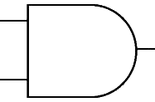
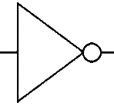
Wires
Wires (or nets) are used to connect elements (e.g. ports of modules)
Wires have values continuously driven onto them by outputs they connect to
// Defining the wires
// for this circuit:
a
c
d
wire a;
wire a, b, c;
b

Slide 10
Registers
Registers store data
Registers retain their data until another value is put into them (i.e. works like a FF or latch)
A register needs no continuous driver
reg myregister; // declare a new register (defaults to 1 bit)
myregister = 1'b1; // set the value to 1

Slide 11
Vectors of wires and registers
// Define some wires:
wire a; // a bit wire
wire [7:0] abus; // an 8-bit bus
wire [15:0] bus1, bus2; // two 16-bit busses
// Define some registers
reg active; // a single bit register
reg [0:17] count; // a vector of 18 bits

Slide 12
Non-synthesisable Data types
These datatypes are used both during the compilation and simulation stages to do various things like checking loops, calculations.
Integer 32-bit value
  integer i; // e.g. used as a counter
Real 32-bit floating point value
  real r; // e.g. floating point value for calculation
Time 64-bit value
  time t; // e.g. used in simulation for delays

Slide 13

Memory jogger…
Q: Explain the Verilog value 10’h10 …
A:
(a) 10-bit value 10₁₀
(b) Arbitrary size value 16₁₀
(c) 10-bit value 10₁₆
(d) array [16,16,16,16,16,16,16,16,16,16]

Slide 14
Verilog Parameters & Initial block
Parameter: the rather obscurely named ‘parameter’ works more like a constant in C (or generic in VHLD)
  Parameters can be used in implementation of both synthesisable and simulation code
Initial: used to initialize parameters or registers or describe a process for initializing a module (i.e. like constructor in C++)
  An initial block is effectively an always@ block that is triggered on the start of simulation (NB: it is not synthesisable)
  Initial can only be used in simulation code

Slide 15
Ports
The tradition is to list input ports first and then output ports. This makes reading of code easier. i.e.:
ModuleName ( <input ports> <output ports>);
module mygate (
reset, // reset line if used
clk , // clock input
xout, // 1 bit output
ain ); // a 1 bit input
// define inputs
input reset, clk, ain;
// define outputs
output xout;
… rest of implementation …
endmodule
mygate
clk
xout
ain
reset

Slide 16
Register Output Ports
These are output port that hold their value. An essential feature needed to construct things like timers and flip flops
module mycounter (
clk, // Clock input of the design
count_out // 8 bit vector output of the
);
// Inputs:
input clk;
output [7:0] count_out; // 8-bit counter output
// All the outputs are registers
reg [7:0] count_out;
…
endmodule

Slide 17
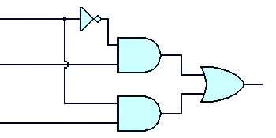
Instantiating modules and connecting up ports
These two tasks usually done in one go…
Modules are instantiated within modules
  Syntax: <module name> <instance name> (<arguments>)
EXAMPLE:
// Multiplexer implemented using gates only*
module mux2to1 (a,b,sel,y);
input a,b,sel;
output y;
wire sel,asel,bsel,invsel;
not U_inv (invsel,sel);
and U_anda (asel,a,invsel),
U_andb (bsel,b,sel);
or U_or (y,asel,bsel);
endmodule
U_inv
sel
invsel
U_anda
asel
U_or
a
y
Module instance names
b
bsel
Port mapping (like arguments in a C function call)
U_andb
* Based on source: http://www.asic-world.com/code/hdl_models/mux_2to1_gates.v

Slide 18
Instantiating modules
Why give instances names?
  In Verilog 2001 you can do:
module mux2to1 (input a, input b, input sel, output y);
…
and (asel,a,invsel), // can have unnamed instance
…
endmodule
Major reason for putting a name in is when it comes to debugging: Xilinx tends to assign instance names arbitrarily, like the and above might be called XXYY01 and then you might get a error message saying something like “cannot connect signals to XXYY01” and then you spend ages trying to track down which gate is giving the problem.

Slide 19
Verilog Primitive Gates
Examples:
and
or
not
and a1 (OUT,IN1,IN2);
nand
nor
xor
not n1 (OUT,IN);
Buffer (i.e. 1-bit FIFO or splitter)
buf
Example:
buf onelinkbuf (OUT, IN);
buf twolinkbuf (OUT1, OUT2, IN);

Slide 20
BufIf (hardware if gate)
Tri-state buffer. Can choose to drive out with value of in (if ctr = 1) or don’t drive anything to out (i.e. if ctr = 0 connect high impedance to out)
in
out
bufif1 operation
ctr →
in →
ctr
 | 0 | 1 | x | z
0 | z | 0 | L | L
1 | z | 1 | H | H
x | z | x | x | x
z | z | x | x | x
bufif1 (out, in, ctr)
See also notif (works in the apposite way: if ctr=0 then drive out with in)

Slide 21
Where to go from here…
The preceding slides have given a very brief look at Verilog, but has covered much of the major things that are used most commonly.
It’s best to get stuck into experimenting and testing code in order to learn this language
Some thoughts for experimenting to do soon…

Slide 22
Verilog Recommended Coding Styles
Consistent indentation
Align code vertically on the = operator
Use meaningful variable names
Include comments (i.e. C-style // or /**/ )
  brief descriptions, reference to documents
  Can also be used to assist in separating parts of the code (e.g. indicate row of /*****/ to separate different module implementations)

Slide 23
Code Example1 : MUX
Do get into a habit of providing a preamble for each file.
//-----------------------------------------------------
// Design Name : mux_using_assign
// File Name : mux_using_assign.v
// Function : 2:1 Mux using Assign
// Coder : Deepak Kumar Tala
//-----------------------------------------------------
module mux_using_assign(
din_0 , // Mux first input
din_1 , // Mux second input
sel , // Select input
mux_out // Mux output
);
//-----------Input Ports---------------
input din_0, din_1, sel ;
//-----------Output Ports---------------
output mux_out;
//------------Internal Variables--------
wire mux_out;
//-------------Code Start-----------------
assign mux_out = (sel) ? din_1 : din_0;
endmodule //End Of Module mux
Do make use of divider lines to separate different pieces of the code
Do try to provide useful comments especially if the argument names are not very obvious
For older versions of Verilog (before 2001)
Adapted from source: http://www.asic-world.com/code/hdl_models/mux_using_assign.v
Try it on EDA Playground : https://www.edaplayground.com/ (run HDL code using online simulators)

Slide 24
Testbenches
A testbench is essential code that is written to test your design, or exercise a module you’re building
Basically you set up a testbench to run a series of test vectors or manipulate pins to see what happens.
The are usually written in the same language as the module under test, but not necessarily… I often use a combination of Verilog, Matlab and/or C in my testbenches (Matlab or C to generate test vectors and a Verilog testbench module as the interface to this)

Slide 25

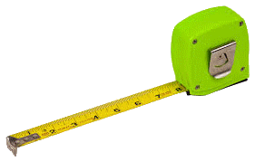
Testbench Example
Verilog 4-bit counter with testbench
EEE4084F

Slide 26
Counter Design
Before you jump into coding, you should do some design…
Let’s think about what a 4-bit counter needs…
(1) A module
(2) interfaces: some inputs… reset and clock
(3) interfaces: an output… count value
(4) Maybe further embellishments … like enable line
reset
clk
Counter
count
enable
OK, that sounds like enough for now.. Let’s code it!

Slide 27
Code Example2 : Counter
Do get into a habit of providing a preamble for each file.
//-----------------------------------------------------
// Design Name : counter
// File Name : counter.v
// Function : 4 bit up counter
// Adapted from http://www.asic-world.com/examples/verilog/counters.html
//-----------------------------------------------------
module counter (clk, reset, enable, count);
// Define port types and directions
input clk, reset, enable;
output [3:0] count;
reg [3:0] count;
always @ (posedge clk)
if (reset == 1'b1) begin
count <= 0;
end else if ( enable == 1'b1) begin
count <= count + 1;
end
endmodule
Here’s our port interface, including enable and reset lines. Count is the current count value that will increase with each clock.
i.e. the output port count holds it value
Note: always name your .v file the same as the main module in that code file
(i.e. if counter is the entry point module then name the file counter.v)
Adapted from source: http://www.asic-world.com/examples/verilog/counters.html

Slide 28

Let’s do it in iVerilog
With iVerilog you basically need a good text editor
Should install gnuplot too, there are ways to graph waveforms
Verilog compiles the .v code into an executable. To do so:
iverilog -ooutputfile inputfile.v
Generates an executable file called outputfile
So lets do: iverilog -ocount count.v
And amazingly we see a counter file generated…
Ooooh how fun! What exciting stuff will happen if we run it?!!!
Nothing!
Because we don’t have a testbench

Slide 29
Code Example2 : Counter
Do get into a habit of providing a preamble for each file.
//-----------------------------------------------------
// Design Name : counter
// File Name : counter.v
// Function : 4 bit up counter
// Adapted from http://www.asic-world.com/examples/verilog/counters.html
//-----------------------------------------------------
module counter (clk, reset, enable, count);
// Define port types and directions
input clk, reset, enable;
output [3:0] count;
reg [3:0] count;
always @ (posedge clk)
if (reset == 1'b1) begin
count <= 0;
end else if ( enable == 1'b1) begin
count <= count + 1;
end
endmodule
Note: always name your .v file the same as the main module in that code file
(i.e. if counter is the entry point module then name the file counter.v)
Adapted from source: http://www.asic-world.com/examples/verilog/counters.html

Slide 30
Counter Testbench Design
So again before you jump into coding, do some more design…
Let’s think about how to test a 4-bit counter…
Basically you need:
$monitor the lines you want to see.
Do a reset high and toggle clock (because it is an active reset)
Then continue on setting reset low and enable high and continuously toggle the clock
reset
clk
Counter
count
enable
OK, that sounds like a plan… let’s do it!

Slide 31
Code Example2 : Counter_tb1
// Counter Test bench version 1
// This just hooks up the test bench
module counter_tb; // this will become the TLM
reg clk, reset, enable; // define some regs, like global vars
wire [3:0] count; // just need a wire for count as it is stored
// within the counter module
counter U0 ( // instantiate the counter (U0 = unit under test)
.clk (clk), // these are explicit port maps (usually one
.reset (reset), // doesn’t both to do this in Verilog).
.enable (enable),
.count (count)
);
endmodule
But this will of course still not do anything in the simulator…
we need to exercise some pins!

Slide 32
Code Example2 : Counter_tb2
// Counter test bench 2
// Set up a monitor and change some pins
// Coder: S. Winberg
// 4-bit Upcounter testbench
module counter_tb;
reg clk, reset, enable;
wire [3:0] count;
counter U0 (
.clk (clk), .reset (reset), .enable (enable), .count (count) ); // instantiate the module
initial
begin
// Set up a monitor routine to keep printing out the
// pins we are interested in...
// But first do a display so that you know what columns are used
$display("\t\ttime,\tclk,\treset,\tenable,\tcount");
$monitor("%d,\t%b,\t%b,\t%b,\t%d",$time, clk,reset,enable,count);
// Now excercise the pins!!!
clk = 0;
reset = 0;
enable = 0;
#5 clk = !clk; // The # says pause for x simulation steps
// The command just toggles the clock
reset = 1;
#5 clk = !clk; // Let's just tiggle it again for good measure
end
endmodule
Monitor pins and change some of their values
Note: you need to tell iverilog all the files to include, so use:
iverilog -o counter_tb2 counter_tb2.v counter.v

Slide 33
What we get out:
$ ./counter_tb2
time, clk, reset, enable, count
0, 0, 0, 0, x
5, 1, 1, 0, 0
10, 0, 1, 0, 0

Slide 34
Code Example2 : Counter_tb3
// Counter test bench 3
// Set up a monitor and change some pins
// Coder: S. Winberg
// 4-bit Upcounter testbench
module counter_tb;
reg clk, reset, enable;
wire [3:0] count;
counter U0 (
.clk (clk), .reset (reset), .enable (enable), .count (count) ); // instantiate the module
initial
begin
// Set up a monitor routine to keep printing out the
// Now excercise the pins!!!
clk = 0; reset = 0; enable = 0;
#5 clk = !clk; // The # says pause for x simulation steps
reset = 1;
#5 clk = !clk; // Let's just toggle it again for good measure
reset = 0; // Lower the reset line
enable = 1; // now start counting!!
repeat (10) begin
#5 clk = !clk; // Let's just toggle it a few more times
end
end
endmodule
Monitor pins and change some of their values
But First…
Test Your Knowledge:
But first…
What will count count up to with this code??
Note: you need to tell iverilog all the files to include, so use:
iverilog -o counter_tb3 counter_tb3.v counter.v

Slide 35
What we get out:
swinberg@forge:~/Verilog$ ./counter_tb3
time, clk, reset, enable, count
0, 0, 0, 0, x
5, 1, 1, 0, 0
10, 0, 0, 1, 0
15, 1, 0, 1, 1
20, 0, 0, 1, 1
25, 1, 0, 1, 2
30, 0, 0, 1, 2
35, 1, 0, 1, 3
40, 0, 0, 1, 3
45, 1, 0, 1, 4
50, 0, 0, 1, 4
55, 1, 0, 1, 5
60, 0, 0, 1, 5
It will count up to 5 because in each iteration of the repeat it does half a clock

Slide 36

Over to you
to experiment further with iverilog

Slide 37
Learning Verilog By Example
EEE4084F

Slide 38
Learning Verilog
The best approach is starting small, and there are lots of example Verilog programs on line that you can test, have a look at sites such as:
  http://www.asic-world.com/examples/verilog/
  http://www.edaboard.com/
Free for students Active-HDL (includes nice simulator, takes less space than ISE)
  https://www.aldec.com/en/products/fpga_simulation/active_hdl_student
You can also generate Verilog from the schematic editor, which can help in deciding the syntax to use… short example of how to do this follows… (at least this can be useful for quickly generating gate-based / architectural combinational logic designs)

Slide 39

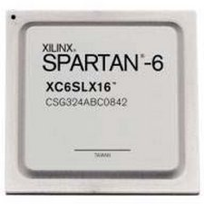
Counter on a Nexys
EEE4084F

Slide 40
Learning Verilog with Xilinx ISE
If you are using ISE to practice you can do so with or without a platform connected; but you still need to set up a desired target platform in order to start a project (so might as well specify an available platform – this example uses a Nexys2 but you could select a different option if you just want to use the simulator)

Slide 41
Implementing an 8-bit counter
Count8w
8
8
start
out
enable
wrapped
clk
Requirements:
INPUTS
Want a counter that counts up for each positive edge clock pulse on clk
Input line enable that to enables (1) or disables (0) the count operation
An 8-bit start value that specifies the starting value for the counter and is loaded when enable is 0
OUTPUTS
B-bit output out that provides the current counter value.
Wrapped changes from 0 to 1 each time the counter wraps (i.e. goes from 255 to 0).

Slide 42
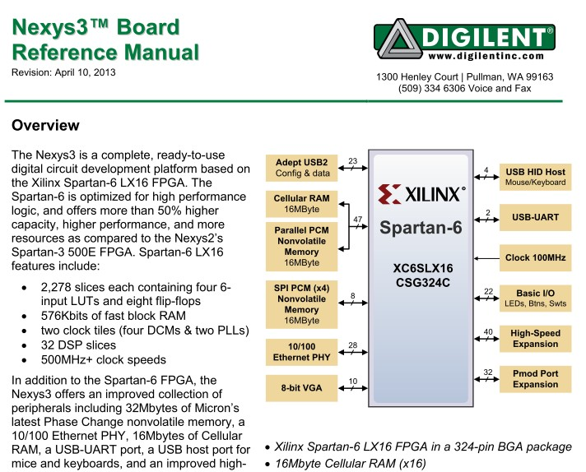
The Nexys Reference Manual
You need to get hold of the right reference manual for the Nexys board that
you are using, see resources for Prac5. Needed for pin assignments etc.
Named e.g. “Nexys3_rm_V2.pdf” for the Nexys3 reference manual.

Slide 43
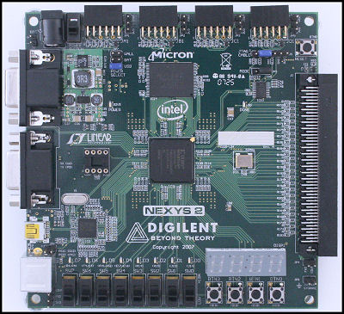
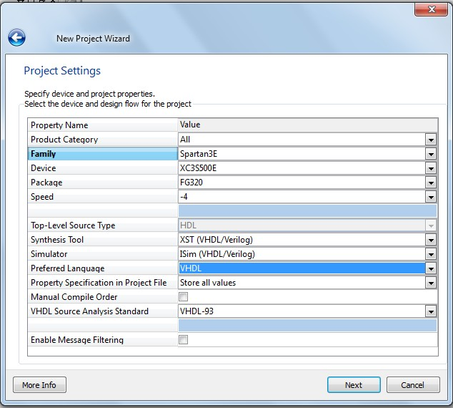
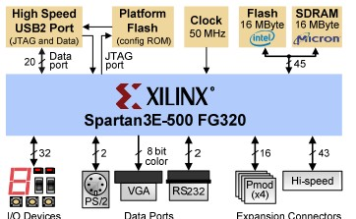
Starting with Verilog in ISE
Starting with a new project… (can use an existing project also)
Example using a Nexys2
Can read off FPGA device name here
Or pg1 of reference manual should have the device name indicated
Change to Verilog
(optional as you can
add in Verilog to a
project with preferred
language VHDL)

Slide 44
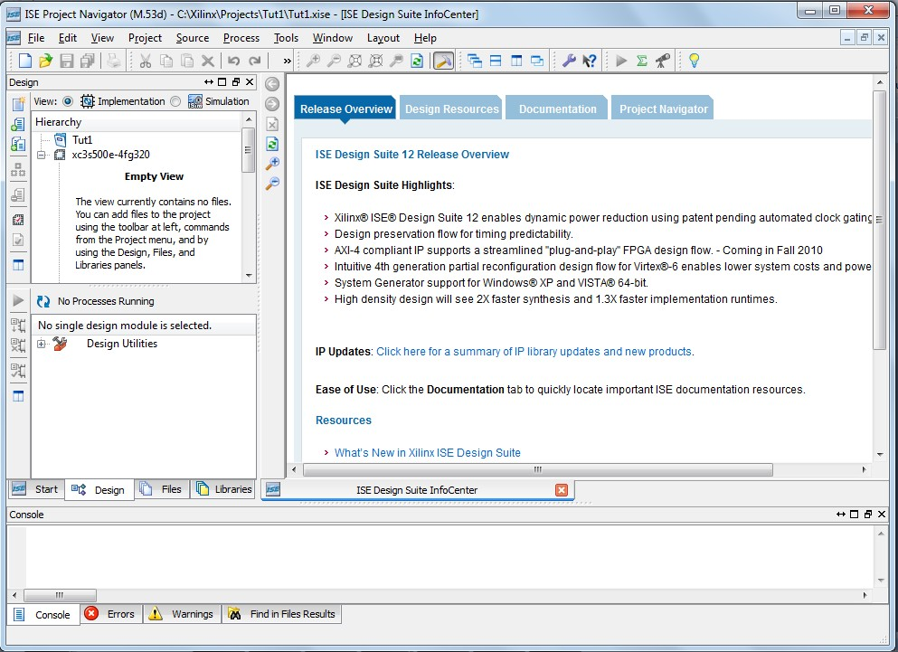
Should get something like this displayed…
Implementation view of hierarchy should confirm which device you are using

Slide 45
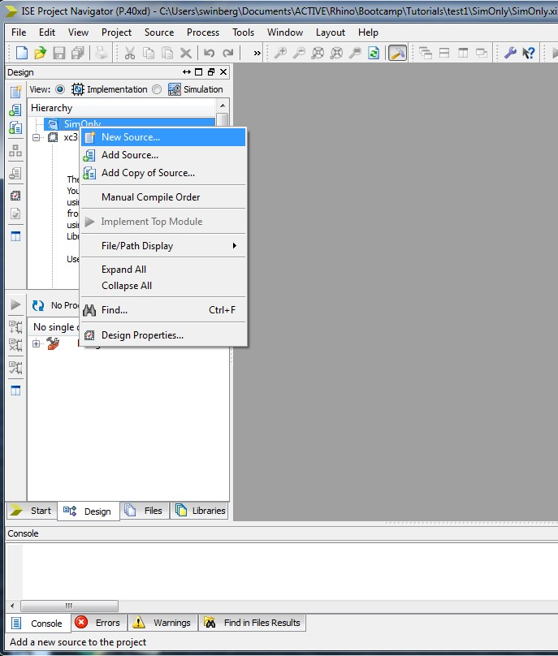
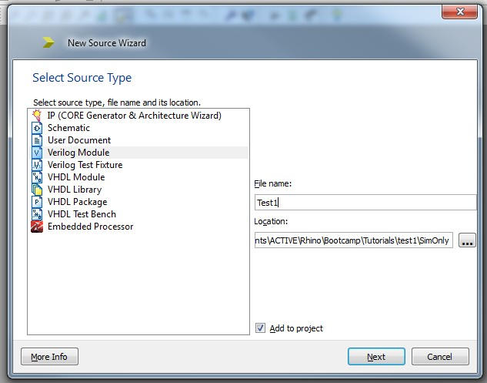
Add a Verilog file…
Add in a new file by right-clicking On the project object in the design hierarchy view
Select add a Verilog file

Slide 46
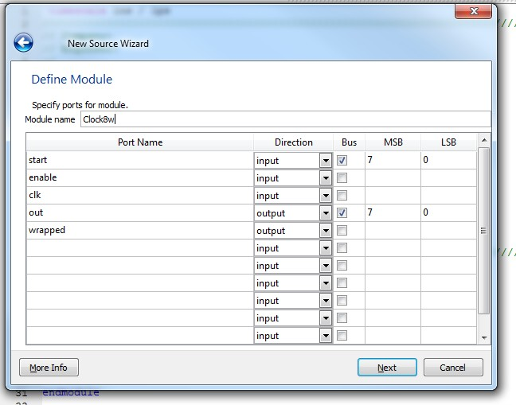
You can use the Define Module form if you want to specify the ports
without typing in manually, but you may prefer to skip this and define the
ports in the code (especially as this is something that may need to be edited later)
Simulation configuration setting:
timescale <reference_time>/ <precision>
Each 1ns step simulated with 1ps precision *
Specifies some
busses
`timescale 1ns / 1ps
//////////////////////////////////////////////////////////////////////////////////
// Company:
…
// Design Name:
// Module Name: Count8w
// Project Name:
…
//
//////////////////////////////////////////////////////////////////////////////////
module Count8w(
input [7:0] start,
input enable,
input clk,
output [7:0] out,
output wrapped
);
endmodule
Generates a starting file like this
These two are just single
bit / wire ports
* Example of timescale use:
`timescale 1ns/1ps
means time scale is 1ns with resolution or least count of 1ps
#1 ; // 1ns delay
#0.001; // 0.001 ns this is the minimum delay at this time scale
#0.0001; // give 0 ns delay!! (not simulating to this fine a resolution)

Slide 47
Expand on the Verilog design…
// Additional Comments: counter with start input and wrap detection
module Count8w(
input [7:0] start,
input enable,
input clk,
output reg [7:0] out, // this one needs to be a register to keep its data
output reg wrapped // set to true if gone past start
);
reg org_start; // save the original start value
// start an always loop -- is activated for each clk positive edge
always @(posedge clk)
if (~enable) begin
out <= start; // the output is set to start if enable if low
org_start <= start;
wrapped <= 0;
end else begin
out <= out + 1;
if (out == start) begin
wrapped <= 1;
end
end
endmodule
This is an adaptation of a more standard counter, as can be found on http://www.asic-world.com/examples/verilog/simple_counter.html#8-Bit_Simple_Up_Counter

Slide 48
Test Bench
A Test Bench is a HDL program that verifies the functional correctness of the hardware design.
The test bench program checks whether the hardware model does what it is supposed to do.
Used with the simulator, tends to need addition of simulator commands such as using the delay (#n) operation

Slide 49
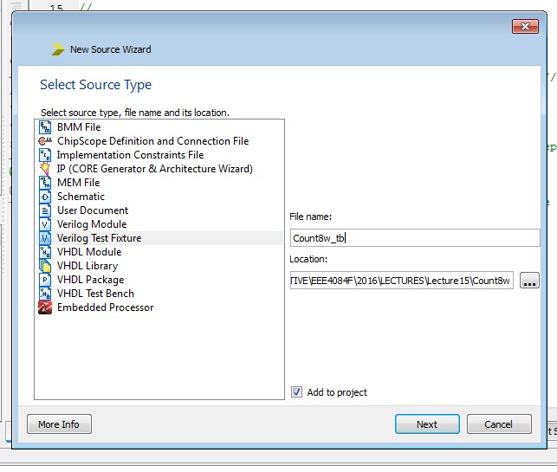
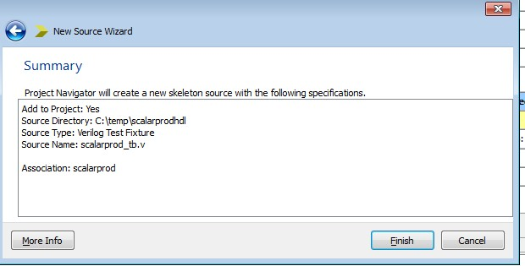
Adding this to the simulator…
.. And put in a suitable name for the resultant file, usually
It is followed by _tb to show it is a test bench.
Creating a Verilog Test Fixture
Provide it a useful file name
Next window lets you associate to a file, choose Count8w, should finally show summary of tile to add:

Slide 50
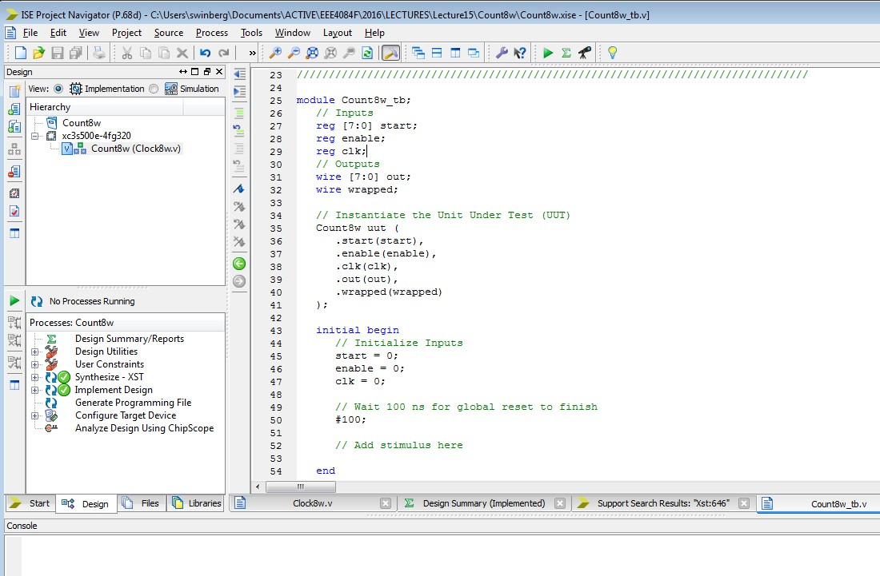
This is test bench file generated…
.. And put in a suitable name for the resultant file, usually
It is followed by _tb to show it is a test bench.
Creating a Verilog Test Fixture
This creates an instance of the module.
This is the part you want to edit to generate simulation ‘stimulus’ (i.e. toggling lines etc.)
Use #100 to simulate waiting for 100 time units (typically 100ns)

Slide 51
Example test bench
`timescale 1ns / 1ps // simulation precision
…
initial begin
// Initialize Inputs
start = 0;
enable = 0;
clk = 0;
// Wait 100 ns for global reset to finish
#100;
// Add stimulus here
start = 'd10;
enable = 'b0;
clk = 1;
#10; // delay 10ns
// Add stimulus here
enable = 'b1;
clk = 0;
#10; // delay 10ns
end
In the Altera simulator the waveform editor allows initial conditions of lines to be set and addition of clock lines, but in test bench code you need to implement this behaviour

Slide 52
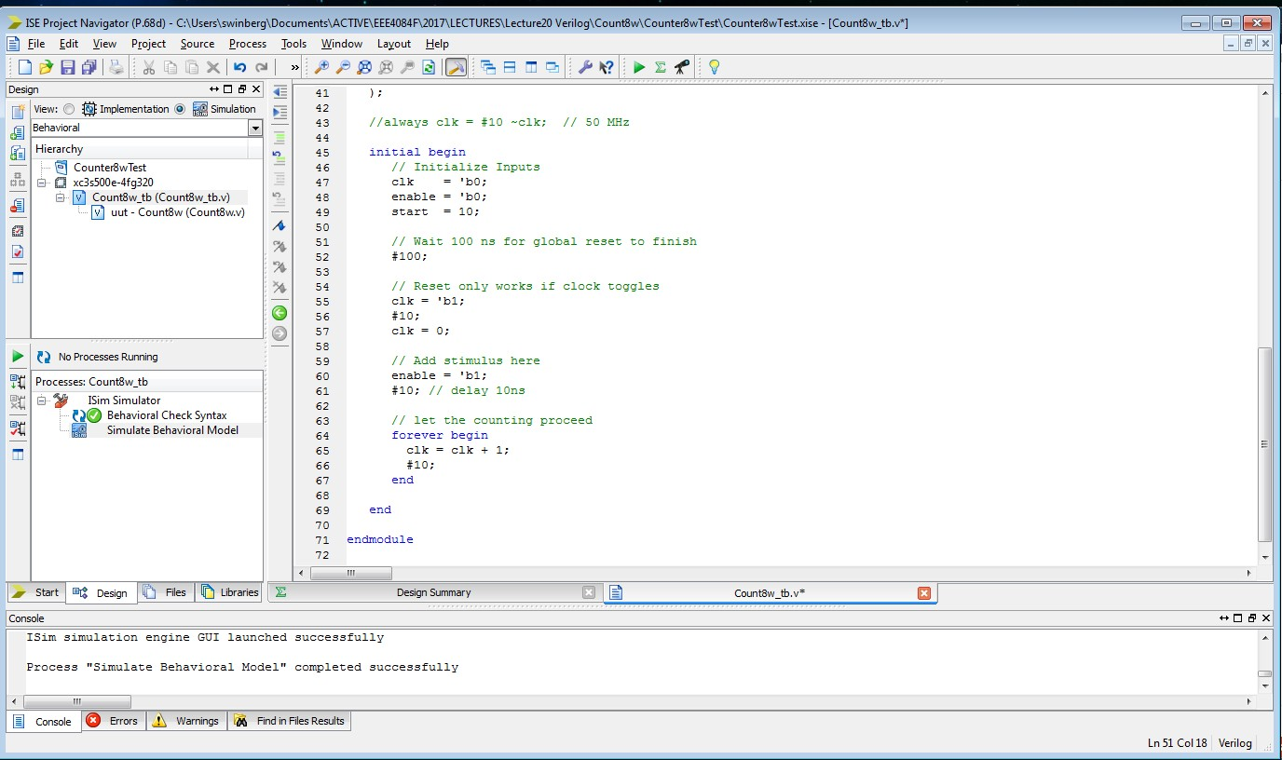
Click on Simulator and then double click simulate behavioural model
Double click
Testbench can be further refined to simulate behaviour of other inputs
and continue the clock for longer (e.g. using always or ‘forever begin’ simulation commands.

Slide 53
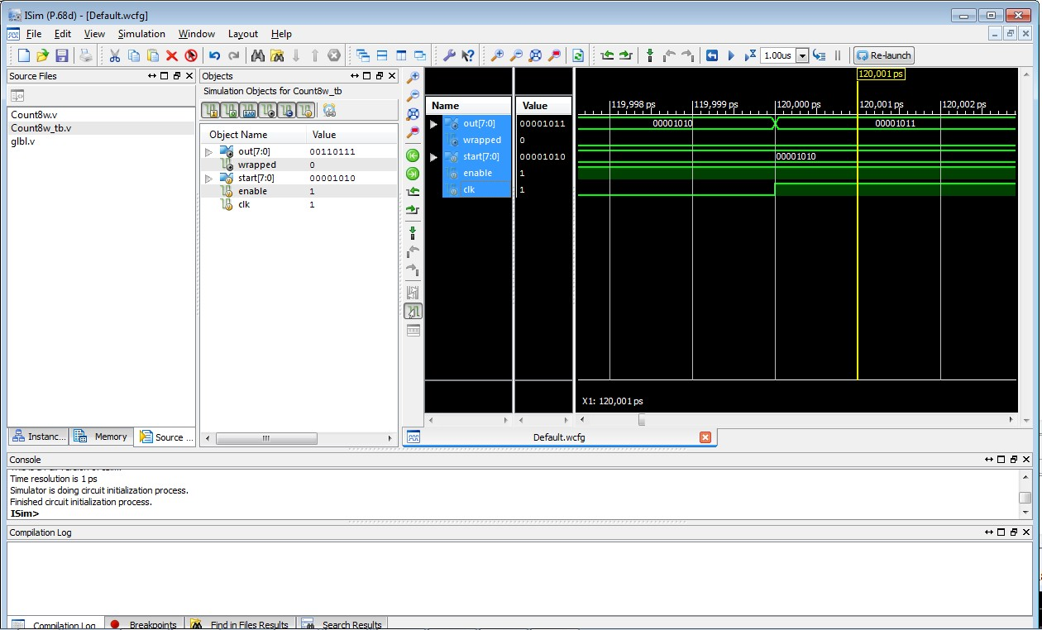

Slide 54
Further examples to try using simulators or on the actual hardware:
More http://www.asic-world.com/examples/verilog (these also provide examples that can be run using iVerilog)

Slide 55
Generating Verilog from the Schematic Editor
It can occasionally be useful to generate a Verilog code file from an existing schematic, e.g. if you
started with a schematic and then wanted to change to using the Verilog code directly.
Starting with a new project… (can use an existing project also)
Change to Verilog
(optional as you can
add in Verilog to a
project with preferred
language VHDL)

Slide 56
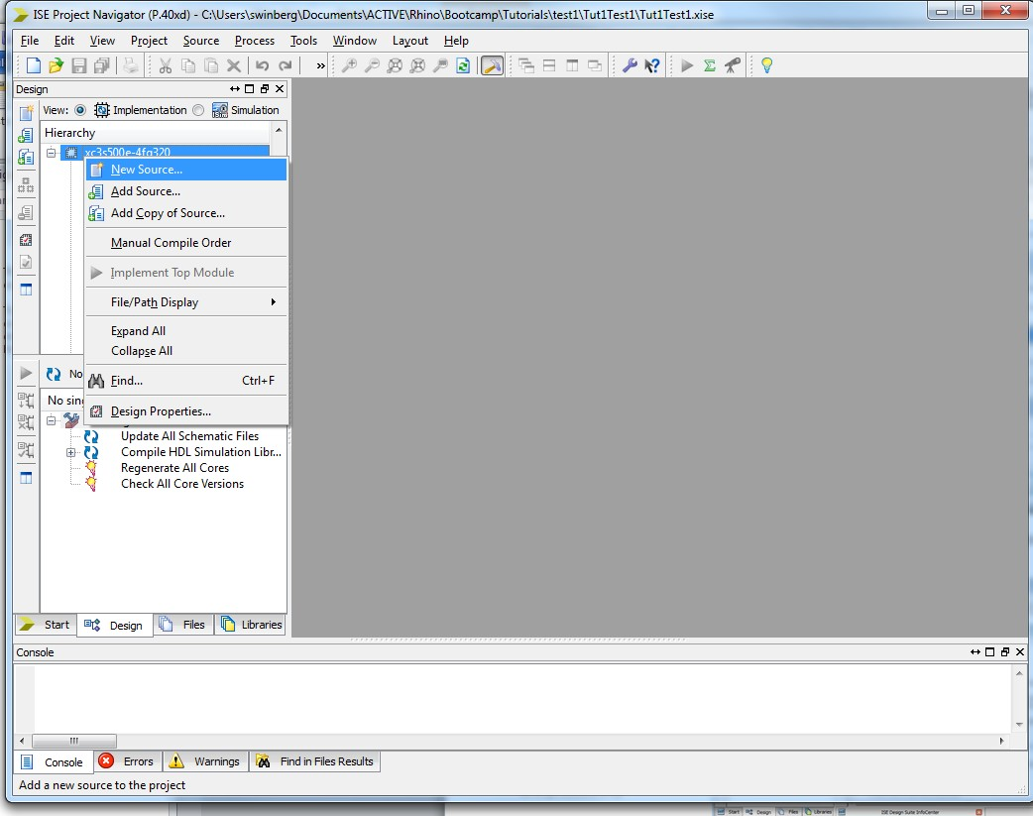
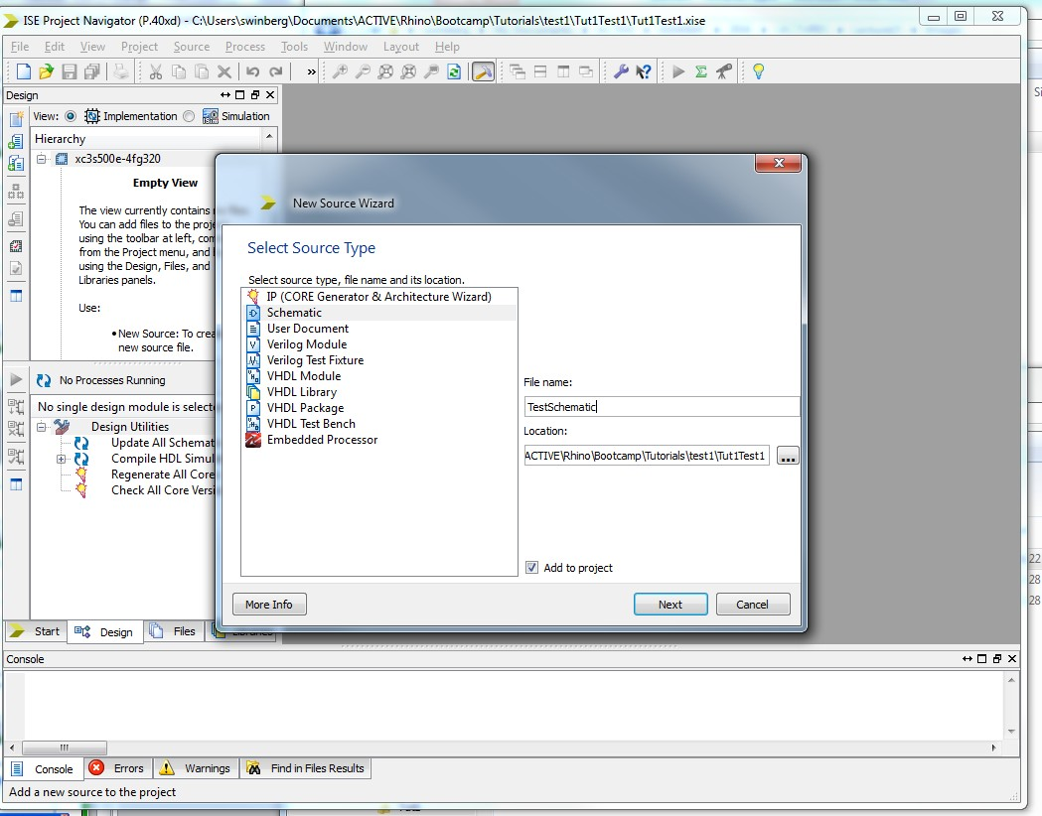
Click to create a new source file
Can add a schematic
to start with…

Slide 57
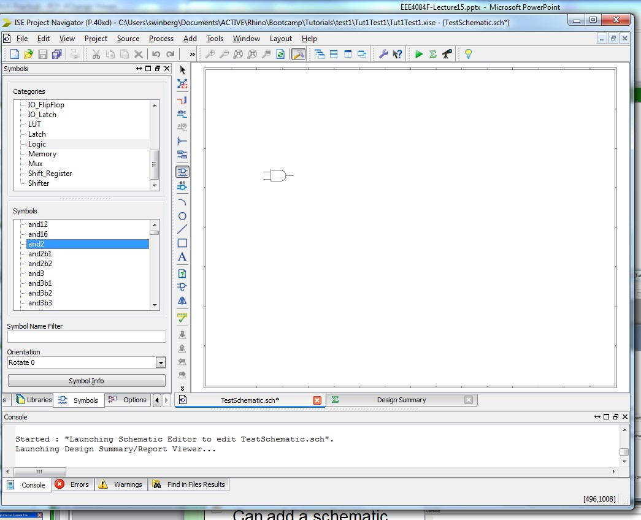
Add a symbol…
Place somewhere

Slide 58
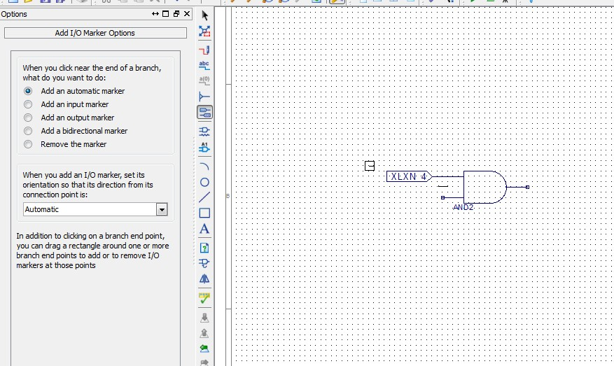
Add an IO marker or three

Slide 59
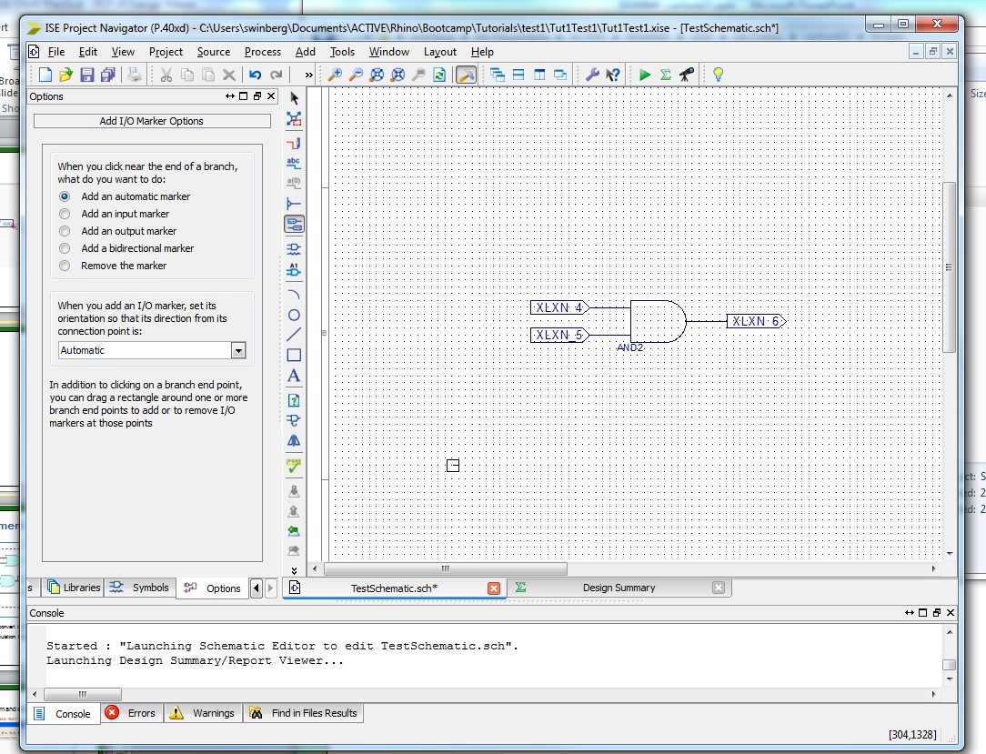
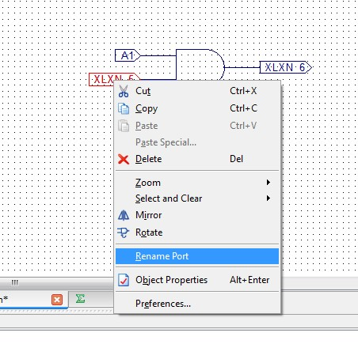
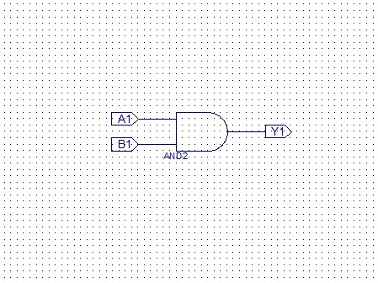
Put in some better names

Slide 60
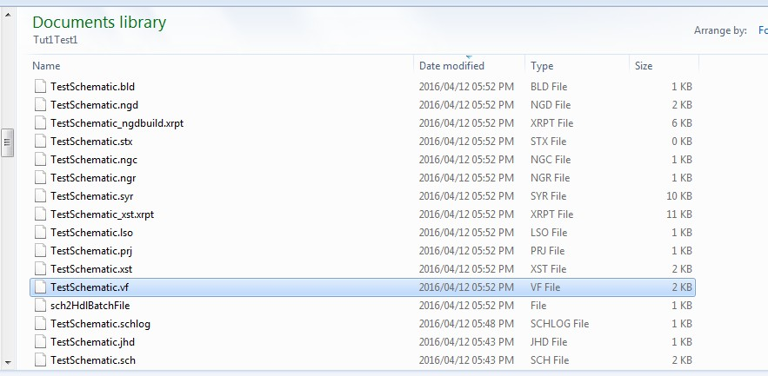
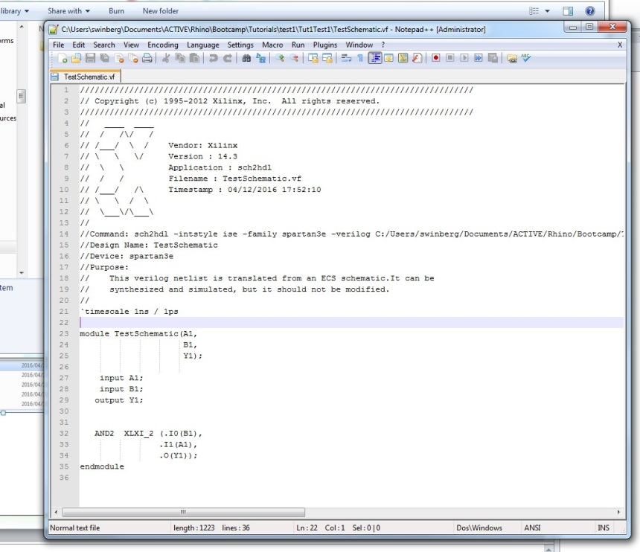
Generating the Verilog…
You need to run synthesis to generate the Verilog code (only works if you chose Verilog as preferred language)
Once done, look for the VF file with the same name as the schematic file.
Code is fairly human readable although some obscure, automatically generated symbols names are added (e.g. XLXI_2)
Further discussion about Schematic to Verilog: http://www.edaboard.com/thread217131.html
and Schematic to VHDL: http://stackoverflow.com/questions/8968982/how-to-generate-vhdl-code-from-a-schematic-in-xilinx

Slide 61
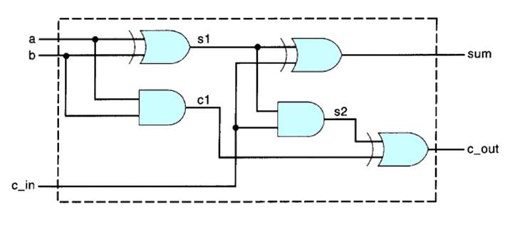
Suggested assignment
A
B
Sum
Carry
C
This is a 4-bit adder design. Try to convert this into Verilog.
Try to run on one or a few of the simulation tools presented in next slides…

Slide 62
Supplement
If you have QuartusII installed already you could of course also use it for experimenting and generating Verilog…
You may find the QuartusII simulator easier to use, which could be a reason to use this tool.

Slide 63
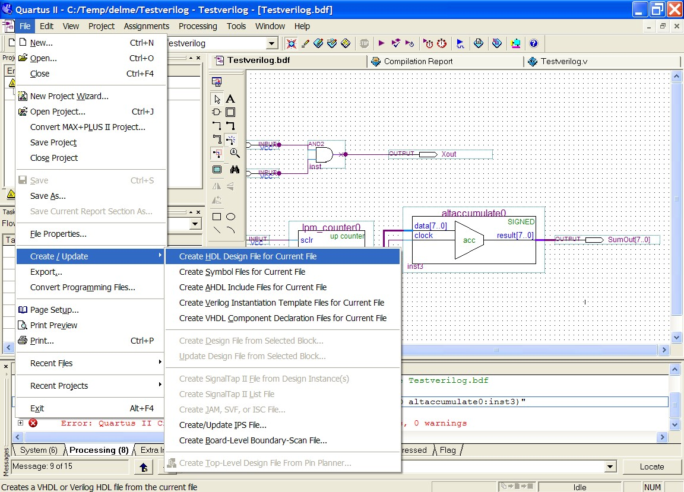
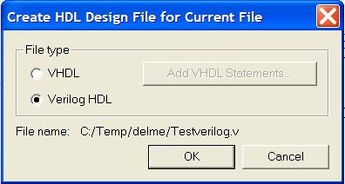
Learning Verilog in QuartusII
One approach is using a block diagram and converting to Verilog HDL.
E.g. using Altera Quartus II
(See test1.zip for example Quartus project)

Slide 64
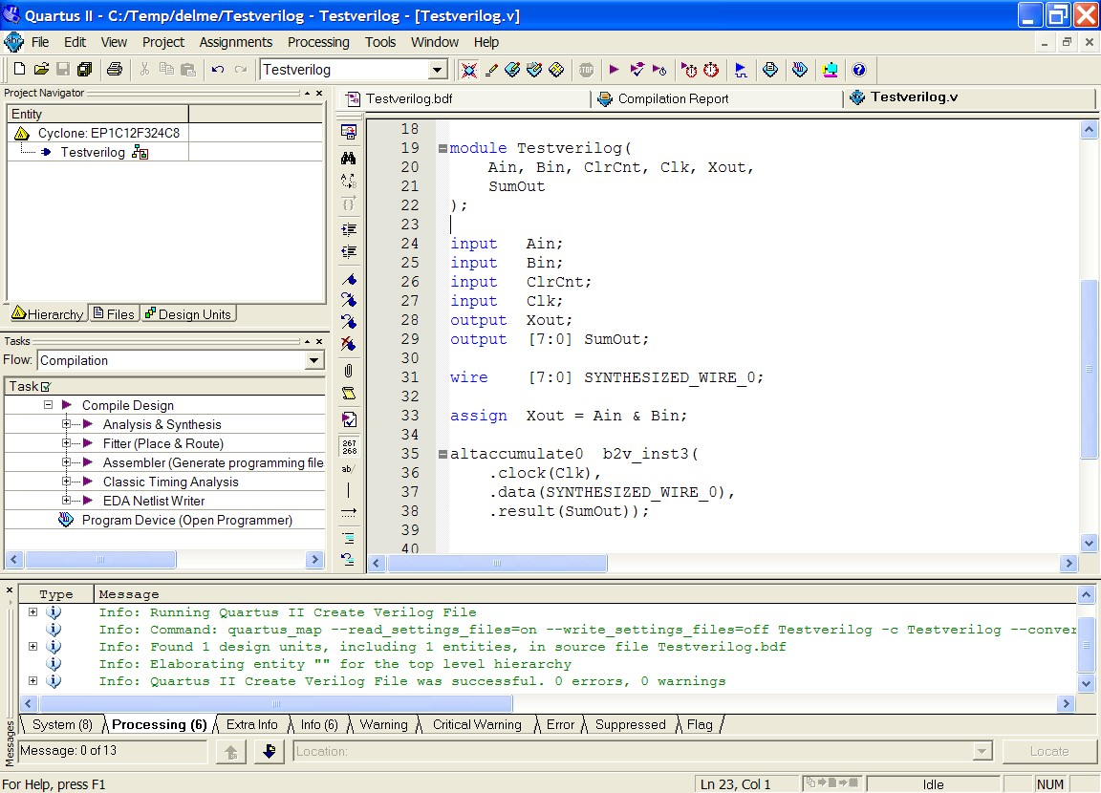
Learning Verilog
One approach is using a block diagram and converting to Verilog HDL.
E.g. using Altera Quartus II
See how param types are
specified
See how in QuartusII included modules are instantiated and ports explicitly mapped (Xilinx chose not to do the explicit port mapping when converting from schematic to code)

Slide 65
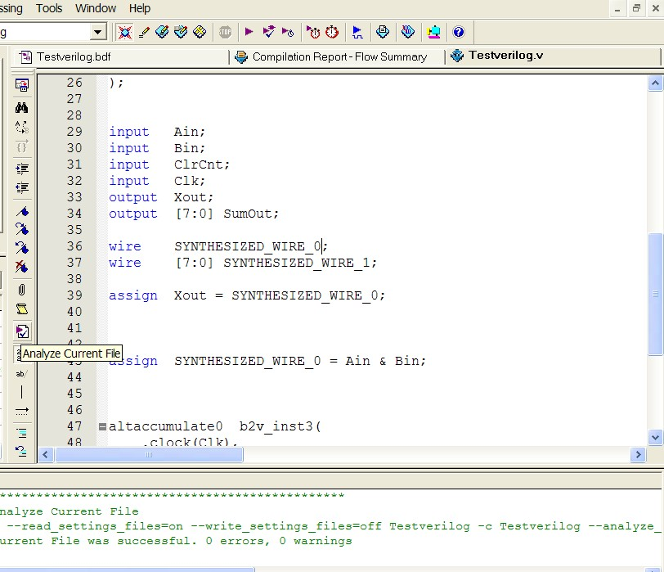
Checking syntax
I find a handy tool is the file analyser tool in Quartus II. This can be used to check the syntax of the file without having to go through the whole build process.

Slide 66
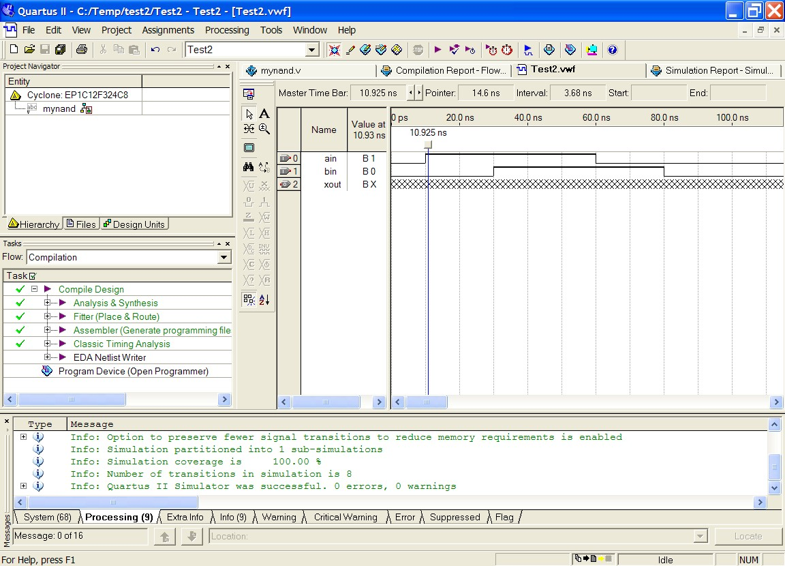
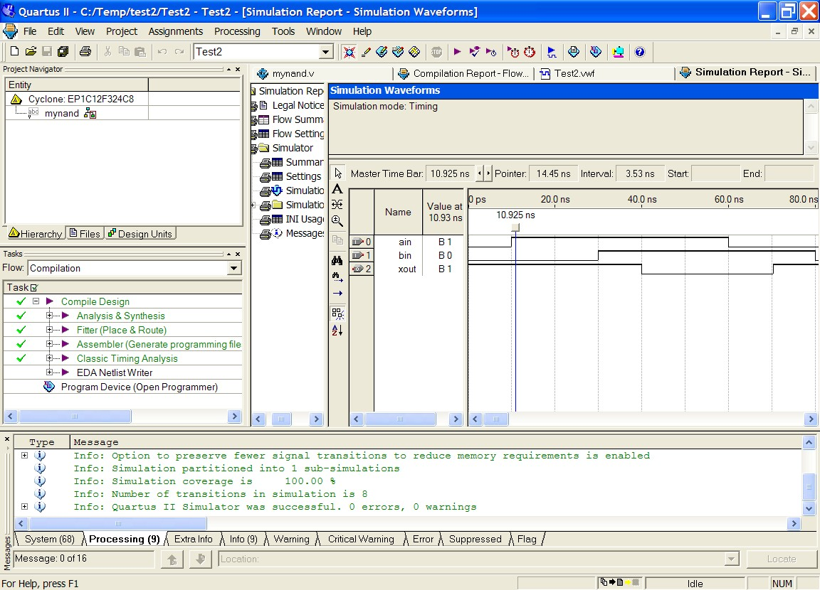
Testing
(See test2.zip for example Quartus project that contains only Verilog files and waveform file)
Running the simulation should allow you to verify the design is working as planned (i.e. NANDing)
Load the Test2 file, if using Quartus make sure that mynand is the top level Entity

Slide 67

Suggested study ideas…
See Verilog tutorials online, e.g.:
  http://www.verilogtutorial.info/
Icarus Verilog – An open-source Verilog compiler and simulator
  http://iverilog.icarus.com/
  Try iverilog on forge.ee
Gplcver – Open-source Verilog interpreter
  http://sourceforge.net/projects/gplcver/
  Try cver on forge.ee
Verilator – An open-source Verilog optimizer and simulator
  http://www.veripool.org/wiki/verilator
Comprehensive list of simulators:
http://www.asic-world.com/verilog/tools.html

Slide 68
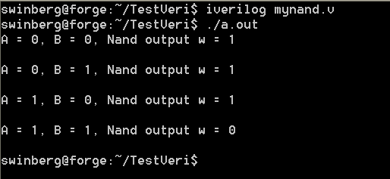
Icarus Verilog
Probably the easiest free open-source tool available
Excellent for doing quick tests.
Takes very little space (a few megs) & runs pretty fast.
Installed on forge.ee
For Ubuntu or Debian you can install it (if you’re linked to the leg server), using: apt-get install iverilog
Iverilog parsing the Verilog code and generates an executable the PC can run (called a.out if you don’t use the flags to change the output executable file name)
I suggest the following to get to know iverilog… upload mynand.v example to forge.ee, compile it with iverilog. Run it. Try changing the testbest code, put in some more operations
  http://iverilog.icarus.com/

Slide 69
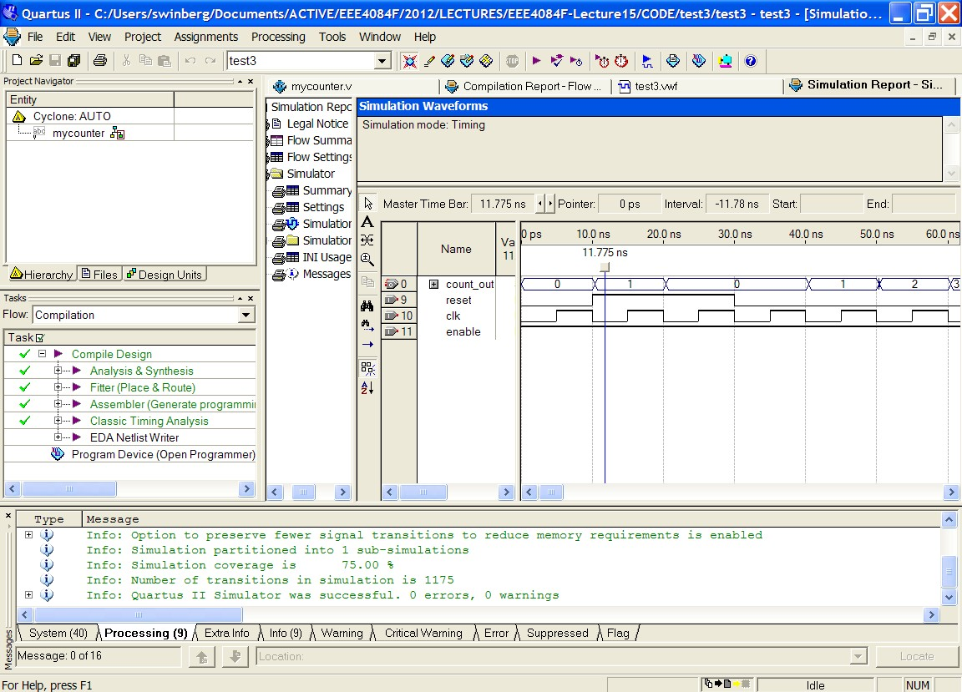
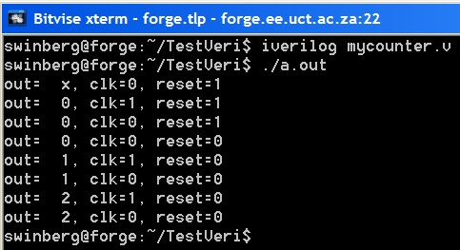
More Experimenting
Try test3 or mycounter.v as a more involved program and test
Experiment with using both Altera Qauartus II, Icarus Verilog, and Xilinx ISE ISim

Slide 70

Intro to Xilinx ISE using simulation
Xilinx ISE Simulation Tutorial.mp4
Short video
https://www.youtube.com/watch?v=pkJAWpkaiHg

Slide 71
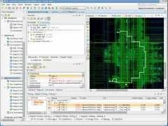
Intro to Xilinx Vivado
Short video
http://www.youtube.com/watch?v=H6W4HKbjnaQ

Slide 72
Disclaimers and copyright/licensing details
I have tried to follow the correct practices concerning copyright and licensing of material, particularly image sources that have been used in this presentation. I have put much effort into trying to make this material open access so that it can be of benefit to others in their teaching and learning practice. Any mistakes or omissions with regards to these issues I will correct when notified. To the best of my understanding the material in these slides can be shared according to the Creative Commons “Attribution-ShareAlike 4.0 International (CC BY-SA 4.0)” license, and that is why I selected that license to apply to this presentation (it’s not because I particularly want my slides referenced but more to acknowledge the sources and generosity of others who have provided free material such as the images I have used).
Image sources:
man working on laptop – flickr
scroll, video reel, big question mark – Pixabay http://pixabay.com/ (public domain)
References: Verilog code adapted from
http://www.asic-world.com/examples/verilog

