Slide 1



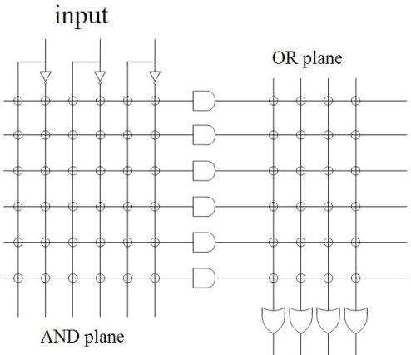
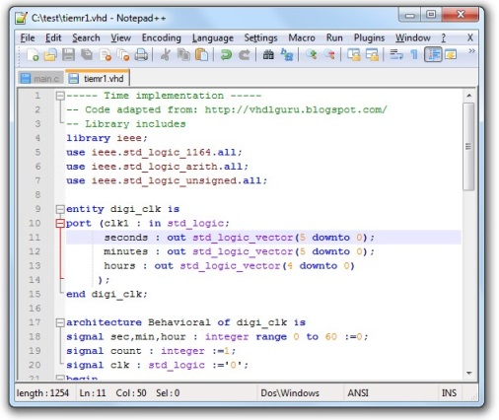
EEE4084F
Digital Systems
Lecture 18 X:
HDL & VHDL Quick Recap
Lecturer:
Simon Winberg
Attribution-ShareAlike 4.0 International (CC BY-SA 4.0)

Slide 2
Outline for today
HDL & VHDL Recap

Slide 3
YODA Project
Reminder about forming your teams
HDL coding for YODA, can use either of these or a combination of them:
  VHDL
  Verilog
  Schematic editor
Can also integrate with software that runs on the host PC, e.g. could have a C program that communicates with the FPGA

Slide 4
HDL & VHDL Recap
EEE4084F

Slide 5
Why use a Hardware Description Language (HDL)?
Major reasons for using a HDL:
Towards better and more reliable designs
Avoid design errors
Reduce costs and time
General benefits of the HDL approach:
Rapidly model and test a functional system/subsystem
Means of modeling, testing, refining requirements and specification for a system
Formal verification (and an ‘interface’ to such mechanisms)
Testing designs options through use of simulation
Synthesis of ICs / digital logic systems

Slide 6
Summary of Elements of the VHDL Paradigm
Entity : A part of the system (can be a subsystem)
Ports : Connections (or interfaces) between
Behavior : What an entity does
Structure : What an entity comprises
Analysis : Checks syntax, etc. Does various automated tests and simulations on the design to verify that it can be synthesized and deployed on a particular programmable device / IC.
Test Bench : How entities or a whole design is tested
Synthesis : Deciding gates and how to connect them / generating the bitstream to configure the hardware.

Slide 7
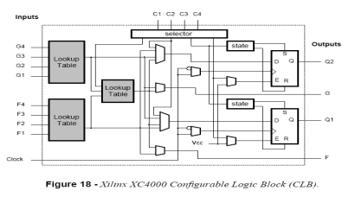
PLD/FPGA Development Flow
Design
Specification
Design and RTL Coding
- Behavioral or Structural Description of Design
- Writing VHDL, deciding i/o, formulating tests
RTL Simulation
- Functional Simulation
- Verify Logic Model & Data Flow
- View model-specified timing
LE
M512
Synthesis
- Translate Design into Device Specific Primitives
- Optimization to Meet Required Area & Performance Constraints
M4K
I/O
Place and Route (PAR)
- Map primitives to specific locations inside
FPGA with reference to area & performance
constraints
- Specify routing resources to use
… PTO …
This development cycle diagram is an adaptation of that
prepared by Dr. Junaid Ahmed Zubairi,
Avail: http://www.cs.fredonia.edu/zubairi/training/fpga.ppt

Slide 8
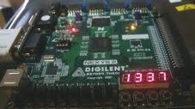
Development Flow
Place and Route (PAR)
t_{clk}
Timing Analysis
- Verify performance specifications
- Static timing analysis
Gate Level Simulation
- Timing simulation
- Verify design will work on target platform
Program and test on hardware
- Generate bit file
- Program target device
- Activate the system

Slide 9




Development Flow:
Where is most time spent?
Every development project is different. In my own experience,
most of the time is probably spent…
Eish!
Design and RTL Coding
- Behavioral or Structural Description of Design
- Writing VHDL, deciding i/o, formulating tests
t_{clk}
Timing Analysis
- Verify performance specifications
- Static timing analysis
Engineer’s
time
Eish!
Place and Route (PAR)
- Map primitives inside FPGA
- Specify routing resources to use
PC’s time

Slide 10

VHDL Basics
What VHDL stands for….
VHSIC =
Very-High-Speed Integrated Circuit
VHDL =
VHSIC Hardware Description Language
VHDL =
Very High-level Description Language
+
VHDL =
Very Hard Development Language
*
+
(although you would be kind of right to say VHDL has these properties)
*

Slide 11
VHDL Terms and Keywords
Entity: designs are expressed in terms of entities, these are components that are interfaced together via ports and maps
Architecture: Describes the behaviours of the entity. Each entity can have multiple architectures.
Configuration: binds a component instance to a entity-architecture pair
Architecture
Entity
(black box)
← Configuration ←
Ports
Source: Perry, D. 2002. VHDL Programming by Example. 4th ed. McDraw-Hill.

Slide 12
Important Terms
Top-level module: module at the top of the hierarchy
Package: collection of commonly used data types, subroutines, for implementing architectures
Driver: source on a signal
Bus: a signal that can have its sources turned off
Signal vector: what we usually think of as a bus
Attribute: data attached to VHDL objects (e.g., event status)
Generic: a parameter to pass information to an entity
Process: a basic unit of execution. Multiple processes are usually active at a time.
Source: Perry, D. 2002. VHDL Programming by Example. 4th ed. McDraw-Hill.

Slide 13
VHDL Example
Let’s implement this combinational logic circuit:
A
AND2
C
B
1-bit output
1-bit inputs
AND2 operation: C = A AND B

Slide 14
VHDL Example
Start by defining the entity:
-- Here’s a comment
library IEEE;
use IEEE.STD_LOGIC_1164.ALL;
entity AND2 is
port ( A : in STD_LOGIC;
B : in STD_LOGIC;
C : out STD_LOGIC );
end AND2;

Slide 15
VHDL Example
Then add an architecture:
…
architecture AND2bhv of AND2 is
begin
C <= A and B; -- The <= links signals and ports
end AND2bhv;
Name of this architecture
Name of architecture
As is the program should compile in Xilinx ISE; the system will create an
instance of AND2 as it is the top level module, so no need to add an explicit configuration statement.

Slide 16
Concurrent operation
Each statement in a VHDL architecture block executes concurrently, whenever there is a change / event
e.g.
  C <= A and B; -- executes when A or B changes
  D <= A or B; -- executes when A or B changes
If A were to change (e.g. A changes from 0 to 1) then both the lines will execute at once)

Slide 17
Sequential operation
Sequential operation is described within a PROCESS block. Example:
library ieee; use ieee.std_logic_1164.all;
entity fulladder is
port (A1, A2, Cin: in std_logic;
sum, Cout : out std_logic );
end fulladder;
architecture arch1 of fulladder is
begin
process(A1,A2,Cin) -- define a sequential operation
begin
sum <= Cin xor A1 xor A2;
Cout <= (A1 and A2) or (Cin and (A1 xor A2));
end process;
end arch1;
General rule for end: if the structure has a name say ‘end name’, if it doesn’t ‘use structure_keyword’.
Sensitivity list (note not sensitive to Cout)
This line runs first
Then this line runs
Note: two process blocks in the same architecture
block run concurrently
A process doesn't have a name so you have to say ‘end process’

Slide 18


VHDL coding
Best way to learn VHDL is to practice coding with it.
General thing to remember to get the syntax right:
Outside a PROCESS:
COMPONENT declaration
SELECT statement
WHEN – conditional assignment
Inside a PROCESS:
IF-THEN-ELSE
CASE statement
But if you haven’t done VHDL then note…
See the VHDL Cheat Sheet on VULA

Slide 19
VHDL coding
?
Note that: we will dive into Verilog to prepare you for Prac4.
So if you haven’t done VHDL, might as well focus on Verilog.
But take note:
Computer engineers often end up having to manage with both flavors of HDL to save time by reusing designs.
The YODA project can be done in either VHDL, Verilog or a combination of the two.
Many large projects end up being a combination of the two just because: engineers might not know the other, or the one HDL might be better suited to solving a problem than the other.

Slide 20
Recommended Steps for
VHDL coding
Plan dataflow and code entities
Implement behaviours
Structural modelling (build complex entities using lower level ones)
Recommended online VHDL support:
http://esd.cs.ucr.edu/labs/tutorial/
This site provides a collection of useful VHDL example code and tutorials

Slide 21
Next lecture
Verilog coding

Slide 22
Disclaimers and copyright/licensing details
I have tried to follow the correct practices concerning copyright and licensing of material, particularly image sources that have been used in this presentation. I have put much effort into trying to make this material open access so that it can be of benefit to others in their teaching and learning practice. Any mistakes or omissions with regards to these issues I will correct when notified. To the best of my understanding the material in these slides can be shared according to the Creative Commons “Attribution-ShareAlike 4.0 International (CC BY-SA 4.0)” license, and that is why I selected that license to apply to this presentation (it’s not because I particulate want my slides referenced but more to acknowledge the sources and generosity of others who have provided free material such as the images I have used).
Image sources:
PLD illustration on title slide - Wikipedia Open Commons
FPGA chip illustrations - Wikipedia Open Commons
Stuck in Mud – fickr (CC2 for free reuse and modification)
Typing ninja – Pixabay http://pixabay.com/ (public domain)

