Slide 1


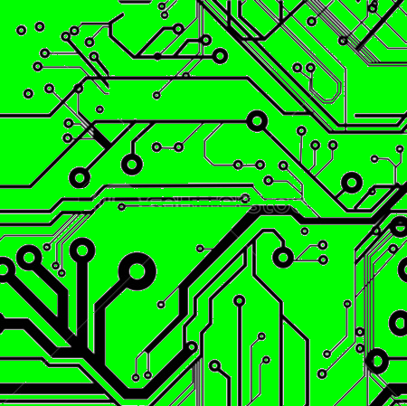
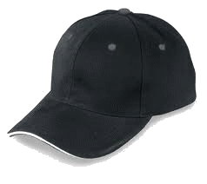
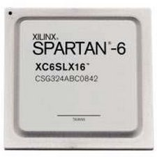
EEE4084F
Digital Systems
Lecture 19
FPGA & CPU Performance Comparison
FPGA Families
Lecturer:
Simon Winberg
Attribution-ShareAlike 4.0 International (CC BY-SA 4.0)

Slide 2
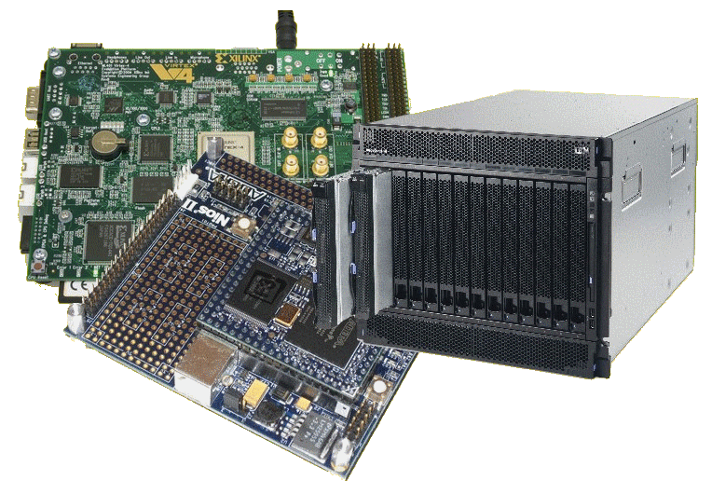
Lecture Overview
FPGA performance evaluation
FPGA vs CPU performance
FPGA families
YODA issues

Slide 3
Evaluating Performance
Evaluating synthesis (simplified) of an FPGA design

Slide 4
HDL to FPGA execution & LE cost
In order to implement a HDL design, the design need to be decomposed and mapped to the physical LBs on the FPGA and the interconnects need to be appropriately configured.
Example:
x = AND(e,f,g)
y = AND(b,NAND(NAND(b,c),d))
out = NAND((NAND(x,y),NAND(a,y))
Map ‘AND(e,f,g)’ to LB1
Map ‘NAND((NAND(x,y),NAND(a,y))’ to LB2
x
out
y
Map ‘AND(b,NAND(NAND(b,c),d)) ’ to LB3
Costing: 3 LBs, 8 LEs (assuming LBs have LEs that are AND or NAND gates)

Slide 5
Timing calculations
The previous slide didn’t show whether the connections were synchronized (i.e., a shared clock) or asynchronous –since they are all logic gates and no clocks show it’s probably asynchronous
Determining the timing constrains for synchronous configurations are generally easier, because everything is related to the clock speed. Still, you need to keep in mind cascading calculations.
For asynchronous use, the implementation could run faster, but can also become a more complicated design, and be more difficult to work out the timing…

Slide 6
Async Timing calculations
Keep in mind that the propagation delays for the various gates / LUTs may be different – for example, in the previous example, let’s assume each AND may take 6ns to stabilise, and the NANDS 10ns.
So time to compute out is =
  MAX OF (time to compute x, time to compute y) + 2x10ns = (2x10ns+6ns) + 20ns = 46ns = pretty fast!! Or is it??
  Compared to a 1GHz CPU using just registers (and no mem access)?
  Try this calculation for yourself ...
  (assume each instruction takes on avg. 3 clocks due to pipeline,
  data dependencies, etc, as worst case performance on a
  RISC processor)

Slide 7
Comparing to CPU speed
CPU running at 1GHz → each clock 1ns period
Assume each instruction takes ~ 5 clocks each due to pipeline etc
CODE:
int doit ( unsigned a, b, c, d, e, f, g ) {
unsigned x = AND(e,f,g);
unsigned y = AND(b,NAND(NAND(b,c),d))
out = NAND((NAND(x,y),NAND(a,y))
return out;
}
But some of these
Can’t be done as just 1
RISC instruction.
unsigned t1 = AND(e,f); → 1 instruction, i.e. AND t1,e,f
unsigned x = AND(t1,g);
unsigned t1 = NAND(b,c)
unsigned t2 = NAND(t1,d)
unsigned y = AND(b,t2)
t1 = NAND(x,y)
t2 = NAND(a,y)
out = NAND(t1,t2)
in all 8 instructions → 8 x 3 clocks ea.
= 24 ns (assuming all registers pre-loaded)
A speed-up of 1.92 over the FPGA case

Slide 8
Digital Clock Manager (DCM) blocks
An important element included in FPGA designs nowadays are DCM blocks, which are used to eliminate clock distribution delay and can also increase or decrease the frequency of the clock

Slide 9
FPGA Families
EEE4084F

Slide 10
The Manufacturers
The ‘Big 2’ (most commonly used)
  Xilinx – Capital $8.52B, 2984 employees
  Altera – Capital $12B, 2555 employees
The others pretty big ones…
  Actel (Microsemi Corp) – $2B capitalizations, 2250 employees
  Lattice Semiconductor Corp – $700M capitalizations, 708 employees
Sources: “100 Power Tips for FPGA Designers” – based on 2011 stats

Slide 11
About the FPGA Families
Xilinx
  Focusing on high performance and high capacity
    e.g. Vertex family (such as Vertex 7)
  Provides lower-cost options with high capacity (e.g. Spartan 6 family)
  Range of variations, e.g. low power options, economy (lower capacity) models.
Note that the top performance FPGA changes over time and is not necessarily consistently one or other of the manufacturers

Slide 12
About the FPGA Families
Altera
  Stratix: higher performance and density models (e.g. Startix-10)
  Arria: mid-range, lower-power, but also lower performance and denisity compared to Stratix.
  Cyclone: lowest cost option, also aimed at low power, cost sensitive and mobile applications

Slide 13
About the FPGA Families
Actel
  Focuses on providing the lowest power, and widest range of small packages
  IGLOO : low power, small footprint
  SmartFuson : Mixed FPGA and ARM processor
  RTAX/RTSX : radiation tolerant and very high reliability.

Slide 14
About the FPGA Families
Lattice
  Range of options (low power; high performance; small package)
  Own specialized development tools
  (of these four, this one is the only firms not in California; they are currently in Oregon)

Slide 15
About the FPGA Families
Others
  Achronix – focusing on building the fastest FPGAs (not necessarily highest capacity)
  Tabula – unique FPGA technology ‘SpaceTime’, focusing on highest capacity and memory capabilities

Slide 16
Memory jogger…
Q: Name a high-capacity FPGA family.
A: Xilinx Vertex (e.g. ver 7+) / Altera Stratix (ver 10+)
Q: Which of the following is a FPGA manufacturer ?
(a) Acrobatics
(b) Geometrix
(c) Achronix
Note that the producers are constantly bringing out new versions so this slide may get stale quite quickly.

Slide 17
YODA Issues
EEE4084F

Slide 18

Project Teams
Start ASAP with forming a project team
Teams should be 2 or 3 members each
Ideally, you want a diverse team, a teammate to bring in different
perspectives, alternate experiences and a variety of skills.
Allocate team member roles as well (see spreadsheet)
Good team dynamics doesn’t necessitate a mad party
(To have a ‘special’ team of a different size, e.g. of 4, please check with lecturer)

Slide 19

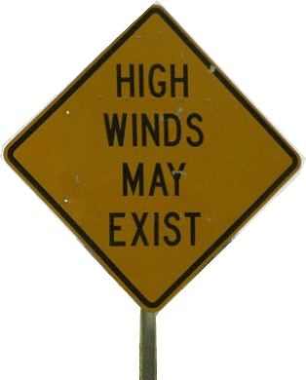
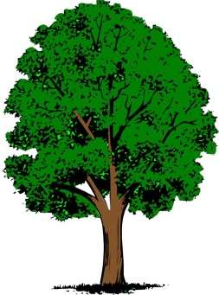


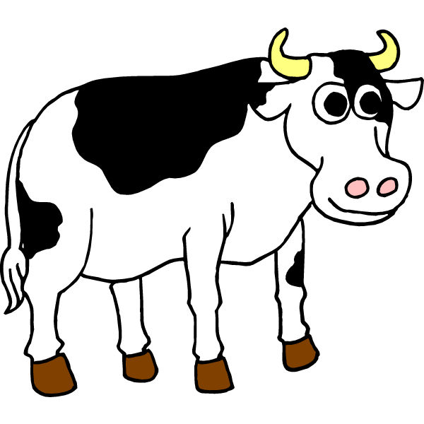
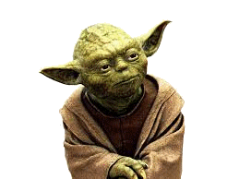
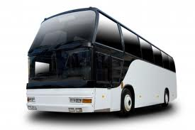
A whirlwind tour
YODA Projects

Slide 20
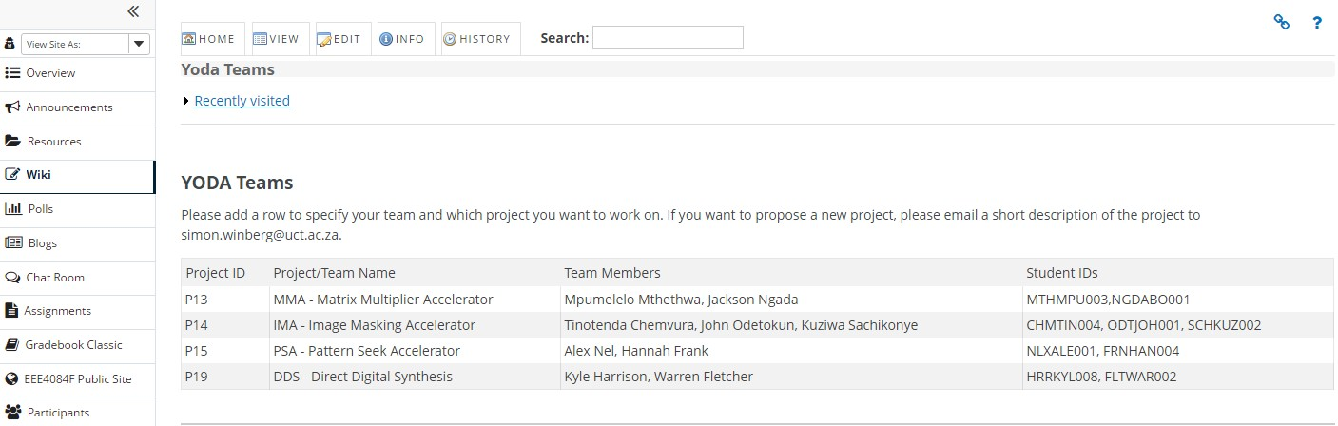
Forming a team
Please use the wiki to capture your team composition and topic. (see Yoda Teams in the wiki)

Slide 21
YODA Proj ID & Blog | Project/Team Name | Team Members | Student IDs
P00 | MP3 Player (example entry) | Dodo Johns, John Doe, Jane Doe | JOHDXX341, …, …
P18 | PADAWAN | Keegan Crankshaw, Liam Clark, Andrew Olivier | CRNKEE002, CLRLIA002, OLVAND008
P10 | BCDC - Binary Coded Decimal Converter | Mutafa Rashid, Tatenda Muvhu, Petrus Kambala | RSHMUS001, MVHADM001, KMBPET001
P14 | IMA - Image Masking Accelerator | Xolisani Nkwentsha, Sange Maxaku, Thapelo Nthithe | NKWXOL003, MXKSAN002, NTHTHA012
P17 | VADER - VERSATILE ACCELERATED DIGITAL ENCRYPTION RECOVERY | Munsanje Mweene, Claude Betz | MWNMUN001, BTZCLA001
P05 | DM - DELTA MODULATOR | David Fransch, Thato Semoko | FRNDAV011, SMKTHA004
P03 | IF - Interpolation filter | Lebohang Mbele, Tato Moaki, Mashau Zwivhuya | MBLLEB006, MKXTAT001, MSHZWI001
P13 | MMA | Qayyoom Arieff, Ashentha Naidoo, Prej Naidu, Muhammed Razzak | ARFABD001, NDXASH016, NDXPRE047, RZZMUH001
P16 | DE - DATA ENCRYPTION ACCELERATOR | Alexandra Barry, Edwin Samuels, Nicholas Antoniades | BRRALE004, SMLEDW002,ANTNIC006
P20 | Polyphase Filtering | Sylvan Morris, Alex Knemeyer | MRRSYL001, KNMALE002
24 students assigned, still a couple more teams need to be formed!

Slide 22
Topic listing
YODA PROJECT TOPICS
P01: SF - Smoothing Filter
P02: CAM - Content Addressable Memory
P03: IF - Interpolation filter
P04: PRNG - Parallel Random Number Generator
P05: DM - Delta modulator
P06: ASG - Arithmetic series generator
P07: SALG - Selection Address List Generator
P08: FSG - Function Samples Generator
P09: BSS - Bit Sequence Sniffer
P10: BCDC - Binary Coded Decimal Convertor
P11: NCSM - Nonlinear Check Sum Module
P12: MD5 - Message Digest version 5
P13: MMA - Matrix Multiplier Accelerator
P14: IMA - Image Masking Accelerator
P15: PSA - Pattern Seek Accelerator
P16: DE - Data Encryption Accelerator
P17: VADER - Versatile Accelerated Digital Encryption Recovery
P18: PADAWAN - Parallel Accelerator for Digitising Audio with Attenuation of Noise
P19: DDS - Direct Digital Synthesis

Slide 23
Preparing the Blog
View example Blogs in YODA Hall of Fame (see description)
Make sure you cover…
Preamble
  Topic name (big and clear)
  Names and main roles
Prototype / Specification
  Define problem and suggested solution [10 marks]
  Identified specs/design questions to solve [10 marks]
  Identify criteria for an acceptable solution [10 marks]
References & information sources [5 marks]

Slide 24
Back to some Verilog
Or short intermission

Slide 25
References & Acknowledgements
References sources used include:
  Todman, Timothy J., et al. "Reconfigurable computing: architectures and design methods." Computers and Digital Techniques, IEE Proceedings-. Vol. 152. No. 2. IET, 2005.
  Stavinov, Evgeni. 100 Power Tips for FPGA Designers. Evgeni Stavinov, 2011.
Acknowledgement
  Thanks to John-Philip Taylor (TA) for time taken to review slides and spotting typos and inaccuracies.

Slide 26
Disclaimers and copyright/licensing details
I have tried to follow the correct practices concerning copyright and licensing of material, particularly image sources that have been used in this presentation. I have put much effort into trying to make this material open access so that it can be of benefit to others in their teaching and learning practice. Any mistakes or omissions with regards to these issues I will correct when notified. To the best of my understanding the material in these slides can be shared according to the Creative Commons “Attribution-ShareAlike 4.0 International (CC BY-SA 4.0)” license, and that is why I selected that license to apply to this presentation (it’s not because I particularly want my slides referenced but more to acknowledge the sources and generosity of others who have provided free material such as the images I have used).
Image sources:
man working on laptop – flickr
scroll, video reel – Pixabay http://pixabay.com/ (public domain)
References: Verilog code adapted from
http://www.asic-world.com/examples/verilog

