Slide 1



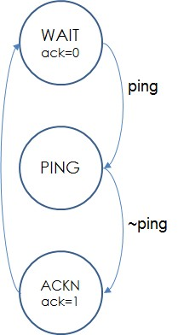
EEE4084F
Digital Systems
Lecture 20
More Verilog, Statemachine, Constraints
module myveriloglecture ( wishes_in, techniques_out );
…
// implementation of today’s lecture
…
endmodule
Lecturer:
Simon Winberg
statemachine
Attribution-ShareAlike 4.0 International (CC BY-SA 4.0)

Slide 2
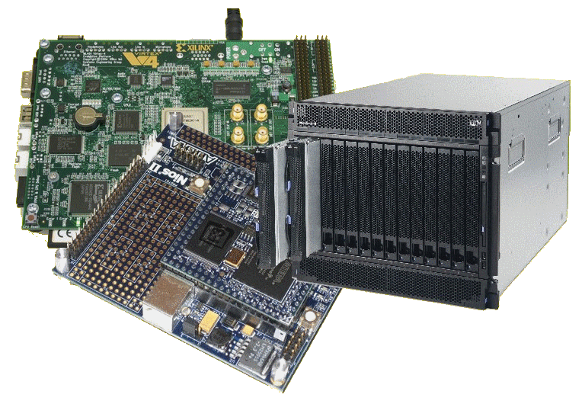
Lecture Overview
Brief recap
Busses and endianess
Functions in Verilog
Implementing state machines
Constraints
UCF Files

Slide 3
Module declaration (recap)
Modules are defined in Verilog as follows:
module mymodule (a, b, x, y);
input a, b; // these are inputs, usually first
output x, y; // outputs, listed usually after inputs
x <= or(a,b); // these all executed at same time:
y <= and(a,b);
endmodule // no semicolon needed after endmodule

Slide 4
Initial block
module testbench; // top level module
wire a, b, x; // set up some signals
add myadd(a,b,x); // module to test
myAnd_tb1 tb(a, b, x); // use this test
endmodule;
module myAnd_tb1(a,b,x);
input a,b;
output x;
reg a, b; // registered inputs
initial begin
// log these signals as follows:
$monitor ($time,
“a=%b, b=%b, x=%b”, a, b, x);
// exercise the signals
a = 0; b = 0;
#10 b = 1;
#10 a = 1;
#10 b = 0;
#10 $finish; // tell simulator to quit
end // end initial
endmodule
The initial block is like a constructor for a Verilog module in simulation. It is activated the first time the module starts up.
Used in simulation to set up conditions and to implement test benches.

Slide 5
Monitor : a standard Verilog simulation operation
The monitor operation is sensitive to a selection of signals. Whenever one of the signals change, it prints out whatever is requested to be printed, using a printf type formatting
$monitor(text,signals) — give it a string (or multiple strings) followed by a list of variables.
e.g. $monitor(“mysigs: ”, “a=%b b=%b:”, a,b);
Examples:
$monitor($time,”a=%b”,a); // displays time value followed by a=xx (bin val)
// $time is actually a string value

Slide 6
The always@ (sensitivity_list)
The always@ expression is used within a Verilog module to group operations that activate whenever the sensitivity list is triggered
Syntax:
always @ (<sensitivity1, sensitivity2, …>)
begin
<actions>
end
Used in behaviour descriptions and statemachines
Example: Implementing a D-type flip-flop …

Slide 7
always@ Example : D-type Flip Flop
module flipflop (din, clk, rst,q);
input din, clk, rst;
output q;
reg q; // q is a registered output
always @ (posedge clk) // whenever clk
begin
if (rst == 1) q = 0; // keep q low in reset
else q = din;
end
endmodule

Slide 8
Busses & endian
Busses or bit signal vectors are specified as follows:
  reg [20:0] dataA; // little endian LSB in bit 0
  reg [0:20] dataB; // big endian MSB in bit 0
It doesn’t really matter if you are using them just as busses, it is only relevant when applying operations such as add.
Question: Can you say dataA <= dataB without an error?

Slide 9
Functions in Verilog
functions are not
modules in Verilog
Functions can be used as macros within the body of a Verilog module.
  These can effectively save typing.
  They work differently to module instantiations.
  These are defined inside a module.
  Can only have input parameters
Example:
reg [15:0] a;
wire [15:0] x;
assign b = negate (a);
initial begin
a=10;
a = add(1, a);
$display(" a=%b -a=%b”, a, b);
end
function [31:0] negate;
input [31:0] a;
negate = ~a;
endfunction

Slide 10
Example function:
Converting endianness
If need be you can construct a function to convert endianness, e.g.:
  function [31:0] toBigEndian;
  // transform data from little-endian to big-endian
  input [31:0] x;
  toBigEndian = {x[7:0], x[15:8], x[23:16], x[31:24]};
  endfunction

Slide 11
Vectors & Signal concatenation { }
Syntax for concatenating wires: { x1, x2, … xn } the collective can be used just the same as any other variable.
module adder4 (a, b, cin, sum, cout);
input [3:0] a, b; // 2x 4 bit vector inputs
input cin; // carry input
output [3:0] sum; // 4-bit little endian vector
output cout; // carry out
// perform the adder operation
assign {cout,sum} = a + b + cin;
// the leftmost is MSB since it is little endian
endmodule
i.e. if the input is little endian so is the output
If you said {sum,cout}=A

Slide 12
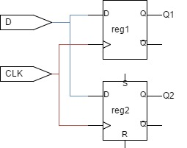
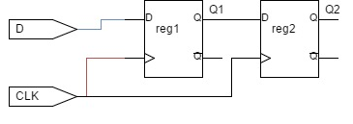
Blocking/Non-blocking statemets
Blocking
Non-blocking
module blockFFs (
input D, input clk,
output reg Q1, output reg Q2)
always @ (posedge clk)
begin
Q1 = D;
Q2 = Q1;
end
endmodule
module nonblockFFs (
input D, input clk,
output reg Q1, output reg Q2)
always @ (posedge clk)
begin
Q1 <= D;
Q2 <= Q1;
end
endmodule

Slide 13
Implementing a FSM
Creating finite state machines in Verilog

Slide 14
Statemachines
A state machine has:
  Input events
  Output events
  Set of states
  A function that maps
  (state,input) → (state,output)
  A indication of the initial state
A Finite State Machine (FSM) has a limited number of states

Slide 15
Implementing a FSM with Verilog
The state machine needs a register to store its state
It is sensitive to zero or more inputs, which can change state and/or produce an output

Slide 16
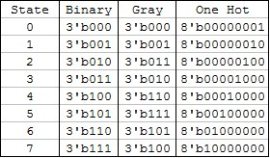
The state register
States could be numbered in sequence 0 .. 2^{n}-1 where n is the number of bits for the state.
Or a different encoding / ordering scheme could be used to make state changes more robust, e.g.:
  use of grey scale or ‘one hot’
  encoding (where ‘one hot’
  means there is just one pin
  in the state set at a time)

Slide 17
The states and state changes
Need a means to force initial state at startup (i.e. reset state register)
  Typically a reset handler does this.
Specifying and changing states
  Usually a case construct is used to define the states, but could use ifs and elses
Need to decide if the statemachine
  is synchronous (clocked) or
  asynchronous (activates whenever an input changes)
May need recovery mechanism (e.g. watchdog or recovery default state)

Slide 18
Example Statemachine
AliveFSM
Sends blip out ack if pinged
// Code your design here
module alivefms (input clk, input reset, input ping, output reg ack,
output reg[1:0] state);
parameter [1:0] WAIT = 2'b11;
parameter [1:0] PING = 2'b01;
parameter [1:0] ACKN = 2'b10;
always @(posedge clk or posedge reset or
posedge ping or negedge ping)
begin
if (reset)
begin
state <= WAIT;
ack <= 0;
end else
begin
case(state)
WAIT: begin
if (ping) state <= PING;
else state <= WAIT;
ack <= 0;
end
PING: if (ping) state <= PING;
else state <= ACKN;
ACKN: begin
ack <= 1;
state <= WAIT;
end
default: state <= WAIT;
endcase
end
end
endmodule
ping
ack
clk
← Activation
WAIT
ack=0
← Start up
ping
PING
← States
~ping
ACKNack=1
← Recovery
…
Notes: Must only send ack only after ping goes low

Slide 19
Create a testbench
// testbench for alivefsm
module alivefms_tb ();
reg clk, reset, poke;
wire ack;
wire [1:0] state;
integer i;
// instantiate the FSM
alivefms alivefsm_tb (clk,reset,poke,ack,state);
initial // method for testing the FSM:
begin
// enable monitoring of wires of interest
$monitor("reset=%d state=%d poke=%d ack=%d\n",
reset,state,poke,ack);
clk = 0; reset = 1; #5 // do the reset
reset = 0; clk=0; #5
poke = 1; clk=1; #5 // poke the fsm
poke = 0; #5 // release poke
clk = 0; #5 // needs a clk transition
clk = 1; #5
if (ack == 1) // check if worked as planned
begin
$display("SUCCESS\n");
end
end
endmodule
Avail onlne at: https://www.edaplayground.com/x/25N5

Slide 20
Run on iverilog (or other sim)
$ iverilog '-Wall' design.sv testbench.sv && unbuffer vvp a.out
reset=1 state=3 poke=x ack=0
reset=0 state=3 poke=x ack=0
reset=0 state=1 poke=1 ack=0
reset=0 state=2 poke=0 ack=0
reset=0 state=3 poke=0 ack=1
SUCCESS
Done

Slide 21
Attributes and Constraints
A Xilinx Perspective

Slide 22
Difference between Attributes and Constraints
Two types of attributes:
  Predefined attributes (a part of the 1076 standard*)
  Those outside the standard provided by the designer or by the design tool supplier (such as Xilinx or Altera)
* http://vhdl-manual.narod.ru/books/ieee_manual.pdf

Slide 23
Classes of FPGA constraints
Grouping Constraints
Timing Constraints
Logical Constraints
Physical Constraints
Mapping Directives
Placement Constraints
Routing Directives
Synthesis Constraints
Configuration Constraints
Source: http://xilinx.eetrend.com/files-eetrend-xilinx/forum/201103/1746-3205-02a_ucf_editing_12.pdf

Slide 24
Where constrains can be defined
Depending on a attribute they can be defined in various places:
  Constraints Editor for Timing Constraints
  Floorplanner for Non-timing placement constraints
  PACE for IO placement and area constraints
  Floorplan Editor for IO placement and area constraints
  Schematic and Symbol Editors for IO placement and RLOC constraints
The UCF (User Constrains File) is where you can manually (and quickly!!) define constraints, we will focus on this option.

Slide 25
UCF
Xilinx User Constraints Files

Slide 26
UCF Files
UCF files are in ASCII
They are used to specify constraints on the logical design
You can use your favorite text editor to edit them UCF (can edit in ISE)
NCF file:
  this often goes with UCT file.
  The Netlist Constraint File (NCF) is also an ASCII file that is usually generated by some synthesis programs

Slide 27
UCF Files Syntax
UCF files are generally case sensitive
However any Xilinx constraint keyword (e.g., LOC, PERIOD, LOW, HIGH) may be entered in all uppercase, in all lower-case, or mixed case.
Each statement is terminated by a semicolon (;) - the errors are sometimes cryptic, not obviously indicating missing the ‘;’.
Keep a blank line at the end of the file
Comments are started with # and end at the end of the line. The C / C++ comments // and /**/ are also supported

Slide 28
UCF Files Syntax
Each line have a structure such as:
  {NET|INST|PIN} “name” constraint;
Particular bus lines on a bus are indicated by using name<n> where n is the bit (counted from 0) that you want to refer to
Typical usage: setting location of pins
  NET reset LOC=P16;
  NET leds<0> LOC=P23;
  NET leds<1> LOC=P24;

Slide 29
UCF quick features
Wildcards can be used for the naming, such as
  The asterisk (*): represents any string of zero or more characters
  The question mark (?): represents a single character
Examples:
  NET “leds*” SLOW;
  NET “CLK?” FAST;

Slide 30
Xilinx Constraints Editor
The Xilinx Constraints Editor is useful for enter timing constraints
The GUI simplifies constraint entry by using wizards to guide the user through constraint creation, without needing to understand UCF file syntax.
Although it is useful to see what kinds of constrains result in the file as this could help speed up constrains entry/reuse in future projects

Slide 31
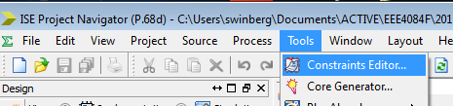
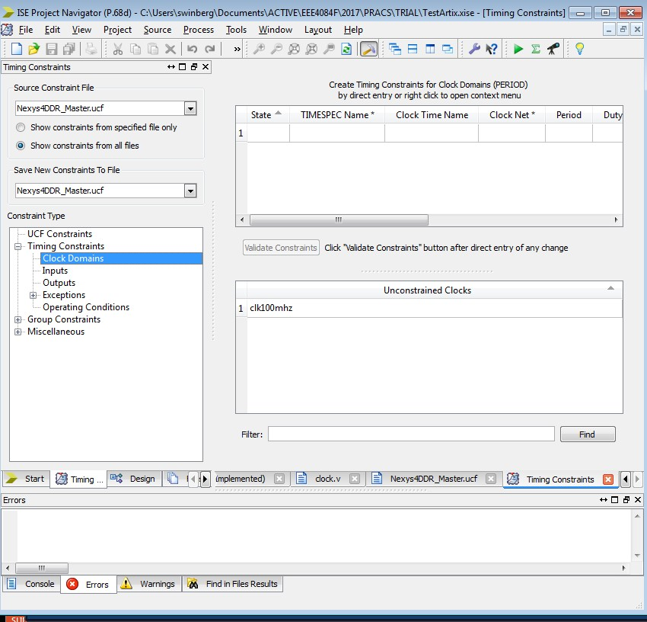
Constraints Editor
Runs synthesize etc.
Provides functions to find pins, to assign wires to groups, to structure clock domains.
Can view the UCF file lines in the “UCF Constraints” tab (this includes the comment lines).

Slide 32
PERIOD constraints
The PERIOD constraint provide accurate timing requirements, so it indicates…
  Clock skew between the source and destination
  registers / flip-flops
  Synchronous elements clocked on edge
  Unequal clock duty cycles
  Clock jitter
ISE uses this information to place and route elements of your design in an attempt to satisfy these requirements (and thus make the design work on hardware)

Slide 33
Example PERIOD constraint
The PERIOD statement covers all timing paths that start or end at a register, latch, or synchronous RAM that are clocked by the reference net
Assumptions…
  50% duty cycle on CLK line
  PERIOD constraint of 10 ns
Clocking
  Because reg2 will be clocked on the falling edge of CLK, the link between
  the flip-flops will be constrained to 50% of 10 ns = 5 ns
The implementation tools will automatically account for triggering the one flip-flop on the rising edge and another on the falling edge
FF1
FF2
CLK
BUFG
INV
NET clock PERIOD = 10ns ;

Slide 34
Tutorial on using UCF files
Recommended tutorial by Xilinx on understanding and using UCF files
  http://xilinx.eetrend.com/files-eetrend-xilinx/forum/201103/1746-3205-02a_ucf_editing_12.pdf
Exam hint: statemachines are highly likely to come up in the exam or class test, building statemachines is an essential skill for HDL developers.

Slide 35
Disclaimers and copyright/licensing details
I have tried to follow the correct practices concerning copyright and licensing of material, particularly image sources that have been used in this presentation. I have put much effort into trying to make this material open access so that it can be of benefit to others in their teaching and learning practice. Any mistakes or omissions with regards to these issues I will correct when notified. To the best of my understanding the material in these slides can be shared according to the Creative Commons “Attribution-ShareAlike 4.0 International (CC BY-SA 4.0)” license, and that is why I selected that license to apply to this presentation (it’s not because I particularly want my slides referenced but more to acknowledge the sources and generosity of others who have provided free material such as the images I have used).
Image sources:
man working on laptop – flickr
scroll, video reel, big question mark – Pixabay http://pixabay.com/ (public domain)
References: Verilog code adapted from
http://www.asic-world.com/examples/verilog

