Slide 1



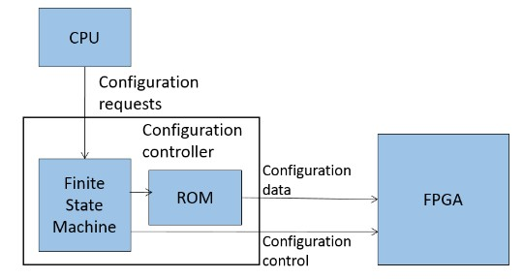
EEE4084F
Digital Systems
Lecture 21
More Verilog. Configuration Architectures. RC Building Blocks (IP Cores), basic handshaking, latches and other interface ingredients
Lecturer:
Simon Winberg
Attribution-ShareAlike 4.0 International (CC BY-SA 4.0)

Slide 2
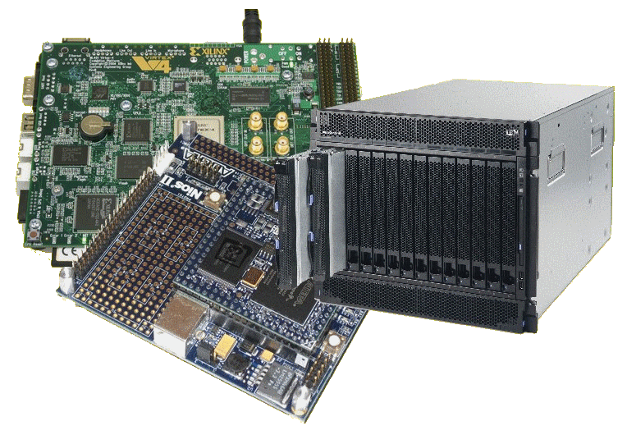
Lecture Overview
When to use assign
Blocking & non-blocking simulation and potential pitfalls
The unconditional always
Configuration
architectures
Digital signals,
Interface basics,
Using latches

Slide 3
When to use assign?
Assign is a continuous driver, it essentially links some source on the RHS to a wire
Assign is
  Used outside an always blocks
  Has a net or wire on the LHS
The syntax is:
  always netname <= RHS_expression
Assign is used for driving a source (on the RHS) to some wire or net type element on the LHS.
The wire on the LHS changes value in response to the source driving it, so whenever any source on the RHS changes, the RHS expression is evaluated and assigned to LHS.

Slide 4
Using blocking and non-blocking assignments in simulation
While one typically things to use blocking and non-blocking assignments in implementing cores, it is also useful (almost essential sometimes) for simulation. Consider these examples:
module blocking ();
reg a, b, c, d , e, f ;
// Blocking assignments
initial begin
$monitor("%g a=%b b=%b c=%b",
$time,a,b,c);
a = #10 1'b1;
// sim assigns 1 to a at time 10
b = #20 1'b0;
// sim assigns 0 to b at time 30
c = #30 1'b1;
// sim assigns 1 to c at time 60
end
endmodule
module nonblocking();
reg a, b, c ;
// Nonblocking assignments
initial begin
$monitor("%g a=%b b=%b c=%b",
$time,a,b,c);
a <= #10 1'b1;
// sim assigns 1 to a at time 10
b <= #20 1'b0;
// sim assigns 0 to b at time 20
c <= #30 1'b1;
// sim assigns 1 to c at time 30
end
endmodule
iverilog output:
0 a=x b=x c=x
10 a=1 b=x c=x
30 a=1 b=0 c=x
60 a=1 b=0 c=1
iverilog outpt
0 a=x b=x c=x
10 a=1 b=x c=x
20 a=1 b=0 c=x
30 a=1 b=0 c=1
https://www.edaplayground.com/x/25Yx
https://www.edaplayground.com/x/ars

Slide 5
Potential pitfalls
If blocking assignments are not properly ordered, a race condition could occur
  A race condition is an undesirable situation that may occur when a device attempts to perform two or more operations at the same time, but due to the nature of the device the operations must be done in the proper sequence to be completed correctly.
When blocking assignments are scheduled to execute in the same time step (e.g. in different always blocks), then order of execution is unknown
Example:
always @(posedge clock)
  x = y;
always @(posedge clock)
  y = x;
clock
x
y
 | 10 | 15 | 20 | 25 | 30
Case where the first always block execute first… but maybe just luck.

Slide 6
The unconditional always
The always block does not necessarily need to have a sensitivity list. In such a case the always block is activated continuously
This is commonly used for simulation, e.g. to generate a clock…
let’s see a quick example

Slide 7
Example: simulating a clock
let’s first implement a module that we want to send a clock to
// Implement a simple 4-bit counter
module counter4 (clock,reset,count);
input clock;
input reset;
output reg[3:0] count;
always @(posedge clock)
begin
if (reset)
count = 0;
else
count = count + 1;
end
endmodule
Run example at: https://www.edaplayground.com/x/28dF

Slide 8
Example: simulating a clock
Now let’s generate some code that first initializes the counter and then sends a clock to it. The clock will have a period of 100 simulation units, and the simulation will terminate after 1000 simulation units.
// generate a simulated clock that is connected to a 4-bit counter
module sim_clockgen (output clock);
parameter half_cycle = 50; // specify 1/2 clock period
parameter max_time = 1000; // max sim units to run for
reg clock; // the simulated clock
reg reset; // the simulated reset line
reg[3:0] count; // counter value to link to counter
initial // let's first reset the clock
begin
// tell the simulator what wires we want to monitor
$monitor("%g clock=%b count=%d",$time,clock,count);
clock <= 0;
reset <= 1; #200
reset <= 0;
end
… // …

Slide 9
Example: simulating a clock
In this simulation we use an unconditional always to generate a clock
// generate a simulated clock that is connected to a 4-bit counter
module sim_clockgen (output clock);
… // …
// here is an unconditional always that continuously runs
always
begin
#half_cycle clock = ~clock;
end
// instantiate the 4-bit counter
counter4 mycounter (clock,reset,count);
initial // tell the simulator when to end
#max_time $finish;
endmodule

Slide 10
Configuration Architectures
RC Architecture

Slide 11
Configuration Architectures
Configuration architecture =
  Underlying circuitry that loads configuration data and keeps it at the correct locations
Could store pre-configured bitmaps in memory
on the platform without having to send it each time
from the CPU. Include hardware for programming
the hardware (instead of the slower process of e.g.,
programming devices via JTAG from the host)
CPU
Configuration
requests
Configuration
controller
FPGA
Finite State Machine
Configuration
data
ROM
Configuration
control
Adapted from Hauck and Dehon Ch4 (2008)

Slide 12
Configuration Architectures
Larger systems (e.g., the VCC) may have many FPGAs to be programmed)
Models:
  Sequentially programming FPGAs by shifting in data
  Multi-context – having a MUX choose which FPGA to program
Configuration
clock
FPGA
FPGA
FPGA
Configuration
bit
…
IN
OUT
IN
OUT
IN
OUT
Configuration
enable
Adapted from Hauck and Dehon Ch4 (2008)

Slide 13
Configuration Architectures
Partially reconfigurable systems
  Not all configurations may need entire chip
  Could leave parts of chips unallocated
  Partial configuration decreases configuration time
  Modifying part of a previously configured system
    E.g., a placement and routing configuration based on a currently configured state
Initial Configuration
Updated Configuration

Slide 14
Configuration Architectures
Block configurable architecture
  Not the same as “logical blocks” in an FPGA
  Relocating configurations to different blocks at run time also referred to as “swappable logic units” (SLUs)
Example: SCORE* relocatable architecture in which configurable blocks are handled in the same way as a virtual memory system
* Capsi & DeHon and Wawrzynek. “A streaming multithreaded model” In Third workshop on media and stream processors. 2001

Slide 15
Additional Reading
Reading
  Hauck, Scott (1998). “The Roles of FPGAs in Reprogrammable Systems” In Proceedings of the IEEE. 86(4) pp. 615-639.

Slide 16
RC Building Blocks:
Digital Signals and
Data Transfers
Reconfigurable Computing
Developing reusable gateware components / IP Cores

Slide 17
Overview of digital signals
Although our objective is towards parallel operations, there are still sequential issues involved, for example a device B waiting for a device A to provide input
Furthermore the input to a device A might disappear (become invalid) before device A has completed its computations.
Device A
Device B
In
Out

Slide 18
Overview of digital signals
There are various issues involved such as:
  How does device A know when new data has arrived?
  How does device B know when device A has completed?
  What if both devices need to be clocked, but aren’t active all the time?
  What if you want to share address and data lines?
Device A
handshaking
lines
Device B
In
Out

Slide 19
Digital logic modular design issues
A sequential logic system typically involves two parts:
  Storage (aka “bistable” device)
  Combinational logic (OR, AND, etc. gates)
INPUTS
Combinational Logic Device
OUTPUTS
Another
combinational logic device(s)
Another
combinational logic device(s)
Data
Data
potentially shared data busses, possibly 2 separate busses for full-duplex, one for read one for write
control lines (e.g., do you want to read or write, are you done setting all the bits, etc.)
Storage

Slide 20
Handshaking – making sure the data gets there
Reconfigurable Computing
Notes:
DMA moved to later lecture

Slide 21
Interface Handshaking basics
Handshaking is a means to ensure reliable transfer of data and/or control between two devices that could be far apart (long latencies between pins) or could be operating at different clock frequencies.
Essentially, handshaking provides additional pins to synchronize the transfer of data, so that data is sent when the receiver is ready.

Slide 22
Handshaking
For effective data exchange:
  Sender needs to first know when receiver is able to receive data, and when the data has been successfully received.
  Receiver needs to know when the data is ready to be sent to it, and when the sender has determined that the receiver has acquired the data.

Slide 23
Handshaking
There are many types of handshaking, but they are generally either:
  Explicit handshaking
  Implicit handshaking
Information based on Digilent training resources available at: https://reference.digilentinc.com/learn/courses/unit-3/start

Slide 24
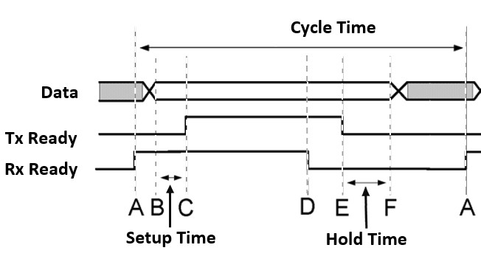
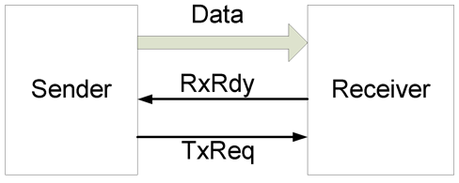
Explicit Handshaking
Explicit handshaking, basic 4-phase handshake:
  This form of handshaking uses dedicated control signals (e.g. Rx Ready and Tx Ready) to indicate the impending action from the sender and readiness of the receiving device.
  The receiving device must indicate when it is ready to receive data, and when it is done.
  The sending device must strobe (tell) the receiving device when new data is ready for it, and when the data is no longer available.
Rx Ready
Tx Ready
Standard 4-phase handshaking

Slide 25
Implicit Handshaking
In terms of implicit handshaking it usually an assumption that the receiver is ready to receive provided timing constraints (such as synchronization with a clock) is met.
Clock
WE
DATA
data written
E.g. devise sending data assume receover will be ready. Data must remain on the bus for at least one clock

Slide 26
Digital Signal Interfaces
Generally need the following
  Address bus
  Data bus
  Control lines
    Chip / Device select lines (CS)
    Write enable lines (WE)
    Read enable lines (RE)

Slide 27
Interface / Handshaking Standards
Next lecture we look at a selection of interfacing standards for developing your own reusable IP cores.
We also look at standard memory interfaces and DMA transfers
For now though we continue on with some latching and signal capture which are essential ingredients in reliable gateware interfaces

Slide 28
RC Building Blocks:
Latching
(capturing Signals)
Reconfigurable Computing
Notes:
DMA moved to later lecture

Slide 29
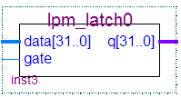
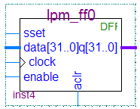
Digital Signal Capture and Storage
In order to capture the signals, you need some storage
Two basic types of storage:
Latches
Flip-flops

Slide 30
Difference between latch and flip-flop
Latches Q = D
  Changes state when the input states change (referred to as “transparency”)
  Can include an enable input bit – in which case the output (Q) is set to D only when the enable input is set.
Flip-flop Q = D (Q changes when clocked)
  A flip-flop only change state when
  the clock is pulsed.

Slide 31
When to use a latch or a flip-flop
Latches are used more in asynchronous designs wire X, Y; assign X <= A; assign Y <= B;
Flip-flips are used in synchronous designs reg X, Y; X = A; Y = B;
A “synchronous design” is a system that contains a clock
You can of course mix synchronous and asynchronous, and this is particularly applicable to parallel systems in which different parts of the system may run at different speeds (e.g., the main processor working at 1GHz and specialized hardware possibly operating asynchronously as fast as their composite pipelined operations are able to complete)

Slide 32
SR Latch
S
S | R | Q | Q
0 | 0 | 1 | 1
0 | 1 | 1 | 0
1 | 0 | 0 | 1
1 | 1 | X | X
Q
R
Q
S-R Latch (set / reset latch)
Symbol
A basic latch has two stable states:
State 1 Q = 1 not Q = 0
State 2 Q = 0 not Q = 1
And an unstable state in which both S and R are set (which can
cause the Q and not Q lines to toggle)

Slide 33
Gated SR Latch: a latch with enable
Combinational logic circuit with a clock (or enable) input connected
Usually the type used in digital systems.
It of course costs more in transistors!!
or “gate” input
Example signals
Gated SR-Latch
Symbol
Only changed on clock pulse

Slide 34
The JK and D Flip-flops
The standard JK flip-flop is much the same as a gated SR latch, modified so that Q toggles when J = K = 1
JK flip-flop
The D-type flip flop (which you may want to use in Prac5 to store data) is a JK flop flop modified (see left) to hold the state of input D at each clock pulse.
clock | D | Q
0 | 0 | X
1 | 1 | 0
2 | 1 | 1
3 | 0 | 1
… | … | …
D flip-flop

Slide 35
T-type Flip-flop
Clock | T | Q
0 | 1 | 0
1 | 0 | 1
2 | 1 | 1
3 | 0 | 0
… | … | …
The T-type flip-flops toggle the input. Q = not Q each time T is set to 1 when the clock pulses
T flip-flop

Slide 36
Preset and Clocking
Preset line (PR) and clear line (CL) are asynchronous inputs used to set (to 1) or clear the value stored by the flip-flop.
This is a type of structure one may need to use if init blocks were synthesised to initialize register values.

Slide 37
Edge triggered devices
A note on notation:
Edge-triggered inputs are shown using a triangle.
Negative edges triggered inputs are shown without a circle on the incoming line.
in
in
Positive edge triggered
Negative edge triggered

Slide 38
End of Lecture
Any Question??

Slide 39
Disclaimers and copyright/licensing details
I have tried to follow the correct practices concerning copyright and licensing of material, particularly image sources that have been used in this presentation. I have put much effort into trying to make this material open access so that it can be of benefit to others in their teaching and learning practice. Any mistakes or omissions with regards to these issues I will correct when notified. To the best of my understanding the material in these slides can be shared according to the Creative Commons “Attribution-ShareAlike 4.0 International (CC BY-SA 4.0)” license, and that is why I selected that license to apply to this presentation (it’s not because I particularly want my slides referenced but more to acknowledge the sources and generosity of others who have provided free material such as the images I have used).
Image sources:
man working on laptop – flickr
scroll, video reel, big question mark – Pixabay http://pixabay.com/ (public domain)
some diagrammatic elements are from Xilinx ISE screenshots
References: Verilog code adapted from
http://www.asic-world.com/examples/verilog

