Slide 1



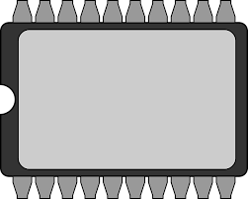
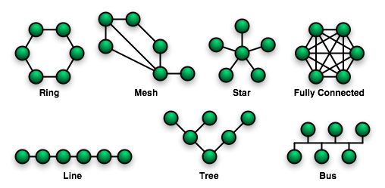
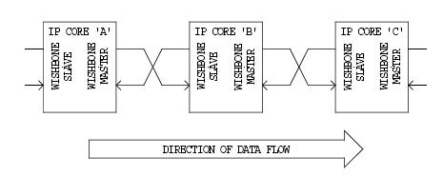
EEE4084F
Digital Systems
Lecture 22
On-chip Interconnection Topologies, Wishbone, Memories, DMA
Lecturer:
Simon Winberg
Attribution-ShareAlike 4.0 International (CC BY-SA 4.0)

Slide 2
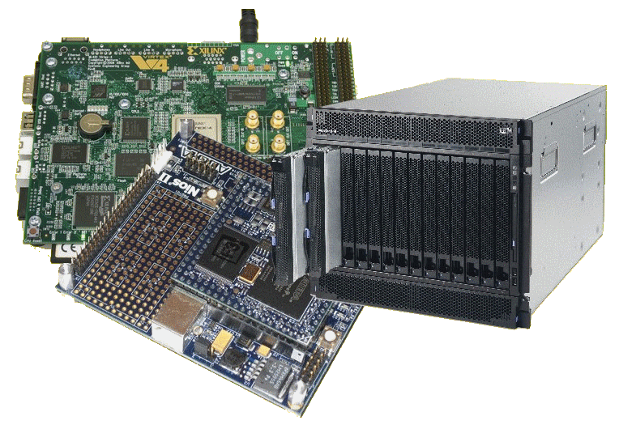
Lecture Overview
Interconnection on-chip bus topologies
Interfacing standards
A look at Wishbone and how it works
Standard memory interfaces
DMA transfers
Memory types

Slide 3
On-chip interconnection topologies
Point-to-point direct coupling (or dedicated peer interface)
  One-to-one connection, or one to many
  Benefits: simple (simplest, isn’t really a bus), fast, allows high bandwidth, low area, quick & easy, low power (closely coupled), efficient to implement (no need for driver lines, separate arbitrator etc.).
  Drawbacks: only direct connections. Often non-standard control lines.
(may lead to daisy chaining)

Slide 4
On-chip daisy chain topologies / dataflow interconnects
Chain of point-to-point directly coupled links
  A sequence of one-to-one connections
  Benefits: (fairly) simple, natural approach for much signal processing (feed forward data flow), supports pipelining, fast neighbour links allows high bandwidth, low area, typically no need for separate arbitrator (if sequenced right).
  Drawbacks: Comprise only direct links between neighbours. Often non-standard control lines. Challenges in different processing speeds for each core (can lead to trickey buffering).
(may lead towards ring topology)

Slide 5
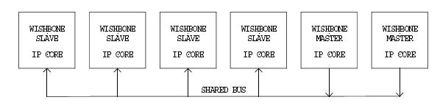
On-chip bus topologies
Shared bus topology
  Multiple masters and slaves on a shared bus.
  Requires a bus arbiter (or bus arbitrator module, the BAM; ‘master’ could be this)
  Benefits: simple, extensible, low area cost, easy to build & efficient to implement.
  Drawbacks: Larger load per data bus line, longer delay for data transfer, larger energy consumption,
  and lower
  bandwidth.

Slide 6
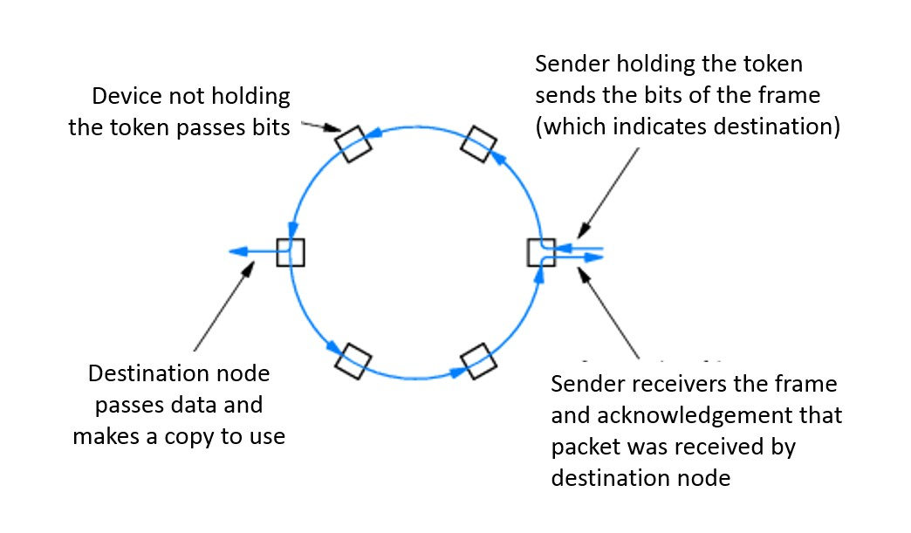
On-chip bus topologies
Ring topology
  Each node alternates between master/slave to receive and transmit over the ring interface.
  Need a ring communication protocol, usually a token-pass protocol.
  Benefits: somewhat scalable, comprises only closely coupled connections between neighbouring devices (i.e., not all components needing to be coupled to the same bus lines). Low power for driving signals (not needing to drive signals far and to many receivers). Possibly higher bandwidths.
  Drawbacks: limited scalability,
  potentially high latencies (long
  delay for getting token and
  forwarding aspect of data
  transfer), and lower bandwidth.
  May cause collectively higher
  power (due to having to relay
  signals, albeit each relay using
  little power)

Slide 7
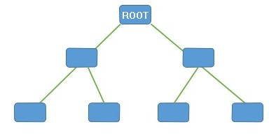
On-chip bus topologies
Hierarchical bus:
  Several shared buses interconnected by bridges forming a hierarchy / tree.
  Components placed at an appropriate level in the hierarchy according to the performance level they require and which nodes they speak to.
  Disadvantages: Transactions across the bridge involve additional overhead; during transfer both buses inaccessible to other nodes.
  Advantages: Larger throughput using this model (than simple bus) because:
    Decreased load per bus segment,
    Potential for simultaneous parallel
    transactions on different buses
    Multiple transfers can be
    preceded bridges in a
    pipelined manner.
BRIDGE

Slide 8
Interfacing Standards
The Avalon bus by Altera – Open Standard
Advanced Microcontroller Bus Architecture (AMBA) by ARM – Open Standard
On-chip Peripheral Bus (OPB) by Xilinx
Wishbone bus (originally developed by Silicore Corporation) – Open Standard

Slide 9

Wishbone bus
A brief view of the wishbone bus architecture

Slide 10
Wishbone
Initially developed by Silicore Corporation.
OpenCores has chosen to recommend Wishbone compatability for all open IP cores particularly ones added to their repository
The Wishbone bus structure and protocol is not copyrighted and can be freely copied and distributed
Wishbone is made to let designers combine several designs written in Verilog, VHDL or some other HDL for reuse and electronic design automation

Slide 11
Wishbone
There are two main interfaces for Wishbone:
  Master and slave interfaces
Master interface
  These are IP cores that are capable of initiating bus use cycles.
Slave interface
  These capable of accepting and responding to bus use cycles.
Various interconnection topologies are supported by this standard, including:
  Point-to-point connection
  Daisy chain / Dataflow interconnection
  Shared bus
  Hierarchical topology / crossbar switches

Slide 12
Wishbone
Bus size: 8, 16, 32, 64-bit
Signals are synchronous to a single clock but some slave responses must be generated combinatorial for maximum performance.
Wishbone permits addition of a "tag bus" to describe the data. But reset, simple addressed reads and writes, transfer of data blocks, and indivisible bus cycles all work without tags.
Technically (by decree of OpenCores) “A device does not conform to the Wishbone specification unless it includes a data sheet to describe what it does, bus width, utilization, etc”. This promotes reuse of design.
Information Source: https://en.wikipedia.org/wiki/Wishbone_(computer_bus

Slide 13
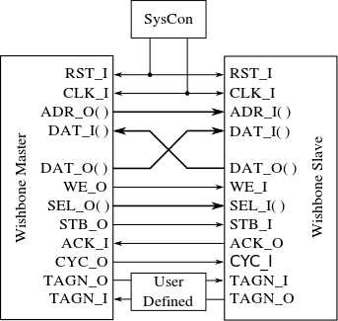
Wishbone – the interface
Global signals / SysCon control module
CLK_O : system clock output generated by SysCon module. It coordinates all activities for the internal logic. Connects to CLK_I on MASTER and SLAVE
RST_O: The reset output generated by the SysCon module. Forces all Wishbone interfaces to restart. All internal self-starting state machines are forced into an initial state.
RST_O
CLK_O
Standard connection for timing diagrams.
Image source: https://en.wikipedia.org/wiki/Wishbone_(computer_bus)

Slide 14
Wishbone – the interface
Signals Common to MASTER and SLAVE Interfaces
CLK_I: The clock input, coordinates all activities for the internal logic within the Wishbone interconnect.
All Wishbone input signals are stable before the rising edge of CLK_I.
Wishbone output signals are registered at the rising edge of CLK_I
RST_O
CLK_O
Standard connection for timing diagrams.

Slide 15
Wishbone – the interface
Signals Common to MASTER and SLAVE Interfaces
RST_I: Force Wishbone interface to restart.
DAT_I: Data input port to slave/master. The bus size is
determined by the port size (8, 16, 32 or 64-bit).
DAT_O: Data output port used. Bus size as above, max 64bits.
RST_O
CLK_O
Standard connection for timing diagrams.

Slide 16
Wishbone – the interface
Signals Common to MASTER and SLAVE Interfaces
TGD_I: Tag for Data. Contains information that is associated with the data input array (e.g. type of data sent), and is qualified by signal STB_I. e.g. parity protection, error correction and time stamp information can be attached to the data bus. These tag bits simplify the task of defining new signals because their timing (in relation to every bus cycle) is pre-defined by this specification. The name and operation of a data tag must be defined in the Wishbone Datasheet for the device.
TGD_O: as per above for output
RST_O
CLK_O
Standard connection for timing diagrams.

Slide 17
Wishbone – the interface
MASTER Interfaces
ACK_I: Acknowledge input, indicates the normal termination of a bus cycle (see also ERR_I & RTY_I for exception handling)
ADR_O: The address output bus, used to indicate address if device accessed.
CYC_O: The cycle output marker.
When asserted, indicates a valid bus cycle is in progress.
Signal is asserted for duration of all bus cycles. (e.g. during block transfer CYC_O is asserted for first data transfer and remains asserted to last data transfer)
Useful for interfaces with multi-port interfaces such as dual port memories.
Standard connection for timing diagrams.

Slide 18
Wishbone – the interface
MASTER Interfaces
WE_O: Write enable output indicates whether the current local bus cycle is a READ or WRITE cycle. The signal is negated during READ cycles, and is asserted during WRITE cycles.
SEL_O: The select output array indicates:
when valid data is expected on the DAT_I bus during READ cycles, and
when it is placed on the DAT_O signal array during WRITE cycles.
STB_O: The strobe output indicates a valid data transfer cycle. Qualifies various other signals on the interface such as SEL_O.
The SLAVE asserts either ACK_I, ERR_I or RTY_I in response to every assertion of STB_O by master.
Standard connection for timing diagrams.

Slide 19
Wishbone – the interface
MASTER Interfaces – special error handing signals
STALL_I: pipeline stall input indicates current slave is not able to accept the transfer in the transaction queue (used in pipelined mode). ERR_I: indicates an abnormal cycle termination.
LOCK_O: The lock output when asserted indicates the current bus cycle is uninterruptible. Lock is asserted to request complete ownership of the bus.
RTY_I: The retry input indicates the interface is not ready to accept or send data, and that the cycle should be retried. (when and how the cycle is retried is defined by the IP core supplier).
Standard connection for timing diagrams.

Slide 20
Wishbone – the interface
SLAVE Interfaces
ACK_O: Acknowledge output, when asserted, indicates the termination of a normal bus cycle.
ADR_I: Address input array passes a binary address. Bus size is specific to the address width of the core. NB: Lower array boundary is determined by the data port size. E.g. 32-bit data port has ADR_O [31:2].
CYC_I: When asserted, indicates that a valid bus cycle is in progress
Standard connection for timing diagrams.

Slide 21
Wishbone reset
Reset can be asserted for any length of time
All Wishbone interfaces must initialize themselves at the rising CLK_I edge following the assertion of RST_I.
They must stay in the initialized state until the rising CLK_I edge that follows the negation of RST_I.
RST_I must be asserted for at least one complete clock cycle.
Note: CLK_I line schedules the process as to by when signals are asserted and sensed (e.g. the order of asserting STB_O and CYC_I is arbitrary, but must be done before a positive clock edge)
  There is method in this clock-triggered approach because it simplifies the interfacing logic and the statemachines for the master and slave by having them only trigged by posedge CLK_I and not anything else (FPGAs typically are designed around making the clock accessible and synched, also save space for other modules).

Slide 22
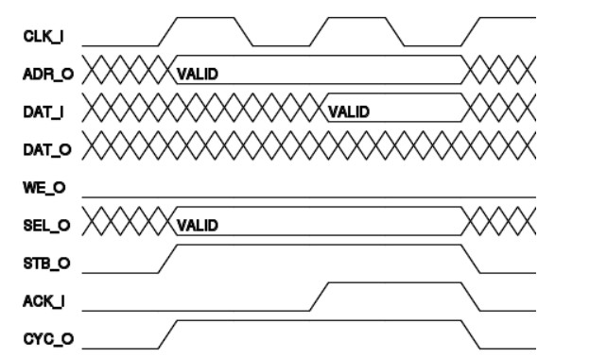
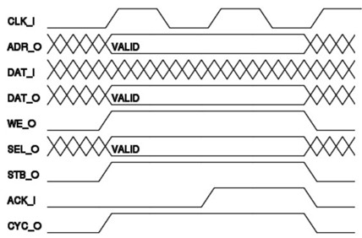
Wishbone Standard Read/Write Cycle
MASTER initiate a transfer cycle by asserting CYC_O
MASTER MUST assert CYC_O for the duration of READ/WRITE cycle
MASTER asserts STB_O when ready to transfer data
STB_O remains asserted until SLAVE asserts one of the cycle terminating
signals ACK_I], ERR_I or RTY_I
At every rising edge of CLK_I the slave/master samples the signals and must respond by asserting relevant signals before the next rising clock edge.
Slave will sense signals here
Slave must
assert signals before here
Slave will sense signals here
Slave must
assert signals before here
Master senses signals here
Standard SINGLE WRITE cycle
Standard SINGLE READ cycle

Slide 23
Wishbone examples / templates
Recommended
  Simple starting point provided by OpenCores: https://opencores.org/forum,Cores,0,608

Slide 24
Altera/Intel Avalon Bus
Altera Avalon interface bus used as Nios embedded processor peripheral bus
Designed (originally) to accommodate peripheral development for the System-On-a-Programmable-Chip (SOPC) environment.
Qsys now replaces SOPC tool
The generated switch fabric logic includes several chip select signals for
  data-path multiplexing, address decoding, wait-state generation, interrupt-priority assignment, dynamic-bus sizing, multi-muster arbitration logic and advanced switch fabric transfer.
Mainly intended for implemented on Altera devices using Qsys / SOPC Builder
Avalon Bus is generated automatically, when a new Nios core with peripherals is created in Sys/SOPC-builder
Is an open standard (can develop own Avalon modules)

Slide 25
RC Building Blocks:
DMA – Efficient Data Transfer
Reconfigurable Computing

Slide 26
Direct Memory Access (DMA)
Originally direct memory access (DMA) referred to a feature provided on a computer systems whereby peripherals within the computer can access the system memory for reading and/or writing independently of the central processing unit.
This is still an appropriate definition; except rather consider DMA as a more general description, whereby separate hardware can both access memory directly (without the CPU doing any work), and can request the memory subsystem (really the DMAC) to perform memory copies or transfers.

Slide 27
Typical computer design without DMA
Memory (Device 0)
In this approach, each peripheral
signals the CPU and tells it to
receive data and r/w memory
address
CS*
CS0*
CPU
address
Address Decoder
CS1*
IRQ
data
UART
(Device 1)
RD*
CS2*
WR*
…
CS*
IRQ
data
RD*
WR*
Signals:
Address : address line (e.g. 32 bits)
Data : data line (e.g., 32 bits)
IRQ : Interrupt ReQuest line
CS* : Chip select (active low)
RD* : Read enable (active low)
WR*: Write enable (active low)

Slide 28
DMA : Direct Memory Access
Memory
address
CPU
Device
(e.g., Graphics Card)
IRQ
DMA
Controller
IRQ
data
DMA Direct memory access is system in which memory is accessed without using the CPU. A certain stimulus (e.g. a device needing data sent/received) can have this data sent/received directly from/to a block of memory location via the DMA controller (DMAC). Peripherals such as ADCs, GPUs and Ethernet, which require frequent movements of memory, typically support DMA. DMA controllers can be configured to handle moving collected data from peripherals into specific memory locations (e.g., arrays directly accessible from a C program). Additional control logic is required to manage the sharing of the address and data bus.
Further reading: http://www.freebsd.org/doc/en/books/developers-handbook/dma.html

Slide 29
DMA configurations
Standard block transfer
  DMAC does sequence of memory transfers
  Load operation from source address, store operation to destination
  Initiated under software control (e.g., copying data from one memory area to another) i.e., array X = array Y
Demand-mode transfer
  Same as block transfer, but controlled by external device. I/O device requests and synchronizes the operation
Ref: Catsoulis, J. (2003). Designing Embedded Hardware. O’Reilly.

Slide 30
DMA configurations
Fly-by transfers
  High speed operation
  Memory and I/O on different bus
  E.g., I/O given read request at same time that memory is given write request
  Can simultaneously read/write I/O device and write/read memory
Data-chaining transfers
  Linked list in memory
  DMAC given pointer to descriptor
  Descriptor indicates: size, src address, dest address, next descriptor

Slide 31
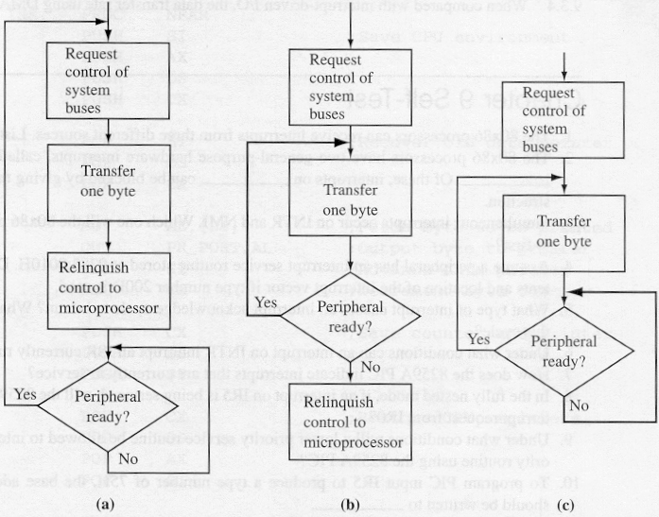
DMAC Modes of Operation
1
1
DMA Controller can support a range of modes. The three modes shown left are commonly supported.
1
2
2
2
3
w
w
w
3
Byte Mode
Burst Mode
Block Transfer Mode
123w123w123w…
12w2w2w3…
12w2w2www…
Sequence of states
CPU deactivates
Adapted from source: http://calab.kaist.ac.kr

Slide 32
Memories (recap)
EEE4084F

Slide 33
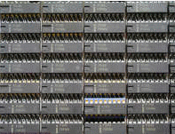
Memory types
Volatile
Non-volatile

Slide 34
Volatile memory
DRAM
  Capacitor stores “memory” that leaks away and needs to be periodically refreshed
  High memory capacity
SDRAM = Synchronous DRAM
  Runs in synch with system* clock
  DDR SDRAM = Double-data rate SDRAM, runs at 2x the system clock
* Note the system clock in this case is closer to the “motherboard” clock. Usually considerably slower than the processor clock (standard DRAM may have its own even slower clock and synchronization hassles)

Slide 35
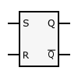
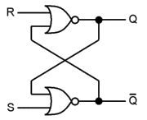
Volatile memory
SR Latch to hold
a bit of SRAM *
SRAM
  Static RAM
  Does not need refreshing
  Uses “bistable latching circuitry”
  (i.e. a flip flop) to store each bit
  Can be very fast compared to DRAM
  A small amount of SRAM (~16 Kb) is typically used within a microcontroller / FPGA to hold things such as a boot loader and interrupt vectors, and as CACHE
SR Latch implemented using two NOR gates *
* Images from http://en.wikipedia.org/wiki/Latch_(electronics)

Slide 36
Volatile Memory
BRAM or Block RAM
  This refers to a small block of RAM (a few Kilobytes) integrated within the FPGA (connected some LBs)
  Generally only found in higher-end FPGAs (e.g. 16Kb takes ~ 256K transistors if not more for connection and addressing logic)
  Block SRAM is more common and easier to use; the FPGA may include Block DRAM
  Generally can be set to RAM or ROM
  As ROM it can be used as a (big) LUT
  Usually not directly accessible form outside the FPGA (need to provide circuitry / softcore and comms protocol to access it from a PC)

Slide 37
Volatile memory
Under development
  Z-RAM : Zero-capacitor RAM
    Single transistor
    Higher density than DRAM
    Although it is called zero-capacitor, the capacitor is actually there in the form of a “floating body effect” caused by the transistor substrate
    See: http://www.innovativesilicon.com/

Slide 38
Non-Volatile memory
Trusty old ROM and EEPROM
  Still widely used as it is highly robust
  Current versions store large amounts of data
  Fairly simple technology (i.e. fused connections) and (in EEPROM ability to fuse and then program/un-fuse connections)
Usually ROM is slower than RAM
Shadowing ROM (i.e. copy to RAM) to make it faster – especially for EEPROMs
EEPROM very slow write; faster read

Slide 39
Non-Volatile Memory
Flash memory
  Can be electrically erased and programmed
  High capacity (e.g., millions of bytes/chip)
  Needs to be programmed one block at a time (~8Kb / block)
    Erased (all bits in block set to 1)
    Programmed one block at a time
  Memory wear
    Limited to about 100,000 erase – write cycles
    Usually a file system (e.g. ext3) will keep track of bad sectors (i.e., mark deteriorated blocks). But this deterioration might happen a certain time after the erase and write is complete and verified.

Slide 40
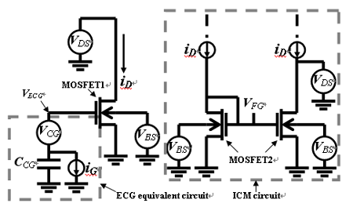
NAND Flash memory model
Image source: IEEE Electron Device Letters, Vol. 26, No. 8, AUGUST 2005, pg 564 Available at: http://koasas.kaist.ac.kr/bitstream/10203/1570/1/01468223.pdf
*
The above diagram provides a macro circuit model for a single flash memory cell, showing a Effective-Control-Gate (ECG) equivalent circuit and the Ideal-Current-Mirror (ICM) used to calculate the floating gate (FG*) voltage. MOSFET1 is the equivalent N-MOSFET model of a flash memory cell, and MOSFET2 is the model of a N-MOSFET test structure that is identical with the flash memory cell (excluding the short between FG and CG).

Slide 41
End of Lecture
Any Question??

Slide 42
Disclaimers and copyright/licensing details
I have tried to follow the correct practices concerning copyright and licensing of material, particularly image sources that have been used in this presentation. I have put much effort into trying to make this material open access so that it can be of benefit to others in their teaching and learning practice. Any mistakes or omissions with regards to these issues I will correct when notified. To the best of my understanding the material in these slides can be shared according to the Creative Commons “Attribution-ShareAlike 4.0 International (CC BY-SA 4.0)” license, and that is why I selected that license to apply to this presentation (it’s not because I particularly want my slides referenced but more to acknowledge the sources and generosity of others who have provided free material such as the images I have used).
Image sources:
man working on laptop – flickr
scroll, video reel, big question mark – Pixabay http://pixabay.com/ (public domain)
some diagrammatic elements are from Xilinx ISE screenshots
https://commons.wikimedia.org/wiki/Category:Images (creative commons)

