Slide 1
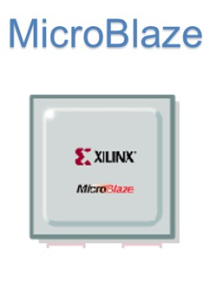
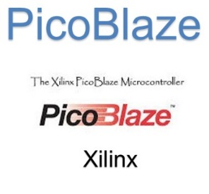
EEE4084F
Digital Systems
Lecture 23
Softcore Processors
soft
processor
Lecturer:
Simon Winberg
Attribution-ShareAlike 4.0 International (CC BY-SA 4.0)

Slide 2
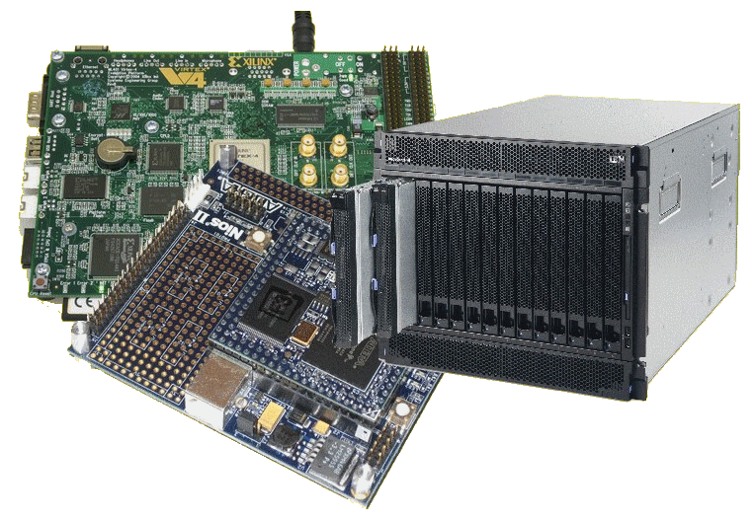
Lecture Overview
Softcore processors
Case studies:
Xilinx Microblaze
Xilinx Picoblaze
DUGONG (a simplified ‘sort of’ interface control processor)
[Optional: Altera/Intel NIOS2]

Slide 3
Softcore processors
EEE4084F

Slide 4
Soft core Processors: Processors within FPGAs
What is a ‘soft core’?
A soft microprocessor is a microprocessor core that can be wholly implemented using logic synthesis.
It is essentially an item of ‘Intellectual Property’ (IP) that contains the design of a processor.
A soft core processors can be incorporated into a design and then the design synthesized, place & routed to generate an executable.
Examples of these:
Altera NIOS II
Xilinx Microblaze & Xilinx Picoblaze
A variety of ARM processors
How do these compare to hard cores? … see later!

Slide 5
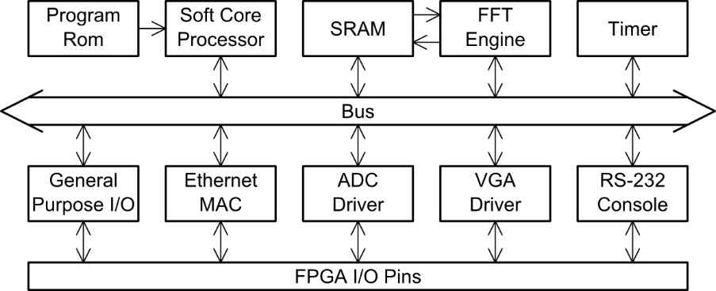
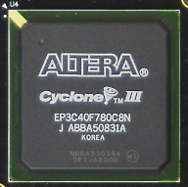
How a Soft core typically fits in to a design
Soft Core Processor
Avalon bus for NIOS,
OPB (Onchip Peripheral Bus) or PLB (Processor Local Bus) for Microblaze
FPGA

Slide 6
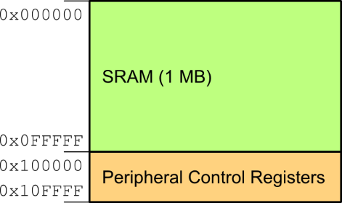
Address Bus for the Processor
FFT Engine
Timer
GPIO
Eth MAC
VGA
… etc …

Slide 7
Thinking Time
What are some of the reasons for using a softcore processor?
Work with a classmate and make
a list of reasons and then prioritize these

Slide 8
Reasons for using a softcore processor
Design Flexibility
‘best of both worlds’ – allows you to choose either a software or hardware solution for implementing particular functionality
Implementing complex (not necessarily very fast) functionality
Software is useful for implementing complex control logic or functions that the system may need, e.g. to implement the TCP/IP protocol stack (doing this in combinational logic is hard and takes up much logic).
Reuse!!
Your underlying software is likely to outlive the specific platform it was initially designed for
Saving logic
Some implementations are just more efficient to do using a processor (multiple reusable instruction approach) rather than implementing a circuit for this.
Multiple core support
Choose how many cores you need, from 0 to however many you can fit on the FPGA.
Avoiding obsolescence
Your software is likely to last a lot longer compared to a CL design that may be more tied to the platform.

Slide 9
Soft Cores Ingredients
Which are likely influence the design of FPGAs now and in the future.

Slide 10
Ingredients Needed for Soft Cores
Could implement it all as gates, but that can be rather inefficient and wasteful
On-chip resources that soft core processors typically use:
RAM blocks - various configurations
Full adders
DSP cores (e.g. integer multipliers, etc.)
State machines

Slide 11
Hard core vs. Soft core ?!
Hardcore =
Difficult??
Softcore =
Lite/Easy??
Not necessarily…

Slide 12
Hard Core Processor Characteristics
Not implemented as gateware programmed into the FPGA logic
Implemented in silicon/ASIC; unchangeable
Benefits:
Usually much higher performance
Manufacturer typically provides optimized compiler for their chips

Slide 13
Reading (supplementary, not examined)
Paper L21 - 07157822 - Dual-Issue Embedded Processor for Low Power Devices.pdf
“A Dual-Issue Embedded Processor for Low Power Devices” by H Lozano, M Ito
The authors propose “an energy efficient dual-issue embedded processor that can deliver up to 60% improvement in IPC (instruction-per-cycle)…”
http://dx.doi.org/10.4108/icst.iniscom.2015.258414

Slide 14
Case Studies (shortly)
MicroBlaze
32-bit processor, RISC instructions.
Thirty-two 32-bit general purpose registers
Generate, configure and program with Xilinx SDK
Picoblaze
8 bit, simple RISC instructions
Free for use on Xilinx
DUGONG (a scenario showing example developed by a UCT student, a state machine with instructions)
Planning to be control module
Open-source
NIOS II
Altera’s soft core processor, 32 bit, configurable
Commercial
NIOS II Gen2 improved, more options
Alternate soft cores: MP32 / MIPS32, ARM
More powerful, closer to full CPU
Simpler, closer to simple FSM
NIOS is recommended additional reading (it is an Altera/Intel product)

Slide 15
Considerations for Using Soft Core Processors
First two points are most common use
A major purpose is:
Make it easier to communicate / transfer & packetize data
Test designs (e.g. like reading/adjusting setting while running)
Set up the initial conditions of your design / HDL block configuration
Highly configurable processor structure – e.g. add a custom instruction to baseline processor
Of course also e.g. testing novel processor designs
Should consider the soft core processor is
More an aid to control the system
facilitate comms, advantages of software running in system, e.g. O/S
The soft core processor shouldn’t
Be provide the main solution to you digital accelerator, unless there is good reason such as experimenting with performance of a cluster of processors on FPGA

Slide 16
Optional Case Study
NIOS II
Altera’s soft core processor, 32 bit, configurable
Commercial
NIOS II Gen2 improved, more options
Alternate soft cores: MP32 / MIPS32, ARM
More powerful, closer to full CPU
NIOS is recommended additional reading, see last slides
It is an Altera/Intel product

Slide 17
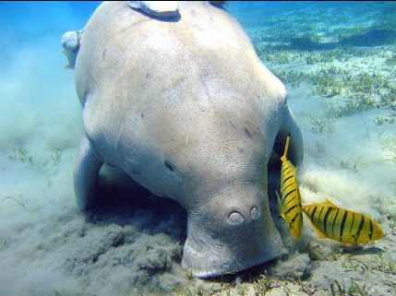
Soft Core Case Studies
MicroBlaze
PicoBlaze
DUGONG
Xilinx
(Open source)

Slide 18
Xilinx Microblaze
MicroBlaze was developed by Xilinx
It is a soft microprocessor core designed and optimized for use on Xilinx FPGAs
MicroBlaze is a Reduced Instruction Set Computer (RISC)
Generated, configured and programmed using Xilinx EDK (Embedded Development Kit)

Slide 19
FPGAs that support Microblaze
You can’t run it on any FPGA!! It works on only supported those Xilinx FPGAs. These include the FPGAs families:
Spartan-3/3A/3AN/3A DSP/3E FPGA
Spartan-6
Virtex-4 FX (also supports PowerPC 405 processors) and LX/SX FPGA
Virtex-5 FXT (alost PowerPC 440 processor) LX/LXT FPGA (MicroBlaze)
Virtex-6 (MicroBlaze processor)

Slide 20
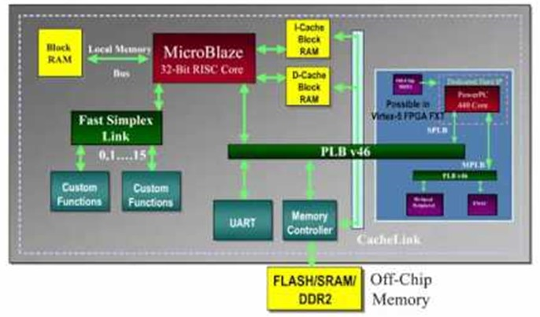
Microblaze and its surrounding components
Supports two bus Standards:
PLB (Processor Local Bus) (ver. V46)
for high speed & high bandwidth peripherals.
Supports 128 bits of data, 36 bit address
XILINX Local Memory Bus (LMB) to interface local PLBs

Slide 21
MicroBlaze memory
Cache
By default MicroBlaze has no cache.
Can enable cache in EDK (which will use BRAM)

Slide 22
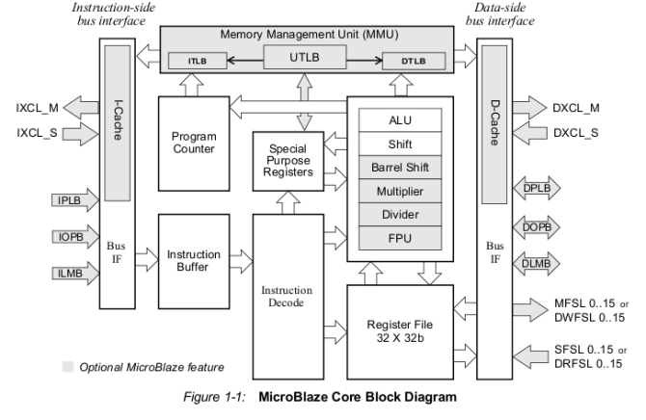
MicroBlaze Architecture

Slide 23
Features
Highly configurable soft processor
Can select a specific set of features needed
Fixed features of the processor are:
Thirty-two 32-bit general purpose registers
32-bit instruction word with three operands and two addressing modes
32-bit address bus
Single issue pipeline
The MicroBlaze can be parameterized to enable inclusion of additional functionality.

Slide 24
MicroBlaze instructions
The MicroBlaze has a versatile interconnect system to support a variety of embedded applications.
MicroBlaze instruction set is similar to that of the RISC-based DLX architecture.
Most vendor-supplied and third-party IP modules interface to PLB directly (or through an PLB to OPB bus bridge.)
For access to local-memory (BRAM in the FPGA), the MicroBlaze uses a dedicated LMB bus that reduces loading on the other buses (e.g. OPB).
User-defined coprocessors are supported through a dedicated FIFO-style connection called FSL (Fast Simplex Link).
The coprocessor(s) interface can accelerate computationally intensive algorithms by offloading parts or the entirety of the computation to a user-designed hardware module.

Slide 25
Microblaze
High performance soft processor
Most of instructions completed with 1 cycles
Short pipelines, higher working frequency
FPGA optimized implementation
Fast carry chain MUX, hardware multiplier
RLOC placement constraints
Easy (relatively) to use with Xilinx EDK
Linux/GCC support

Slide 26
MicroBlaze Limitations
No MMU support
No protection among processes
Implies it cannot support full version of Linux
No double precision floating point
No atomic instructions
hard to implement lock
non-blocking FIFO instruction problem
No cache coherent support

Slide 27
Micro MicroBlaze
A smaller, but powerful MicroBalze:
The MicroBlaze MicroController System (MCS)
MCS offers an even smaller package
MCS consists of MicroBlaze in a fixed 3-stage pipeline configuration for the smallest footprint, and is surrounded by a system of common embedded design peripherals*.
* MCS can run from IDS Logic Edition without the need for a full embedded design license

Slide 28
MicroBlaze – references & where to find out more
Xilinx MicroBlaze Wiki
http://www.wiki.xilinx.com/MicroBlaze
Wikipedia
https://en.wikipedia.org/wiki/MicroBlaze
Building an embedded system using a Microblaze on an Nexys3
http://islab.soe.uoguelph.ca/sareibi/TEACHING_dr/XILINX_TUTORIALS_dr/EDK_dr/EDK-NEXYS3-Elhossini2012.pdf
Some of the information regarding MicroBlaze based on slides by K. Siddhapathak

Slide 29
Soft Core Case Studies
MicroBlaze
PicoBlaze
DUGONG
Xilinx
(Open source)

Slide 30
PicoBlaze Soft Core Processor
Info available from: www.xilinx.com/picoblaze
Size:
Takes on 96 slices !! (slice = group of PLBs)
Big advantage considering low cost FPGAs have a few 100 slices; and 1000s slices for medium range
Not coded as behavioral VHDL
It is manually pre-compiled (IP block)
Built by instantiation of Xilinx raw primitives
Can still be simulated using Modelsim

Slide 31
PicoBlaze Soft Core Processor
Main Uses
Control / configuration of parameters
Some data processing (add / integer operations)
Comms / UI facilities (i.e. ‘talk’ to control PC, especially UART, USB connection)
Testing & debugging your design on hardware

Slide 32
PicoBlaze Soft Core Processor
Can be very helpful to speed-up & simplify development
Changing the instructions running on the softcore PicoBlaze is likely faster than changing the HDL code (especially with rebuilding time)
Has a simple and easy to learn instruction set, also offers opportunities for reuse of the PicoBlaze code in other systems.

Slide 33
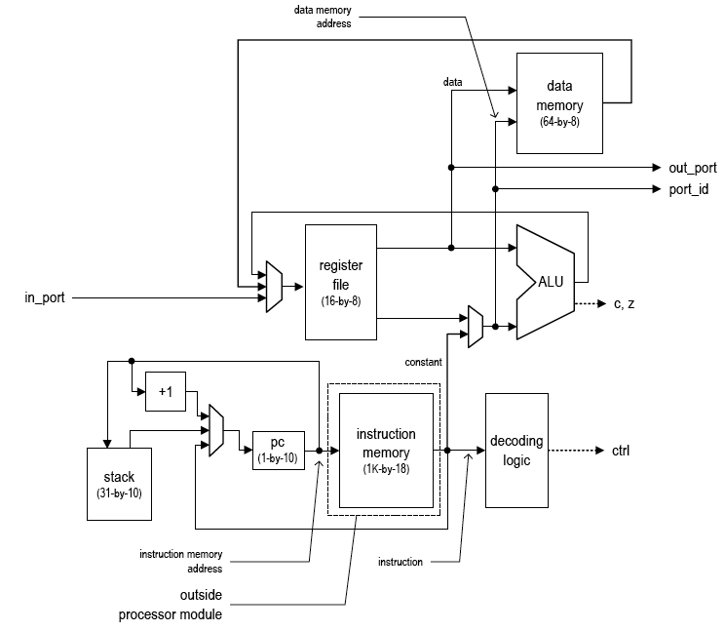
PicoBlaze
Architecture

Slide 34
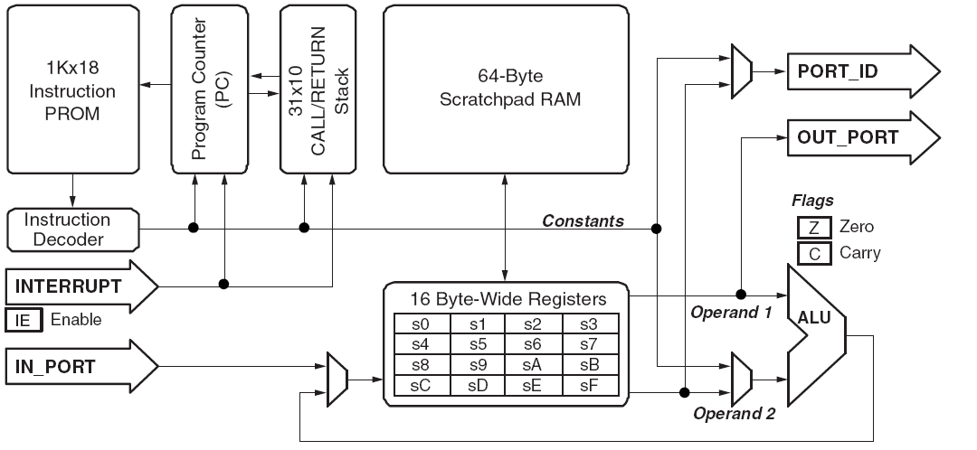
Overview of the PicoBlaze

Slide 35
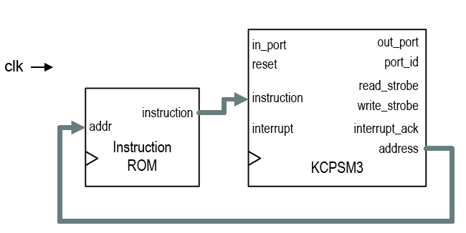
Interfacing to the PicoBlaze
PicoBlaze
clock→
KCPSM = constant (K) Coded Programmable State Machine

Slide 36
PicoBlaze Interface
Name | Direction | Size | Function
clk | input | 1 | System clock signal in
reset | input | 1 | Reset signal
address | output | 10 | Address of instruction mem. Specifies address of the instruction to be retrieved.
Instruction | input | 18 | Fetched instruction.
port_id | output | 8 | Address of the input or output port.
in_port | input | 8 | Input data from I/O peripherals.
read_strobe | output | 1 | Strobe associated with the input operation.
out_port | output | 8 | Output data to I/O peripherals.
write_strobe | output | 1 | Strobe associated with the output operation.
interrupt | input | 1 | Interrupt request from I/O peripherals.
interrupt_ack | output | 1 | Interrupt acknowledgment to I/O peripherals

Slide 37
PicoBlaze Addressing Modes
Instruction example
Explanation
Immediate mode
ADDCY s2,08
SUB s7, 7
s2+08+C → s2
s7–7 → s7
Direct mode
INPUT s5, 2a
ADD sa, sf
PORT[2a]→ s5
sa + sf → sa
Indirect mode
INPUT s9, (s2)
STORE s3, (sa)
PORT[RAM[s2]]→s9
s3→ RAM[RAM[sa]]

Slide 38
Example Program
; DEMONSTRATION PROGRAM
; EXERCISE THE 7 SEGMENT DISPLAYS
cold_start:
LOAD s3, 11 ; clear all time values
OUTPUT s3, 04
LOAD s4, 00
OUTPUT s4, 05
main_loop:
OUTPUT s5,04 ; Update 4 digit 7 seg display
OUTPUT s3,06
JUMP main_loop

Slide 39
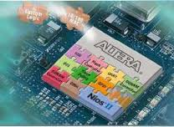
Soft Core Case Studies
Nios II
PicoBlaze
DUGONG
Xilinx
(Open source)

Slide 40
Why look at this one
This provides a case study of a custom-designed processor which provides a variety of useful facilities that are useful especially in configuring other modules in an FPGA, or being used as a junction for moving data around within the FPGA or steering the data to e.g. an output port or for doing debug inspections (kind of like a boot monitor for an FPGA; you can send it various commands – in machine language – and it can carry them out to do inspections on the modules running in the system)

Slide 41
DUGONG
Developed by Matthew Bridges (SDRG student), part of a larger research project
Designed from scratch (a solution to a need)
Design around compatibility with Wishbone interface
Designed with a focus on simplicity with scalability
Available at:
https://github.com/matthewbridges/dugong
But what is it???

Slide 42
‘DUGONG’ name?
A dugong is actually a type of underwater mammal, colloquially called ‘sea cow’ that is found in the Indian Ocean (similarities to ‘manatees’)
The DUGONG controller was given this name as it’s a ‘underwater’ hidden feature, and no one else is likely to choose the name… and it is a kind of grazer like a RHINO

Slide 43
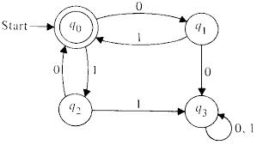
DUGONG
Essentially it is a glorified state machine
But has limited number of states and transition types (i.e. predefined list of triggers, operations, transitions, etc.)

Slide 44
DUGONG
Essentially it is a glorified state machine
Works as follows:
A list of timing and transfer operations are loaded into it, and it runs through these sequentially
Send
config
Data in
OP1
OP1
OP2
OP2
OP3
OP3
MODES:
Config mode
Redirect mode
Various other modes, some simultaneous.

Slide 45
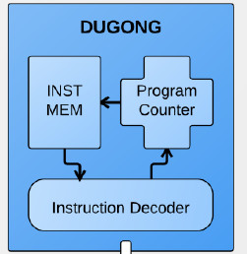
DUGONG Structure
Has one register, the accumulator, through which data is transferred.
To control processor interface (GPMC bus on RHINO)
WISHBONE

Slide 46
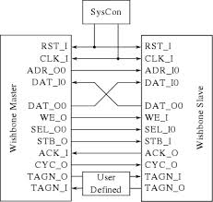
Connecting to DUGONG
Serves as the Master on the wishbone bus
Wishbone bus: Open source hardware interconnect bus structure for connecting computational blocks within ICs / reconfigurable computers. This bus structure is commonly used by designs provided by OpenCores.
Wishbone interfaces for Master and Slave modules

Slide 47
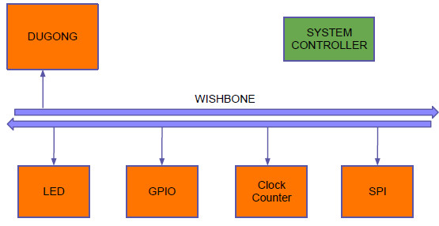
How DUGONG fits in to a Wishbone-based design
Controls the wishbone clock lines, etc.

Slide 48
DUGONG
Designed around simplicity & scalability (connect up and configure small to big designs)
Has no function unit (FU) – with good reason
Can I use it for processing? Comparisons?
Sorry, no can do: that is someone else's problem (or rather use a CPU e.g. Nios II)
There are lots of other opensource soft cores available, see e.g.:
OpenCores.org: http://opencores.org/
Open Hardware Repository: http://www.ohwr.org/

Slide 49
DUGONG Instruction Set
DUGONG1:
4 bit Instruction Set
Structure: <CODE:4 bits> <DATA:28 bits>
Code | Instruction | Description
0000 | NOP | No operation
0001 | WRITE | Write data to addr
0010 | READA | Read from addr to acc
0011 | WRITEA | Write from acc to addr
0100 | BRANCH | write data to pc / controller
1000 | WAIT | Wait for a number of clock cycles equal to data field

Slide 50
DUGONG Typical Program
WRITE #0, [0xFF000000] // write 0 to address
READA [0xFF100000] // read from addr into A
WAIT #4 // wait for 4 clock cycles
WRITEA [0xFF200000] // write A to addr
BRANCH // send data in A to controller
NOP
NOP …

Slide 51
Q & A

Slide 52
Soft Core Case Studies
Nios II
PicoBlaze
DUGONG
Xilinx
(Open source)

Slide 53
Altera Nios II Processor
A 32-bit soft core processor from Altera
Three standard cores versions:
Fast, Standard, Light
The cores have tradeoffs in:
FPGA LEs needed ←→ power ←→ speed
RISC architecture: Simple instructions
Harvard Architecture:
Separated data and instruction memories (a likely safer approach to the Von Neumann arch. style)
32 interrupt levels
Avalon Bus interface
C/C++ compilers; can also use plain assembly

Slide 54
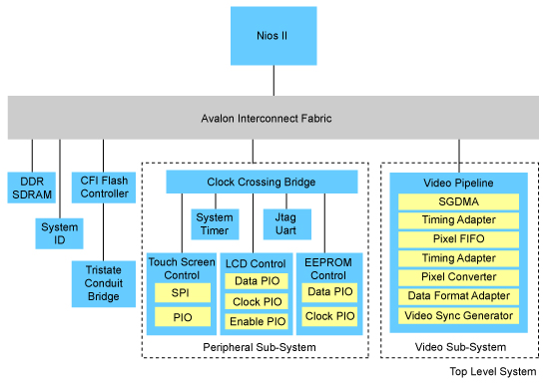
NIOS II Architecture
Let’s have a closer look at the core
Image source: www.altera.com

Slide 55
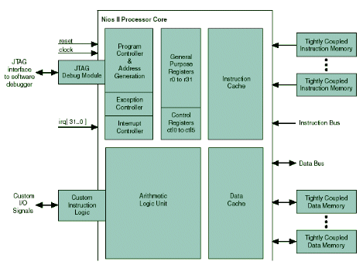
NIOS II Core

Slide 56
How do you get a NIOS II soft core processor and set it up?

Slide 57
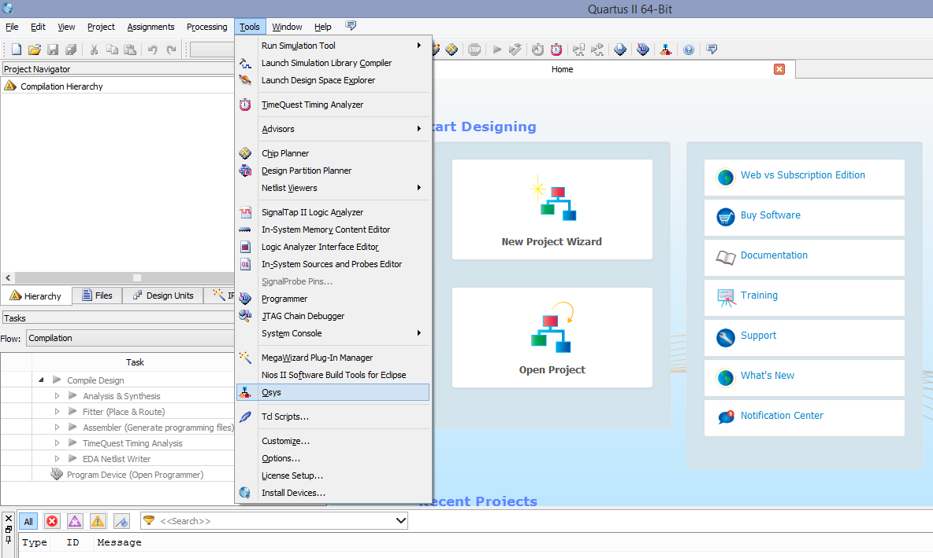
Altera Qsys: In later versions of Quartus II
1. Select Tools
2. Select Qsys

Slide 58
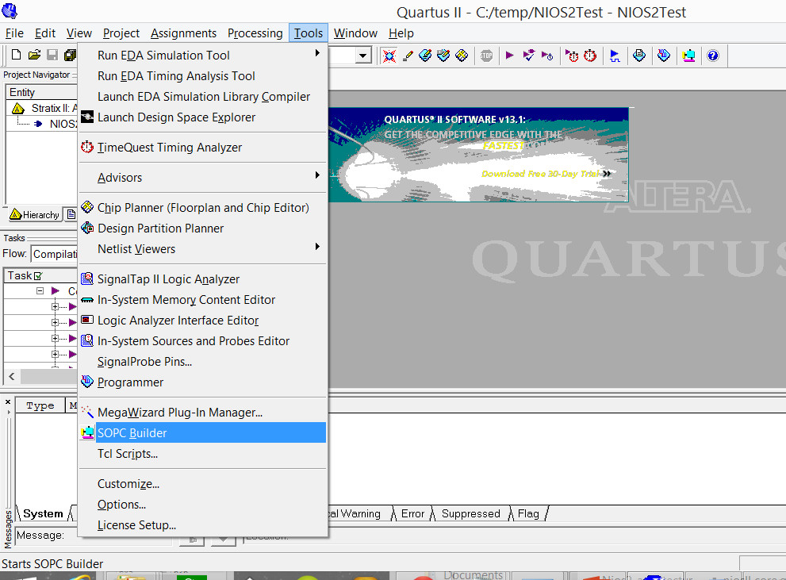
Altera SOPC Builder: In earlier versions of Quartus II
1. Select Tools
2. Select SOPC Builder

Slide 59
Altera QSys

Slide 60
Disclaimers and copyright/licensing details
I have tried to follow the correct practices concerning copyright and licensing of material, particularly image sources that have been used in this presentation. I have put much effort into trying to make this material open access so that it can be of benefit to others in their teaching and learning practice. Any mistakes or omissions with regards to these issues I will correct when notified. To the best of my understanding the material in these slides can be shared according to the Creative Commons “Attribution-ShareAlike 4.0 International (CC BY-SA 4.0)” license, and that is why I selected that license to apply to this presentation (it’s not because I particularly want my slides referenced but more to acknowledge the sources and generosity of others who have provided free material such as the images I have used).
Image sources:
man working on laptop – flickr
scroll, video reel, big question mark – Pixabay http://pixabay.com/ (public domain)
some diagrammatic elements are from Xilinx ISE screenshots
https://commons.wikimedia.org/wiki/Category:Images (creative commons)

