Slide 1



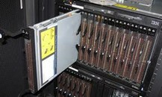
EEE4084F
Digital Systems
Lecture 24: RC Platform Case Studies 1/2
Tools and toolchain considerations & The Cell Processor
Microprocessor-based: The Cell Broadband Engine Architecture,
IBM Blade
FPGA-based:
PAM, VCC, SPLASH …
(next lecture)
Lecturer:
Simon Winberg
Attribution-ShareAlike 4.0 International (CC BY-SA 4.0)

Slide 2
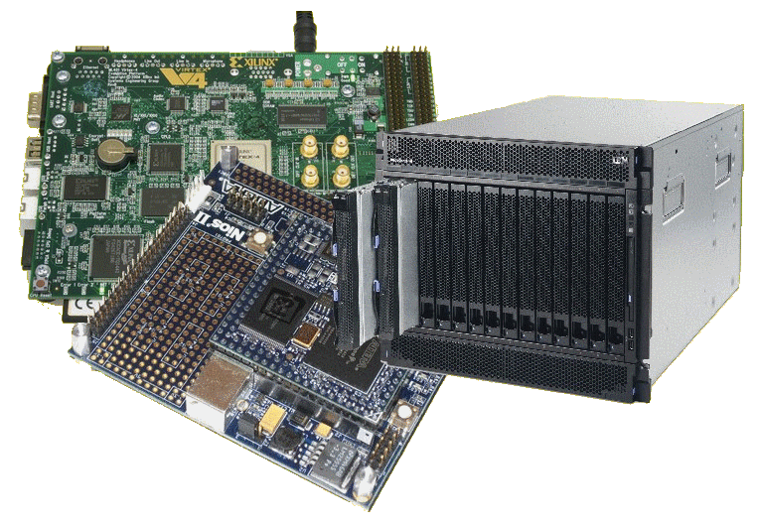
Lecture Overview
Detailed case study of RC / heterogeneous computer architecture
  Purpose of this lecture
  Cell Processor
  Cell Processor Programming models
  IBM Blade

Slide 3

Notice:
Test 2 next Thrusday (17 May)
Held 2pm EM303, 50 minutes
Syllabus to be announced soon!
Test 2 in 2 weeks time. Eeeek!

Slide 4
Slides ahead & comments
The slides that follow focus on reviewing the IBM Blade platform.
The IBM Blade can be considered a reconfigurable microprocessor-based platform. It is also a heterogeneous computer architecture*.
Examples of the types of tools and application resources that were developed to support application development for this platform follows.
For other architectures, such as FPGA-based reconfigurable platforms, a similar selection of platform elements, such as tools and application support facilities, may also be needed to support applications efficient development for these architectures.
The next lecture proceeds to review FPGA based platforms for which you can think about tools that are needed to support them. You can also think about how your YODA projects, which may also be a hybrid architecture (using e.g. CPU and FPGA), could be more easily programmed or modified by having its own set of support tools.
Note on ‘hybrid’ vs. ‘heterogeneous architecture’. Sometimes these terms are mixed up but refer to the same thing (I used to do this for years). Technically:
Hybrid computers: these are computers that exhibit features of both analog computers and digital computers. The digital part normally serves as the controller and provides logical and numerical operations, while the analog component often serves as an analog solver of some sort (e.g. of mathematically complex equations).
*Heterogeneous computers: Heterogeneous computers use more than one kind of processor or type of core. They gain greater performance or energy efficiency not just by adding multiple processors of the same type, but adding dissimilar coprocessors, usually incorporating specialized processing capabilities to handle particular tasks.
(ihis is probably what you mean!!)

Slide 5
Is it or isn’t it reconfigurable…?
(recap)
A determining factor is ability to change hardware datapaths and control flows by software control
This change could be either a post-process / compile time or dynamically during runtime (doesn’t have to be both)
While the trivial case (a computer with one changeable datapath could be argued as being reconfigurable) it is usually assumed the computer system concerned has many changeable datapaths.
processing
elements
Datapath

Slide 6
Purpose of this
case study
Look at a complex heterogeneous processor architecture
Consider specialized programming models designed around this architecture
How to ‘package’ it as a potential computing product
Consider tools to support this unique architecture
→ Understanding of what is needed were you to build your own HPEC / RC platform and supporting tools.

Slide 7
Cell Broadband Engine Architecture Processor
EEE4084F Case Study of heterogeneous architecture for a microprocessor-based RC

Slide 8
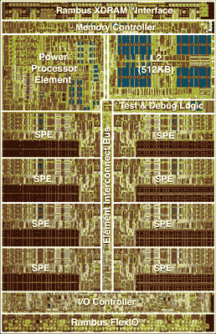
The “Cell Processor” :
Cell Broadband Engine Architecture Processor
Developed by STI alliance, a collaboration of Sony,
Sony Computer Entertainment, Toshiba, and IBM.
Why Cell?
  Actually “Cell” is a shortening for “Cell Broadband Engine
  Architecture” (i.e., it isn’t an acronym)
  Technically abbreviated as CBEA in full, alternatively “Cell BE”.
The design and first implementation of the Cell:
  Performed at STI Design Center in Austin, Texas
  Carried out over a 4-year period from March 2001
  Budget approx. 400 million USD
Image of the Cell processor
Information based mainly on http://en.wikipedia.org/wiki/Cell_(microprocessor)

Slide 9
The Cell Processor Milestones
2005 Feb^{[1,2]}
  IBM’s technical disclosures of cell processors quickly led to new platforms & toolsets ^{[2]}
Oct 05: Mercury Cell Blade
Nov 05: Open Source SDK & Simulator
Feb 06: IBM Cell Blade
Resources / further reading
  http://www-128.ibm.com/developerworks/power/cell/
  http://www.research.ibm.com/cell/
    (see copy of condensed article: Lect17 - The Cell architecture.pdf)
[1] IBM press release 7-Feb-2005: http://www-03.ibm.com/press/us/en/pressrelease/7502.wss
[2] http://www.scei.co.jp/corporate/release/pdf/051110e.pdf

Slide 10
Cell Processor Hardware
Rambus XRAM ™ Interface
9 cores
  1 x Power Processor
  8 x Synergistic Processor
  Element (SPE)
  10 threads
  (2x PPE threads + 8x SPE threads)
Transistors: 241x10⁶
Size: 235 mm²
Clock: 3.2 GHz
Cell ver. 1: 64-bit arch
Memory Controller
Power
Processor
Element
L2 Cache
(512 Kb)
Element interconnect bus
Test&Debug
SPE
SPE
SPE
SPE
SPE
SPE
SPE
SPE
IO Controller
Layout of Cell processor adapted from
  http://www.research.ibm.com/cell/
Rambus FlexIO™

Slide 11
Synergistic Processing Element (SPE)
Cells: heterogeneous multi-core system architecture
  Power cell element for control tasks
  Synergistic Processing Elements for data-intensive processing
Each SPE
  Synergistic Processor Unit (SPU)
  Synergistic Memory Flow Control (MFC)
    Data movement and synchronization
    Interface to high-performance Element Interconnect Bus (EIB)

Slide 12
Cell Broadband Architecture Design
SPE
SPE
SPE
SPE
SPE
SPE
SPE
SPE
SPU
SPU
SPU
SPU
SPU
SPU
SPU
SPU
MFC
MFC
MFC
MFC
MFC
MFC
MFC
MFC
EIB
PPU
MIC
MIC
L2 Cache
PPU
XRAM ™
FLEX™ IO
  Synergistic Processor Unit (SPU)
  Synergistic Memory Flow Control (MFC)

Slide 13
Programming Extensions
Application Binary Interface (ABI) Specifications
  Defines: data types, register usage, calling conventions, and object formats to ensure compatibility of code generators and portability of code.
Examples
  IBM SPE (Strategic Processor Elements) ABI
  Linux Cell ABI

Slide 14
IBM SPE for Cell Processors
SPE C/C++ Language Extensions
  Defines: standardized data types, compiler directives, and language extensions used to make use of SIMD capabilities in the core

Slide 15
Cell Processor Programming Models
Reconfigurable Computing

Slide 16
Cell Processor Programming Models
Cell Processor change SPEs according to application
Models
  Application-specific accelerators
  Function offloading
  Computation acceleration
  Heterogeneous multi-threading

Slide 17
Application Specific Accelerators
Example
3D Visualization Application
Software
PPE
DATA
Stores
Hardware
FLEX™ IO
EIB
SPE 1
SPE 2
SPE 3
SPE 4
SPE 5
SPE 6
SPE 7
SPE 8
3D Graphics Acceleration
Texture
mapping
Data
decompression
Data comparison and classification
3D Scene Generation
Software

Slide 18
Function offloading models…
  Multi-staged pipeline
PPE
SPE
SPE
SPE
  Example:
  LZH_compress(‘data.dat’)
  Parallel stage of processing
  sequence
PPE
  Example:
  Matrix X,Y
  Y = quicksort(X)
  m = Max(X)
  X = X + 1
SPE
  Remember:
  All the SPEs can access the
  shared memory directly via the
  EIB (element interconnect bus)
SPE
SPE

Slide 19
Computation Acceleration
  Similar to model for functional offloading, except each SPE can be busy with other forms of related computation, but tasks not necessarily directly dependent (i.e. the main task isn’t always blocked, waiting for the others to complete)
PPE
Task
#3
Processing
resource
usage
  Set of specific computation tasks scheduled optimally, each possibly needing multiple SPEs and PPE resources
SPE1
SPE2
SPE3
SPE4
SPE1 configured for tasks of type #1
SPE2 configured for tasks of type #2
SPE3 and SPE4 configured for tasks of type #3
Task
#1
Task
#2

Slide 20
Heterogeneous multi-threading
PPE
Processing resource
usage
Thread
#1
Thread
#4
Spawn new threads as needed
SPE1
SPE2
SPE3
SPE4
SPE5
SPE6
SPE7
SPE8
waiting
disabled processing resources
Thread
#3
Thread
#5
PPE configured for thread types #1 and #2
SPE1 configured for threads of type #6
SPE2 configured for threads of type #3
SPE3 and SPE4 for threads of type #5
No threads of type #6 currently exist
Thread
#3
(this thread is blocked)
All SPEs configured to handle general types of tasks required by the application
Combination of PPE threads and SPE threads
Certain SPEs configured to speed certain threads, but able to handle other threads also

Slide 21
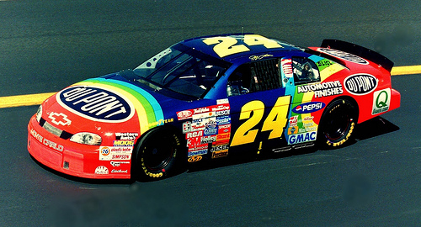

Designing for performance
Three-step approach for
application operation
Step 1 : Staging
  Telling the SPEs what they are to do
  Applying computation parameters
Main Memory
PPE
assigning tasks
L2 Cache
SPE
SPE
SPE
SPE
SPE
SPE
SPE
SPE
todo
todo
todo
todo
todo
todo
todo
todo

Slide 22
Designing for performance
Step 1 : Staging
  Each SPE can use a different block of memory
Step 2 : Processing
  Each SPE does its assigned task
Main Memory
PPE
1
3
5
7
Each SPE uses its allocated
part of memory
2
4
6
8
L2 Cache
SPE
SPE
SPE
SPE
SPE
SPE
SPE
SPE

Slide 23

Designing for performance
Step 1 : Staging
Step 2 : Processing
Step 3 : Combination
Main Memory
PPE
Power PC combines results that
were left by the SPEs in memory,
using its L2 cache to speed it up
1
3
5
7
2
4
6
8
L2 Cache
SPE
SPE
SPE
SPE
SPE
SPE
SPE
SPE

Slide 24
A Packaged Product
EEE4084F Case Study of heterogeneous architecture for a microprocessor-based RC

Slide 25

IBM Blade &
The Cell Processor
CASE STUDY:
IBM Blade rack
(one way to package the processor technology)
  Cell (or Meta-) processors
  Changeable in smaller parts – the ‘Strategic Processing Units’ (SPUs) and their interconnects

Slide 26
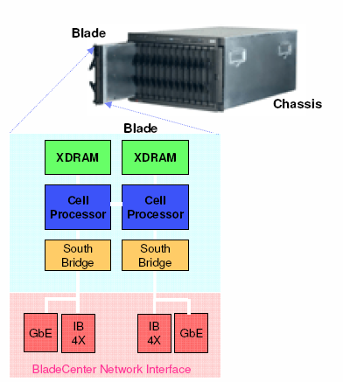
IBM Blade
Each blade contains
  Two cell processors
  IO controller devices
  XDRAM memory
  IBM Blade center interface

Slide 27
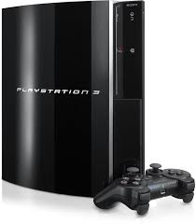

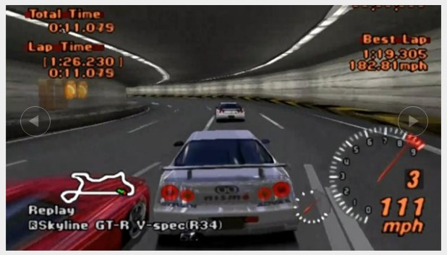
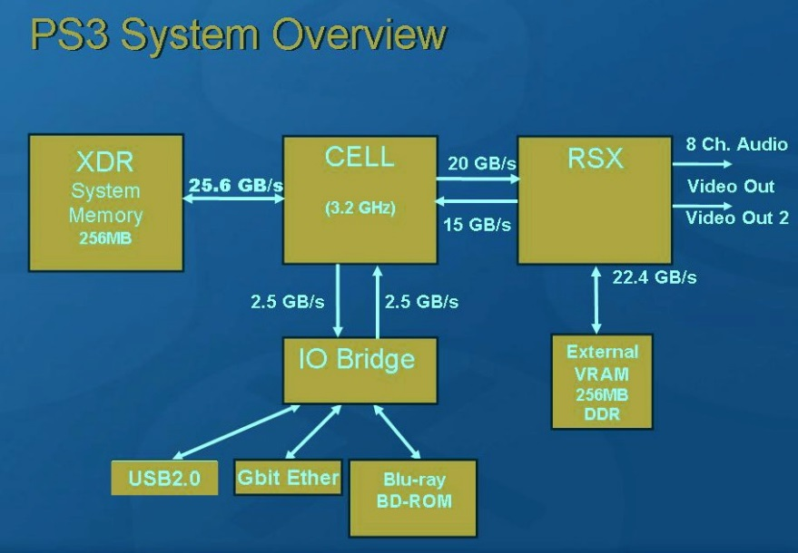
Sony PlayStation 3
Each PS3 contains
  CPU: 3.2-GHz Cell Broadband Engine
  GPU: RSX “Reality Synthesizer” 500MHz, 400 GFLOPS floating point performance
  Mem: 256MB XDR Main RAM, 256MB GDDR3 VRAM
Specs based on information from:
https://www.digitaltrends.com/gaming/playstation-3-vs-playstation-4-in-depth-spec-comparison/

Slide 28
Specialized Languages and tools to support application development for specialized platforms
EEE4084F

Slide 29
Languages for your RC platform
Language extensions
  This could be functionality for example to configure where declared data is placed (e.g. the global)
  Adding specialized operators or operator overloading
Configuration scripts, e.g.
  Shell script calls made from the program
  Could be programming particular FPGAs in the system, setting up comms speeds
Could be a huge amount of work needed for this… but maybe not as much with new technologies…

Slide 30
Technologies to support heterogeneous computing development
Open Computing Language (OpenCL)
  Framework for developing programs that can run across heterogeneous platforms that can comprise CPUs, GPUs, DSP processors, FPGAs and possibly other types of processing hardware for which support can be added.
Berkeley Operating system for ReProgrammable Hardware (BORPH)
  An extended version of the Linux kernel that handles FPGAs as if they were CPUs with various on-FPGA peripherals attached
  Introduces the concept of a 'hardware process', which is a hardware design that runs on an FPGA but behaves just like a normal user program.

Slide 31
Disclaimers and copyright/licensing details
I have tried to follow the correct practices concerning copyright and licensing of material, particularly image sources that have been used in this presentation. I have put much effort into trying to make this material open access so that it can be of benefit to others in their teaching and learning practice. Any mistakes or omissions with regards to these issues I will correct when notified. To the best of my understanding the material in these slides can be shared according to the Creative Commons “Attribution-ShareAlike 4.0 International (CC BY-SA 4.0)” license, and that is why I selected that license to apply to this presentation (it’s not because I particulate want my slides referenced but more to acknowledge the sources and generosity of others who have provided free material such as the images I have used).
Image sources:
IBM Blade rack (slide 3), IBM blade, Checkered flag – Wikipedia open commons
NASCAR image – flickr CC2 share alike
Wikipedia opencommons

