Slide 1


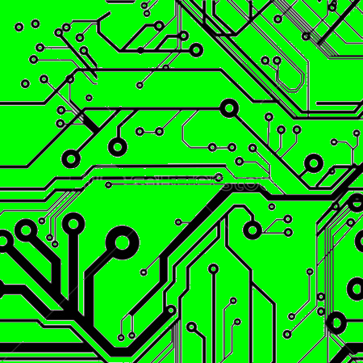
EEE4084F
Digital Systems
Lecture 27:
Design of Parallel Programs /
Heterogeneous Computing Solutions
+ DeepQA
PARTS 3,4
Presented by:
Simon Winberg
Attribution-ShareAlike 4.0 International (CC BY-SA 4.0)

Slide 2
Reminder!
Test 2 scheduled for:
17 May 2pm
45 minutes, usual lecture venue
Lectures:
Lect 9 - much of OpenCL stuff you can skip
Lect 10 - know well!
Lect 11 - should know some of the types of cloud computing
Lect 12 - focus on monitoring development progress (from slide 19-46)
Lect 13 - software quality, up to slide 15 (formal spec and later slides not incl)
Lect 14 - know the general stuff, MPI coding won't be examined
Lect 15 - skip (hooray!)
Lect 16 - skip (double hooray!)
Lect 17 - should know but you can skip stuff about slices
Lect 18 - relevant, you will be asked to do a tiny bit of verilog
Lect 19 - can go up to this point (probably nothing will be asked about FPGA vs CPU)
Seminars:
ADC Ch7

Slide 3
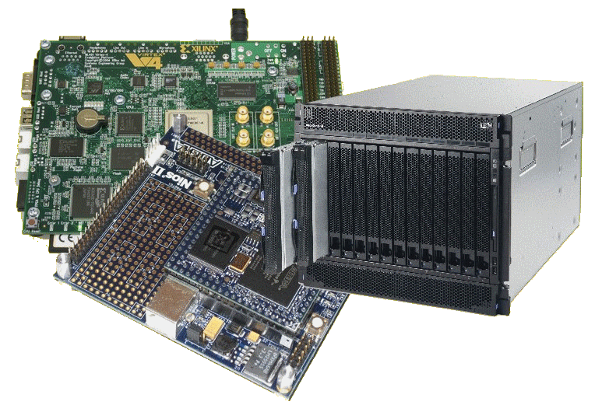
Lecture Overview
DeepQA – a HPEC case study
Designing parallel programs (continued)
  Steps 5-8 (see later slide showing steps)

Slide 4

A short case study of a high performance computing system
DeepQA project and
The Watson machine
A seriously expensive
game console!?

Slide 5

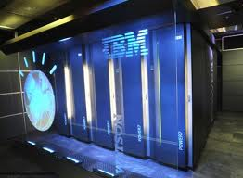
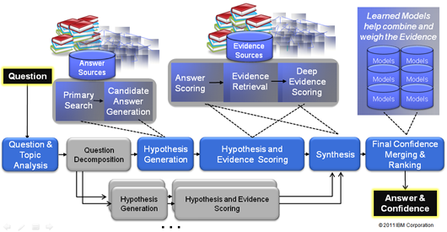
IBM DeepQA
DeepQA (as in Question and Answer)*
  A natural language processing system
  Can precisely answer questions expressed over a broad range of knowledge areas.
DeepQA Machine
DeepQA Architecture
Image sources: http://researcher.ibm.com/researcher/view_page.php?id=2159

Slide 6
IBM DeepQA
Motivation for the DeepQA project
  Current computers store and deliver much digital content, but can’t operate on it in human terms.
  A quest for building a computer system that can do Open-domain Question Answering…
*Read more at: http://www.research.ibm.com/deepqa/deepqa.shtml

Slide 7
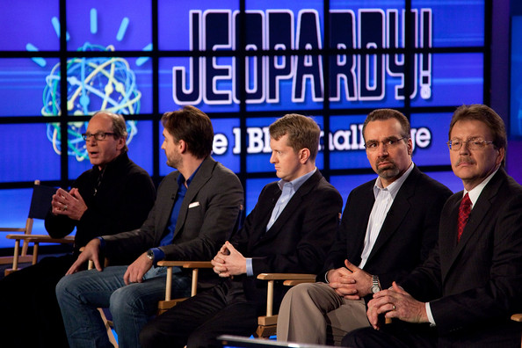
IBM DeepQA
Ultimately driven by a broader vision:
  Get computers to operate more effectively in human terms rather in computer terms.
Surely not! I
think it’s a
stupid game.
Spoil sport,
you lost as
You didn’t ask
something.
  Get computers to
  function in ways that understand complex information requirements (as people would express them), e.g. responding to natural language questions or requests.
What is a game
that you can
only respond in
questions?
Is there a game
other than Jeopardy that is
played in that way?
Say what?
*Read more at: http://www.research.ibm.com/deepqa/deepqa.shtml

Slide 8

IBM Watson… a short film
Putting DeepQA to the test
IBM and the Jeopardy Challenge.mp4

Slide 9
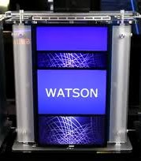
The IBM Watson
Jeopardy was chosen as a game that
makes significant cognitive demands on its payers.
It involves questions and answers, but structuring
both in a specific manner that makes sense beyond
the surface level of the question/answer text given.
What has this shown us?
  A computer can be designed to pose meaningful answers to questions in a natural language.
  Watson as the supreme champion of Jeopardy*
Beyond Jeopardy
  IBM is planning to apply the Watson system design in areas such as healthcare, customer service, finance… etc etc.
I wonder how great this will be in reality…
* http://www.geek.com/articles/geek-cetera/how-ibms-watson-could-have-been-beaten-in-jeopardy-20110226/

Slide 10
IBM DeepQA :
where could it lead?...

Slide 11
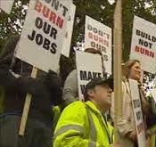

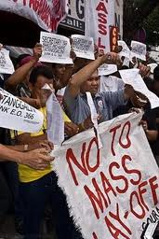
Future aftermath of DeepQA??
How may I help you today? ☺ ☺
I’d like to check my bank balance.
Scenario…
When was the first bank in England opened?
I don’t know. Please, I need to check my balance!
What the $&%# !! Bring back the touch-tone menu options!
The famous Battle of Waterloo tipped the balance of power for what emperor in 1815?

Slide 12
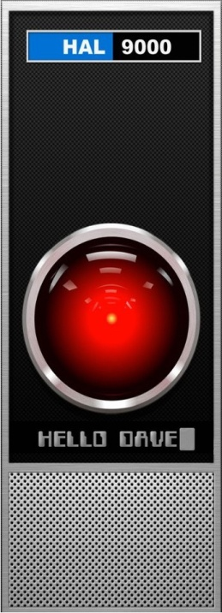

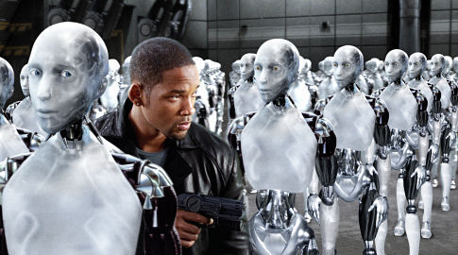
IBM DeepQA : where could it lead?
“Can a robot
write a symphony? Can a robot turn a... canvas into a beautiful masterpiece?”
<< I am putting myself to the fullest possible use, which is all I think that any conscious entity can ever hope to do. >>
<< Can you? >>
<< Well, I can act without a conscious. >>
No! But I can act.
… and I have a
conscious (I think)

Slide 13


Steps in designing parallel programs
The hardware may come first or later
The main steps:
Understand the problem
Partitioning (separation into main tasks)
Decomposition & Granularity
Communications
Identify data dependencies
Synchronization
Load balancing
Performance analysis and tuning

Slide 14
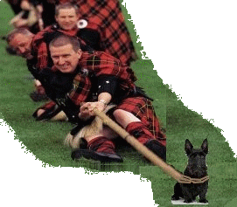
Step 5: Identify Data Dependencies
In dog-think: I’m not budging from here until I’m done. Woof!
EEE4084F

Slide 15
Data dependencies
A dependency exists between statements of a program when the order of executing the statements affects the results of the program.
A data dependency is caused by different tasks accessing the same variables (i.e., memory addresses).
Dependencies are a major inhibition to developing parallel programs.

Slide 16
Data dependencies
Common approaches to working around data dependencies:
  For distributed memory architectures: tend to use synchronization points (periods when sets of shared data is communicated between tasks).
  Shared memory architectures: make use of read/write synchronize operations (no sending of data, just temporarily block other tasks from reading/writing a variable).

Slide 17
Common data dependencies
Loop carried data dependence:
  dependence between statements in different iterations
Loop independent data dependence:
  dependence between statements in the same iteration
Lexically forward dependence:
  source precedes the target lexically
Lexically backward dependence:
  opposite from above
Right-hand side of an assignment precede the left-hand
side
Source: http://sc.tamu.edu/help/power/powerlearn/html/ScalarOptnw/tsld036.htm

Slide 18
Step 6: Synchronization
Design of Parallel Programs
EEE4084F

Slide 19
Types of Synchronization
Barrier
Locking / Semaphores
Synchronous communication operations

Slide 20
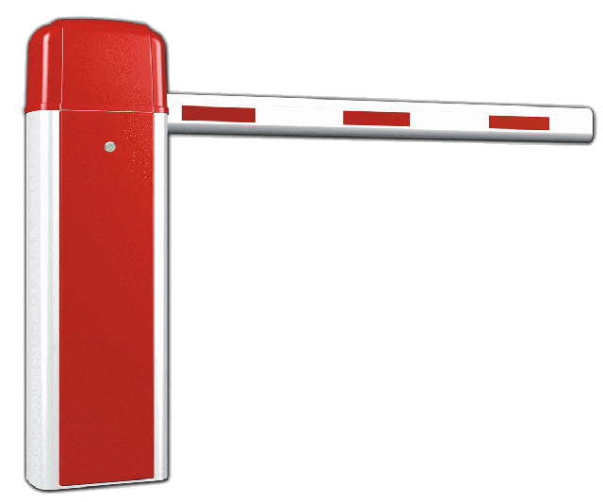
Barrier
All tasks are involved
Each task does work until it reaches the barrier, and then blocks.
When the last task reaches the barrier all the tasks are synchronized.
What happens next?…
  Section of work is done or
  Tasks are automatically released to continue their work… programmer usually decides.

Slide 21

Locking / Semaphores
May concern any number of tasks
Usually used to serialize / protect access to global data or critical section of code.
Only one task at a time may have the lock / semaphore.
Tasks can attempt to get the lock need to wait for the task that has the lock to release it, granted on a FCFS basis.
Usually blocking, could be non-blocking (i.e., do other work until lock is available)

Slide 22
Synchronous communication operations
Concerns only tasks executing a communication operation (or coms op)
When a task performs a coms op, some form of coordination is required with other task(s) involved with this communication.
  For example, before a task can do a send operation, it needs to first receive a clear to send (CTS) signal from the task it wants to send to.

Slide 23
Step 7: Load Balancing
EEE4084F

Slide 24
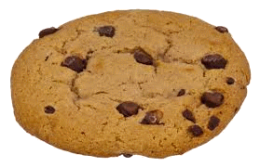

Load Balancing
Distributing work among tasks so
that all tasks are kept busy most of the time
Mainly a minimization of idle time
Relevant to parallel programs for optimizing performance.
  e.g., if every tasks encounters a barrier synchronization point, the slowest task will end up limiting the overall performance.
Relevant to costing, e.g. deciding number of processors needed (can also be used in substantiating the need for a more, rather than less, expensive platform)

Slide 25
Load Balancing – simple trial technique
prog_start
logt[1].start
idle
…
typedef struct { unsigned start, end; } LogEntry;
LogEntry logt[1024];
int logn = 0;
unsigned prog_start, prog_end;
void* task (void* arg)
{
unsigned int end;
unsigned int start = clock();
// do work
// calculate time it took
end = clock();
// update time log
pthread_mutex_lock(&mutex);
logt[logn].start = start; logt[logn].end = end; logn++;
pthread_mutex_unlock(&mutex);
}
logt[0].start
logt[0].end
logt[1].end
busy
prog_end
… in main() get prog_start time, create mutex & threads, wait join, get prog_end time.

Slide 26
Load Balancing – simple trial technique (cont)
...
double calc_stat_stddev ()
{ // calculate standard deviation of busy times
int i;
double sum = 0;
for(i = 0; i < logn; i++) sum += logt[i].end - logt[i].start;
double mean = sum / logn;
double sq_diff_sum = 0;
for(i = 0; i < logn; ++i) {
double diff = logt[i].end - logt[i].start - mean;
sq_diff_sum += diff * diff;
}
double variance = (double)sq_diff_sum / logn;
return sqrt(variance);
}
…

Slide 27
Load Balancing
Well balanced – low standard deviation in busy time*
Task 1
time busy
Time idle
Task 2
time busy
Time idle
Task 3
time busy
Time idle
Task 4
time busy
Time idle
Overall
time busy
Time idle
Poorly balanced – high standard deviation in busy time
Task 1
time busy
Task 2
busy
Time idle
Task 3
time busy
Time idle
Task 4
busy
Time idle
Overall
time busy
Time idle
* You could obviously use idle time – but that’s probably more difficult if using code in prev. slide

Slide 28

Achieving load balance
Two general techniques…
Equally partition work as a preprocess
  Workload can be determined accurately before starting the operation
Dynamic work assignment
  For operations where the workload is unknown, or cannot be effectively calculated, before starting the operation

Slide 29
Achieving balance – Work assignment as pre-process
Examples include
  Array or matrix operations for which each task performs similar work. Can evenly distribute the data set among tasks / available processors.
  Loop iterations where the work in each iteration is similar, and can be evenly distributed.
May be less easy to do if using a heterogeneous mix of machines that have varying performance characteristics. In such cases, a comprehensive analysis tool may be needed to determine load imbalances and revise work disctribution.

Slide 30
Achieving balance – Work assigned dynamically
Examples include
  Sparse arrays/matrices (i.e., if matrix simply divided equally, some tasks may have lots to do but others little to do)
  N-body simulations (particles owned by some tasks may involve more work than others)
  Adaptive grid refinement (some tasks may need to refine their grips)
General principle: tasks that are busier send a request for assistance, whereas tasks that complete quickly are available to help the busier tasks.

Slide 31

Vertical vs. horizontal load balancing
Recommended video clip to view
Load Balancing with Cloud Computing.mp4

Slide 32

Vertical vs. horizontal load balancing
Vertically:
  More power, but centralized (one app. may run faster / more response / less latency for RT)
  Adding CPUs + memory to one system
  More dependent on one machine / group of closely coupled machines
Horizontally:
  More power, but wider distribution (more apps able to run at one time)
  Simpler scalability
  More distribution / redundancy / better risk management
MOPS
…
MOPS

Slide 33
Step 8: Performance analysis
EEE4084F

Slide 34
Performance analysis
Simple approaches involve using timers (i.e., as shown in previous code snippet)
  Usually quite straightforward for a serial situation or global memory
Monitoring and analyzing parallel programs can get a whole lot more challenging than for the serial case
  May add comms overhead
  Needing synchronization to avoid corrupting results, … could be a nontrivial algorithm itself

Slide 35
MPI Timing functions
MPI_Wtime
  Returns the elapsed wall clock time in seconds (a double) on the calling processor
MPI_Wtick
  Returns the timer resolution in seconds (a double) of MPI_Wtime.

Slide 36
StdC: gettimeofday
gettimeofday
  Very portable, part of the StdC library
  Should be available on any Linux system
  Returns time in seconds and microseconds since midnight January 1 1970
  Uses struct timeval comprising
    tv_sec : number of seconds
    tv_usec : number of microseconds*
  Converting to microseconds will use huge numbers, rather work on differences
* Word of caution: some implementations always return 0 for the usec field!!
On Cygwin, the resolution is only in milliseconds, so tv_usec in multiples of 1000.
Not provided in DevC++.

Slide 37
gettimeofday example
see timing.c code file
Provided previously
#include <stdio.h>
#include <sys/time.h>
#include <time.h>
struct timeval start_time, end_time; // variables to hold start and end time
int main() {
int tot_usecs;
int i,j,sum=0;
gettimeofday(&start_time, (struct timezone*)0); // starting timestamp
/* do some work */
for (i=0; i<10000; i++)
for (j=0; j<i; j++) sum += i*j;
gettimeofday(&end_time, (struct timezone*)0); // ending timestamp
tot_usecs = (end_time.tv_sec-start_time.tv_sec) * 1000000 +
(end_time.tv_usec-start_time.tv_usec);
printf("Total time: %d usec.\n", tot_usecs);
}

Slide 38
Benchmarking
Process of measuring performance of DS
A program that Quantitatively evaluates computer Hardware and software resources
Benchmark suites – sets of benchmarks defined to get better system picture
Suitable benchmark for a system leads to an effective system

Slide 39
Benchmarking (cont…)
What can be benchmarked? ( In DSP Compiler, Processor, Platform)
Compiler – Converts High Level Language to Assembly language thus we benchmark compiler efficiency
The Processor – code should be an Assembly (No more high level code)
Platform – Written in High Level language(Processor & Compiler)

Slide 40
Benchmarking: what to measure
In DSP/HPEC systems we benchmark Cycle count, Data and Program memory usage, Execution time and Power consumption
What can we benchmark in Databases/Web servers (i.e Oracle, MySQL, SQL Server)?
SPEC defined several benchmarks in the digital world - SPECweb99, SPECmail, etc.

Slide 41
Benchmark: Approaches
Metrics (MIPS, MOPS, MFLOPS, etc) – not really meaningful in RISC architectures(Why?)
Complete DSP Application – consumes time and effort as well as memory because it measure the whole system
DSP Algorithm Kernels – extracted from real DSP programs and consist of small loops which perform number crunching, bit processing, etc.

Slide 42

Benchmarking: Types
EEMBC (pron. embassy) – For embedded System and written in C
BDTIMARK – a DSP benchmark suite
Check this paper for a List of FPGA benchmarking types: Raphael Njuguna: A Survey of FPGA Benchmarks Available at: http://www.cse.wustl.edu/~jain/cse567-08/ftp/fpga.pdf) -- might be in exam
More Reading: Performance evaluation and Benchmarking, Lizy K. John and Lieven Eeckhout, Taylor & Francis Group

Slide 43

End of:
Design of Parallel Programs

Slide 44
Questions?
?
?
?
?
?
?
?
?
?
?
?
?
?

Slide 45
Further Reading / Refs
Suggestions for further reading, slides partially based / general principles elaborated in:
A Survey of FPGA Benchmarks Available at: http://www.cse.wustl.edu/~jain/cse567-08/ftp/fpga.pdf
Data dependencies suggested reading: http://sc.tamu.edu/help/power/powerlearn/html/ScalarOptnw/tsld036.htm
Load Balancing with Cloud Computing. https://www.youtube.com/watch?v=_xH5POea0Jc
FPGA benchmarking types: Raphael Njuguna: A Survey of FPGA Benchmarks Available at: http://www.cse.wustl.edu/~jain/cse567-08/ftp/fpga.pdf
“Performance evaluation and Benchmarking”, Lizy K. John and Lieven Eeckhout, Taylor & Francis Group

Slide 46
Disclaimers and copyright/licensing details
I have tried to follow the correct practices concerning copyright and licensing of material, particularly image sources that have been used in this presentation. I have put much effort into trying to make this material open access so that it can be of benefit to others in their teaching and learning practice. Any mistakes or omissions with regards to these issues I will correct when notified. To the best of my understanding the material in these slides can be shared according to the Creative Commons “Attribution-ShareAlike 4.0 International (CC BY-SA 4.0)” license, and that is why I selected that license to apply to this presentation (it’s not because I particulate want my slides referenced but more to acknowledge the sources and generosity of others who have provided free material such as the images I have used).
Image sources:
Man running up stairs - Wikipedia (open commons)
Chocolate Chip Biscuit - Wikipedia (open commons)
Scales, Checked Flag - Open Clipart (http://openclipart.org)
Calendar Planning Image, Note pad – Pixabay (Public Domain CC0)
Yoga lady - adapted from Open Clipart

