Slide 1






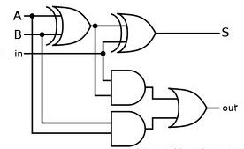
EEE4084F
Digital Systems
Lecture 28X
C → HDL Automatic Conversion
NOT IN 2018 EXAM
Lecturer:
Simon Winberg
Attribution-ShareAlike 4.0 International (CC BY-SA 4.0)

Slide 2
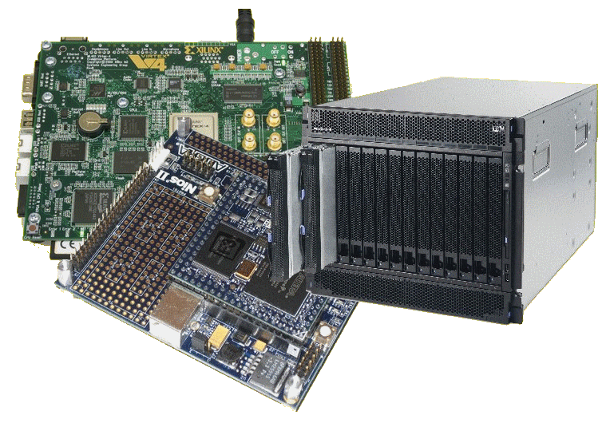
Lecture Overview
MIPS and FLOPS are not enough…
C → HDL automatic conversion
  Overview of conversion process
  Limitations
  Scenario
  Mapping C to
  HDL behavioural
  Some tools

Slide 3
Terminology buffs?
Every heard of DMIPS?
In relation to a VAX?
How bizarre… how is that possibly of any relevance to HPEC?...

Slide 4
Why MIPS and FLOPS are not enough
Limitations of MIPS and FLOPS
  MIPS alone are not all that meaningful for benchmarking because 1 CISC instruction may be worth many RISC instructions (but the CISC might still complete the task faster)
  Similarly MFLOPS alone, while a bit more useful, do not give a sufficiently full picture, the processor could do lots of FLOPS but be low on other things (e.g. memory operations)
DMIPS =
  Dhrystone MIPS (Million Instructions Per Second). Shows number of iterations of the Dhrystone loop repeated per second. More holistic performance measure aligned to likely processing needs
  DMIPS = Dhrystone_score / 1,757
  The value 1,757 is the number of Dhrystones per second obtained on the VAX 11/780, nominally a 1 MIPS machine

Slide 5

Whetstone, Dhrystone and CoreMark
Whetstone is a collection of commonly used computation tasks, repeated in a loop, and the time the loop takes to complete equates to the Whetstone rating.
For further details see:
http://www.coremark.org/home.php

Slide 6

Whetstone, Dhrystone and CoreMark
The Dhrystone benchmark contains no floating point operations; it is works similarly to the Whetstone, but uses computations appropriate for fixed-point or integer based applications.
For further details see:
http://www.coremark.org/home.php

Slide 7

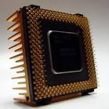

Whetstone, Dhrystone and CoreMark
CoreMark is a smaller benchmark
Developed by the Embedded Microprocessor Benchmark Consortium (EEMBC)
Focuses on the CPU core, similar to Dhrystone.
CoreMark is intended to
  Execute on any processor, incl. small micro-controllers.
  Avoid issues such as the compiler computing the work during compile time
  Use real algorithms rather than being mostly synthetic.
  CoreMark has established rules for running the benchmark and for reporting the results.
For further details see:
http://www.coremark.org/home.php

Slide 8
C to HDL Automatic Conversion
EEE4084F

Slide 9
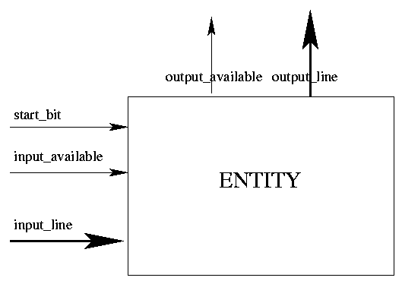
C to HDL Converters
C program: functions; variables;
  based on sequence (start to end) and the use of memory/registers operations
VHDL / Verilog HDL:
  Implements an entity/module for the procedure
C code converted to VHDL

Slide 10
C to HDL
Standard C characteristics
  Memory-based
  Variables (registers) used in performing computation
  Normal C and C programs are sequential
Specialized C flavours for parallel description & FPGA programming:
    Mitrion-C , SystemC , pC (IBM Parallel C) System Crafter, Impulse C , OpenCL
    FpgaC Open-source (http://fpgac.sourceforge.net/) – does generate VHDL/Verilog but directly to bit file

Slide 11
How C → HDL translators usually work (simplified)
Input
  Often one C module at a time, no C libraries (operations like sqrt hardcoded as VHDL and H file interface, e.g. math.h)
  More complete versions could use multiple user-developed modules and libraries
Output
  HDL code describing a top-level element with ports that can be hooked-up to other elements (e.g. using Altera Quartus II or LabView FPGA*) such as memory (e.g. BRAM, SDRAM), multipliers and dividers – similar to what you’ve done in Prac5
* http://www.ni.com/fpga/what_is.htm

Slide 12
Common Limitations for
C → VHDL translators
No global variables
  (i.e. how would you connect a global variable/register to components in a module?)
Forced to use additional arguments and operational mechanisms
  E.g. adding lines to control/arbitrate memory accesses, clock lines, etc. which may needed to be manually accounted for in hooking things up and fiddling with if things aren’t compiling / working
Limited arguments
  E.g. limited to 4 user arguments
Does not support all C constructs
  E.g. struct, typedef, pointers (to variables)
One function at a time

Slide 13
C → VHDL Scenario
Looking at the steps a translation tool would take
Program requirements:
  Implement a 4-bit up-counter in C that counts from an initial value (default of 0) and sets a reset_alarm variable once the target has been reached
  Also want a reset operation and ability to set the count value

Slide 14
C Coding: Attempt 1
Let’s write it as we’d naturally write in C
  Set up a few global variables
  Set up a few functions
  Write a main() function as starting point of the program
Please refer to the Handle-C handout that describes the style & syntax
(note this handout is a simplification of the official Handle-C syntax)
See handlec.c in: resources / class activities / handlec-example.zip

Slide 15
Program continues here
/** upcount (attempt 1): 4-bit up-counter
with reset alert.
This is a C program that we want to
translate into VHDL. */
/* Global variables */
int count = 0; // our global counter
int target = 5; // the targer value
// Reset function sets count to 0
void reset () {
count = 0;
}
/** Our upcount function. Return nonzero when target reached. */
int upcount ()
{
count=(count + 1)%7;
if (count==target) return 1;
else return 0;
}
int main () {
reset(); // reset the counter
// wait a bit...
while (!upcount());
// override with another value
count = 2;
return 0;
}

Slide 16
Concerns to deal with
VHDL program doesn’t really have a starting point
  Usually data flows, sending signals to a port and getting signals back
  We’re essentially wanting the program to become a VHDL entity
  Need to account for other entities wanting to control this one (e.g., telling this program to “reset”)
  What about the clock?

Slide 17
C Code Attempt 2
Design around “lines” (shown as variable parameters) that control the upcount function (to become the upcount entity)
  Parameters
    Reset = reset the counter
    Loadcnt = request value to load
    Data = input value to load into count
    Target = target to up to

Slide 18
C Interface → VHDL Port
H file for C program
VHDL Code Port
/* 4-bit up-counter
with reset alert. */
void upcount (
_in bit reset,
_in bit loadcnt,
_in int 4 target,
_in int 4 data,
_out bit reset_alert );
/* Increments count until it reaches target. Returns 1 if target reached else returns 0
*/
-- interface for entity upcount
ENTITY upcount IS PORT(
clock, reset, loadcnt : IN BIT;
target, data: IN BIT_VECTOR( 3 DOWNTO 0 );
reset_alert: OUT BIT;
);
END counter_4;

Slide 19
Variables vs. signals
VHDL types
The translation needs to map C variable types into VHDL signals…
VHDL standard types…
Scalar (single valued) signal types:
  bit, boolean, integer
Examples:
  A: in bit;
  G: out boolean;
  K: out integer range -2**4 to 2**4-1;

Slide 20
Variables vs. signals
VHDL types
Aggregate (collection) signal types:
  bit_vector – array of bits representing an unsigned binary number
  signed – array of bits representing a signed binary number
Examples:
  D: in bit_vector(0 to 7);
  E: in bit_vector(7 downto 0);
  M: in signed (4 downto 0);
  -- signed 5-bit vector for a binary number

Slide 21
C implementation to
VHDL architecture
C implementation
  Initialization of global variables
  Operation of the functions
  The entry point (main) and sequencing of program (i.e. main calls upcount)
VHDL translation
  Initialization of registers
  Clocks (to synchronize operations)
  Architecture/behaviour descriptions describing what the entities do

Slide 22
C to HDL:
Large part is converting C into a VHDL behaviour description…
C Code
VHDL Code
/* 4-bit up-counter
with reset alert. */
int count = 0;
// this function runs
// all the time:
int upcount (
_in int 4 data,
_in int 4 target,
_in bit loadcnt,
_in bit reset,
_out bit reset_alert)
{
if (reset) count=0;
if (loadcnt) {
count=data;
return 0; }
count=(count + 1)%15;
if (count==target)
reset_alert=1;
else reset_alert=0;
}
ENTITY upcount IS PORT(
clock : IN BIT;
data : IN BIT_VECTOR (3 DOWNTO 0);
target: IN BIT_VECTOR (3 DOWNTO 0);
loadcnt, reset : IN BIT;
reset_alert: OUT BIT );
END counter_4;
ARCHITECTURE behavioral OF counter_4 IS
BEGIN
upcount: PROCESS( clock )
VARIABLE count: BIT_VECTOR(3 DOWNTO 0);
BEGIN
IF (clock= '1') THEN
IF (reset = '1') THEN
count <= "0000";
ELSIF (loadcnt='1') THEN count <= data;
ELSE
-- … adder here (see next slide) …
END PROCESS upcount;
END behavioral;

Slide 23
Continuation of last slide (for completeness sake)…
VHDL Code
-- full adder --
count(0) <= NOT count(0);
count(1) <= count(0) XOR count(1);
count(2) <= ( count(0) AND count(1) )
XOR count(2);
count(3) <= ( count(0) AND count(1)
AND count(2) ) XOR count(3);
IF count = target THEN
reset_alert <= '1';
ELSE
reset_alert <= '0';
END IF; -- IF count = target
END IF; -- IF reset = ‘1’
END IF; -- IF clock = '1’

Slide 24
Current C to VHDL Converters
Handles the basic C data types
  ints, arrays / pointers, reference variables (e.g., int& ref)
Handles basic C constructs such as:
  arithmetic operations
  if-then-else and switch
  Loops: for, while-do, do-while
General rule of practice: avoid using loops (esp. for) unless it’s really needed as better and more efficient code is generally produced if you keep in mind that the whole function restarts after a return / reaches the end.
Notes:
Pointers are declared as integers and their value is the index of the variable they are pointing to. All the variables whose references are used are stored in an array. The variables are aliased with one location in this array.

Slide 25
C to VHDL Mapping
if-then-else if-then-else
while-do while-do
do-while first iteration, while-do
for-do for-do
Arithmetic Arithmetic
operations operations

Slide 26
Limitations of Current Automatic Convertors
Mutual recursion not supported
Hardware to hardware communication generally not supported
For some convertors, The return statement at the end of code should return only void or integer (e.g., DimeC)
Declarative limitations for variables and procedures (e.g., not more than 4 parameters – depends on interconnect limitations of FPGA)

Slide 27
Class Activity / Take-home task
Implement a pattern counter:
  Send a starting address (byte addressing used)
  Send an ending address
  Send a 2-byte (16-bit) sequence to search for (this can be a 16-bit input)
  Send an enable pulse to read all the inputs and start searching (note the inputs may change later during the execution)
  Returns a 16-bit integer showing the number found, and raises done to high
See lecture 26 class activity on pattern counter exercise (and sample solution)

Slide 28
C → HDL Tools
Commercial Conversion Tools

Slide 29
SystemC Example (an alternative)
#include "systemc.h"
SC_MODULE(adder) // module declaration (like class)
{
sc_in<int> a, b; // ports
sc_out<int> sum;
void do_add () // define a process...
{
sum = a + b;
}
SC_CTOR(adder) // constructor
{
SC_METHOD(do_add); // register do_add with kernel
sensitive << a << b; // sensitivity list for ‘do_add’
}
};
(lecturers comment: as the code shows, it’s not such a straight forward syntax; I recommend starting with something like HandleC and then try SystemC if you need its expressivity and other features.)

Slide 30
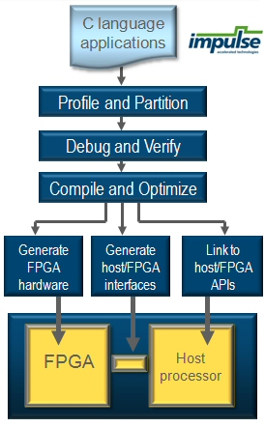
ImpulseC
Write FPGA processing applications in (fairly standard) C
Provides a sophisticated IDE
Include tools for profiling and to help you optimize your code
Generates both hardware bit files for the FPGA (s) used and an FPGA interface for custom PC-based programs
http://www.impulsec.com/products.htm

Slide 31
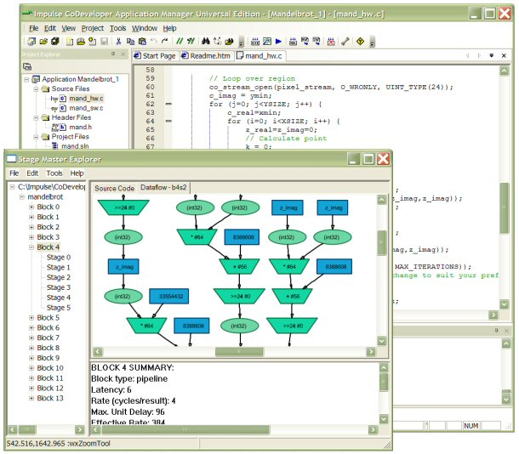
ImpulseC Screenshot
http://www.impulsec.com/products.htm

Slide 32
C → Verilog
C -> Verilog converters are actually more common. Many of the C → VHDL also include C → Verilog, or you may be able to do the conversion in Xilinx Vivado or Altera Quartus II.
Free online C to Verilog translator
  http://www.c-to-verilog.com/online.html
Note re use of these tools with YODA: Yes, you are welcome to use C->HDL type tools in the project, but do look over the end result, often manual inspection and refinement of the code leads to a better solution, but the benefit is that at least you may end up with a usable solution more quickly.

Slide 33
Example Run
http://www.c-to-verilog.com/online.html
Verilog (281 lines of code A,B 8-bit)
module _Z7my_mainPjS_ (
clk, reset, rdy,// control
// memport for: A
mem_A_out0, mem_A_in0,
mem_A_addr0, mem_A_mode0,
// memport for B:
mem_B_out0, mem_B_in0,
mem_B_addr0, mem_B_mode0,
// 2nd mem port for A for parallel proc
mem_A_out1, mem_A_in1,
mem_A_addr1, mem_A_mode1,
…);
// params input wire clk; input wire reset;
// output rdy; reg rdy; output return_value; reg return_value; input [7:0] p_A; input [7:0] p_B;input wire [31:0] mem_A_out0;output reg [31:0]
…
C CODE (6 lines)
#define ITEMS 256
// of each word of B[] in A[]
void my_main(unsigned int* A, unsigned int* B) {
for (int i=0; i<ITEMS; i++)
A[i] = A[i] + B[i];
}
(lecturers comment: as you can see, there is a certain amount of connecting up to memory, clk, etc. that would need to be done manually to make the generated code work.)

Slide 34
Disclaimers and copyright/licensing details
I have tried to follow the correct practices concerning copyright and licensing of material, particularly image sources that have been used in this presentation. I have put much effort into trying to make this material open access so that it can be of benefit to others in their teaching and learning practice. Any mistakes or omissions with regards to these issues I will correct when notified. To the best of my understanding the material in these slides can be shared according to the Creative Commons “Attribution-ShareAlike 4.0 International (CC BY-SA 4.0)” license, and that is why I selected that license to apply to this presentation (it’s not because I particulate want my slides referenced but more to acknowledge the sources and generosity of others who have provided free material such as the images I have used).
Image sources:
Product logos/icons from applications concerned
Chip image – Wikipedia open commons
Desert photo snippet – segment from photo on flickr
Ruler – Open Clipart www.openclipart.org (public domain)
ImpulseC – images from http://www.impulsec.com/products.htm

