Slide 1
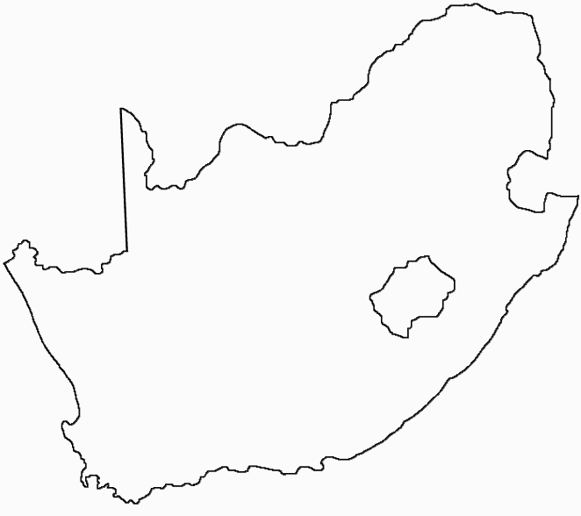
Building local knowledge in a high-tech field
Knowledge 2011
Presentation by:
Simon Winberg
Department of Electrical Engineering
University of Cape Town
Higher education and entrepreneurship
Software Defined Radio
Research Group
29-March-2011

Slide 2
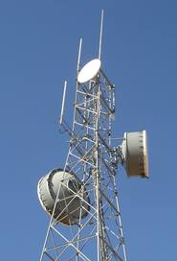
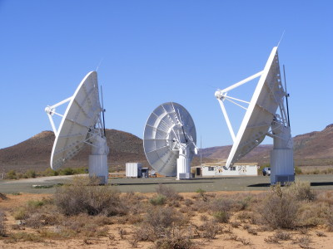
Introduction
Electrical engineering postgraduate studies
Building skills and entrepreneurial opportunities in a specialist area…
Specialized area:
High performance computing
Radio (wireless comms) and radar applications
Using reconfigurable computing systems
A revolutionary
new area!

Slide 3
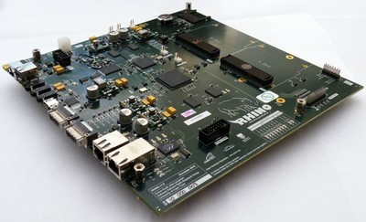
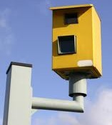
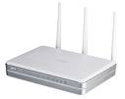
A high-tech field
Building and using reconfigurable computers:
A computer system that can autonomously change parts of its own hardware (i.e., without manual intervention to solder wires, etc.)
Reconfigurable
computer platform
Can be configured to
provide general computing operation
Reconfigured to be a radar system
Reconfigured to be a wireless router

Slide 4
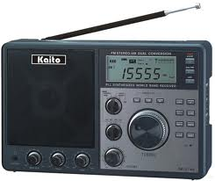
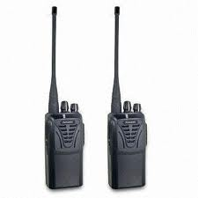
Focus: Software Defined Radio (SDR) reconfigurable computer
Examples of radio applications:
Wireless router
Cellular 3G transceiver
FM radio
Television
Radar (e.g. speed sensor)
Some benefits of reconf. computing:
Save time & cost for new systems
Upgrading infrastructure with more flexible hardware
Some electronic products that can be emulated using a Rhino platform

Slide 5
Why SDR in SA?
Digital Engineers needed
Skills in
- Translation of system specifications to VHDL
- Implementation of correlation algorithms
- Design, implementation and verification of FPGA firmware
- Design and implementation of driver software
One of many example advisements calling for skills in this area *
SKILLS SHORTAGE WORLDWIDE !!
Skilled employees needed!
Based on evidence from the European JIVE initiative
*
Source: http://www.jive.nl/
* Very Long Baseline Interferometry (VLBI): major research area in analyzing signals for radio astronomy

Slide 6
Where the jobs are…
Need to both build skills, to be globally competitive, but also create more jobs locally to retain the knowledge within the country.
SA knowledge economy
(incl. Australia)
& other North
American nations
But it
gets worse
While SA is in the lead in Africa, the country is still lagging in global terms.
Overseas
Note: in the case of continent the flag represents the country with the largest electronics industry
Data based on: Cass, S. 2007. “Where the jobs are”, In IEEE Spectrum: 44(2). pp 51-57

Slide 7
Methodology: building the SDR high-tech field in the SA context
A multi-faceted approach
Collaboration with overseas and local universities and businesses
Research group to attract postgraduates
Building an online community of practice (COP)
Development of ‘boundary objects’*
Training programmes – marketing concept and training people inside and outside the university
Knowledge commodities for the global market
* Knorr-Cetina, K. [1997]. “Sociality with objects: social relations in postsocial knowledge societies.” Theory, culture & society, 14(4): 1-30.

Slide 8
Long-term Methodology
Overseas university collaborations
Overseas Industry
Collaboration/support
CASPER Centre for
Astronomy Signal
Processing and
Electronics Research
Software Defined Radio, UCT Research Group
Online Community of Practice
Local Industry
Other SA Universities and groups
meerKAT Karoo Array Telescope
Research collaborations
Short courses

Slide 9
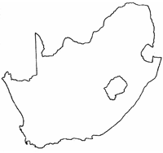
SDRRG Research Group Strategy
Building & maintaining
high-tech knowledge
Postgraduates
Local industry / other universities
Overseas industry/ universities
4th Year Undergraduates

Slide 10
Building of student skills
Skills for reconfigurable computing…
In some respects they need less knowledge…
Some of the analogue electronics not as complex
Less demanding on electronic design skill (e.g., less complex circuit boards, thus faster to build, etc).
In other respects they need more knowledge and new kinds of knowledge…
Adapting analogue techniques to a digital domain
Learning hardware description languages
Understanding theories and practicalities of radio technologies

Slide 11
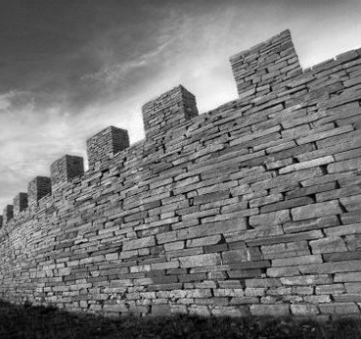
Types of Electrical Engineers
Command approach for university electrical engineering degree Programs
Computer/Digital Electronics Engineers
Focus: building computer systems
Digital systems design
Digital signal processing
Interfacing systems
Co-design
Programming
Analogue Electronics Engineer
Focus: building analogue systems/subsystems
Signal propagation
Analogue signal conditioning and filtering
Electromagnetic theory
SDRRG group needs to establish effective support and training methods to bridge these gaps
Building software defined radio systems using a reconfigurable computer

Slide 12
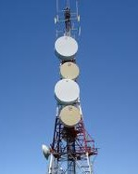
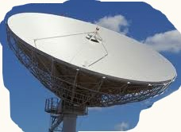
Approach to Building local knowledge in this high-tech field:
A decentralised community of practice (COP) from different universities and organisations
Develop reconfigurable computer system that is a ‘boundary object’ used within the COP
RHINO reconfigurable computer designed to be such a ‘boundary object’ for software defined radio applications

Slide 13
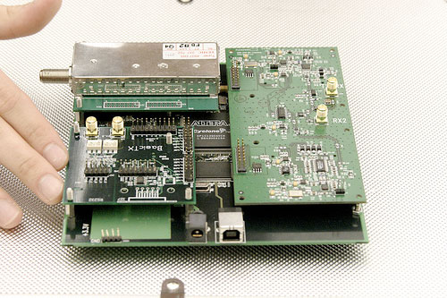
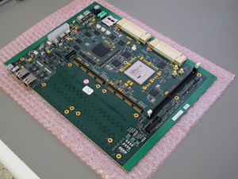
RHINO system
‘Reconfigurable Hardware Interface for computiNg and radiO’
Developing skills by:
Building our own platform
Developing tools and training resources for it
Using it in research projects
www.rhino.ee.uct.ac.za
A variety of more expensive versions exist that are developed in overseas universities
USRP-I
ROACH

Slide 14
Needs analysis for SDR
Needs analysis for SDR in SA was conducted January–June 2010
Activities accomplished
Establish stakeholders and collaborators
Interviews and meetings with local industries
Study existing reconfigurable computing platforms
Collation and correlation of the data
Construct RHINO design based on needs analysis*
* Scott, S. 2010. "RHINO - A Low Cost Reconfigurable Platform for Software Defined Radio“. CASPER Workshop, 16-20 August 2010. Cambridge, MA.

Slide 15
SDRRG Group Operation
RHINO resources &
Research outputs
SDR
Community
Postgraduate students
development
support
4th year undergraduate student projects using RHINO
Assistance
Supervision
Supervision
Academics
Resources & partners
obtain

Slide 16
Progress thus far
SDRRG formed Jan 2010
RHINO hardware built Aug 2010
First training course Feb 2011
4 x MSc students to graduate by Dec 2011

Slide 17
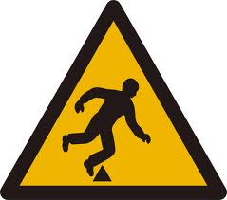
Problems to address
Running two parallel activities
Developing RHINO product and resources
Student research projects
Academics’ time too limited to work closely with students on refining the implementing and detailing design issues
Students working inefficiently due to misunderstanding design and not understanding the theories
Approach to solve this:
Research contract post for experienced engineer to:
Manage technical design aspects; find/keep track of info;
Assist in effective knowledge management techniques
Allowing academics to focus supervise and work on academic work.

Slide 18
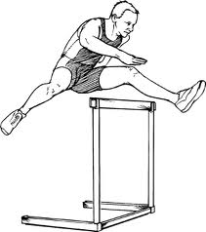
Conclusion
New area of reconf. computing and SDR
Skills base for this high-tech field
Some hurdles to overcome…

Slide 19
Conclusion
Hurdles to overcome…
Undergraduate students’ skill sets
Academics juggling:
research supervision + collaborations + training + design issues + department teaching commitments
Better knowledge management in SDRRG group
Progress is being made…
Usable hardware developed
Contributing to the local growth in the field of reconfigurable computing and SDR

Slide 20
Acknowledgements
SKA meerKAT (Karoo Array Telescope) project for SDRRG and RHINO funding
Xilinx donation of electronic components and software tools
Texas Instruments for donation of development resources and hardware
SDRRG team: thanks to Prof. Inggs, Dr. Langman, and the SDRRG students

Slide 21
QUESTIONS?

